Slide 1
Semi-Supervision Dramatically Improves Time Series Clustering under Dynamic Time Warping
Hoang Anh Dau,
Nurjahan Begum,
Eamonn Keogh,
University of California,
Proceedings of the 25th ACM International on Conference on Information and Knowledge Management, Indianapolis, USA
Presenter : Shu-Kai, Hung
Date : 2017/6/6
Notes:
https://www.google.com.tw/maps/place/%E7%BE%8E%E5%9C%8B%E5%8D%B0%E7%AC%AC%E5%AE%89%E7%B4%8D%E5%8D%B0%E7%AC%AC%E5%AE%89%E7%B4%8D%E6%B3%A2%E5%88%A9%E6%96%AF/data=!4m2!3m1!1s0x886b50ffa7796a03:0xd68e9df640b9ea7c?sa=X&ved=0ahUKEwik7NPGzKPUAhXGGJQKHT_pD_wQ8gEIkwEwDw

Slide 2
Abstract(1/2)
The research community seems to have converged in agreement that for time series classification problems, Dynamic Time Warping (DTW)-based nearest-neighbor classifiers are exceptionally hard to beat. Obtaining the best performance from DTW requires setting its only parameter, the warping window width (w). This is typically set by cross validation in the training stage. However, for clustering, by definition we do not have access to such labeled data. This issue seems to have been largely ignored in the literature, with many practitioners simply assuming that “the larger the better” for the value of w, and using as large a value of w as computational resources permit.

Slide 3
Abstract(2/2)
In this work we show that this is a naive approach which in most circumstances produces inferior clusterings. To address this problem, we introduce a novel semi-supervised technique that allows us to set the best value of w. Unlike virtually all other semi-supervised techniques, our ideas are completely independent of the clustering algorithm used, and can be utilized to improve time series clustering under partitional, hierarchical, spectral or density-based clustering. Our approach requires very little human intervention; moreover, we show that in many cases, true human annotation efforts can be replaced with automatically-generated “pseudo” supervision information. We demonstrate our technique by testing with more than one hundred publicly available datasets.

Slide 4
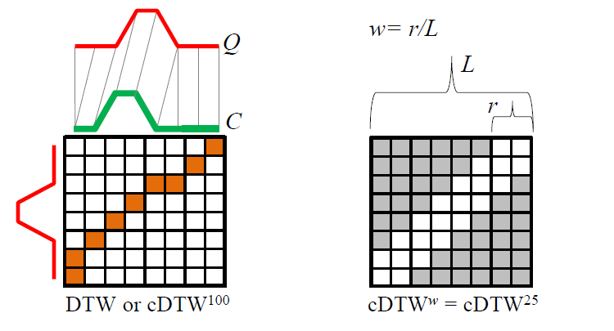
constraint Dynamic Time Warping (cDTW)
Constraint warping path

Slide 5
Rand Index
假設一个集合中有N條 time series
一个集合中有 N(N-1)/2個集合對
TP：同一類的文章被分到同一个簇
TN：不同類的文章被分到不同簇
FP：不同類的文章被分到同一个簇
FN：同一類的文章被分到不同簇
Rand Index度量的正确的百分比
RI = （TP+TN）/（TP+FP+FN+TN）

Slide 6
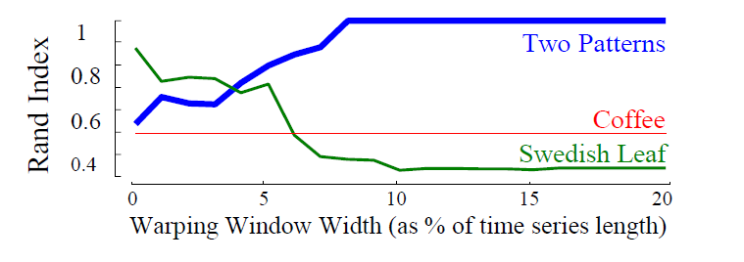

Slide 7
semi-supervised technique
Supervised :
Training a w =>
1. we know the label.
2. we give a w to test it.
3. Modifying the objective function for evaluating candidate clustering.
semi-supervised :
1.don’t know every thing first.
2.know the fact then verify

Slide 8
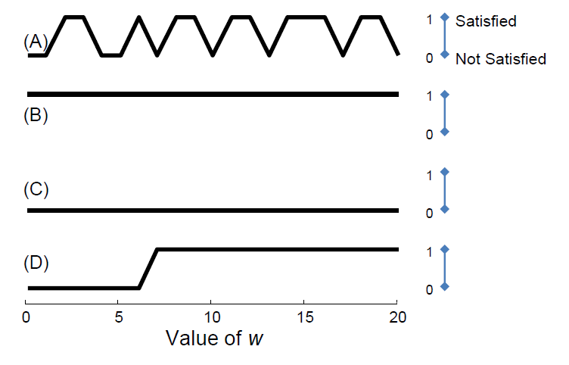

Choosing Constraints
For every possible pair of time series,
constraint vector =(0,1,0,1,0,…..,0,1,1) every pair satisfied or not.${DTW}^{i}⇒i means w of i position$.
Satisfy => correct clustered( TADPole algorithm )

Slide 9
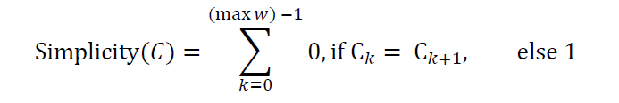
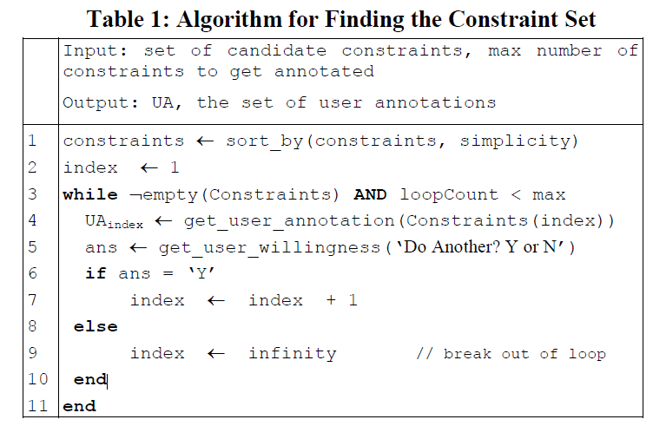
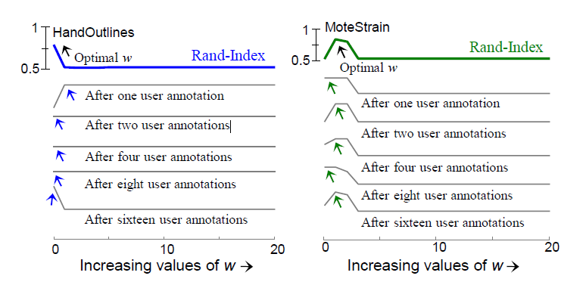

Slide 10
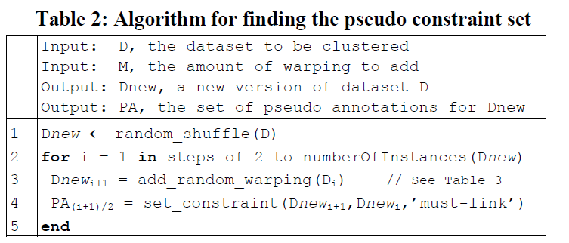
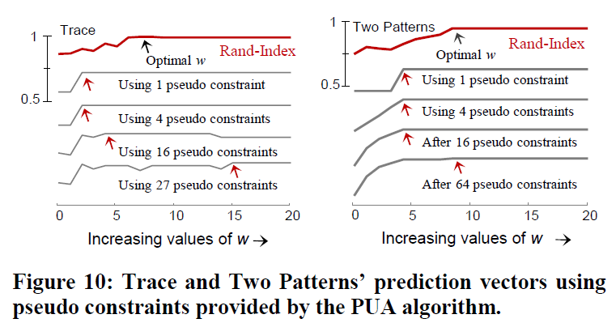

Pseudo User Annotation
The basic idea : An object $O$, copy this object$O$ and give some warping = $\overline{O}$,

Slide 11
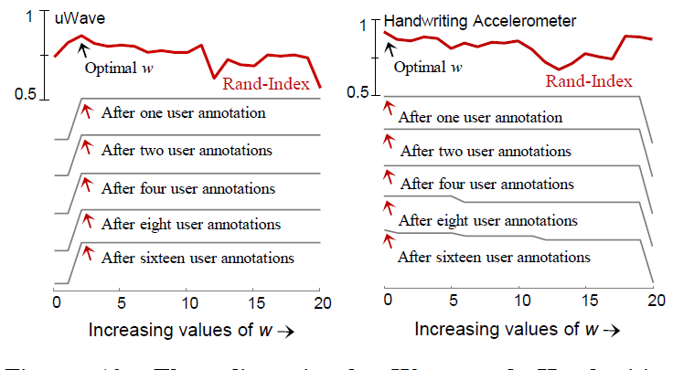
Experiment

Slide 12
