Slide 1
Dynamical Models of Stock Prices Based on Technical Trading Rules—Part III: Application to Hong Kong Stocks
IEEE TRANSACTIONS ON FUZZY SYSTEMS, VOL. 23, NO. 5, OCTOBER 2015
Li-Xin Wang
Presenter：Jia-Hong Liu
Date：2017/6/6

Slide 2
Abstract(1/3)
In Part III of this study, we apply the price dynamical model with big buyers and big sellers developed in Part I of this paper to the daily closing prices of the top 20 banking and real estate stocks listed in the Hong Kong Stock Exchange. The basic idea is to estimate the strength parameters of the big buyers and the big sellers in the model and make buy/sell decisions based on these parameter estimates. We propose two trading strategies:

Slide 3
Abstract(2/3)
1) Follow- the-Big-Buyer, which buys when big buyer begins to appear and there is no sign of big sellers, holds the stock as long as the big buyer is still there, and sells the stock once the big buyer disappears; and 2) Ride-the-Mood, which buys as soon as the big buyer strength begins to surpass the big seller strength and sells the stock once the opposite happens.

Slide 4
Abstract(3/3)
Based on the testing over 245 two-year intervals uniformly distributed across the seven years from July 3, 2007 to July 2, 2014, which includes a variety of scenarios, the net profits would increase 67% or 120% on average if an investor switched from the benchmark Buy-and-Hold strategy to the Follow-the-Big- Buyer or Ride-the-Mood strategies during this period, respectively.

Slide 5
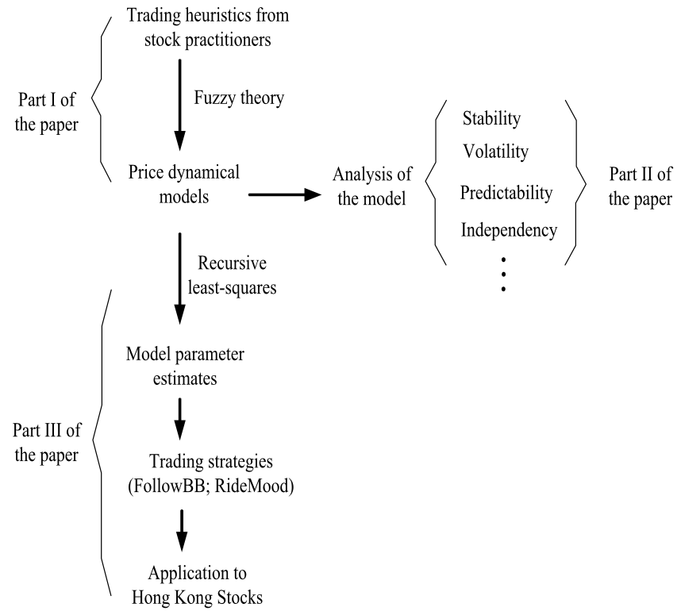

Slide 6
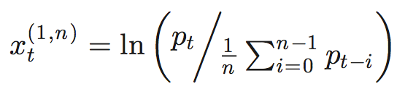


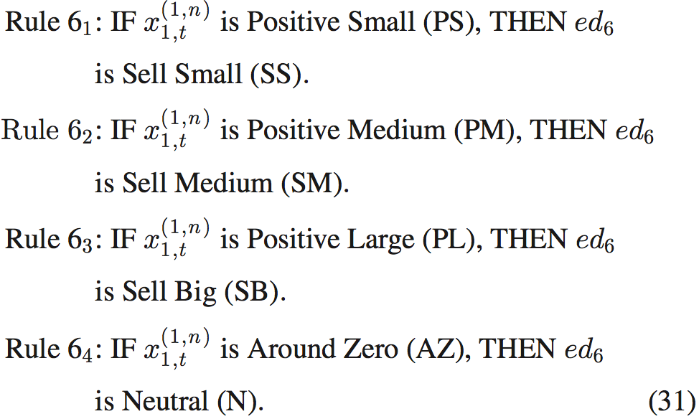
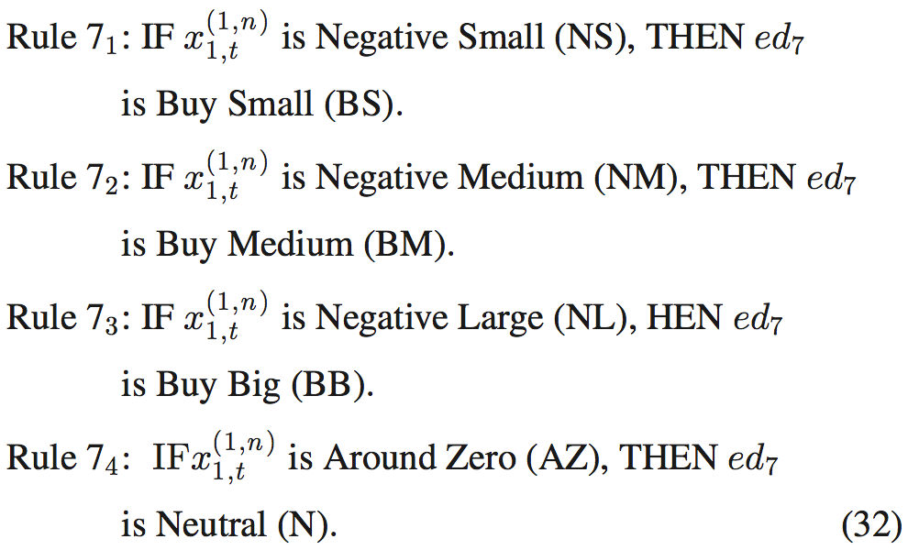

Slide 7
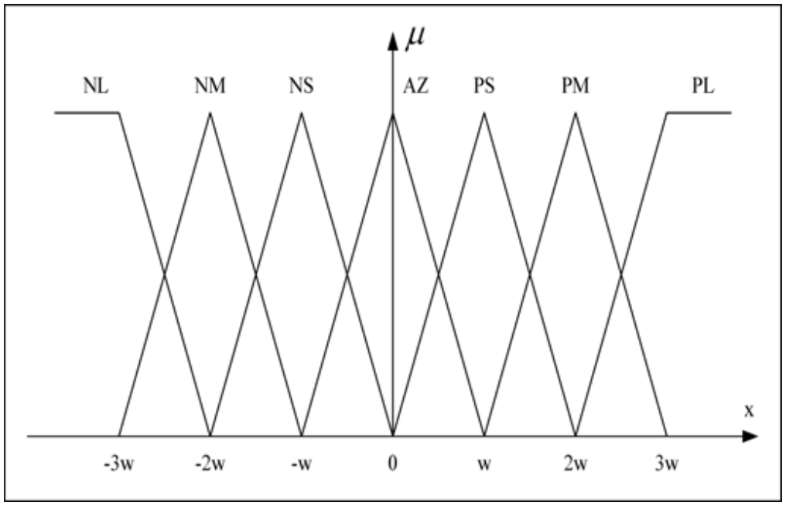
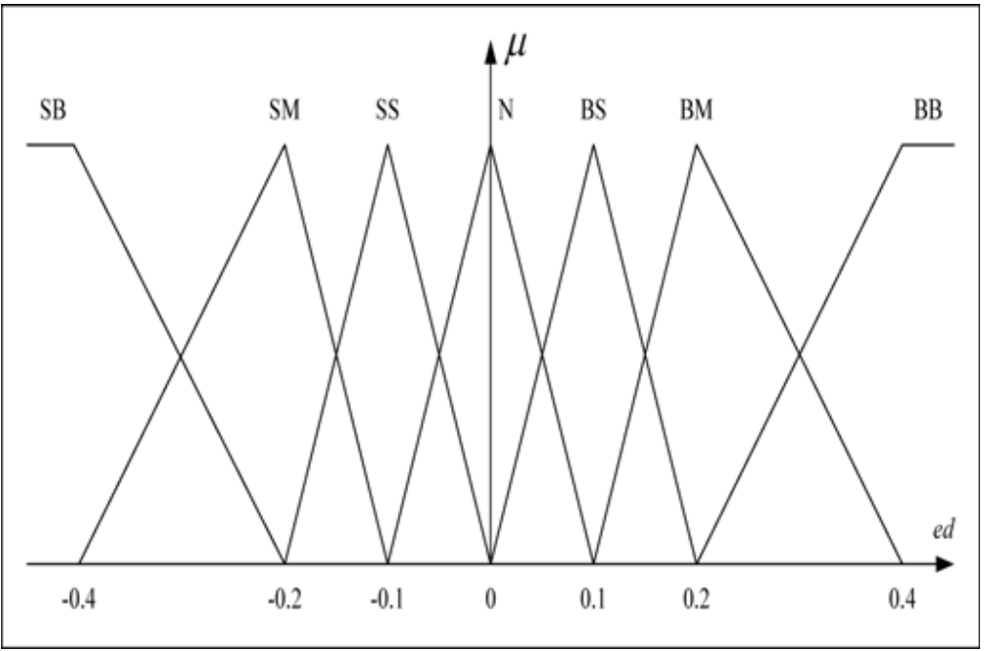
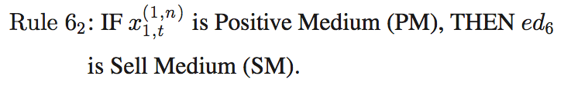

1
0
Example:
excess demand $=−0.2∗μ_{PM}(x_{1,t}^{(m,n)})$

Slide 8


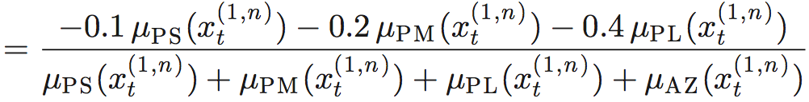
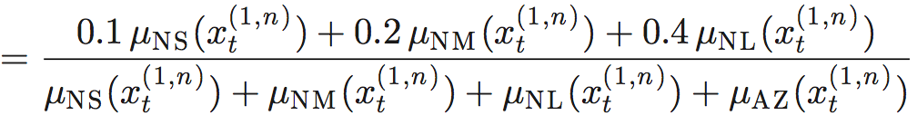

Slide 9
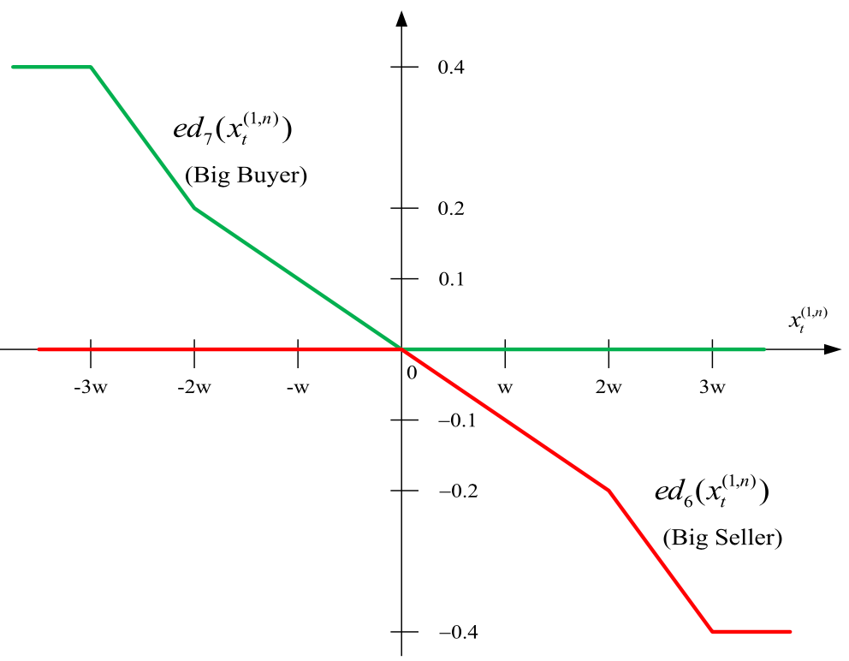

Slide 10



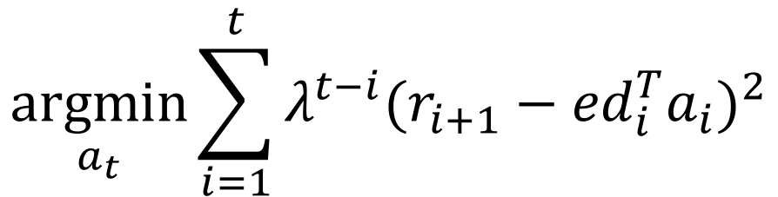
minimizes the weighted summation of error：
$$\underset{a_{t}}{argmin}{\sum_{i=1}^{t}{{λ^{t−i}(r_{i+1}−{ed}_{i}^{T}a_{i})}^{2}}}$$

Slide 11
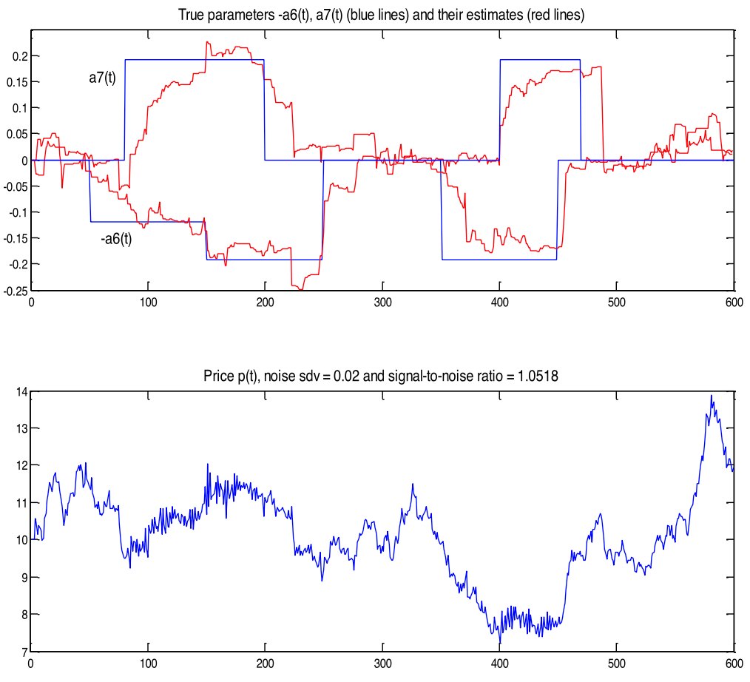
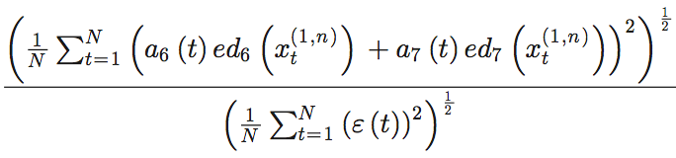

Slide 12
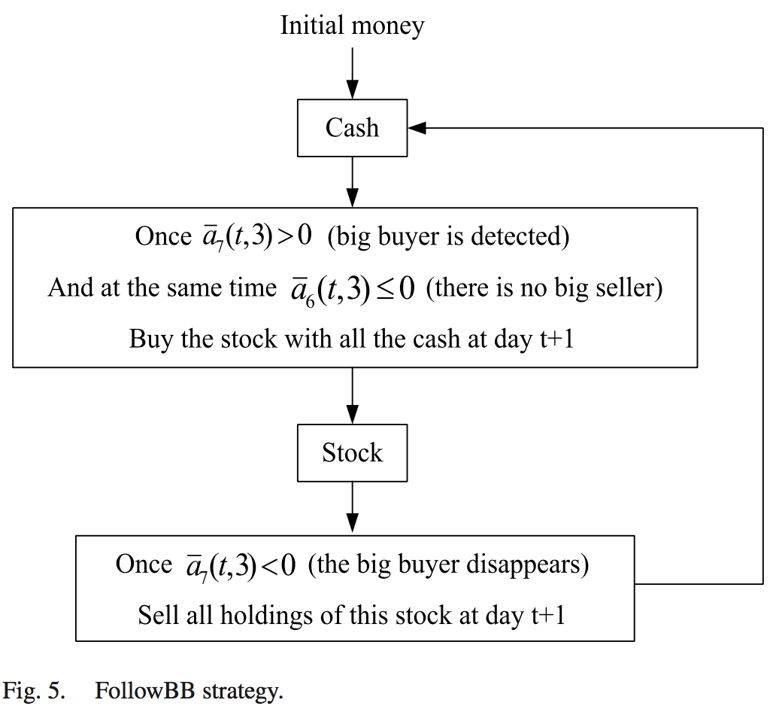


Slide 13
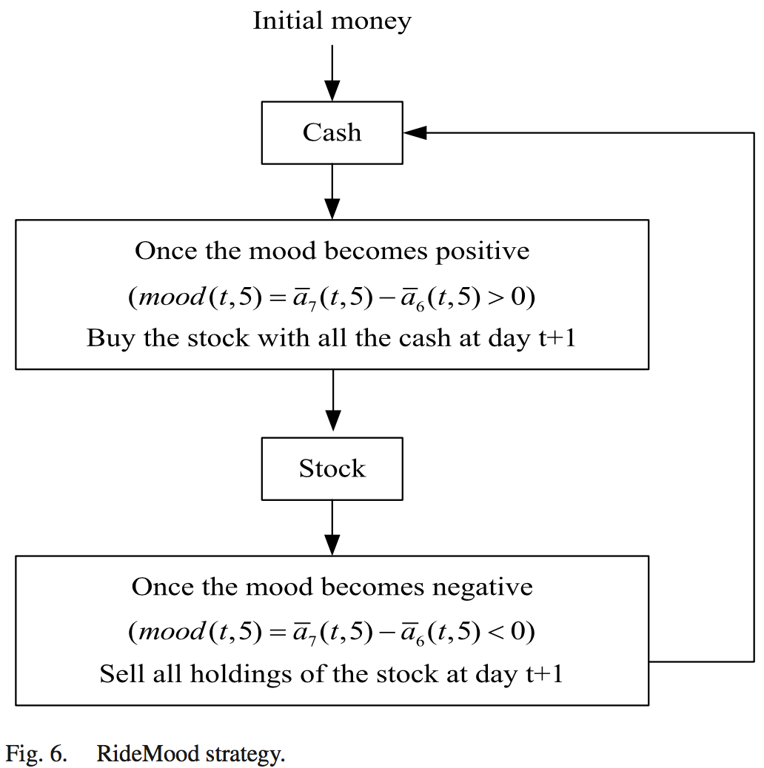

Slide 14
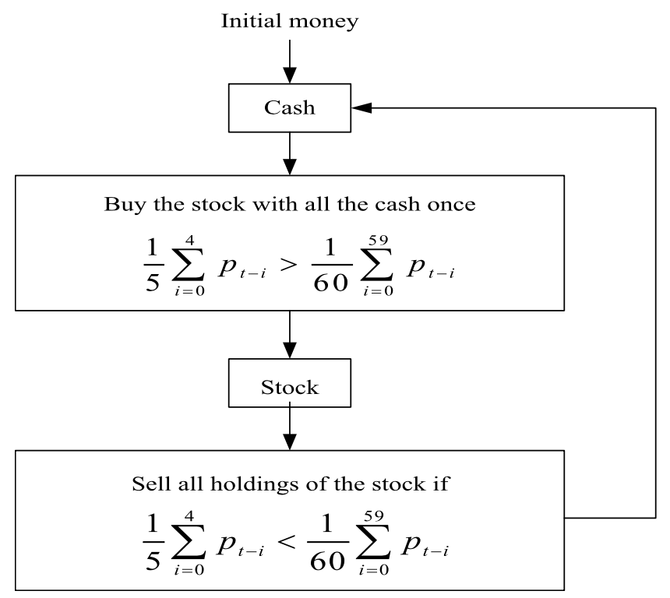

Slide 15
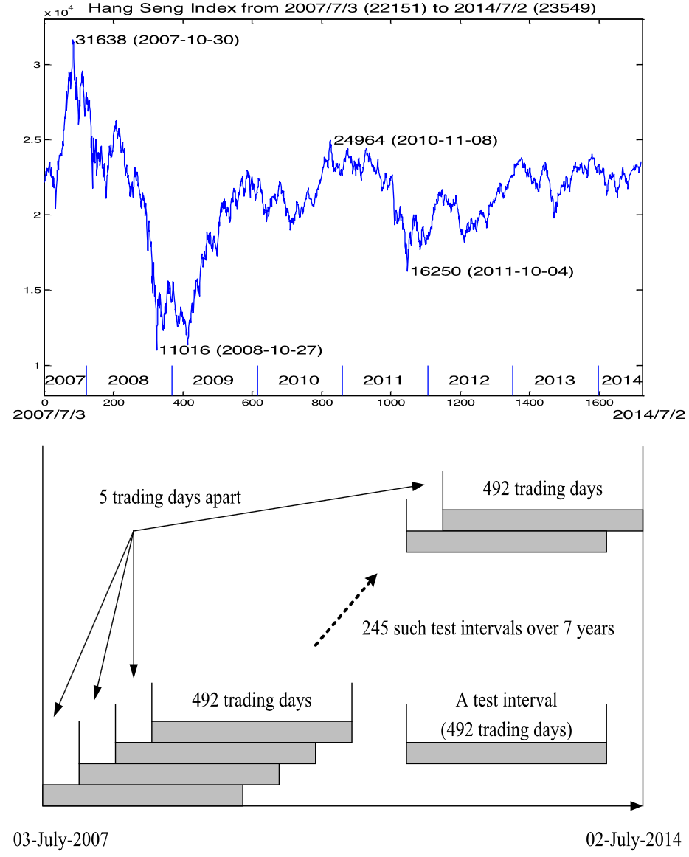
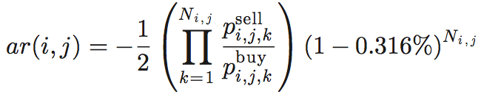
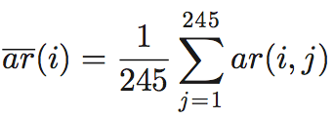
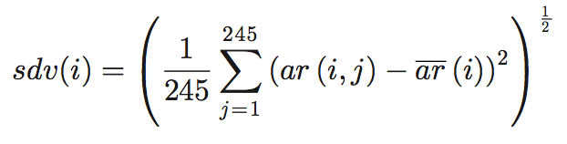
Notes:
(Top) HSI from July 3, 2007 (22151) to July 2, 2014 (23549). (Bottom) Test intervals for the trading strategies: 492 trading days (roughly two years) per test interval, and 245 such test intervals in sequence with five trading days apart.
1) the strong rise in late 2007, 2) the big decline due to the 2008 financial crisis, 3) the recoverary after the panic, and 4) the “ordinary” years from 2010 to 2014)

Slide 16
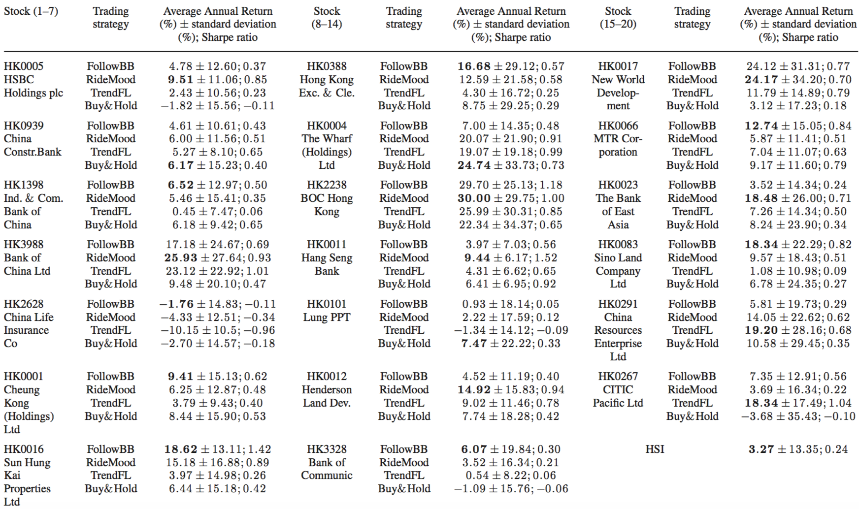

Slide 17
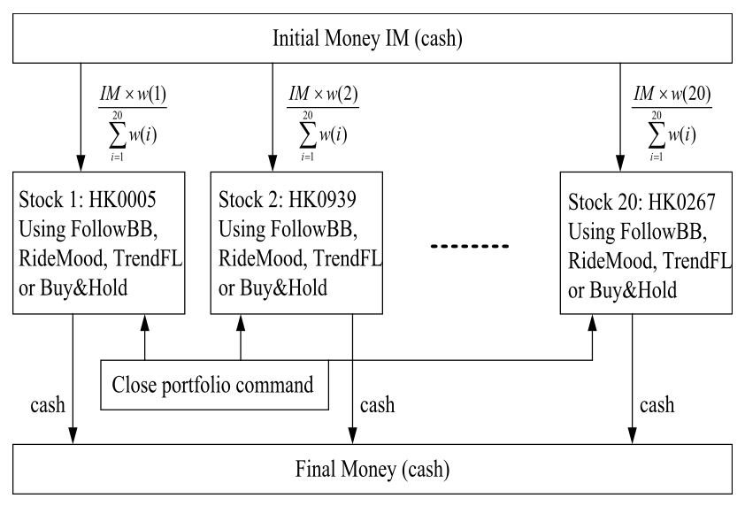

Slide 18
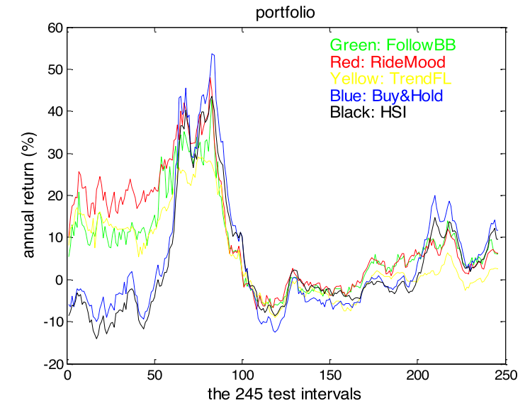
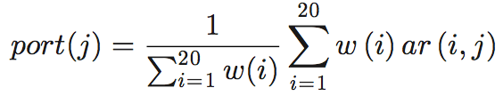

Slide 19
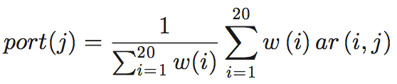
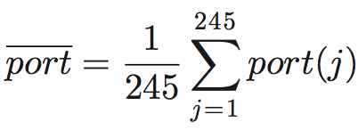
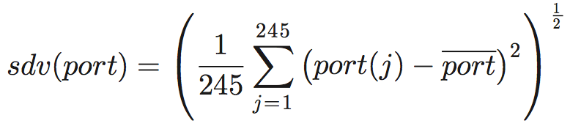
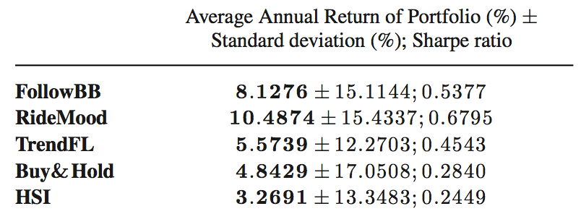

Slide 20
