Slide 1
Efficient Dynamic Time Warping for Time Series Classification
Kumar Vasimalla , Narasimham Challa , S. Manohar Naik
Indian Journal of Science & Technology, Volume 9, Issue 21,
June 2016
Presenter : Bo-Xian Chen
Date : 2017/6/20

Slide 2
Abstract
Dynamic Time Warping (DTW), a similarity measure works in O(n²) complexity. Cause of this it will be used for small datasets only. In this work, we introduced Efficient DTW (EDTW), which works in linear time. It uses two level approaches. In the first level data reduction is performed, and in the second level warping distance and path are calculated. While calculating the values of distance matrix, values along the warping path only considered and calculated. For time series of length n, maximum n values of distance matrix are calculated. So it works in linear time. We applied this distance measure to UCR Time Series archive and calculated error rate of 1NN classification. Most of the cases it is matching, some cases it is better, and some other cases error rate is high.

Slide 3
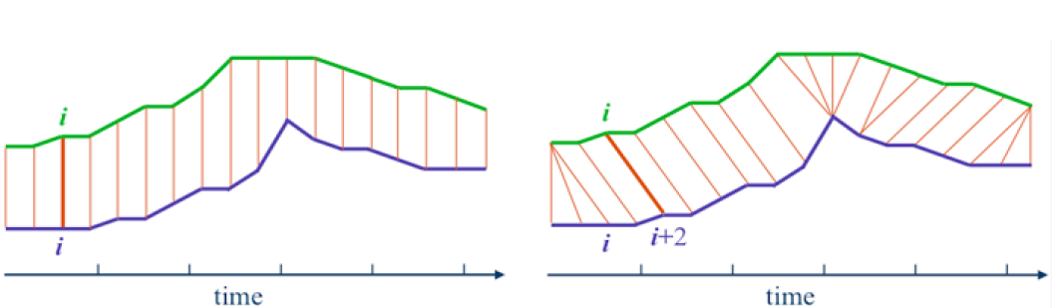
ED versus DTW
O(n)
O(mn)

Slide 4
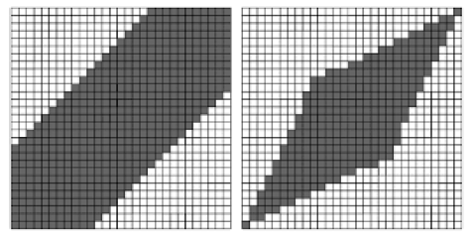
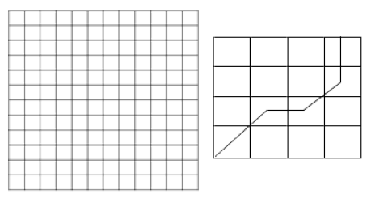
Efficient Dynamic Time Warping
Two Steps :
DTW distance with Constraint
Data Reduction

Slide 5
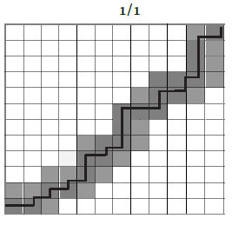
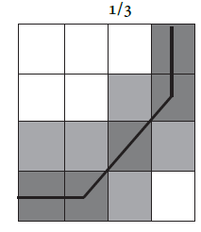
Efficient DTW paths
12*12, 38 cells
4*4, 10 cells

Slide 6
Efficient DTW paths with
12*12, 38 cells
4*4, 10 cells

Slide 7
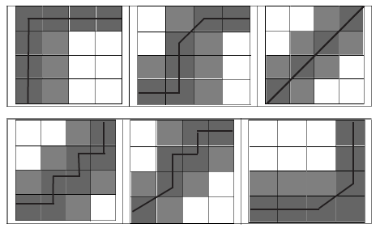
Some possible warping paths in reduced data
4*4, 10~12 cells
space complexity of EDTW is O(N)

Slide 8
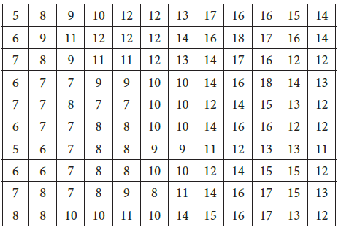
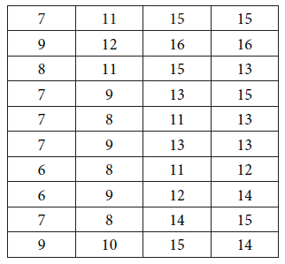
Synthetic Data Set
reduced

Slide 9
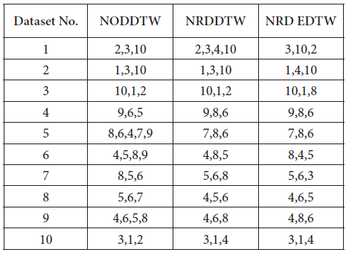
Original/reduced dataset using DTW/EDTW distacne

Slide 10
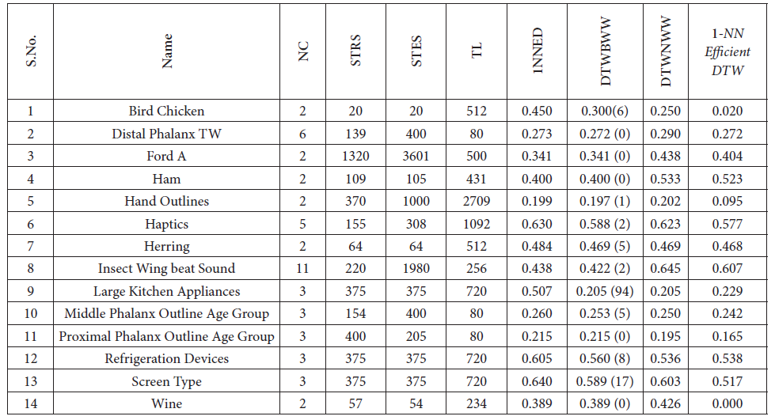
Data sets with less error rate

