Slide 1
IEEE Computer Society Conference on Computer Vision and Pattern Recognition, New York, USA, 2006, Svetlana Lazebnik, Cordelia Schmid and Jean Ponce
Beyond Bags of Feature: Spatial Pyramid Matching for Recognizing Natural Scene Categories
Presenter：Wei-Hao Fu
Date：2017/06/20
Notes:
1

Slide 2
Abstract (1/2)
This paper presents a method for recognizing scene categories based on approximate global geometric correspondence. This technique works by partitioning the image into increasingly ﬁne sub-regions and computing histograms of local features found inside each sub-region. The resulting “spatial pyramid” is a simple and computationally efﬁcient extension of an orderless bag-of-features image representation, and it shows signiﬁcantly improved performance on challenging scene categorization tasks.

Slide 3
Abstract (2/2)
Speciﬁcally, our proposed method exceeds the state of the art on the Caltech-101 database and achieves high accuracy on a large database of ﬁfteen natural scene categories. The spatial pyramid framework also offers insights into the success of several recently proposed image descriptions, including Torralba’s “gist” and Lowe’s SIFT descriptors.

Slide 4
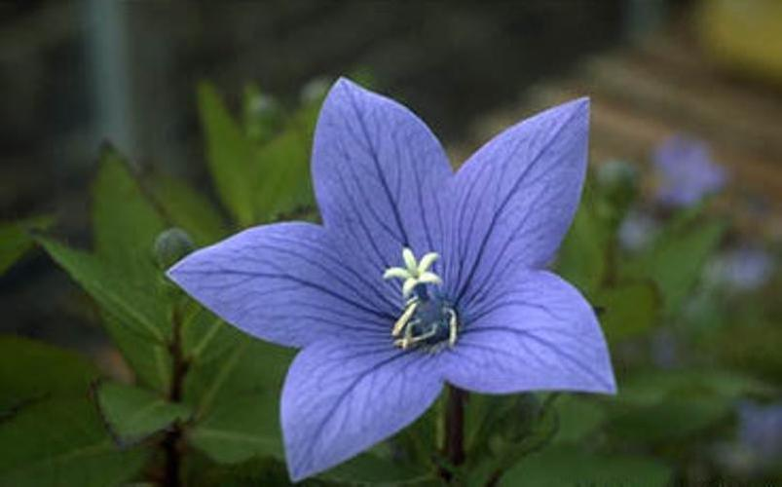
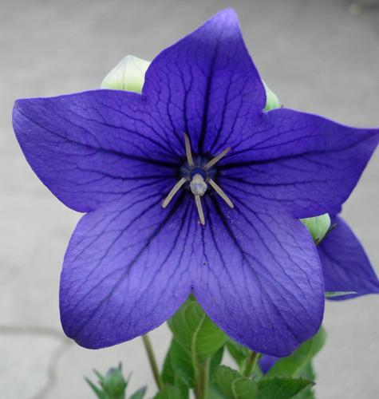
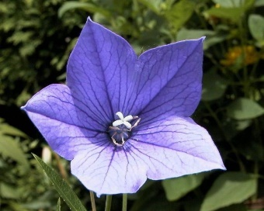

Image Retrieval
What is image retrieval?
When you give some images to an image retrieval system, the system will grant you some images that are similar to what you give.
For browsing, searching and retrieving images from a database.

Slide 5
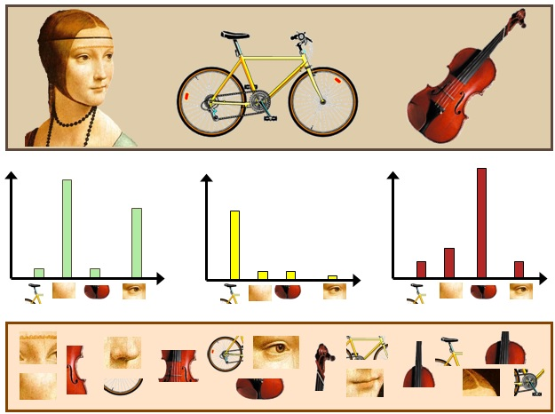
Bag Of Words (BOW)
What is bag of words?
Use some special words to represent a text (such as a sentence or a document).
The BOW is also used for computer vision.
Reference: https://gilscvblog.com/2013/08/23/bag-of-words-models-for-visual-categorization/

Slide 6

Spatial Pyramid Matching
Let X and Y be two sets of vectors in a $d$-dimensional feature space.

Slide 7
Spatial Pyramid Matching
Let X and Y be two sets of vectors in a $d$-dimensional feature space.

Slide 8



Spatial Pyramid Matching
Let X and Y be two sets of vectors in a $d$-dimensional feature space.
Level 0
Level 1
$I^{0}$ = 2
$I^{1}$ = 6

Slide 9
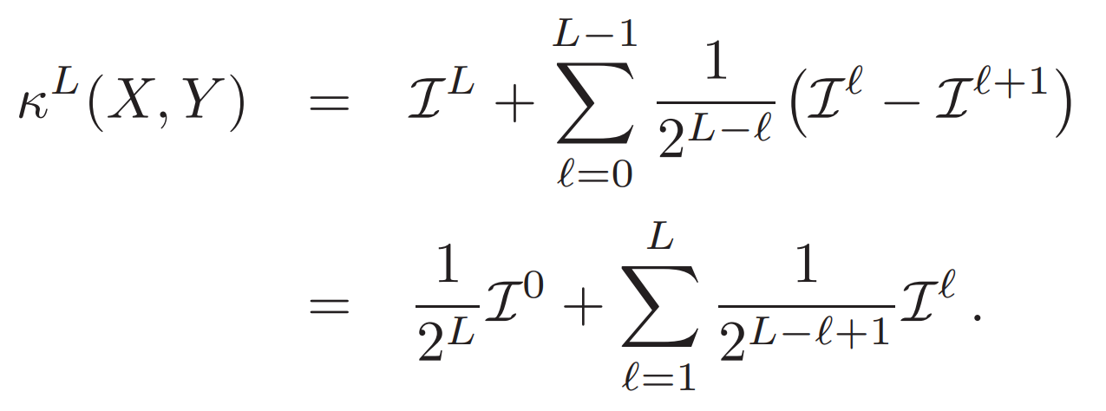
Spatial Pyramid Matching
Intuitively, we want to penalize matches found in larger cells because they involve increasingly dissimilar features.

Slide 10
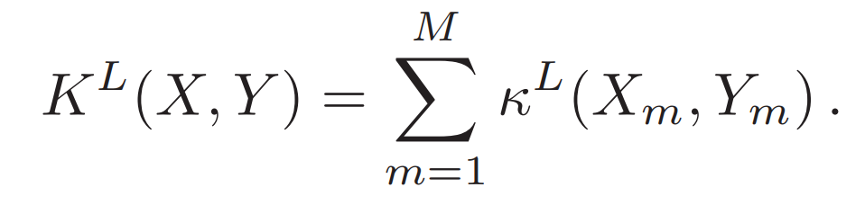
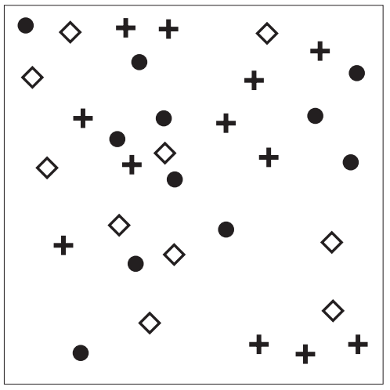
Spatial Pyramid Matching
The final kernel is then the sum of the separate channel kernels:

Slide 11
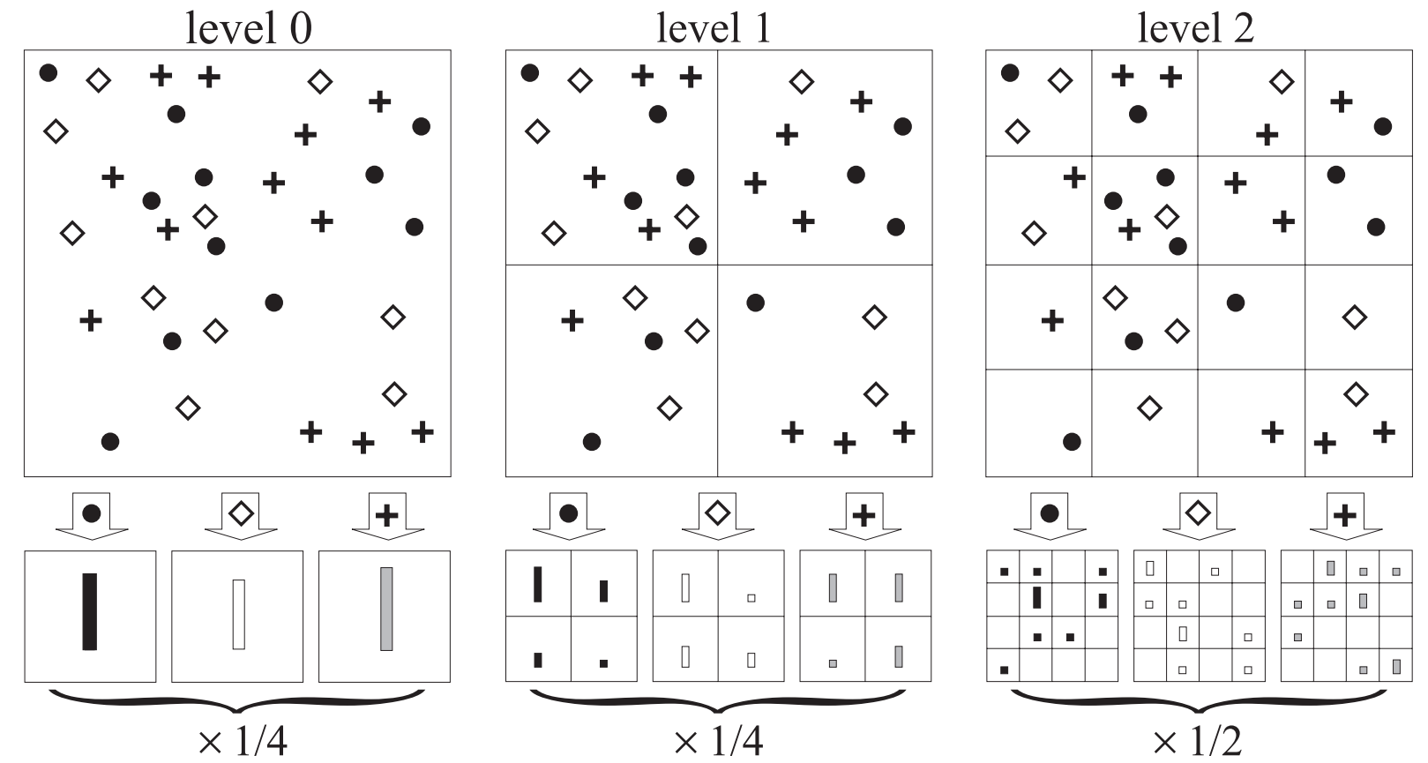

Spatial Pyramid Matching

Slide 12
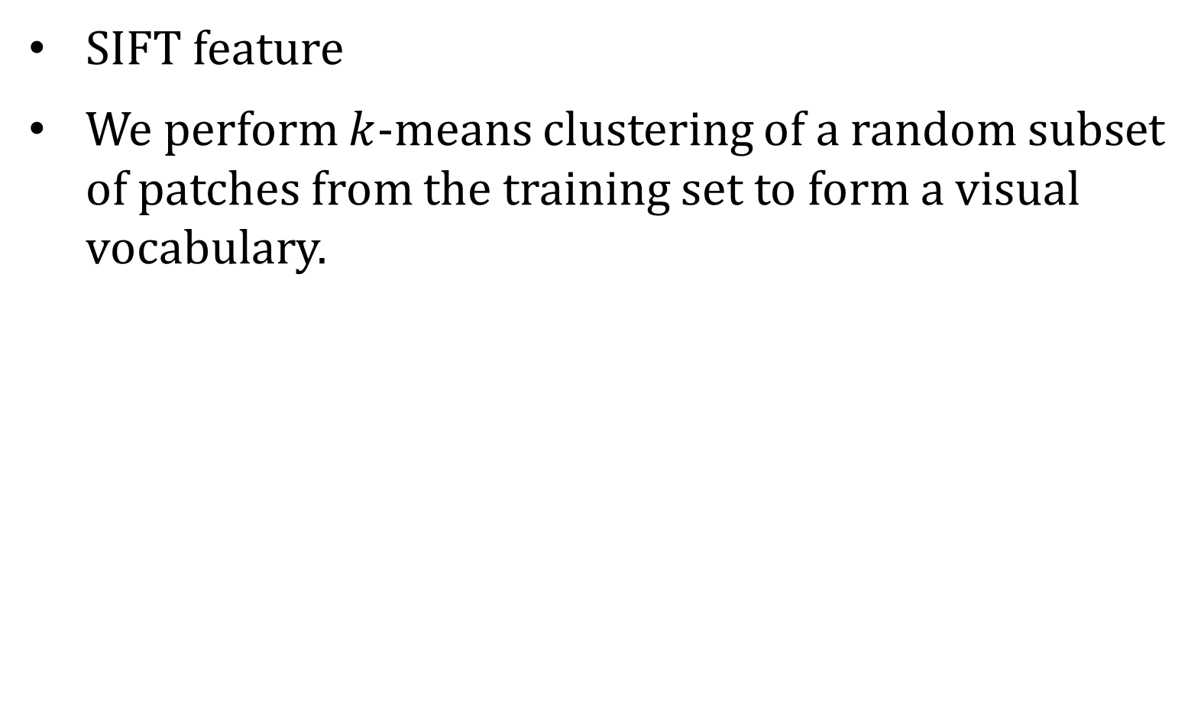
Feature Extraction
SIFT feature
We perform $k$-means clustering of a random subset of patches from the training set to form a visual vocabulary.

Slide 13
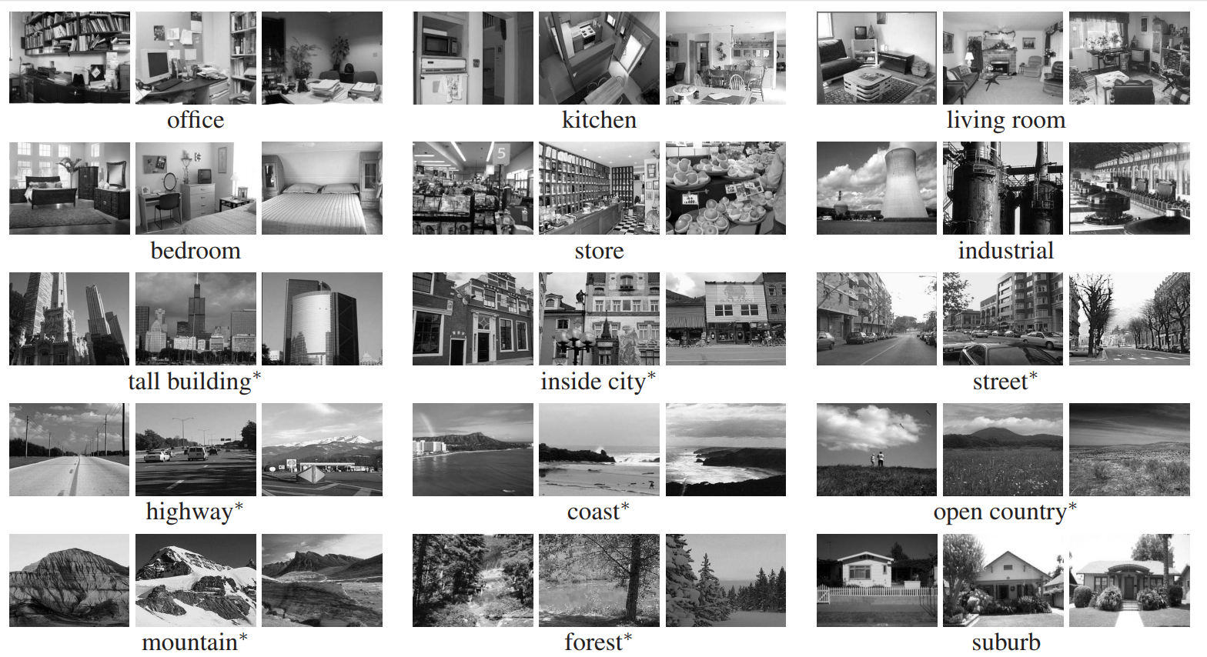
Experiments Result
Dataset:
Oliva and Torralba: 15 categories and each category has 200 to 400 images.

Slide 14
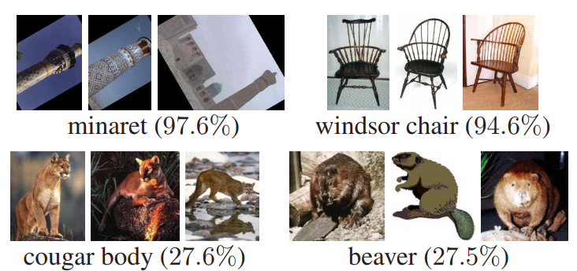
Experiments Result
Dataset:
Oliva and Torralba: 15 categories and each category has 200 to 400 images.
Caltech-101: 101 categories and each category has 31 to 800 images.

Slide 15
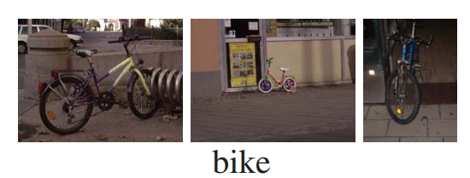
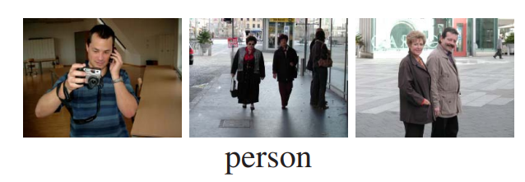
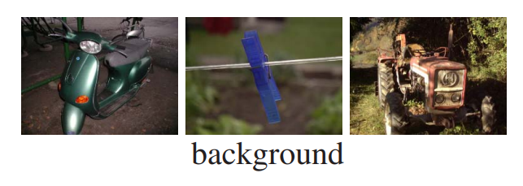
Experiments Result
Dataset:
Oliva and Torralba: 15 categories and each category has 200 to 400 images.
Caltech-101: 101 categories and each category has 31 to 800 images.
The Graz Dataset: 3 categories and each category has 270 to 460 images.

Slide 16
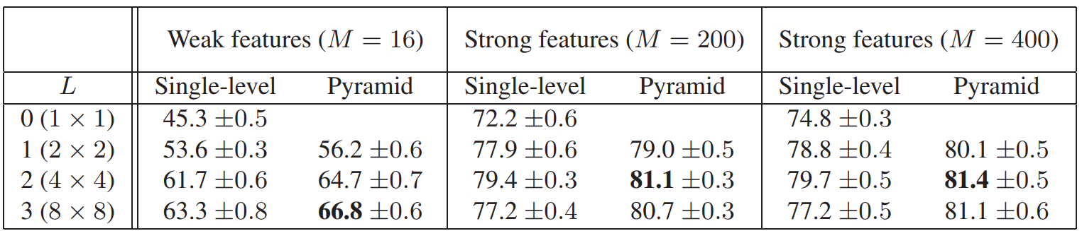
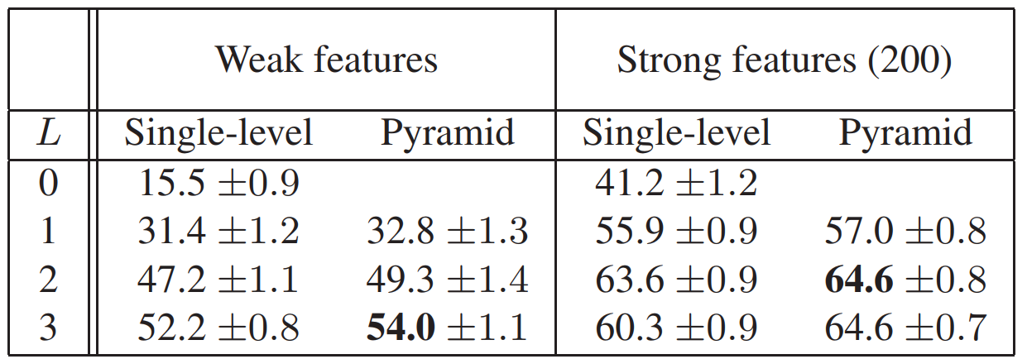
Experiments Result
Oliva and Torralba
Caltech-101

Slide 17
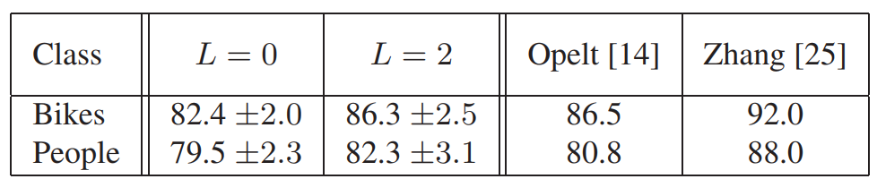
Experiments Result
The Graz Dataset

