Slide 1
A method for automatic stock trading combining technical analysis and nearest neighbor classification
Lamartine Almeida Teixeiraª, Adriano Lorena Inacio de Oliveira^{b}
ª Department of Computing Systems, University of Pernambuco, Recife, Brazil
^{b} Informatics Center, Federal University of Pernambuco, Recife, Brazil
Expert Systems with Applications 37, pp. 6885-6890, 2010

Slide 2
Abstract
In this paper we propose and analyze a novel method for automatic stock trading which combines technical analysis and the nearest neighbor classification. Our first and foremost objective is to study the feasibility of the practical use of an intelligent prediction system exclusively based on the history of daily stock closing prices and volumes. To this end we propose a technique that consists of a combination of a nearest neighbor classifier and some well known tools of technical analysis, namely, stop loss, stop gain and RSI filter. For assessing the potential use of the proposed method in practice we compared the results obtained to the results that would be obtained by adopting a buy-and-hold strategy. The key performance measure in this comparison was profitability. The proposed method was shown to generate considerable higher profits than buy-and-hold for most of the companies, with few buy operations generated and, consequently, minimizing the risk of market exposure.

Slide 3
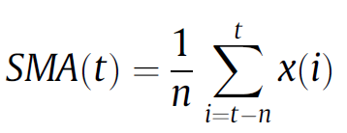
Technical indicator using in this paper
Moving averages(MA)：
Form a smooth curve which makes easier to identify the direction of the trend.
t: 第t天交易日
X(t): 第t天股價

Slide 4
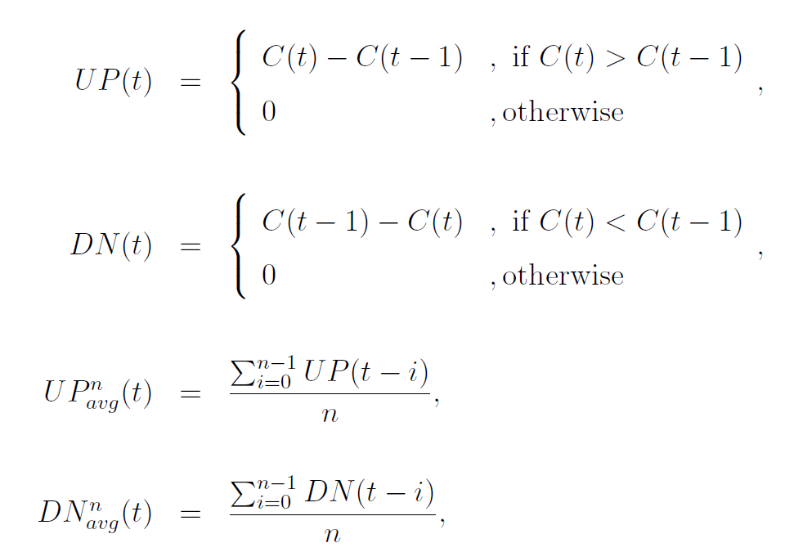
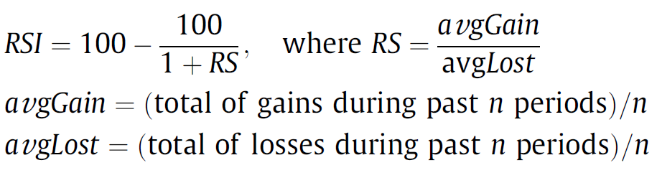
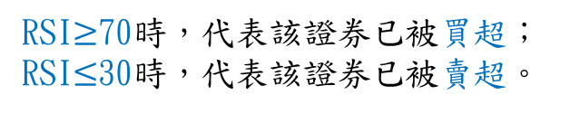
Relative strength index (RSI):
It compares the magnitude of the recent gains to the magnitude of the recent losses and generates a number that ranges from 0 to 100.
(n = 14)
RSI$≥$70時，代表該證券已被買超；
RSI$≤$30時，代表該證券已被賣超。

Slide 5
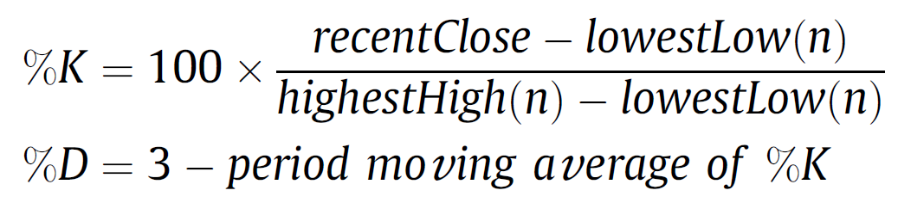
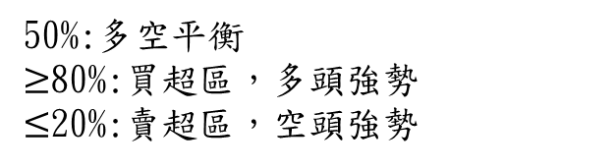
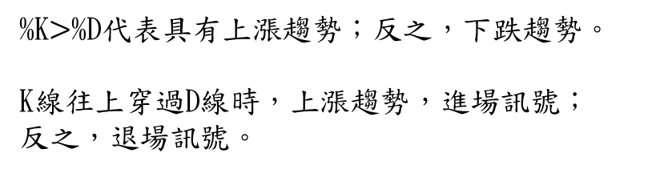
Stochastics oscillator (KD):一種動量分析方法，採用超買和超賣的概念
第t天收盤價
n天中最低價
(n = 14)
(連續3天%k的MA)
50%:多空平衡
$≥$80%:買超區，多頭強勢
$≤$20%:賣超區，空頭強勢
%K$>$%D代表具有上漲趨勢；反之，下跌趨勢。
K線往上穿過D線時，上漲趨勢，進場訊號；
反之，退場訊號。

Slide 6
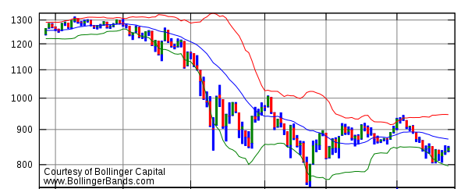
Bollinger bands:
上軌 = 中軌 + 2 × period n之標準差
中軌 = period n之SMA
下軌 = 中軌 − 2 × period n之標準差
(n = 8)
盤整: Bollinger通道縮小
進場: Bollinger通道擴張

Slide 7
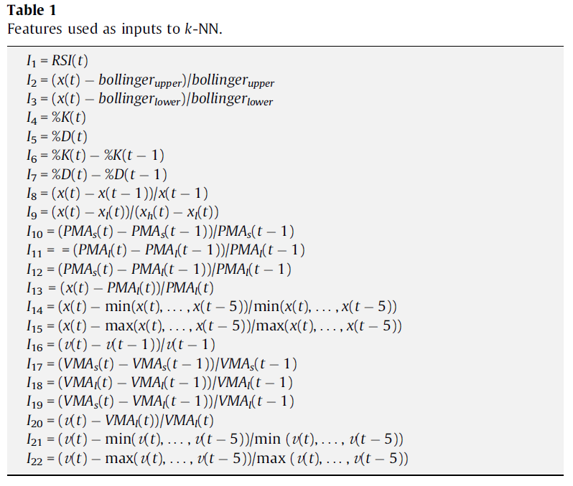
Using K-NN
訓練快速是很好的優點，因為作者打算每天都分析大量的股票資訊。
input:
Sao Paulo Stock Exchange (Bovespa)的15支股票
巴西買賣一次最少100股
1998/4/1~2009/3/9
X_{h}:最高價
X_{l}:最低價
PMA:price MA VMA:volume MA
s:short-term = 10天
l:long-term = 21天

Slide 8
K-NN:
The classifier’s output is used to start a buy (long) or sell (short) operation.
(the minimum number of 100 shares per operation)
Trading rule:
If the classifier’s output for day t is buy, then a long position is performed considering the stock’s closing price and all the available cash balance.
If the classifier’s output is sell and there are any stock available in custody, then all the stocks are sold.
Otherwise, no operation is performed if the generated signal is keep.
Stop gain: 如果證券漲幅超過10%，則將所有證券全數賣出。(可能轉折下跌)
Stop loss: 如果證券跌幅達到 3%，則將所有證券賣出。
RSI filter: 大於70%無論如何都不買入

Slide 9
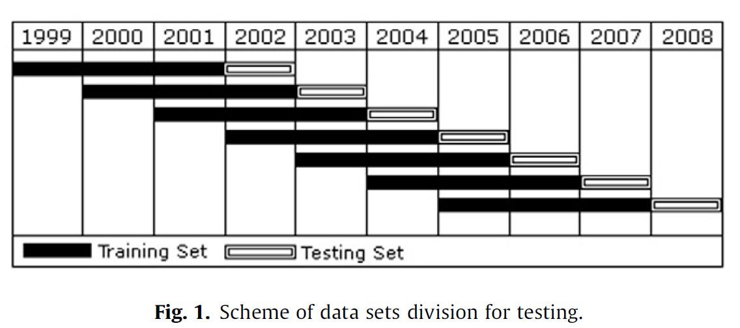
Experiment
3年訓練、1年測試
初始資金 R$ 100,000
交易手續費約 R$ 5

Slide 10
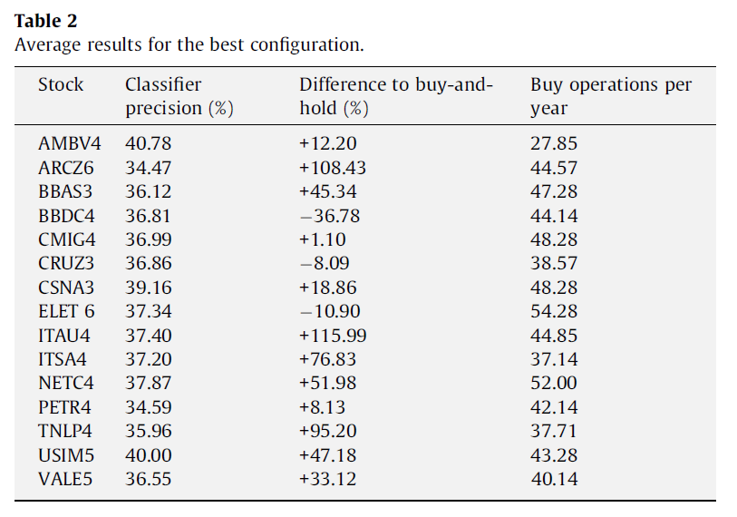
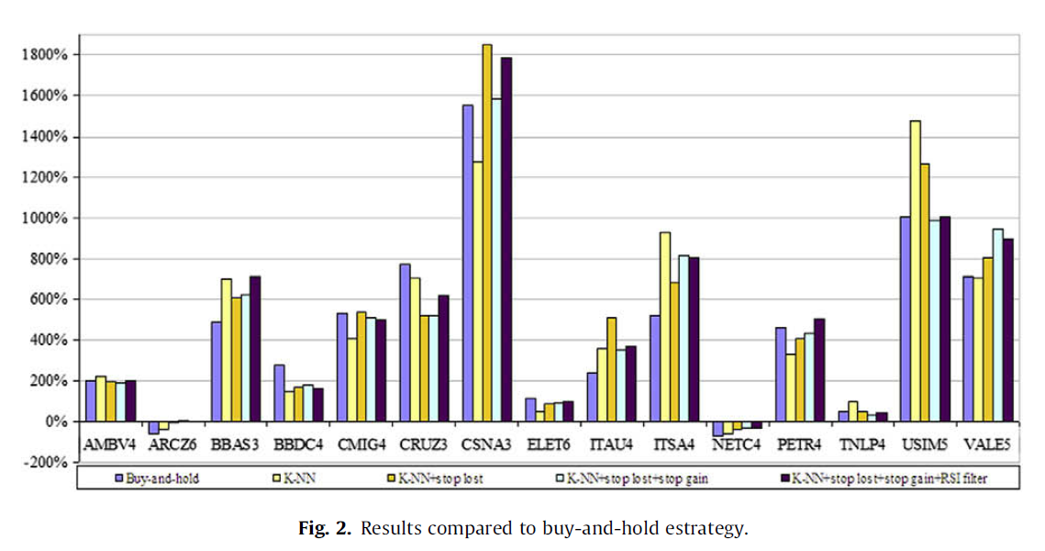
11/15表現好；3/15表現差；1/15類似
一年平均40次 或 每月不到4次，作者認為這樣可降低風險。
(7年testing period累積報酬率)

Slide 11
