Slide 1
Minesweeper is NP-Complete
Richard Kaye
The Mathematical Intelligencer, Vol.22, pp.9-15 (2000)
Presenter: Hsuan-Tsung Chiu
Date:2017/06/27

Slide 2
Abstract
Many of the ideas mentioned above may be illustrated effectively with a game many readers will be familiar with. Minesweeper comes with Microsoft’s Windows operating system. In it, the player is presented with an initially blank grid. Underneath each square there may be a mine, and the object of the game is to locate all these mines without being blown up.

Slide 3
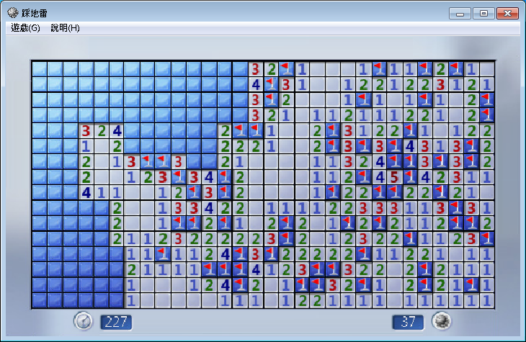
Minesweeper (1/2)

Slide 4
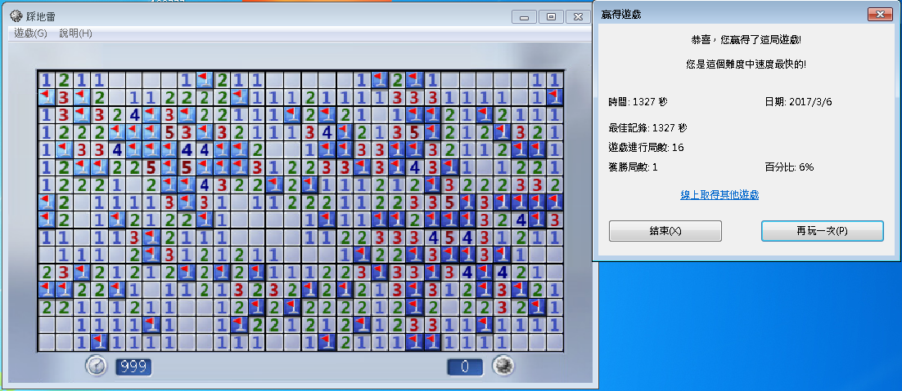
Minesweeper (2/2)

Slide 5
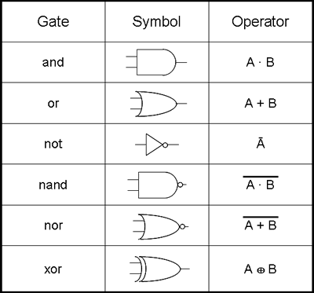
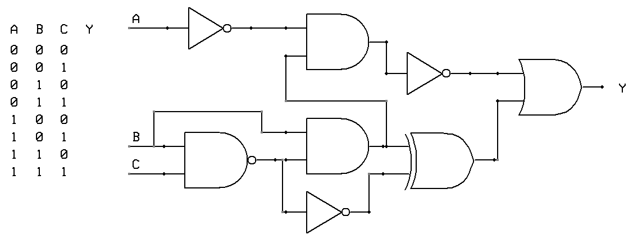
Circuit satisfiability

Slide 6
Wire、NOT Gate
 | 1 | 2 | 2 | 1
1 | 2 | * | * | 3 | 1
x | 1 | x’ | * | * | 2
1 | 1 | 2 | x | * | 2
 |  | 1 | 1 | 2 | 1
 |  | 1 | x’ | 1
 |  | 1 | x | 1
1 | 1 | 1 | 1 | 1 | 1 | 1 | 1 | 1 | 1
x | 1 | x’ | x | 1 | x’ | x | 1 | x’ | x
1 | 1 | 1 | 1 | 1 | 1 | 1 | 1 | 1 | 1
 |  | 1 | 1 | 1
1 | 1 | 2 | * | 2 | 1
x | x’ | 3 | x | 3 | x’
1 | 1 | 2 | * | 2 | 1
 |  | 1 | 1 | 1
 | 1 | 1 | 1
1 | 2 | * | 2 | 1
x | 3 | x’ | 3 | x
1 | 2 | * | 2 | 1
 | 1 | 1 | 1
1 | 1 | 1 | x | 1
x | 1 | x’ | 2 | x’
1 | 1 | 1 | x | 1

Slide 7
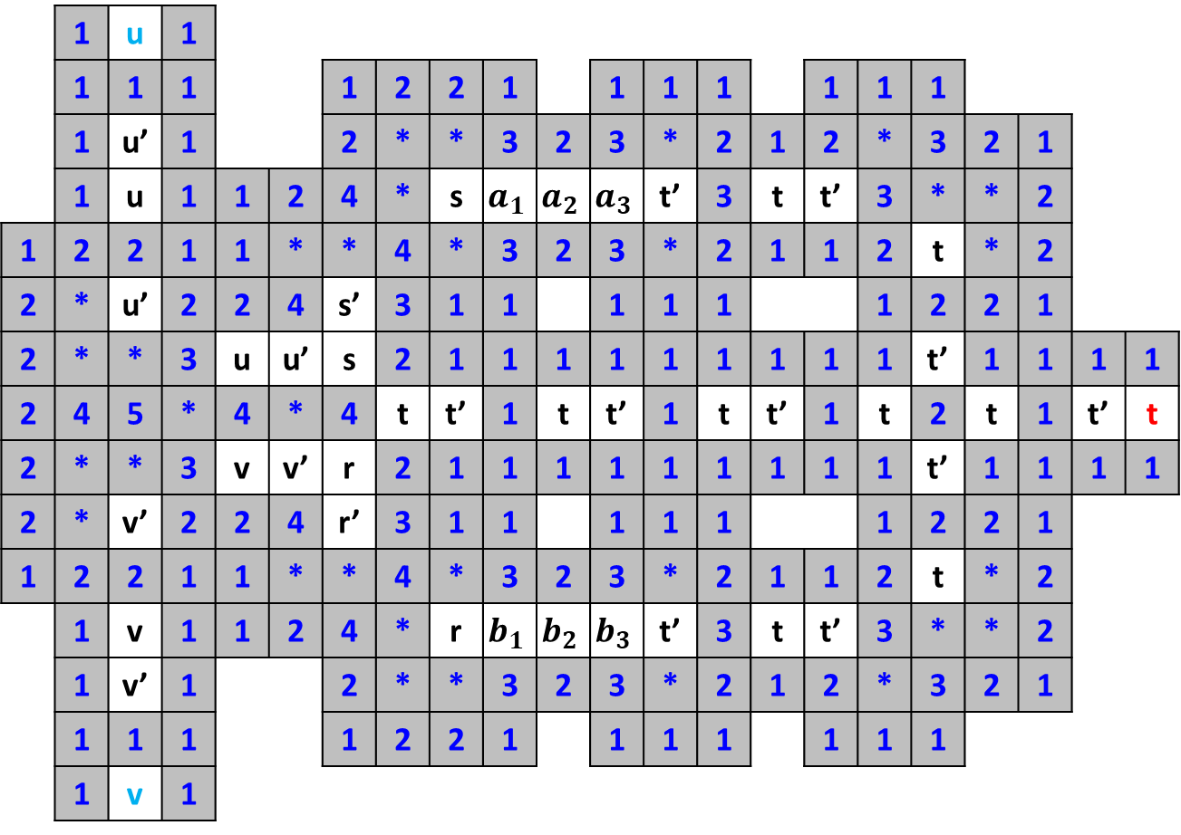
AND Gate
 | 1 | u | 1
 | 1 | 1 | 1 |  |  | 1 | 2 | 2 | 1 |  | 1 | 1 | 1 |  | 1 | 1 | 1
 | 1 | u’ | 1 |  |  | 2 | * | * | 3 | 2 | 3 | * | 2 | 1 | 2 | * | 3 | 2 | 1
 | 1 | u | 1 | 1 | 2 | 4 | * | s | $$a_{1}$$ | $$a_{2}$$ | $$a_{3}$$ | t’ | 3 | t | t’ | 3 | * | * | 2
1 | 2 | 2 | 1 | 1 | * | * | 4 | * | 3 | 2 | 3 | * | 2 | 1 | 1 | 2 | t | * | 2
2 | * | u’ | 2 | 2 | 4 | s’ | 3 | 1 | 1 |  | 1 | 1 | 1 |  |  | 1 | 2 | 2 | 1
2 | * | * | 3 | u | u’ | s | 2 | 1 | 1 | 1 | 1 | 1 | 1 | 1 | 1 | 1 | t’ | 1 | 1 | 1 | 1
2 | 4 | 5 | * | 4 | * | 4 | t | t’ | 1 | t | t’ | 1 | t | t’ | 1 | t | 2 | t | 1 | t’ | t
2 | * | * | 3 | v | v’ | r | 2 | 1 | 1 | 1 | 1 | 1 | 1 | 1 | 1 | 1 | t’ | 1 | 1 | 1 | 1
2 | * | v’ | 2 | 2 | 4 | r’ | 3 | 1 | 1 |  | 1 | 1 | 1 |  |  | 1 | 2 | 2 | 1
1 | 2 | 2 | 1 | 1 | * | * | 4 | * | 3 | 2 | 3 | * | 2 | 1 | 1 | 2 | t | * | 2
 | 1 | v | 1 | 1 | 2 | 4 | * | r | $$b_{1}$$ | $$b_{2}$$ | $$b_{3}$$ | t’ | 3 | t | t’ | 3 | * | * | 2
 | 1 | v’ | 1 |  |  | 2 | * | * | 3 | 2 | 3 | * | 2 | 1 | 2 | * | 3 | 2 | 1
 | 1 | 1 | 1 |  |  | 1 | 2 | 2 | 1 |  | 1 | 1 | 1 |  | 1 | 1 | 1
 | 1 | v | 1

Slide 8
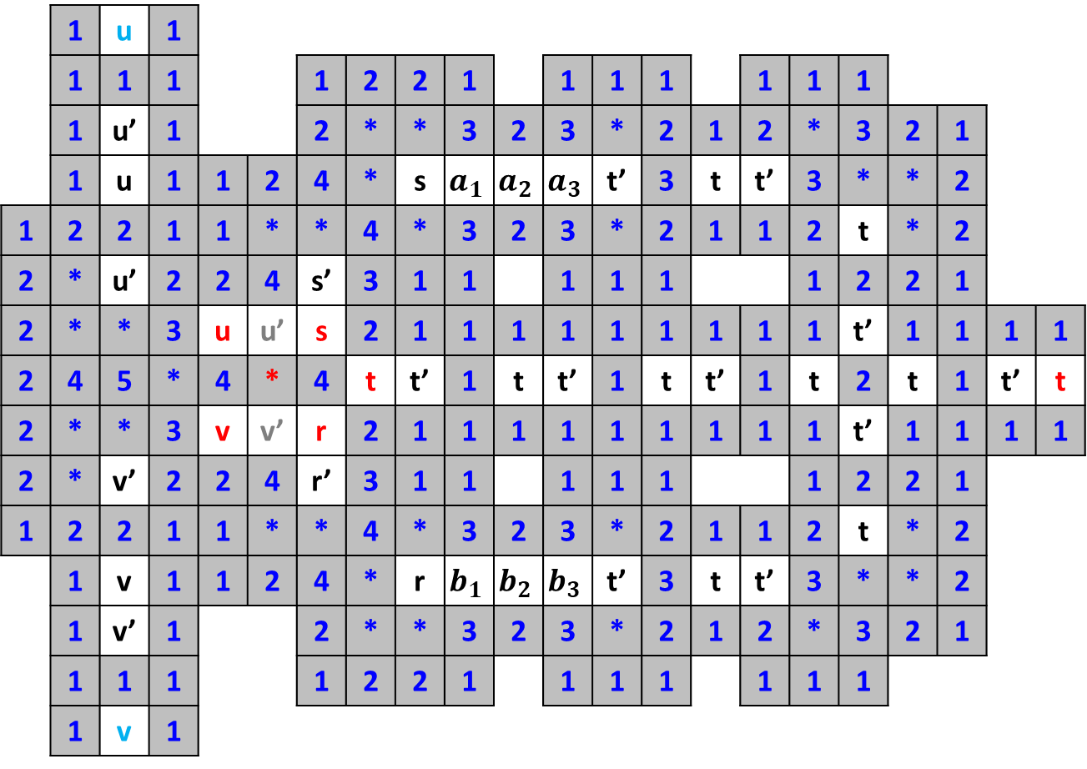
AND Gate
 | 1 | u | 1
 | 1 | 1 | 1 |  |  | 1 | 2 | 2 | 1 |  | 1 | 1 | 1 |  | 1 | 1 | 1
 | 1 | u’ | 1 |  |  | 2 | * | * | 3 | 2 | 3 | * | 2 | 1 | 2 | * | 3 | 2 | 1
 | 1 | u | 1 | 1 | 2 | 4 | * | s | $$a_{1}$$ | $$a_{2}$$ | $$a_{3}$$ | t’ | 3 | t | t’ | 3 | * | * | 2
1 | 2 | 2 | 1 | 1 | * | * | 4 | * | 3 | 2 | 3 | * | 2 | 1 | 1 | 2 | t | * | 2
2 | * | u’ | 2 | 2 | 4 | s’ | 3 | 1 | 1 |  | 1 | 1 | 1 |  |  | 1 | 2 | 2 | 1
2 | * | * | 3 | u | u’ | s | 2 | 1 | 1 | 1 | 1 | 1 | 1 | 1 | 1 | 1 | t’ | 1 | 1 | 1 | 1
2 | 4 | 5 | * | 4 | * | 4 | t | t’ | 1 | t | t’ | 1 | t | t’ | 1 | t | 2 | t | 1 | t’ | t
2 | * | * | 3 | v | v’ | r | 2 | 1 | 1 | 1 | 1 | 1 | 1 | 1 | 1 | 1 | t’ | 1 | 1 | 1 | 1
2 | * | v’ | 2 | 2 | 4 | r’ | 3 | 1 | 1 |  | 1 | 1 | 1 |  |  | 1 | 2 | 2 | 1
1 | 2 | 2 | 1 | 1 | * | * | 4 | * | 3 | 2 | 3 | * | 2 | 1 | 1 | 2 | t | * | 2
 | 1 | v | 1 | 1 | 2 | 4 | * | r | $$b_{1}$$ | $$b_{2}$$ | $$b_{3}$$ | t’ | 3 | t | t’ | 3 | * | * | 2
 | 1 | v’ | 1 |  |  | 2 | * | * | 3 | 2 | 3 | * | 2 | 1 | 2 | * | 3 | 2 | 1
 | 1 | 1 | 1 |  |  | 1 | 2 | 2 | 1 |  | 1 | 1 | 1 |  | 1 | 1 | 1
 | 1 | v | 1

Slide 9
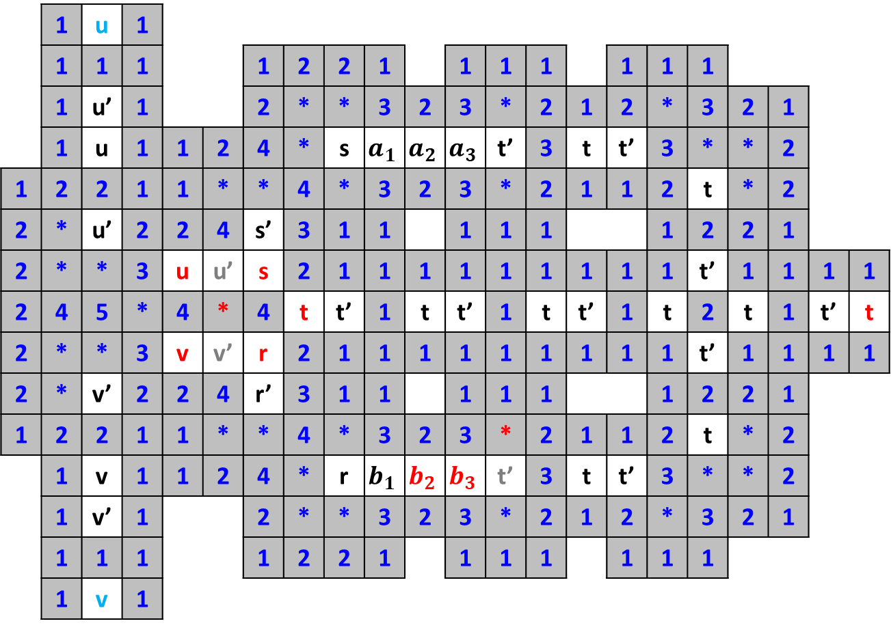
AND Gate
 | 1 | u | 1
 | 1 | 1 | 1 |  |  | 1 | 2 | 2 | 1 |  | 1 | 1 | 1 |  | 1 | 1 | 1
 | 1 | u’ | 1 |  |  | 2 | * | * | 3 | 2 | 3 | * | 2 | 1 | 2 | * | 3 | 2 | 1
 | 1 | u | 1 | 1 | 2 | 4 | * | s | $$a_{1}$$ | $$a_{2}$$ | $$a_{3}$$ | t’ | 3 | t | t’ | 3 | * | * | 2
1 | 2 | 2 | 1 | 1 | * | * | 4 | * | 3 | 2 | 3 | * | 2 | 1 | 1 | 2 | t | * | 2
2 | * | u’ | 2 | 2 | 4 | s’ | 3 | 1 | 1 |  | 1 | 1 | 1 |  |  | 1 | 2 | 2 | 1
2 | * | * | 3 | u | u’ | s | 2 | 1 | 1 | 1 | 1 | 1 | 1 | 1 | 1 | 1 | t’ | 1 | 1 | 1 | 1
2 | 4 | 5 | * | 4 | * | 4 | t | t’ | 1 | t | t’ | 1 | t | t’ | 1 | t | 2 | t | 1 | t’ | t
2 | * | * | 3 | v | v’ | r | 2 | 1 | 1 | 1 | 1 | 1 | 1 | 1 | 1 | 1 | t’ | 1 | 1 | 1 | 1
2 | * | v’ | 2 | 2 | 4 | r’ | 3 | 1 | 1 |  | 1 | 1 | 1 |  |  | 1 | 2 | 2 | 1
1 | 2 | 2 | 1 | 1 | * | * | 4 | * | 3 | 2 | 3 | * | 2 | 1 | 1 | 2 | t | * | 2
 | 1 | v | 1 | 1 | 2 | 4 | * | r | $$b_{1}$$ | $$b_{2}$$ | $$b_{3}$$ | t’ | 3 | t | t’ | 3 | * | * | 2
 | 1 | v’ | 1 |  |  | 2 | * | * | 3 | 2 | 3 | * | 2 | 1 | 2 | * | 3 | 2 | 1
 | 1 | 1 | 1 |  |  | 1 | 2 | 2 | 1 |  | 1 | 1 | 1 |  | 1 | 1 | 1
 | 1 | v | 1

Slide 10

AND Gate
 | 1 | u | 1
 | 1 | 1 | 1 |  |  | 1 | 2 | 2 | 1 |  | 1 | 1 | 1 |  | 1 | 1 | 1
 | 1 | u’ | 1 |  |  | 2 | * | * | 3 | 2 | 3 | * | 2 | 1 | 2 | * | 3 | 2 | 1
 | 1 | u | 1 | 1 | 2 | 4 | * | s | $$a_{1}$$ | $$a_{2}$$ | $$a_{3}$$ | t’ | 3 | t | t’ | 3 | * | * | 2
1 | 2 | 2 | 1 | 1 | * | * | 4 | * | 3 | 2 | 3 | * | 2 | 1 | 1 | 2 | t | * | 2
2 | * | u’ | 2 | 2 | 4 | s’ | 3 | 1 | 1 |  | 1 | 1 | 1 |  |  | 1 | 2 | 2 | 1
2 | * | * | 3 | u | u’ | s | 2 | 1 | 1 | 1 | 1 | 1 | 1 | 1 | 1 | 1 | t’ | 1 | 1 | 1 | 1
2 | 4 | 5 | * | 4 | * | 4 | t | t’ | 1 | t | t’ | 1 | t | t’ | 1 | t | 2 | t | 1 | t’ | t
2 | * | * | 3 | v | v’ | r | 2 | 1 | 1 | 1 | 1 | 1 | 1 | 1 | 1 | 1 | t’ | 1 | 1 | 1 | 1
2 | * | v’ | 2 | 2 | 4 | r’ | 3 | 1 | 1 |  | 1 | 1 | 1 |  |  | 1 | 2 | 2 | 1
1 | 2 | 2 | 1 | 1 | * | * | 4 | * | 3 | 2 | 3 | * | 2 | 1 | 1 | 2 | t | * | 2
 | 1 | v | 1 | 1 | 2 | 4 | * | r | $$b_{1}$$ | $$b_{2}$$ | $$b_{3}$$ | t’ | 3 | t | t’ | 3 | * | * | 2
 | 1 | v’ | 1 |  |  | 2 | * | * | 3 | 2 | 3 | * | 2 | 1 | 2 | * | 3 | 2 | 1
 | 1 | 1 | 1 |  |  | 1 | 2 | 2 | 1 |  | 1 | 1 | 1 |  | 1 | 1 | 1
 | 1 | v | 1

Slide 11
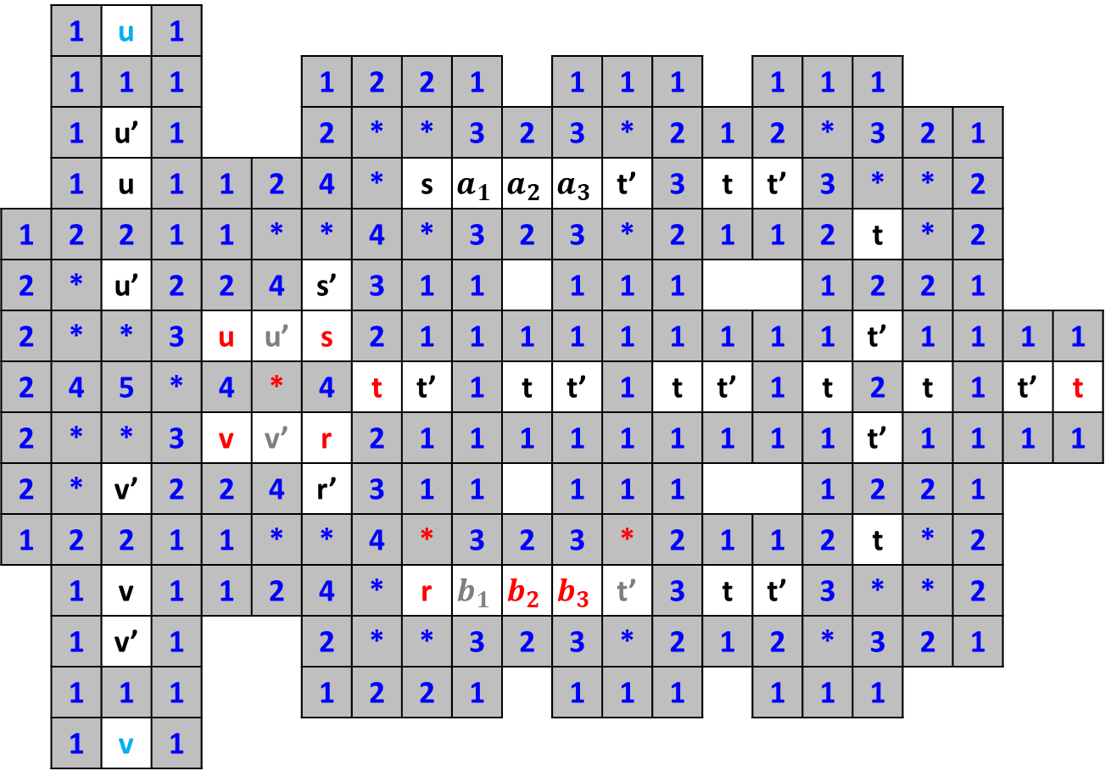
AND Gate
 | 1 | u | 1
 | 1 | 1 | 1 |  |  | 1 | 2 | 2 | 1 |  | 1 | 1 | 1 |  | 1 | 1 | 1
 | 1 | u’ | 1 |  |  | 2 | * | * | 3 | 2 | 3 | * | 2 | 1 | 2 | * | 3 | 2 | 1
 | 1 | u | 1 | 1 | 2 | 4 | * | s | $$a_{1}$$ | $$a_{2}$$ | $$a_{3}$$ | t’ | 3 | t | t’ | 3 | * | * | 2
1 | 2 | 2 | 1 | 1 | * | * | 4 | * | 3 | 2 | 3 | * | 2 | 1 | 1 | 2 | t | * | 2
2 | * | u’ | 2 | 2 | 4 | s’ | 3 | 1 | 1 |  | 1 | 1 | 1 |  |  | 1 | 2 | 2 | 1
2 | * | * | 3 | u | u’ | s | 2 | 1 | 1 | 1 | 1 | 1 | 1 | 1 | 1 | 1 | t’ | 1 | 1 | 1 | 1
2 | 4 | 5 | * | 4 | * | 4 | t | t’ | 1 | t | t’ | 1 | t | t’ | 1 | t | 2 | t | 1 | t’ | t
2 | * | * | 3 | v | v’ | r | 2 | 1 | 1 | 1 | 1 | 1 | 1 | 1 | 1 | 1 | t’ | 1 | 1 | 1 | 1
2 | * | v’ | 2 | 2 | 4 | r’ | 3 | 1 | 1 |  | 1 | 1 | 1 |  |  | 1 | 2 | 2 | 1
1 | 2 | 2 | 1 | 1 | * | * | 4 | * | 3 | 2 | 3 | * | 2 | 1 | 1 | 2 | t | * | 2
 | 1 | v | 1 | 1 | 2 | 4 | * | r | $$b_{1}$$ | $$b_{2}$$ | $$b_{3}$$ | t’ | 3 | t | t’ | 3 | * | * | 2
 | 1 | v’ | 1 |  |  | 2 | * | * | 3 | 2 | 3 | * | 2 | 1 | 2 | * | 3 | 2 | 1
 | 1 | 1 | 1 |  |  | 1 | 2 | 2 | 1 |  | 1 | 1 | 1 |  | 1 | 1 | 1
 | 1 | v | 1

Slide 12
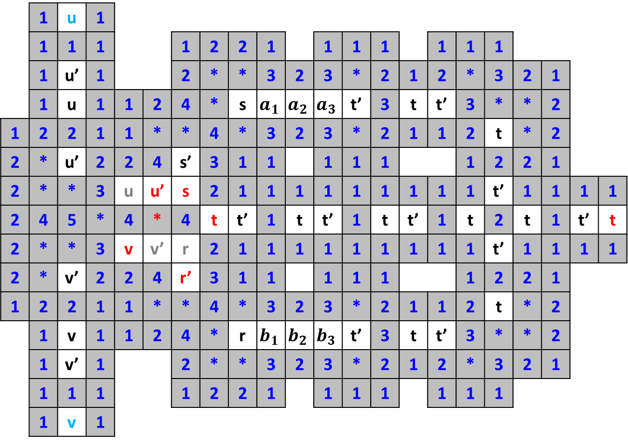
AND Gate
 | 1 | u | 1
 | 1 | 1 | 1 |  |  | 1 | 2 | 2 | 1 |  | 1 | 1 | 1 |  | 1 | 1 | 1
 | 1 | u’ | 1 |  |  | 2 | * | * | 3 | 2 | 3 | * | 2 | 1 | 2 | * | 3 | 2 | 1
 | 1 | u | 1 | 1 | 2 | 4 | * | s | $$a_{1}$$ | $$a_{2}$$ | $$a_{3}$$ | t’ | 3 | t | t’ | 3 | * | * | 2
1 | 2 | 2 | 1 | 1 | * | * | 4 | * | 3 | 2 | 3 | * | 2 | 1 | 1 | 2 | t | * | 2
2 | * | u’ | 2 | 2 | 4 | s’ | 3 | 1 | 1 |  | 1 | 1 | 1 |  |  | 1 | 2 | 2 | 1
2 | * | * | 3 | u | u’ | s | 2 | 1 | 1 | 1 | 1 | 1 | 1 | 1 | 1 | 1 | t’ | 1 | 1 | 1 | 1
2 | 4 | 5 | * | 4 | * | 4 | t | t’ | 1 | t | t’ | 1 | t | t’ | 1 | t | 2 | t | 1 | t’ | t
2 | * | * | 3 | v | v’ | r | 2 | 1 | 1 | 1 | 1 | 1 | 1 | 1 | 1 | 1 | t’ | 1 | 1 | 1 | 1
2 | * | v’ | 2 | 2 | 4 | r’ | 3 | 1 | 1 |  | 1 | 1 | 1 |  |  | 1 | 2 | 2 | 1
1 | 2 | 2 | 1 | 1 | * | * | 4 | * | 3 | 2 | 3 | * | 2 | 1 | 1 | 2 | t | * | 2
 | 1 | v | 1 | 1 | 2 | 4 | * | r | $$b_{1}$$ | $$b_{2}$$ | $$b_{3}$$ | t’ | 3 | t | t’ | 3 | * | * | 2
 | 1 | v’ | 1 |  |  | 2 | * | * | 3 | 2 | 3 | * | 2 | 1 | 2 | * | 3 | 2 | 1
 | 1 | 1 | 1 |  |  | 1 | 2 | 2 | 1 |  | 1 | 1 | 1 |  | 1 | 1 | 1
 | 1 | v | 1

Slide 13
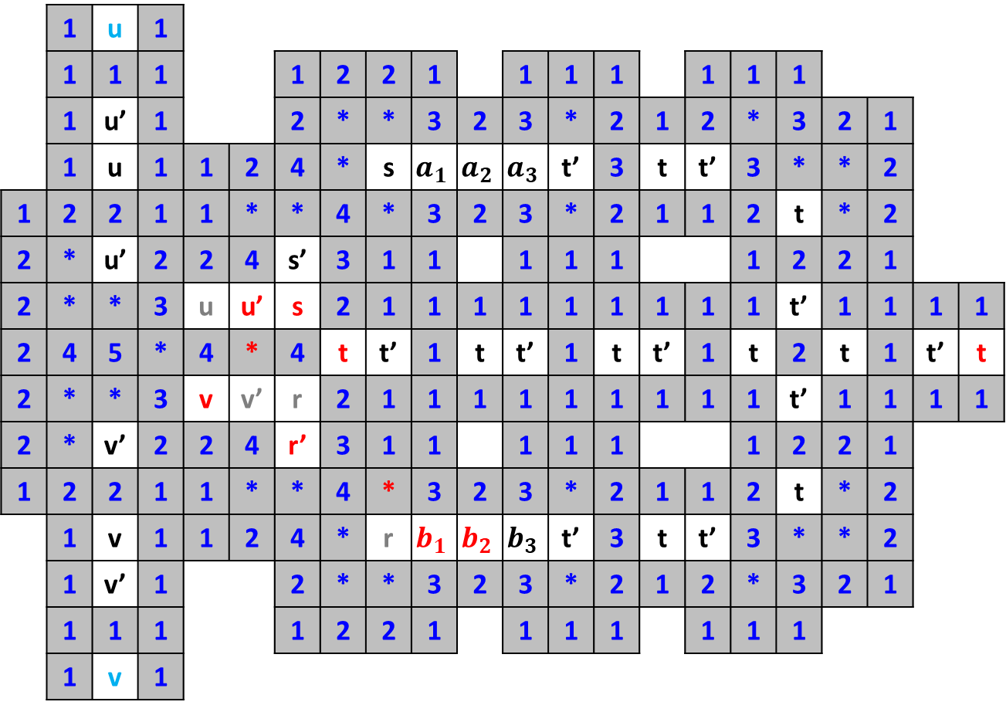
AND Gate
 | 1 | u | 1
 | 1 | 1 | 1 |  |  | 1 | 2 | 2 | 1 |  | 1 | 1 | 1 |  | 1 | 1 | 1
 | 1 | u’ | 1 |  |  | 2 | * | * | 3 | 2 | 3 | * | 2 | 1 | 2 | * | 3 | 2 | 1
 | 1 | u | 1 | 1 | 2 | 4 | * | s | $$a_{1}$$ | $$a_{2}$$ | $$a_{3}$$ | t’ | 3 | t | t’ | 3 | * | * | 2
1 | 2 | 2 | 1 | 1 | * | * | 4 | * | 3 | 2 | 3 | * | 2 | 1 | 1 | 2 | t | * | 2
2 | * | u’ | 2 | 2 | 4 | s’ | 3 | 1 | 1 |  | 1 | 1 | 1 |  |  | 1 | 2 | 2 | 1
2 | * | * | 3 | u | u’ | s | 2 | 1 | 1 | 1 | 1 | 1 | 1 | 1 | 1 | 1 | t’ | 1 | 1 | 1 | 1
2 | 4 | 5 | * | 4 | * | 4 | t | t’ | 1 | t | t’ | 1 | t | t’ | 1 | t | 2 | t | 1 | t’ | t
2 | * | * | 3 | v | v’ | r | 2 | 1 | 1 | 1 | 1 | 1 | 1 | 1 | 1 | 1 | t’ | 1 | 1 | 1 | 1
2 | * | v’ | 2 | 2 | 4 | r’ | 3 | 1 | 1 |  | 1 | 1 | 1 |  |  | 1 | 2 | 2 | 1
1 | 2 | 2 | 1 | 1 | * | * | 4 | * | 3 | 2 | 3 | * | 2 | 1 | 1 | 2 | t | * | 2
 | 1 | v | 1 | 1 | 2 | 4 | * | r | $$b_{1}$$ | $$b_{2}$$ | $$b_{3}$$ | t’ | 3 | t | t’ | 3 | * | * | 2
 | 1 | v’ | 1 |  |  | 2 | * | * | 3 | 2 | 3 | * | 2 | 1 | 2 | * | 3 | 2 | 1
 | 1 | 1 | 1 |  |  | 1 | 2 | 2 | 1 |  | 1 | 1 | 1 |  | 1 | 1 | 1
 | 1 | v | 1

Slide 14

AND Gate
 | 1 | u | 1
 | 1 | 1 | 1 |  |  | 1 | 2 | 2 | 1 |  | 1 | 1 | 1 |  | 1 | 1 | 1
 | 1 | u’ | 1 |  |  | 2 | * | * | 3 | 2 | 3 | * | 2 | 1 | 2 | * | 3 | 2 | 1
 | 1 | u | 1 | 1 | 2 | 4 | * | s | $$a_{1}$$ | $$a_{2}$$ | $$a_{3}$$ | t’ | 3 | t | t’ | 3 | * | * | 2
1 | 2 | 2 | 1 | 1 | * | * | 4 | * | 3 | 2 | 3 | * | 2 | 1 | 1 | 2 | t | * | 2
2 | * | u’ | 2 | 2 | 4 | s’ | 3 | 1 | 1 |  | 1 | 1 | 1 |  |  | 1 | 2 | 2 | 1
2 | * | * | 3 | u | u’ | s | 2 | 1 | 1 | 1 | 1 | 1 | 1 | 1 | 1 | 1 | t’ | 1 | 1 | 1 | 1
2 | 4 | 5 | * | 4 | * | 4 | t | t’ | 1 | t | t’ | 1 | t | t’ | 1 | t | 2 | t | 1 | t’ | t
2 | * | * | 3 | v | v’ | r | 2 | 1 | 1 | 1 | 1 | 1 | 1 | 1 | 1 | 1 | t’ | 1 | 1 | 1 | 1
2 | * | v’ | 2 | 2 | 4 | r’ | 3 | 1 | 1 |  | 1 | 1 | 1 |  |  | 1 | 2 | 2 | 1
1 | 2 | 2 | 1 | 1 | * | * | 4 | * | 3 | 2 | 3 | * | 2 | 1 | 1 | 2 | t | * | 2
 | 1 | v | 1 | 1 | 2 | 4 | * | r | $$b_{1}$$ | $$b_{2}$$ | $$b_{3}$$ | t’ | 3 | t | t’ | 3 | * | * | 2
 | 1 | v’ | 1 |  |  | 2 | * | * | 3 | 2 | 3 | * | 2 | 1 | 2 | * | 3 | 2 | 1
 | 1 | 1 | 1 |  |  | 1 | 2 | 2 | 1 |  | 1 | 1 | 1 |  | 1 | 1 | 1
 | 1 | v | 1

Slide 15

AND Gate
 | 1 | u | 1
 | 1 | 1 | 1 |  |  | 1 | 2 | 2 | 1 |  | 1 | 1 | 1 |  | 1 | 1 | 1
 | 1 | u’ | 1 |  |  | 2 | * | * | 3 | 2 | 3 | * | 2 | 1 | 2 | * | 3 | 2 | 1
 | 1 | u | 1 | 1 | 2 | 4 | * | s | $$a_{1}$$ | $$a_{2}$$ | $$a_{3}$$ | t’ | 3 | t | t’ | 3 | * | * | 2
1 | 2 | 2 | 1 | 1 | * | * | 4 | * | 3 | 2 | 3 | * | 2 | 1 | 1 | 2 | t | * | 2
2 | * | u’ | 2 | 2 | 4 | s’ | 3 | 1 | 1 |  | 1 | 1 | 1 |  |  | 1 | 2 | 2 | 1
2 | * | * | 3 | u | u’ | s | 2 | 1 | 1 | 1 | 1 | 1 | 1 | 1 | 1 | 1 | t’ | 1 | 1 | 1 | 1
2 | 4 | 5 | * | 4 | * | 4 | t | t’ | 1 | t | t’ | 1 | t | t’ | 1 | t | 2 | t | 1 | t’ | t
2 | * | * | 3 | v | v’ | r | 2 | 1 | 1 | 1 | 1 | 1 | 1 | 1 | 1 | 1 | t’ | 1 | 1 | 1 | 1
2 | * | v’ | 2 | 2 | 4 | r’ | 3 | 1 | 1 |  | 1 | 1 | 1 |  |  | 1 | 2 | 2 | 1
1 | 2 | 2 | 1 | 1 | * | * | 4 | * | 3 | 2 | 3 | * | 2 | 1 | 1 | 2 | t | * | 2
 | 1 | v | 1 | 1 | 2 | 4 | * | r | $$b_{1}$$ | $$b_{2}$$ | $$b_{3}$$ | t’ | 3 | t | t’ | 3 | * | * | 2
 | 1 | v’ | 1 |  |  | 2 | * | * | 3 | 2 | 3 | * | 2 | 1 | 2 | * | 3 | 2 | 1
 | 1 | 1 | 1 |  |  | 1 | 2 | 2 | 1 |  | 1 | 1 | 1 |  | 1 | 1 | 1
 | 1 | v | 1

Slide 16
AND Gate
 | 1 | u | 1
 | 1 | 1 | 1 |  |  | 1 | 2 | 2 | 1 |  | 1 | 1 | 1 |  | 1 | 1 | 1
 | 1 | u’ | 1 |  |  | 2 | * | * | 3 | 2 | 3 | * | 2 | 1 | 2 | * | 3 | 2 | 1
 | 1 | u | 1 | 1 | 2 | 4 | * | s | $$a_{1}$$ | $$a_{2}$$ | $$a_{3}$$ | t’ | 3 | t | t’ | 3 | * | * | 2
1 | 2 | 2 | 1 | 1 | * | * | 4 | * | 3 | 2 | 3 | * | 2 | 1 | 1 | 2 | t | * | 2
2 | * | u’ | 2 | 2 | 4 | s’ | 3 | 1 | 1 |  | 1 | 1 | 1 |  |  | 1 | 2 | 2 | 1
2 | * | * | 3 | u | u’ | s | 2 | 1 | 1 | 1 | 1 | 1 | 1 | 1 | 1 | 1 | t’ | 1 | 1 | 1 | 1
2 | 4 | 5 | * | 4 | * | 4 | t | t’ | 1 | t | t’ | 1 | t | t’ | 1 | t | 2 | t | 1 | t’ | t
2 | * | * | 3 | v | v’ | r | 2 | 1 | 1 | 1 | 1 | 1 | 1 | 1 | 1 | 1 | t’ | 1 | 1 | 1 | 1
2 | * | v’ | 2 | 2 | 4 | r’ | 3 | 1 | 1 |  | 1 | 1 | 1 |  |  | 1 | 2 | 2 | 1
1 | 2 | 2 | 1 | 1 | * | * | 4 | * | 3 | 2 | 3 | * | 2 | 1 | 1 | 2 | t | * | 2
 | 1 | v | 1 | 1 | 2 | 4 | * | r | $$b_{1}$$ | $$b_{2}$$ | $$b_{3}$$ | t’ | 3 | t | t’ | 3 | * | * | 2
 | 1 | v’ | 1 |  |  | 2 | * | * | 3 | 2 | 3 | * | 2 | 1 | 2 | * | 3 | 2 | 1
 | 1 | 1 | 1 |  |  | 1 | 2 | 2 | 1 |  | 1 | 1 | 1 |  | 1 | 1 | 1
 | 1 | v | 1

Slide 17

AND Gate
 | 1 | u | 1
 | 1 | 1 | 1 |  |  | 1 | 2 | 2 | 1 |  | 1 | 1 | 1 |  | 1 | 1 | 1
 | 1 | u’ | 1 |  |  | 2 | * | * | 3 | 2 | 3 | * | 2 | 1 | 2 | * | 3 | 2 | 1
 | 1 | u | 1 | 1 | 2 | 4 | * | s | $$a_{1}$$ | $$a_{2}$$ | $$a_{3}$$ | t’ | 3 | t | t’ | 3 | * | * | 2
1 | 2 | 2 | 1 | 1 | * | * | 4 | * | 3 | 2 | 3 | * | 2 | 1 | 1 | 2 | t | * | 2
2 | * | u’ | 2 | 2 | 4 | s’ | 3 | 1 | 1 |  | 1 | 1 | 1 |  |  | 1 | 2 | 2 | 1
2 | * | * | 3 | u | u’ | s | 2 | 1 | 1 | 1 | 1 | 1 | 1 | 1 | 1 | 1 | t’ | 1 | 1 | 1 | 1
2 | 4 | 5 | * | 4 | * | 4 | t | t’ | 1 | t | t’ | 1 | t | t’ | 1 | t | 2 | t | 1 | t’ | t
2 | * | * | 3 | v | v’ | r | 2 | 1 | 1 | 1 | 1 | 1 | 1 | 1 | 1 | 1 | t’ | 1 | 1 | 1 | 1
2 | * | v’ | 2 | 2 | 4 | r’ | 3 | 1 | 1 |  | 1 | 1 | 1 |  |  | 1 | 2 | 2 | 1
1 | 2 | 2 | 1 | 1 | * | * | 4 | * | 3 | 2 | 3 | * | 2 | 1 | 1 | 2 | t | * | 2
 | 1 | v | 1 | 1 | 2 | 4 | * | r | $$b_{1}$$ | $$b_{2}$$ | $$b_{3}$$ | t’ | 3 | t | t’ | 3 | * | * | 2
 | 1 | v’ | 1 |  |  | 2 | * | * | 3 | 2 | 3 | * | 2 | 1 | 2 | * | 3 | 2 | 1
 | 1 | 1 | 1 |  |  | 1 | 2 | 2 | 1 |  | 1 | 1 | 1 |  | 1 | 1 | 1
 | 1 | v | 1

Slide 18
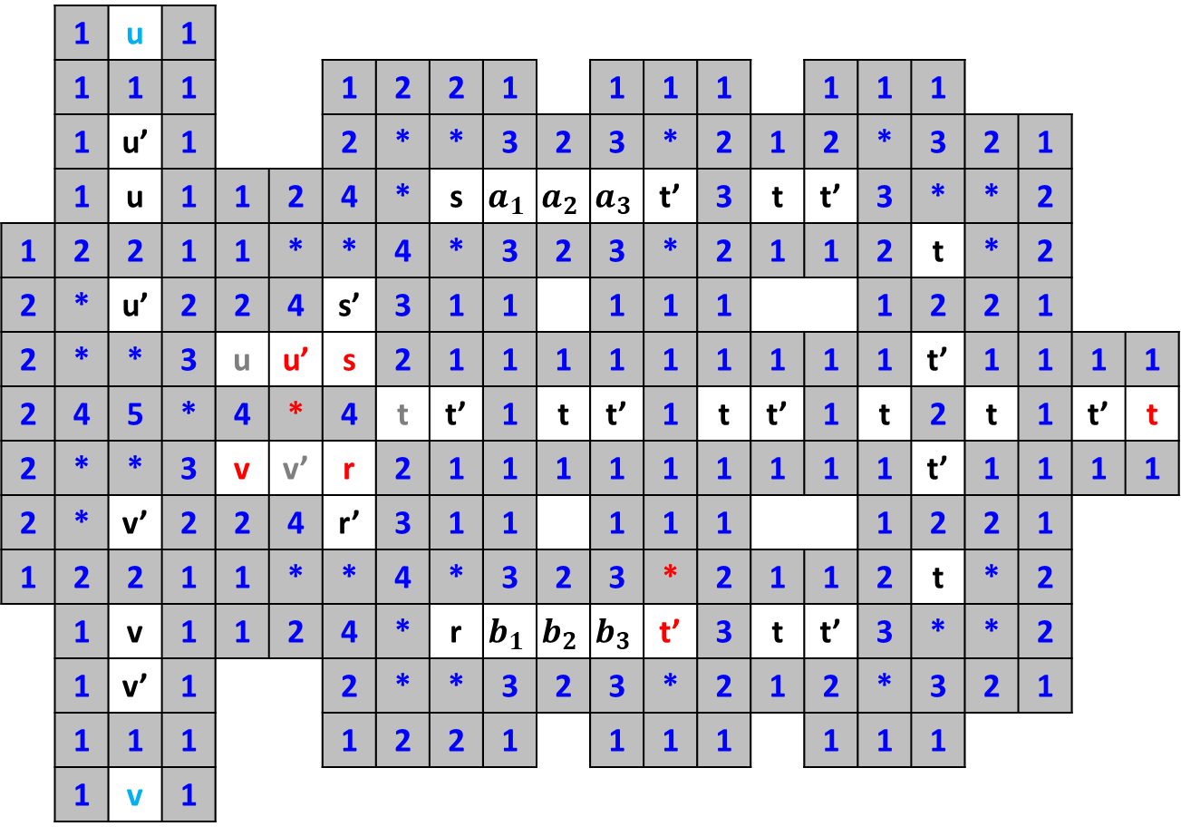
AND Gate
 | 1 | u | 1
 | 1 | 1 | 1 |  |  | 1 | 2 | 2 | 1 |  | 1 | 1 | 1 |  | 1 | 1 | 1
 | 1 | u’ | 1 |  |  | 2 | * | * | 3 | 2 | 3 | * | 2 | 1 | 2 | * | 3 | 2 | 1
 | 1 | u | 1 | 1 | 2 | 4 | * | s | $$a_{1}$$ | $$a_{2}$$ | $$a_{3}$$ | t’ | 3 | t | t’ | 3 | * | * | 2
1 | 2 | 2 | 1 | 1 | * | * | 4 | * | 3 | 2 | 3 | * | 2 | 1 | 1 | 2 | t | * | 2
2 | * | u’ | 2 | 2 | 4 | s’ | 3 | 1 | 1 |  | 1 | 1 | 1 |  |  | 1 | 2 | 2 | 1
2 | * | * | 3 | u | u’ | s | 2 | 1 | 1 | 1 | 1 | 1 | 1 | 1 | 1 | 1 | t’ | 1 | 1 | 1 | 1
2 | 4 | 5 | * | 4 | * | 4 | t | t’ | 1 | t | t’ | 1 | t | t’ | 1 | t | 2 | t | 1 | t’ | t
2 | * | * | 3 | v | v’ | r | 2 | 1 | 1 | 1 | 1 | 1 | 1 | 1 | 1 | 1 | t’ | 1 | 1 | 1 | 1
2 | * | v’ | 2 | 2 | 4 | r’ | 3 | 1 | 1 |  | 1 | 1 | 1 |  |  | 1 | 2 | 2 | 1
1 | 2 | 2 | 1 | 1 | * | * | 4 | * | 3 | 2 | 3 | * | 2 | 1 | 1 | 2 | t | * | 2
 | 1 | v | 1 | 1 | 2 | 4 | * | r | $$b_{1}$$ | $$b_{2}$$ | $$b_{3}$$ | t’ | 3 | t | t’ | 3 | * | * | 2
 | 1 | v’ | 1 |  |  | 2 | * | * | 3 | 2 | 3 | * | 2 | 1 | 2 | * | 3 | 2 | 1
 | 1 | 1 | 1 |  |  | 1 | 2 | 2 | 1 |  | 1 | 1 | 1 |  | 1 | 1 | 1
 | 1 | v | 1

Slide 19

AND Gate
 | 1 | u | 1
 | 1 | 1 | 1 |  |  | 1 | 2 | 2 | 1 |  | 1 | 1 | 1 |  | 1 | 1 | 1
 | 1 | u’ | 1 |  |  | 2 | * | * | 3 | 2 | 3 | * | 2 | 1 | 2 | * | 3 | 2 | 1
 | 1 | u | 1 | 1 | 2 | 4 | * | s | $$a_{1}$$ | $$a_{2}$$ | $$a_{3}$$ | t’ | 3 | t | t’ | 3 | * | * | 2
1 | 2 | 2 | 1 | 1 | * | * | 4 | * | 3 | 2 | 3 | * | 2 | 1 | 1 | 2 | t | * | 2
2 | * | u’ | 2 | 2 | 4 | s’ | 3 | 1 | 1 |  | 1 | 1 | 1 |  |  | 1 | 2 | 2 | 1
2 | * | * | 3 | u | u’ | s | 2 | 1 | 1 | 1 | 1 | 1 | 1 | 1 | 1 | 1 | t’ | 1 | 1 | 1 | 1
2 | 4 | 5 | * | 4 | * | 4 | t | t’ | 1 | t | t’ | 1 | t | t’ | 1 | t | 2 | t | 1 | t’ | t
2 | * | * | 3 | v | v’ | r | 2 | 1 | 1 | 1 | 1 | 1 | 1 | 1 | 1 | 1 | t’ | 1 | 1 | 1 | 1
2 | * | v’ | 2 | 2 | 4 | r’ | 3 | 1 | 1 |  | 1 | 1 | 1 |  |  | 1 | 2 | 2 | 1
1 | 2 | 2 | 1 | 1 | * | * | 4 | * | 3 | 2 | 3 | * | 2 | 1 | 1 | 2 | t | * | 2
 | 1 | v | 1 | 1 | 2 | 4 | * | r | $$b_{1}$$ | $$b_{2}$$ | $$b_{3}$$ | t’ | 3 | t | t’ | 3 | * | * | 2
 | 1 | v’ | 1 |  |  | 2 | * | * | 3 | 2 | 3 | * | 2 | 1 | 2 | * | 3 | 2 | 1
 | 1 | 1 | 1 |  |  | 1 | 2 | 2 | 1 |  | 1 | 1 | 1 |  | 1 | 1 | 1
 | 1 | v | 1

Slide 20
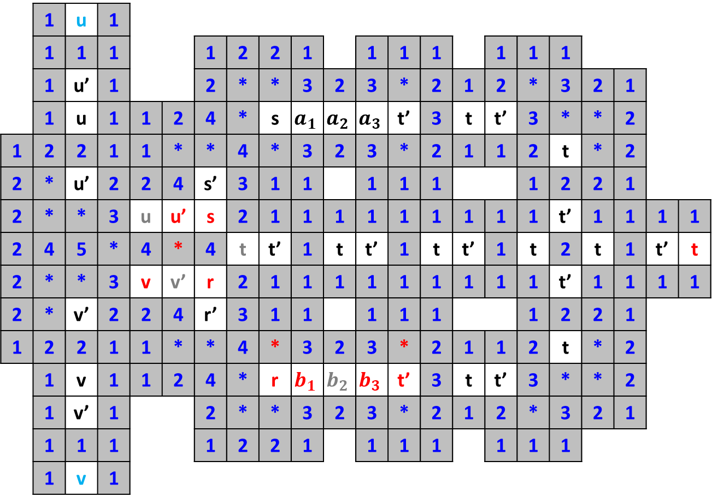
AND Gate
 | 1 | u | 1
 | 1 | 1 | 1 |  |  | 1 | 2 | 2 | 1 |  | 1 | 1 | 1 |  | 1 | 1 | 1
 | 1 | u’ | 1 |  |  | 2 | * | * | 3 | 2 | 3 | * | 2 | 1 | 2 | * | 3 | 2 | 1
 | 1 | u | 1 | 1 | 2 | 4 | * | s | $$a_{1}$$ | $$a_{2}$$ | $$a_{3}$$ | t’ | 3 | t | t’ | 3 | * | * | 2
1 | 2 | 2 | 1 | 1 | * | * | 4 | * | 3 | 2 | 3 | * | 2 | 1 | 1 | 2 | t | * | 2
2 | * | u’ | 2 | 2 | 4 | s’ | 3 | 1 | 1 |  | 1 | 1 | 1 |  |  | 1 | 2 | 2 | 1
2 | * | * | 3 | u | u’ | s | 2 | 1 | 1 | 1 | 1 | 1 | 1 | 1 | 1 | 1 | t’ | 1 | 1 | 1 | 1
2 | 4 | 5 | * | 4 | * | 4 | t | t’ | 1 | t | t’ | 1 | t | t’ | 1 | t | 2 | t | 1 | t’ | t
2 | * | * | 3 | v | v’ | r | 2 | 1 | 1 | 1 | 1 | 1 | 1 | 1 | 1 | 1 | t’ | 1 | 1 | 1 | 1
2 | * | v’ | 2 | 2 | 4 | r’ | 3 | 1 | 1 |  | 1 | 1 | 1 |  |  | 1 | 2 | 2 | 1
1 | 2 | 2 | 1 | 1 | * | * | 4 | * | 3 | 2 | 3 | * | 2 | 1 | 1 | 2 | t | * | 2
 | 1 | v | 1 | 1 | 2 | 4 | * | r | $$b_{1}$$ | $$b_{2}$$ | $$b_{3}$$ | t’ | 3 | t | t’ | 3 | * | * | 2
 | 1 | v’ | 1 |  |  | 2 | * | * | 3 | 2 | 3 | * | 2 | 1 | 2 | * | 3 | 2 | 1
 | 1 | 1 | 1 |  |  | 1 | 2 | 2 | 1 |  | 1 | 1 | 1 |  | 1 | 1 | 1
 | 1 | v | 1

Slide 21
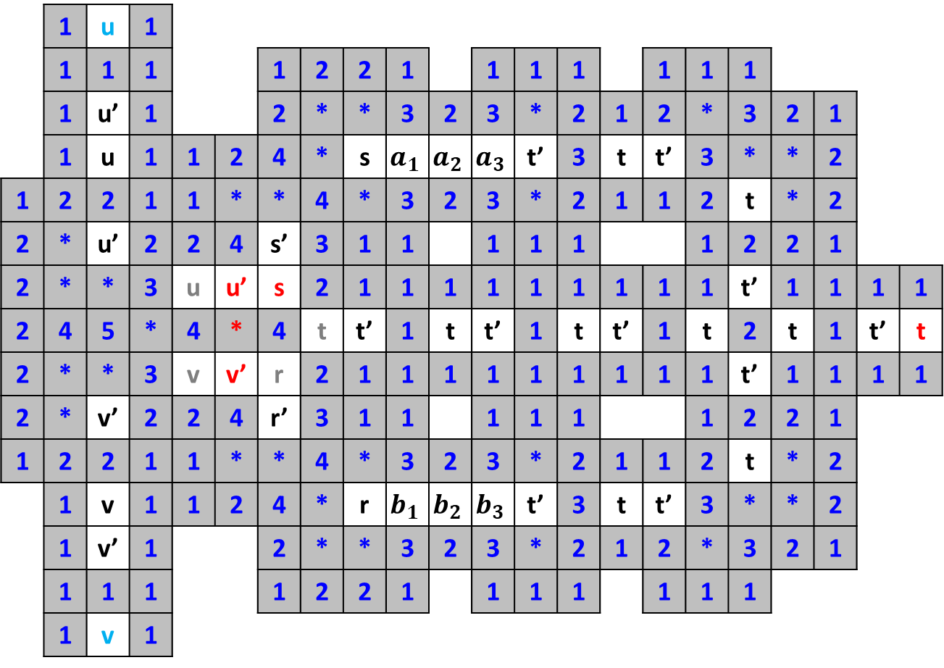
AND Gate
 | 1 | u | 1
 | 1 | 1 | 1 |  |  | 1 | 2 | 2 | 1 |  | 1 | 1 | 1 |  | 1 | 1 | 1
 | 1 | u’ | 1 |  |  | 2 | * | * | 3 | 2 | 3 | * | 2 | 1 | 2 | * | 3 | 2 | 1
 | 1 | u | 1 | 1 | 2 | 4 | * | s | $$a_{1}$$ | $$a_{2}$$ | $$a_{3}$$ | t’ | 3 | t | t’ | 3 | * | * | 2
1 | 2 | 2 | 1 | 1 | * | * | 4 | * | 3 | 2 | 3 | * | 2 | 1 | 1 | 2 | t | * | 2
2 | * | u’ | 2 | 2 | 4 | s’ | 3 | 1 | 1 |  | 1 | 1 | 1 |  |  | 1 | 2 | 2 | 1
2 | * | * | 3 | u | u’ | s | 2 | 1 | 1 | 1 | 1 | 1 | 1 | 1 | 1 | 1 | t’ | 1 | 1 | 1 | 1
2 | 4 | 5 | * | 4 | * | 4 | t | t’ | 1 | t | t’ | 1 | t | t’ | 1 | t | 2 | t | 1 | t’ | t
2 | * | * | 3 | v | v’ | r | 2 | 1 | 1 | 1 | 1 | 1 | 1 | 1 | 1 | 1 | t’ | 1 | 1 | 1 | 1
2 | * | v’ | 2 | 2 | 4 | r’ | 3 | 1 | 1 |  | 1 | 1 | 1 |  |  | 1 | 2 | 2 | 1
1 | 2 | 2 | 1 | 1 | * | * | 4 | * | 3 | 2 | 3 | * | 2 | 1 | 1 | 2 | t | * | 2
 | 1 | v | 1 | 1 | 2 | 4 | * | r | $$b_{1}$$ | $$b_{2}$$ | $$b_{3}$$ | t’ | 3 | t | t’ | 3 | * | * | 2
 | 1 | v’ | 1 |  |  | 2 | * | * | 3 | 2 | 3 | * | 2 | 1 | 2 | * | 3 | 2 | 1
 | 1 | 1 | 1 |  |  | 1 | 2 | 2 | 1 |  | 1 | 1 | 1 |  | 1 | 1 | 1
 | 1 | v | 1

Slide 22
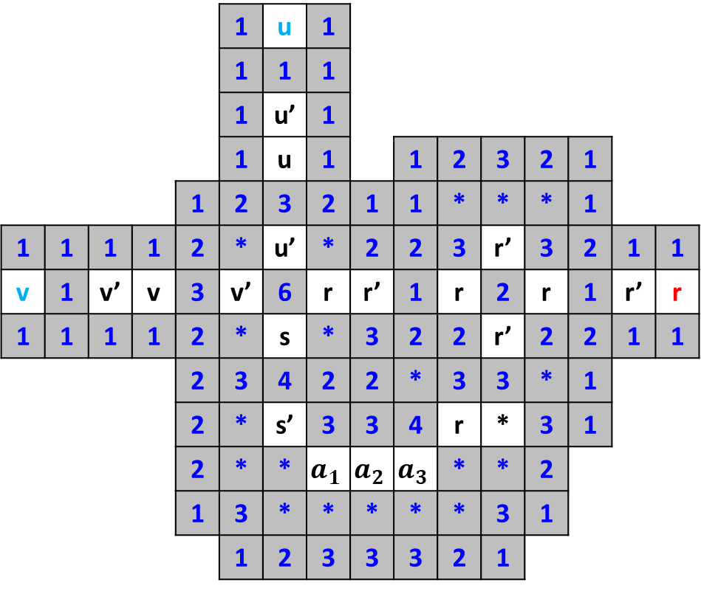
OR Gate
 |  |  |  |  | 1 | u | 1
 |  |  |  |  | 1 | 1 | 1
 |  |  |  |  | 1 | u’ | 1
 |  |  |  |  | 1 | u | 1 |  | 1 | 2 | 3 | 2 | 1
 |  |  |  | 1 | 2 | 3 | 2 | 1 | 1 | * | * | * | 1
1 | 1 | 1 | 1 | 2 | * | u’ | * | 2 | 2 | 3 | r’ | 3 | 2 | 1 | 1
v | 1 | v’ | v | 3 | v’ | 6 | r | r’ | 1 | r | 2 | r | 1 | r’ | r
1 | 1 | 1 | 1 | 2 | * | s | * | 3 | 2 | 2 | r’ | 2 | 2 | 1 | 1
 |  |  |  | 2 | 3 | 4 | 2 | 2 | * | 3 | 3 | * | 1
 |  |  |  | 2 | * | s’ | 3 | 3 | 4 | r | * | 3 | 1
 |  |  |  | 2 | * | * | $$a_{1}$$ | $$a_{2}$$ | $$a_{3}$$ | * | * | 2
 |  |  |  | 1 | 3 | * | * | * | * | * | 3 | 1
 |  |  |  |  | 1 | 2 | 3 | 3 | 3 | 2 | 1

Slide 23
XOR Gate
 |  |  | 1 | 1 | 1 | 1 | 1 | 1 |  | 1 | 1 | 1
1 | 1 | 1 | 2 | * | 3 | 3 | * | 2 | 1 | 2 | * | 2 | 1 | 1
u | 1 | u’ | u | 3 | * | * | 4 | w | w’ | 3 | w | 3 | w’ | w
1 | 1 | 1 | 1 | 2 | u’ | w’ | 3 | 1 | 1 | 2 | * | 2 | 1 | 1
 |  |  | 1 | 2 | 3 | 3 | 2 | 2 | 2 | 3 | 2 | 1
1 | 1 | 1 | 3 | * | u | w | * | 3 | * | * | 2 | 1
v | 1 | v’ | v | * | v’ | 6 | x | 4 | x’ | 6 | * | 2
1 | 1 | 1 | 2 | 3 | * | x | * | 3 | * | x | * | 2
 |  |  |  | 2 | 3 | 5 | 3 | 3 | 2 | x’ | 2 | 1
 |  |  |  | 1 | * | x’ | * | 1 | 1 | 1 | 1
 |  |  |  | 2 | 3 | 4 | 2 | 2 | 2 | x | 1
 |  |  |  | 2 | * | x | 1 | 2 | * | x’ | 2 | 1
 |  |  |  | 2 | * | 5 | x’ | 4 | x | 5 | * | 1
 |  |  |  | 1 | 2 | * | * | 3 | * | * | 2 | 1
 |  |  |  |  | 1 | 2 | 2 | 2 | 2 | 2 | 1

