Slide 1
A Very Fast String Matching Algorithm Based on Condensed Alphabets
Grabowski, Szymon, Simone Faro, and Emanuele Giaquinta.
Algorithmic Aspects in Information and Management. AAIM 2016. Lecture Notes in Computer Science, Vol. 9778.
Presenter : Shie-Yan Lee
2017/6/27

Slide 2
Abstract
String matching is the problem of finding all the substrings of a text which correspond to a given pattern. It’s one of the most investigated problem in computer science, mainly due to its various applications in many fields. In recent years most solutions to the problem focused on efficiency and flexibility of the searching procedure and effective techniques appeared to speed-up previous solutions. In this paper we present a simple and very efficient algorithm for string matching. It can be seen as an extension of the Skip-Search algorithm to condensed alphabets with the aim of reducing the number of verifications during the searching phase. From our experimental results it turns out that the new variant obtains in most cases the best running time when compared against the most effective algorithms in literature. This makes the new algorithm one of the most flexible solutions in practical cases.

Slide 3
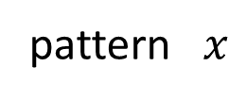
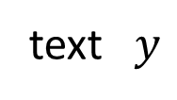

String matching problem
pattern $x$
$$m$$
text $y$
$$n$$

Slide 4



String matching problem
pattern $x$
$$m$$
text $y$
$$n$$
$$m$$
$$m$$
$$m$$

Slide 5
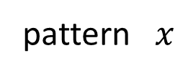
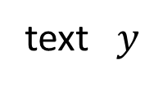
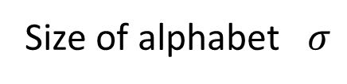


The Skip Search Algorithm
pattern $x$
$$m$$
text $y$
$$n$$
Preprocessing phase
Search phase
Size of alphabet $σ$

Slide 6

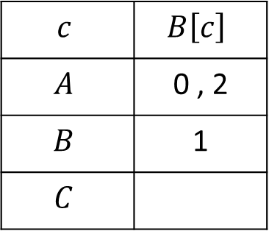


The Skip Search Algorithm
pattern $x$
$$ABA$$
text $y$
$$CABACBAABACCA$$
Preprocessing phase
Search phase
Size of alphabet $σ$
$$B\left[c\right]=all positions of char c in x$$
$$c$$ | $$B\left[c\right]$$
$$A$$ | 0 , 2
$$B$$ | 1
$$C$$

Slide 7
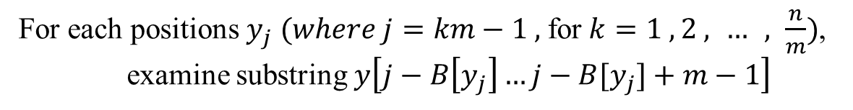



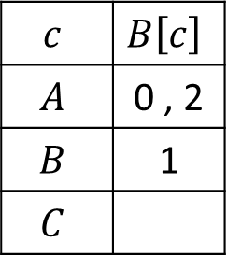



The Skip Search Algorithm
pattern $x$
$$ABA$$
text $y$
$$CABACABABACCA$$
Preprocessing phase
Search phase
Size of alphabet $σ$
For each positions $y_{j} (where j=km−1 ,$for$k=1 , 2 , … , \frac{n}{m})$,
examine substring $y\left[j−B\left[y_{j}\right]…j−B[y_{j}]+m−1\right]$
$$y_{2}$$
$$y_{5}$$
$$y_{8}$$
$$y_{11}$$
$$c$$ | $$B\left[c\right]$$
$$A$$ | 0 , 2
$$B$$ | 1
$$C$$
$$CABACABABACCA$$

Slide 8

The Skip Search Algorithm
pattern $x$
$$ABA$$
text $y$
$$CABACABABACCA$$
Preprocessing phase
Search phase
Size of alphabet $σ$
For each positions $y_{j} (where j=km−1 ,$for$k=1 , 2 , … , \frac{n}{m})$,
examine substring $y\left[j−B\left[y_{j}\right]…j−B[y_{j}]+m−1\right]$
$$y_{2}$$
$$y_{5}$$
$$y_{8}$$
$$y_{11}$$
$$c$$ | $$B\left[c\right]$$
$$A$$ | 0 , 2
$$B$$ | 1
$$C$$
$$CABACABABACCA$$
$$ABA$$

Slide 9



The Skip Search Algorithm
pattern $x$
$$ABA$$
text $y$
$$CABACABABACCA$$
Preprocessing phase
Search phase
Size of alphabet $σ$
For each positions $y_{j} (where j=km−1 ,$for$k=1 , 2 , … , \frac{n}{m})$,
examine substring $y\left[j−B\left[y_{j}\right]…j−B[y_{j}]+m−1\right]$
$$y_{2}$$
$$y_{5}$$
$$y_{8}$$
$$y_{11}$$
$$c$$ | $$B\left[c\right]$$
$$A$$ | 0 , 2
$$B$$ | 1
$$C$$
$$CABACABABACCA$$
$$ABA$$
$$ACA$$

Slide 10
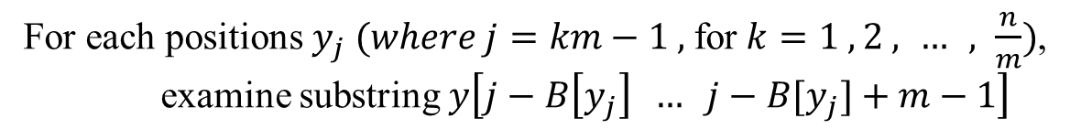


The Skip Search Algorithm
pattern $x$
$$ABA$$
text $y$
$$CABACABABACCA$$
Preprocessing phase
Search phase
Size of alphabet $σ$
For each positions $y_{j} (where j=km−1 ,$for$k=1 , 2 , … , \frac{n}{m})$,
examine substring $y\left[j−B\left[y_{j}\right] … j−B[y_{j}]+m−1\right]$
$$y_{2}$$
$$y_{5}$$
$$y_{8}$$
$$y_{11}$$
$$c$$ | $$B\left[c\right]$$
$$A$$ | 0 , 2
$$B$$ | 1
$$C$$
$$CABACABABACCA$$
$$ABA$$

Slide 11
The Skip Search Algorithm
pattern $x$
$$ABA$$
text $y$
$$CABACABABACCA$$
Preprocessing phase
Search phase
Size of alphabet $σ$
For each positions $y_{j} (where j=km−1 ,$for$k=1 , 2 , … , \frac{n}{m})$,
examine substring $y\left[j−B\left[y_{j}\right] … j−B[y_{j}]+m−1\right]$
$$y_{2}$$
$$y_{5}$$
$$y_{8}$$
$$y_{11}$$
$$c$$ | $$B\left[c\right]$$
$$A$$ | 0 , 2
$$B$$ | 1
$$C$$
$$CABACABABACCA$$

Slide 12






The Skip Search Algorithm
pattern $x$
$$ABA$$
text $y$
$$CABACABABACCA$$
Preprocessing phase
Search phase
Size of alphabet $σ$
$$j_{1}$$
$$j_{2}$$
$$j_{3}$$
……
……
$$substring$$
$$substring$$
$$substring$$

Slide 13
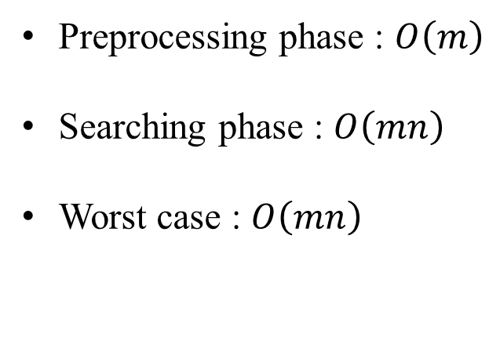
Complexity of the Skip Search Algorithm
Preprocessing phase : $O\left(m\right)$
Searching phase : $O\left(mn\right)$
Worst case : $O\left(mn\right)$

Slide 14
The Alpha Skip Search Algorithm
Preprocessing phase
Search phase

Slide 15
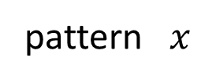

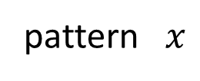

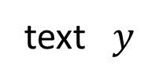



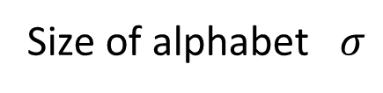





The Alpha Skip Search Algorithm
pattern $x$
$$m$$
Preprocessing phase
Search phase
text $y$
$$n$$
Size of alphabet $σ$
Arrange all the substrings of length $l \left( l=\log_{σ}{m} \right)$ in a trie $T_{x}$ .
pattern $x$
$$BCBACBAAB$$
$$l=\log_{3}{9}=2$$
$$BC$$
$$CB$$
$$BA$$
$$AC$$
$$AA$$
$$AB$$

Slide 16
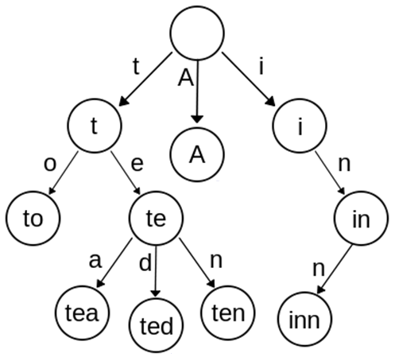
Trie (前綴樹 / 字典樹)
A , to , tea , ted ,
ten , i , inn , in

Slide 17


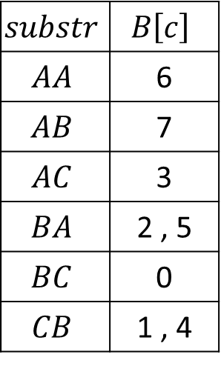






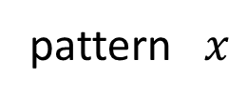














The Alpha Skip Search Algorithm
pattern $x$
$$BCBACBAAB$$
$$C$$
$$A$$
$$BC$$
$$B$$
$$CB$$
$$A$$
$$BA$$
$$B$$
$$AC$$
$$B$$
$$C$$
$$C$$
$$AA$$
$$AA$$
$$A$$
$$AB$$
$$CB$$
$$AB$$
$$BC$$
$$AC$$
$$BA$$
$$substr$$ | $$B\left[c\right]$$
$$AA$$ | 6
$$AB$$ | 7
$$AC$$ | 3
$$BA$$ | 2 , 5
$$BC$$ | 0
$$CB$$ | 1 , 4

Slide 18
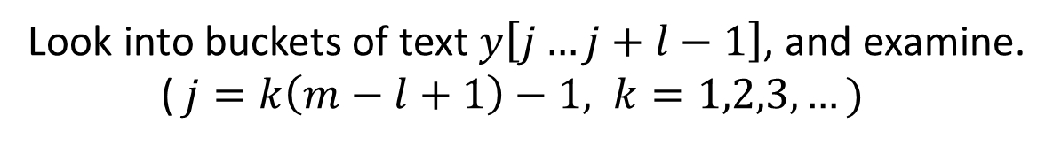
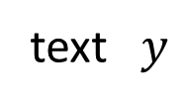


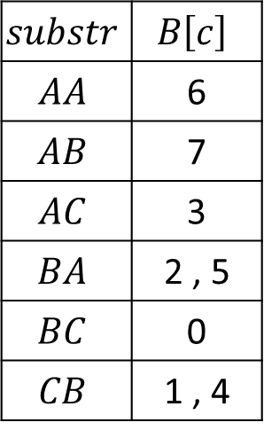



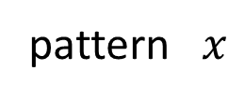

The Alpha Skip Search Algorithm
pattern $x$
$$BCBACBAAB$$
Preprocessing phase
Search phase
text $y$
$$BCCABCBACBAABABABCA$$
Look into buckets of text $y\left[j…j+l−1\right]$, and examine.
($j=k\left(m−l+1\right)−1, k=1,2,3,…)$
$$j_{1}$$
$$substr$$ | $$B\left[c\right]$$
$$AA$$ | 6
$$AB$$ | 7
$$AC$$ | 3
$$BA$$ | 2 , 5
$$BC$$ | 0
$$CB$$ | 1 , 4
$$BCCABCBACBAABABABCA$$
3
$$AC$$
$$BCBACBAAB$$

Slide 19



The Alpha Skip Search Algorithm
pattern $x$
$$BCBACBAAB$$
Preprocessing phase
Search phase
text $y$
$$BCCABCBACBAABABABCA$$
Look into buckets of text $y\left[j…j+l−1\right]$, and examine.
($j=k\left(m−l+1\right)−1, k=1,2,3,…)$
$$j_{2}$$
$$substr$$ | $$B\left[c\right]$$
$$AA$$ | 6
$$AB$$ | 7
$$AC$$ | 3
$$BA$$ | 2 , 5
$$BC$$ | 0
$$CB$$ | 1 , 4
$$BCCABCBACBAABABABCA$$
7
$$AB$$
$$CBAABABAB$$

Slide 20







The Alpha Skip Search Algorithm
$$j_{1}$$
$$j_{2}$$
$$j_{3}$$
……
……
……
$$substring$$
$$substring$$
$$substring$$
$$l$$

Slide 21
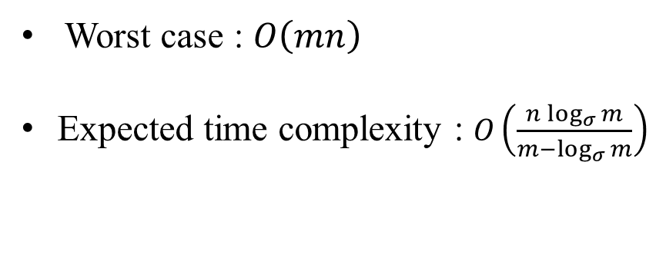
Complexity of the Alpha Skip Search Algorithm
Worst case : $O\left(mn\right)$
Expected time complexity : $O\left(\frac{n\log_{σ}{m}}{m−\log_{σ}{m}}\right)$

Slide 22

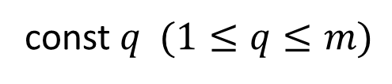


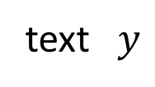




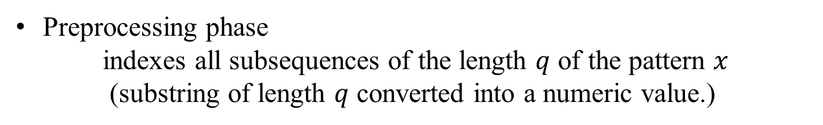


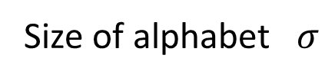





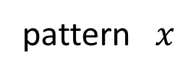

New Fast Variant of the Skip Search Algorithm
pattern $x$
$$m$$
Size of alphabet $σ$
text $y$
const $q (1≤q≤m)$
$$n$$
Preprocessing phase
indexes all subsequences of the length $q$ of the pattern $x$
(substring of length $q$ converted into a numeric value.)
$$v$$
$$k$$
$$k$$
$…$…
$$k$$
$$k$$
$α$-bit
$$x_{i}$$
$$x_{i+1}$$
$$x_{i+q−2}$$
$$x_{i+q−1}$$
$$time complexity :O\left(q\right)$$

Slide 23

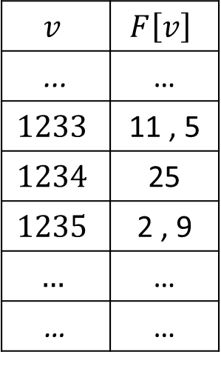
New Fast Variant of the Skip Search Algorithm
pattern $x$
$$m$$
Size of alphabet $σ$
text $y$
const $q (1≤q≤m)$
$$n$$
Preprocessing phase
indexes all subsequences of the length $q$ of the pattern $x$
(substring of length $q$ converted into a numeric value.)
$$v$$ | $$F\left[v\right]$$
... | …
$$1233$$ | 11 , 5
$$1234$$ | 25
$$1235$$ | 2 , 9
$$…$$ | …
… | …

Slide 24
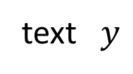

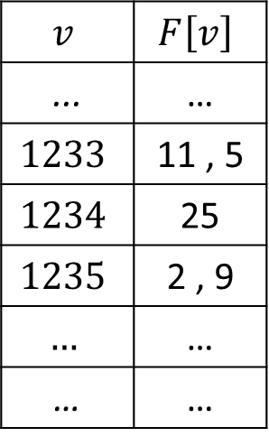



New Fast Variant of the Skip Search Algorithm
Searching phase
examine the candidate substrings
$$v$$ | $$F\left[v\right]$$
... | …
$$1233$$ | 11 , 5
$$1234$$ | 25
$$1235$$ | 2 , 9
$$…$$ | …
… | …
$$j=k\left(m−q+1\right)−1 for k=1,2,3,…$$
$$j_{1}$$
text $y$
$$v_{1}$$
$$q$$

Slide 25

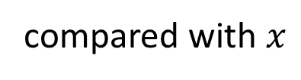
New Fast Variant of the Skip Search Algorithm
Searching phase
examine the candidate substrings
$$v$$ | $$F\left[v\right]$$
... | …
$$1233$$ | 11 , 5
$$1234$$ | 25
$$1235$$ | 2 , 9
$$…$$ | …
… | …
$$j=k\left(m−q+1\right)−1 for k=1,2,3,…$$
$$j_{1}$$
text $y$
$$q$$
compared with $x$
$$m$$

Slide 26

Complexity of this Algorithm
Preprocessing phase: $O\left(qm\right)=O(m)$
Search phase: $O\left(nm\right) (worst)$

Slide 27
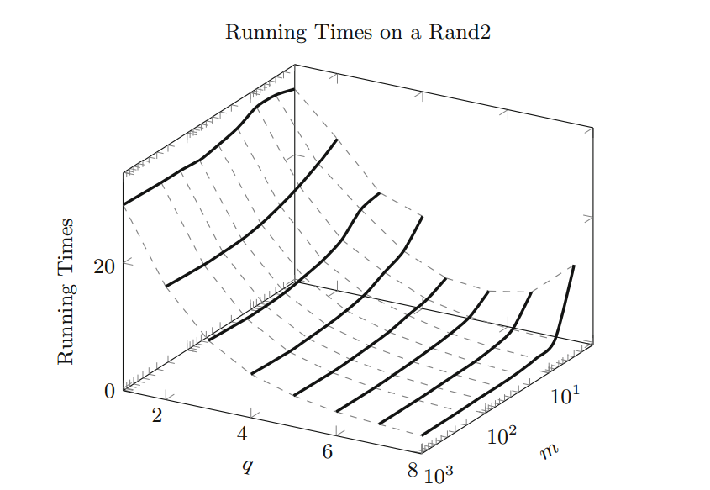
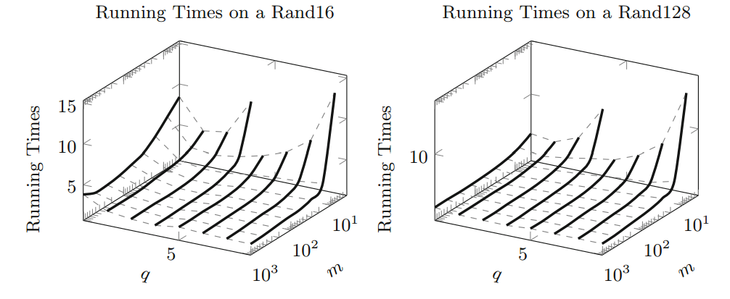
Running time

