Slide 1
Biclustering Learning of Trading Rules
Qinghua Huang, Ting Wang, Dacheng Tao, Senior Member, IEEE, and Xuelong Li, Fellow, IEEE
IEEE TRANSACTIONS ON CYBERNETICS, VOL. 45, NO. 10, pp. 2287-2298, OCTOBER 2015
Presenter：Jia-Hong Liu
Date：2017/6/27

Slide 2
Outline
Technical analysis
Preprocess
Bicluster method
Result

Slide 3
Abstract(1/3)
Technical analysis with numerous indicators and patterns has been regarded as important evidence for making trading decisions in financial markets. However, it is extremely difficult for investors to find useful trading rules based on numerous technical indicators. This paper innovatively proposes the use of biclustering mining to discover effective technical trading patterns that contain a combination of indicators from historical financial data series.

Slide 4
Abstract(2/3)
This is the first attempt to use biclustering algorithm on trading data. The mined patterns are regarded as trading rules and can be classified as three trading actions (i.e., the buy, the sell, and no-action signals) with respect to the maximum support. A modified K nearest neighborhood (K-NN) method is applied to classification of trading days in the testing period.

Slide 5
Abstract(3/3)
The proposed method [called biclustering algorithm and the K nearest neighbor (BIC-K-NN)] was implemented on four historical datasets and the average performance was compared with the conventional buy-and-hold strategy and three previously reported intelligent trading systems. Experimental results demonstrate that the proposed trading system outperforms its counterparts and will be useful for investment in various financial markets.

Slide 6
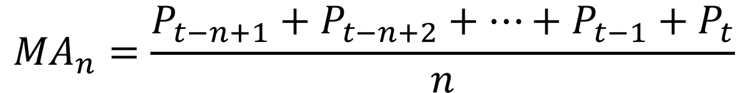
Indicator Analysis
$${MA}_{n}=\frac{P_{t−n+1}+P_{t−n+2}+…+P_{t−1}+P_{t}}{n}$$
Moving Average：

Slide 7
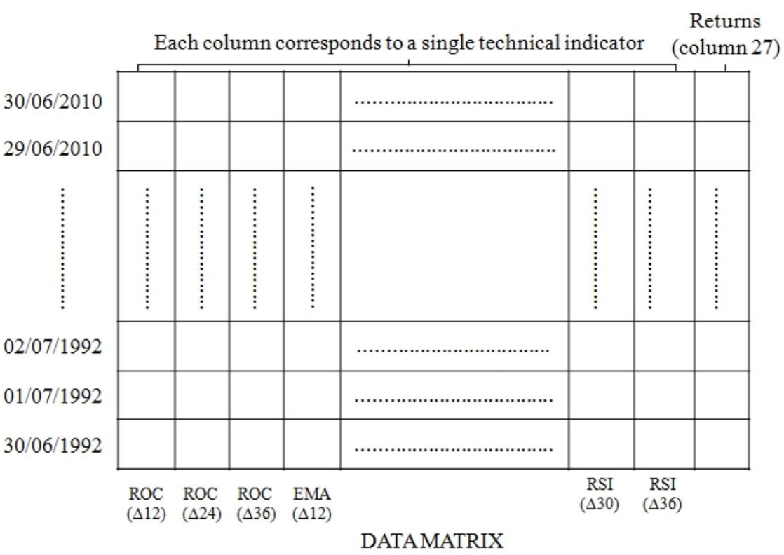
preprocess

Slide 8
preprocess
1/10 | 1 | 1 | 5 | -1 | 2
1/9 | 1 | 3 | 5 | -1 | 3
1/8 | 1 | 3 | 5 | -1 | 4
1/7 | 11 | 3 | 20 | 0 | 4
1/6 | 1 | 10 | 5 | 0 | 4
1/5 | 20 | 7 | 3 | 0 | 4
1/4 | 9 | 7 | 3 | 1 | 4
1/3 | 9 | 7 | 3 | 1 | 3
1/2 | 90 | 20 | 19 | 1 | 2
1/1 | 9 | 7 | 30 | 1 | 1
 | MA△10 | MA△20 | RSI△10 | trend | price

Slide 9
preprocess
1/10 | 1 | 1 | 5 | -1 | 2
1/9 | 1 | 3 | 5 | -1 | 3
1/8 | 1 | 3 | 5 | -1 | 4
1/7 | 11 | 3 | 20 | 0 | 4
1/6 | 1 | 10 | 5 | 0 | 4
1/5 | 20 | 7 | 3 | 0 | 4
1/4 | 9 | 7 | 3 | 1 | 4
1/3 | 9 | 7 | 3 | 1 | 3
1/2 | 90 | 20 | 19 | 1 | 2
1/1 | 9 | 7 | 30 | 1 | 1
 | MA△10 | MA△20 | RSI△10 | trend | price

Slide 10
preprocess
1/10 | 1 | 1 | 5 | -1 | 2
1/9 | 1 | 3 | 5 | -1 | 3
1/8 | 1 | 3 | 5 | -1 | 4
1/7 | 11 | 3 | 20 | 0 | 4
1/6 | 1 | 10 | 5 | 0 | 4
1/5 | 20 | 7 | 3 | 0 | 4
1/4 | 9 | 7 | 3 | 1 | 4
1/3 | 9 | 7 | 3 | 1 | 3
1/2 | 90 | 20 | 19 | 1 | 2
1/1 | 9 | 7 | 30 | 1 | 1
 | MA△10 | MA△20 | RSI△10 | trend | price

Slide 11
preprocess
1/10 | 1 | 1 | 5 | -1 | 2
1/9 | 1 | 3 | 5 | -1 | 3
1/8 | 1 | 3 | 5 | -1 | 4
1/7 | 11 | 3 | 20 | 0 | 4
1/6 | 1 | 10 | 5 | 0 | 4
1/5 | 20 | 7 | 3 | 0 | 4
1/4 | 9 | 7 | 3 | 1 | 4
1/3 | 9 | 7 | 3 | 1 | 3
1/2 | 90 | 20 | 19 | 1 | 2
1/1 | 9 | 7 | 30 | 1 | 1
 | MA△10 | MA△20 | RSI△10 | trend | price

Slide 12
preprocess
1/10 | 0.01 | 0.05 | 0.17 | -1 | 2
1/9 | 0.01 | 0.15 | 0.17 | -1 | 3
1/8 | 0.01 | 0.15 | 0.17 | -1 | 4
1/7 | 0.12 | 0.15 | 0.67 | 0 | 4
1/6 | 0.01 | 0.50 | 0.17 | 0 | 4
1/5 | 0.22 | 0.35 | 0.10 | 0 | 4
1/4 | 0.10 | 0.35 | 0.10 | 1 | 4
1/3 | 0.10 | 0.35 | 0.10 | 1 | 3
1/2 | 1.00 | 1.00 | 0.63 | 1 | 2
1/1 | 0.10 | 0.35 | 1.00 | 1 | 1
 | MA△10 | MA△20 | RSI△10 | trend | price

Slide 13
Bicluster method
1/10 | 0.01 | 0.05 | 0.17 | -1 | 2
1/9 | 0.01 | 0.15 | 0.17 | -1 | 3
1/8 | 0.01 | 0.15 | 0.17 | -1 | 4
1/7 | 0.12 | 0.15 | 0.67 | 0 | 4
1/6 | 0.01 | 0.50 | 0.17 | 0 | 4
1/5 | 0.22 | 0.35 | 0.10 | 0 | 4
1/4 | 0.10 | 0.35 | 0.10 | 1 | 4
1/3 | 0.10 | 0.35 | 0.10 | 1 | 3
1/2 | 1.00 | 1.00 | 0.63 | 1 | 2
1/1 | 0.10 | 0.35 | 1.00 | 1 | 1
 | MA△10 | MA△20 | RSI△10 | trend | price

Slide 14
Bicluster method
1/10 | 0.01 | 0.05 | 0.17 | -1 | 2
1/9 | 0.01 | 0.15 | 0.17 | -1 | 3
1/8 | 0.01 | 0.15 | 0.17 | -1 | 4
1/7 | 0.12 | 0.15 | 0.67 | 0 | 4
1/6 | 0.01 | 0.50 | 0.17 | 0 | 4
1/5 | 0.22 | 0.35 | 0.10 | 0 | 4
1/4 | 0.10 | 0.35 | 0.10 | 1 | 4
1/3 | 0.10 | 0.35 | 0.10 | 1 | 3
1/2 | 1.00 | 1.00 | 0.63 | 1 | 2
1/1 | 0.10 | 0.35 | 1.00 | 1 | 1
 | MA△10 | MA△20 | RSI△10 | trend | price

Slide 15
Bicluster method
1/10 | 0.01 | 0.05 | 0.17 | -1 | 2
1/9 | 0.01 | 0.15 | 0.17 | -1 | 3
1/8 | 0.01 | 0.15 | 0.17 | -1 | 4
1/7 | 0.12 | 0.15 | 0.67 | 0 | 4
1/6 | 0.01 | 0.50 | 0.17 | 0 | 4
1/5 | 0.22 | 0.35 | 0.10 | 0 | 4
1/4 | 0.10 | 0.35 | 0.10 | 1 | 4
1/3 | 0.10 | 0.35 | 0.10 | 1 | 3
1/2 | 1.00 | 1.00 | 0.63 | 1 | 2
1/1 | 0.10 | 0.35 | 1.00 | 1 | 1
 | MA△10 | MA△20 | RSI△10 | trend | price

Slide 16
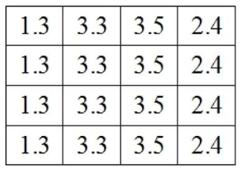
Bicluster method
1/10 | 0.01 | 0.05 | 0.17 | -1 | 2
1/9 | 0.01 | 0.15 | 0.17 | -1 | 3
1/8 | 0.01 | 0.15 | 0.17 | -1 | 4
1/7 | 0.12 | 0.15 | 0.67 | 0 | 4
1/6 | 0.01 | 0.50 | 0.17 | 0 | 4
1/5 | 0.22 | 0.35 | 0.10 | 0 | 4
1/4 | 0.10 | 0.35 | 0.10 | 1 | 4
1/3 | 0.10 | 0.35 | 0.10 | 1 | 3
1/2 | 1.00 | 1.00 | 0.63 | 1 | 2
1/1 | 0.10 | 0.35 | 1.00 | 1 | 1
 | MA△10 | MA△20 | RSI△10 | trend | price

Slide 17
Bicluster method
1/10 | 0.01 | 0.05 | 0.17 | -1 | 2
1/9 | 0.01 | 0.15 | 0.17 | -1 | 3
1/8 | 0.01 | 0.15 | 0.17 | -1 | 4
1/7 | 0.12 | 0.15 | 0.67 | 0 | 4
1/6 | 0.01 | 0.50 | 0.17 | 0 | 4
1/5 | 0.22 | 0.35 | 0.10 | 0 | 4
1/4 | 0.10 | 0.35 | 0.10 | 1 | 4
1/3 | 0.10 | 0.35 | 0.10 | 1 | 3
1/2 | 1.00 | 1.00 | 0.63 | 1 | 2
1/1 | 0.10 | 0.35 | 1.00 | 1 | 1
 | MA△10 | MA△20 | RSI△10 | trend | price

Slide 18
Bicluster method
1/10 | 0.01 | 0.05 | 0.17 | -1 | 2
1/9 | 0.01 | 0.15 | 0.17 | -1 | 3
1/8 | 0.01 | 0.15 | 0.17 | -1 | 4
1/7 | 0.12 | 0.15 | 0.67 | 0 | 4
1/6 | 0.01 | 0.50 | 0.17 | 0 | 4
1/5 | 0.22 | 0.35 | 0.10 | 0 | 4
1/4 | 0.10 | 0.35 | 0.10 | 1 | 4
1/3 | 0.10 | 0.35 | 0.10 | 1 | 3
1/2 | 1.00 | 1.00 | 0.63 | 1 | 2
1/1 | 0.10 | 0.35 | 1.00 | 1 | 1
 | MA△10 | MA△20 | RSI△10 | trend | price

Slide 19
Bicluster method
MA△10 | RSI△10 | trend
0.01 | 0.17 | -1
0.01 | 0.17 | -1
0.01 | 0.17 | -1
0.01 | 0.17 | 0
0.01 | 0.17 | -1
MA△20 | trend
0.15 | -1
0.15 | -1
0.15 | 0
0.15 | -1
MA△10 | MA△20 | trend
0.10 | 0.35 | 1
0.10 | 0.35 | 1
0.10 | 0.35 | 1
0.10 | 0.35 | 1
MA△20 | RSI△10 | trend
0.23 | 0.10 | 0
0.23 | 0.10 | 1
0.23 | 0.10 | 1
0.23 | 0.10 | 1

Slide 20




K-NN
Trading day
MA△10 | MA△20 | RSI△10
0.11 | 0.33 | 0.20
MA△20 | RSI△10 | trend
0.01 | 0.17 | -1
MA△10 | MA△20 | trend
0.10 | 0.35 | 1
MA△20 | trend
0.15 | -1
MA△20 | RSI△10 | trend
0.23 | 0.10 | 1
RMS
$$\frac{\sqrt{{0.32}^{2}}+\sqrt{{0.03}^{2}}}{2}=0.175$$
$$\frac{\sqrt{{0.01}^{2}}+\sqrt{{−0.02}^{2}}}{2}=0.015$$
$$\frac{\sqrt{{0.18}^{2}}}{1}=0.18$$
$$\frac{\sqrt{{0.10}^{2}}+\sqrt{{0.10}^{2}}}{2}=0.10$$

Slide 21
K-NN
Trading day
MA△10 | MA△20 | RSI△10
0.11 | 0.33 | 0.20
MA△20 | RSI△10 | trend
0.01 | 0.17 | -1
MA△10 | MA△20 | trend
0.10 | 0.35 | 1
MA△20 | trend
0.15 | -1
MA△20 | RSI△10 | trend
0.23 | 0.10 | 1
RMS
$$\frac{\sqrt{{0.32}^{2}}+\sqrt{{0.03}^{2}}}{2}=0.175$$
$$\frac{\sqrt{{0.01}^{2}}+\sqrt{{−0.02}^{2}}}{2}=0.015$$
$$\frac{\sqrt{{0.18}^{2}}}{1}=0.18$$
$$\frac{\sqrt{{0.10}^{2}}+\sqrt{{0.10}^{2}}}{2}=0.10$$
Trading action: Buy

Slide 22
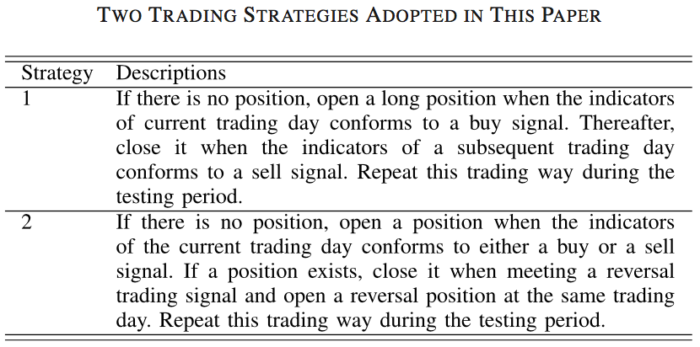

Slide 23
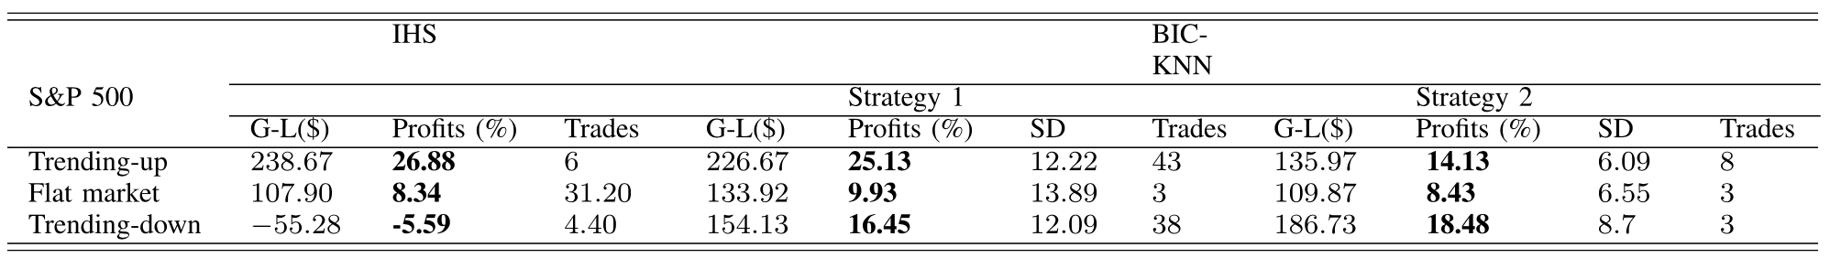
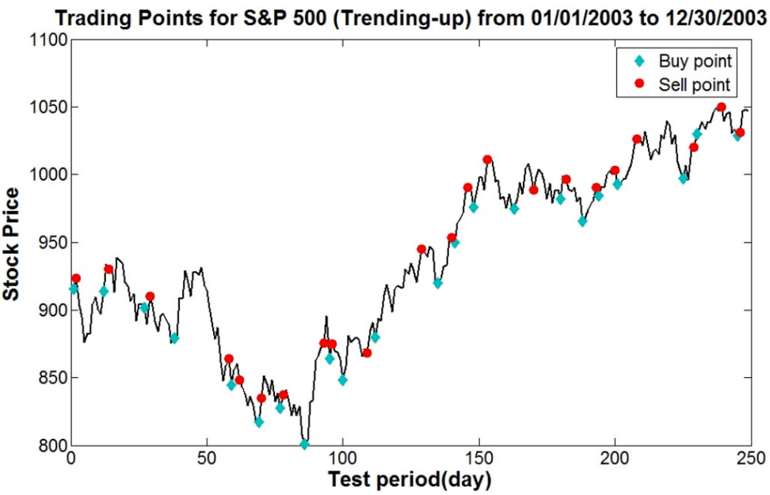
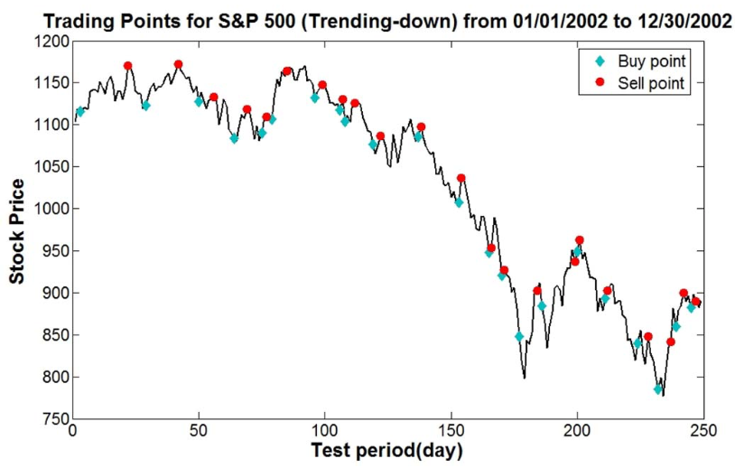
Notes:
For each run, Thc and Tsd are tuned by a random combination of a range from 0.005 to 0.25 and we therefore can find the best results for each dataset.

