Slide 1
Locating Longest Common Subsequences with Limited Penalty
Bin Wang, Xiaochun Yang, and Jinxu Li
Database Systems for Advanced Applications, pp187-201, 2017
Presenter : Yu-Ju, Liao
Date : July 13, 2021

Slide 2
Abstract
Locating longest common subsequences is a typical and important problem. The original version of locating longest common subsequences stretches a longer alignment between a query and a database sequence finds all alignments corresponding to the maximal length of common subsequences. However, the original version produces a lot of results, some of which are meaningless in practical applications and rise to a lot of time overhead. In this paper, we firstly define longest common subsequences with limited penalty to compute the longest common subsequences whose penalty values are not larger than a threshold τ . This helps us to find answers with good locality. We focus on the efficiency of this problem. We propose a basic approach for finding longest common subsequences with limited penalty. We further analyze features of longest common subsequences with limited penalty, and based on it we propose a filter-refine approach to reduce number of candidates. We also adopt suffix array to efficiently generate common substrings, which helps calculating the problem. Experimental results on three real datasets show the effectiveness and efficiency of our algorithms.

Slide 3
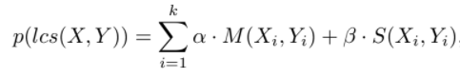
longest common subsequence with limited penalty (a.k.a. LCSp)
X=traobcybgsfd
Y=tracycyraogsfd
Lcs(X,Y)=tracygsfd

Slide 4
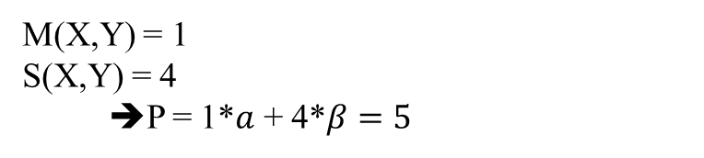
longest common subsequence with limited penalty (a.k.a. LCSp)
X=traobcybgsfd
Y=tracycyraogsfd
Lcs(X,Y)=tracygsfd
M(X,Y) = 1
S(X,Y) = 4
➔P = 1*$a$ + 4*$β=5$

Slide 5
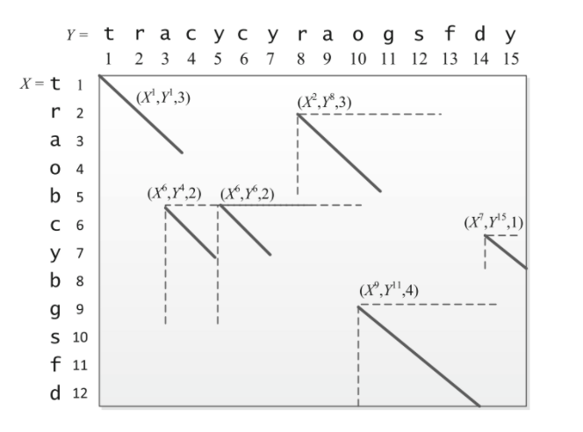
Common Strings
tra:
(X¹, Y ¹, 3)
rao:
(X², Y ⁸, 3),
cy :
(X⁶, Y⁴, 2)
(X⁶, Y⁶, 2)
y:
(X⁷, Y¹⁵, 1)
gsfd :
(X⁹, Y¹¹, 4)

Slide 6
BasicLCSp
tra:
(X¹, Y ¹, 3)
rao:
(X², Y ⁸, 3),
cy :
(X⁶, Y⁴, 2)
(X⁶, Y⁶, 2)
y:
(X⁷, Y¹⁵, 1)
gsfd :
(X⁹, Y¹¹, 4)

Slide 7
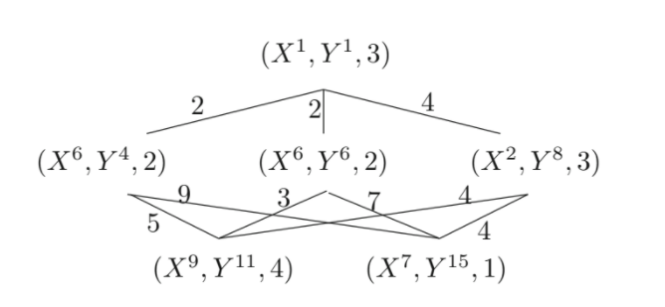
ImprovedLCSp
tra:
(X¹, Y ¹, 3)
rao:
(X², Y ⁸, 3),
cy :
(X⁶, Y⁴, 2)
(X⁶, Y⁶, 2)
y:
(X⁷, Y¹⁵, 1)
gsfd :
(X⁹, Y¹¹, 4)

Slide 8
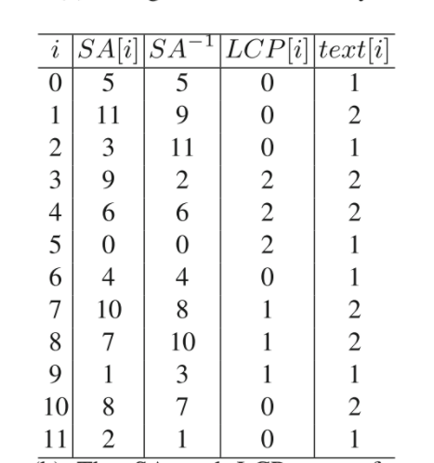
SA array
X = abfab
Y = abeab
then T = abfab#₁abeab#₂
[0] abfab#₁abeab#₂
[1] bfab#₁abeab#₂
[2] fab#₁abeab#₂
[3] ab#₁abeab#₂
[4] b#₁abeab#₂
[5] #₁abeab#₂
[6] abeab#₂
[7] beab#₂
[8] eab#₂
[9] ab#₂
[10] b#₂
[11] #₂
[5] #₁abeab#₂
[11] #₂
[3] ab#₁abeab#₂
[9] ab#₂
[6] abeab#₂
[0] abfab#₁abeab#₂
[4] b#₁abeab#₂
[10] b#₂
[7] beab#₂
[1] bfab#₁abeab#₂
[8] eab#₂
[2] fab#₁abeab#₂

Slide 9
SA array
SA
X = abfab
Y = abeab
then T = abfab#₁abeab#₂
[0] abfab#₁abeab#₂
[1] bfab#₁abeab#₂
[2] fab#₁abeab#₂
[3] ab#₁abeab#₂
[4] b#₁abeab#₂
[5] #₁abeab#₂
[6] abeab#₂
[7] beab#₂
[8] eab#₂
[9] ab#₂
[10] b#₂
[11] #₂
[5] #₁abeab#₂
[11] #₂
[3] ab#₁abeab#₂
[9] ab#₂
[6] abeab#₂
[0] abfab#₁abeab#₂
[4] b#₁abeab#₂
[10] b#₂
[7] beab#₂
[1] bfab#₁abeab#₂
[8] eab#₂
[2] fab#₁abeab#₂

Slide 10
LCP array
X = abfab
Y = abeab,
then T = abfab#₁abeab#₂,
[5] #₁abeab#₂
[11] #₂
[3] ab#₁abeab#₂
[9] ab#₂
[6] abeab#₂
[0] abfab#₁abeab#₂
[4] b#₁abeab#₂
[10] b#₂
[7] beab#₂
[1] bfab#₁abeab#₂
[8] eab#₂
[2] fab#₁abeab#₂

Slide 11
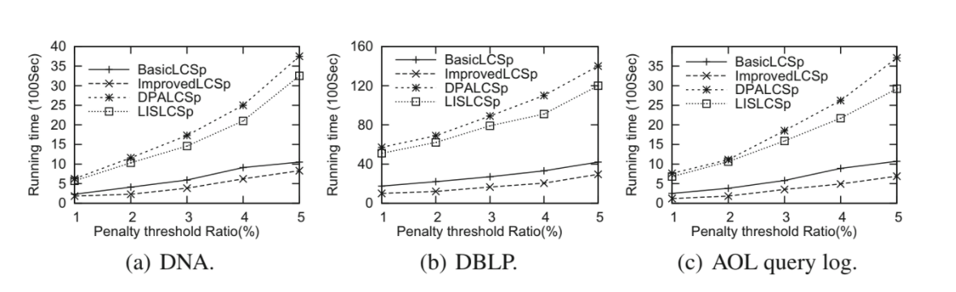
Result

Slide 12
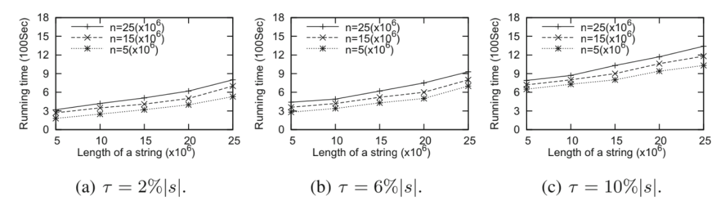
Result

