Slide 1
The exact multiple pattern matching problem solved by a reference tree approach
Yi-Kung Shieh, Shyong Jian Shyu,
Chin Lung Lu, Richard Chia-Tung Lee
Theoretical Computer Science
Available online 17 June 2021
Presenter: Shin-Cheng Lin
Date: July 13, 2021

Slide 2
Abstract(1/2)
Given a text T and a set of r patterns P₁, P₂, ..., P_{r} , the exact multiple pattern matching problem reports the ending positions of all occurrences of P_{i} in T for 1 ≤ i ≤ r. By transforming all substrings with a fixed length of T into a reference tree such that each internal node stores a reference string, the exact multiple pattern matching problem can be efficiently solved by searching patterns in the tree via the guidance of the reference strings. We design elegant algorithms to construct the reference tree (the preprocessing phase) and to search patterns in the tree (the searching phase) using bitwise operations.

Slide 3
Abstract(2/2)
The experiments involving problem instances from the DNA sequence and the English language are conducted to compare the performance of our approach against those of the suffix tree and suffix array algorithms. The computational results demonstrate the advantage of our approach over these algorithms. In spite of the simplicity, our approach is quite efficient, flexible and robust.

Slide 4
T=t₁t₂...t_{n}
r patterns P₁, P₂, ..., P_{r}
r lengths m₁, m₂, ..., m_{r}
alphabet Σ
σ be the size of Σ

Slide 5
EMPM problem
find the ending positions of all occurrences of P_{i} in T for 1 ≤ i ≤ r
(1) resolving whether or not the l-prefix of P_{i} appears in T
(2) verifying whether the rest part of P_{i} also occurs in T

Slide 6
Reference tree
substring s_{i} in T of length l
T=GAGTCA
l=4
S={GAGT , AGTC , GTCA}

Slide 7
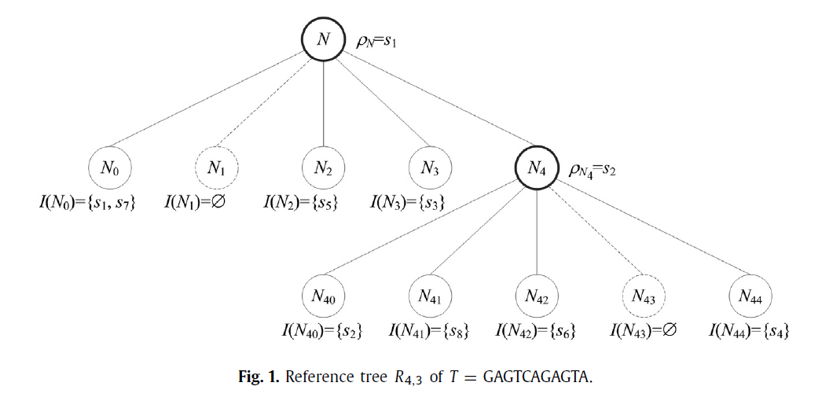
R_{l,k}
l=4
k=3

Slide 8
R_{l,k} is an (l+1)-nary tree rooted at node N.
Each node X in R_{l,k} is associated with a constructing data set I(X).
For root node N, I(N) =S.
If |I(X)| ≤ k or all elements in I(X) are identical, X becomes a leaf node where all strings in I(X) are stored.
The strings in I(X) whose distances from ρ_{X} are d would be dispatched to the subtree rooted at X_{d}.

Slide 9
δ(a, b)denote the Hamming distance between a and b
a ≠ c if δ(a, b) ≠ δ(c, b)
a may be equal to c if δ(a, b) = δ(c, b)
if δ(p, ρ_{X}) = d , find l-prefix p in X_{d}
X_{d} does not exist, stop searching for P
If X_{d} is not empty and d = 0, examine all strings in I(X₀) whether T[i+l, i+m−1] =P[l+1, m] by linear comparison

Slide 10
Hamming distance
a_{i} by bit string α_{i} of 1+log₂σbits
{a₁, a₂, a₃, a₄}={A,C,G,T}
a₁=000
a₂=001
a₃=010
a₄=011

Slide 11
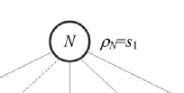
| bi |=l(1+log2σ)
β_{X} be the bit string of ρX
b_{witness}=(1(0)^{log2σ})^{l}
b_{inv_witness}=(0(1)^{log2σ})^{l}
⊕ “exclusive or” (XOR)
+ “ADD”
∧ “AND”
popcount(b) count the number of 1’s

Slide 12
b_{i}⊕β_{X} => not zero if not same
((b_{i}⊕β_{X})+b_{inv_witness}) => corresponding carries if not same
(((b_{i}⊕β_{X})+b_{inv_witness}) ∧ b_{witness}) count distance

Slide 13
σ=4 and l=3
b_{witness}=(1(0)^{log2σ})^{l}=100100100
b_{inv_witness}=(0(1)^{log2σ})^{l}=011011011
s₂=AGT, b_{i}=000010011
ρ_{X}=ACT, β_{X}=000001011
(((b_{i}⊕β_{X})+b_{inv_witness}) ∧ b_{witness})
=(000011000+011011011)^100100100
=011110011^100100100
=000100000

Slide 14
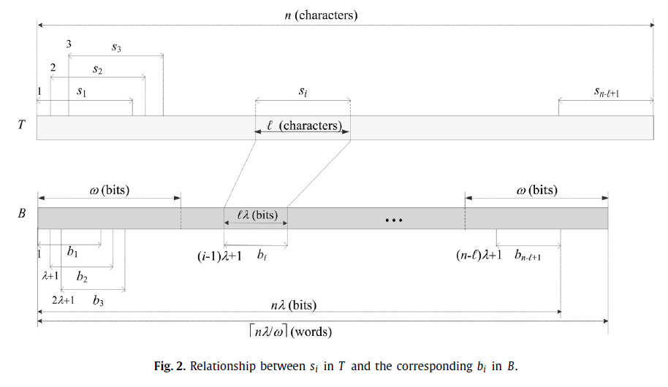
When the size of each b_{i}(and β_{X}) is smaller than or equal to a computer word, Equation (1) counts the number of 1’s in O(1).

Slide 15
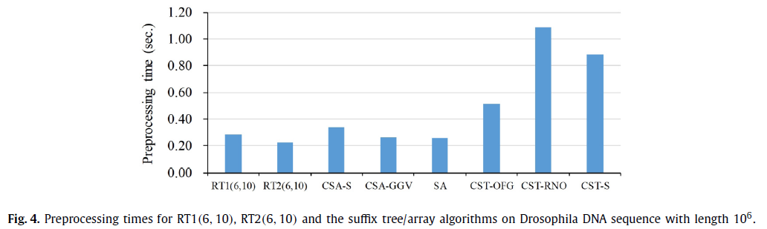
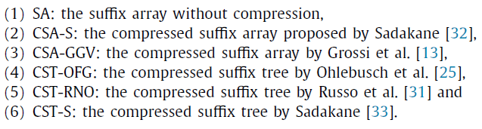
|T| = 10⁶ , r = 10³ ,| Σ | = 4

Slide 16
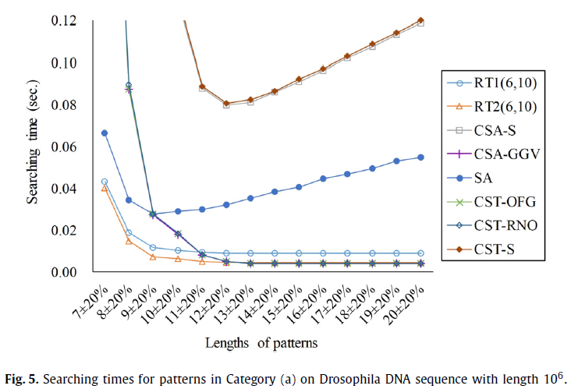
|T| = 10⁶ , r = 10³ ,| Σ | = 4

Slide 17
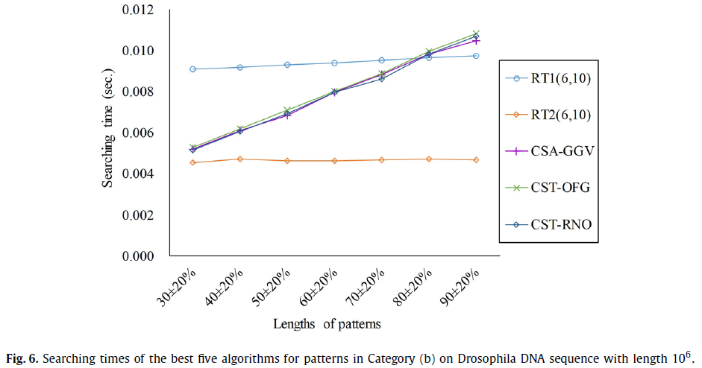
|T| = 10⁶ , r = 10³ ,| Σ | = 4

Slide 18
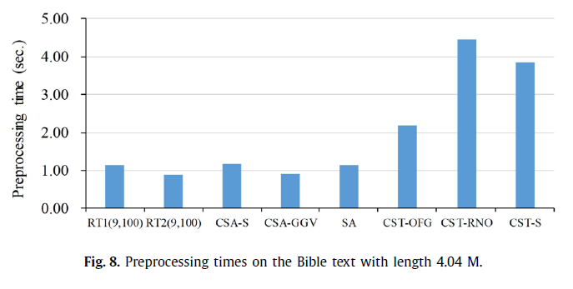
|T| = 10⁶ , r = 10³ ,| Σ | = 63

Slide 19
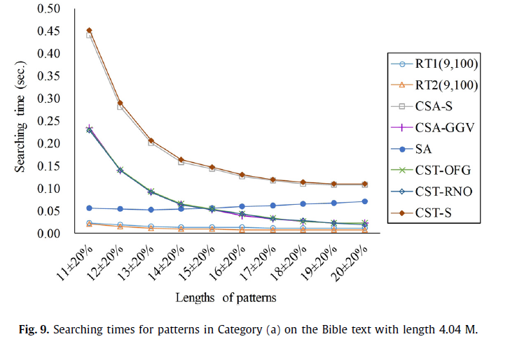
|T| = 10⁶ , r = 10³ ,| Σ | = 63

Slide 20
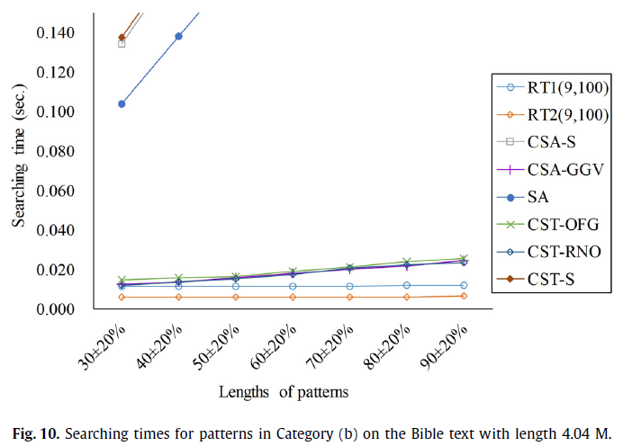
|T| = 10⁶ , r = 10³ ,| Σ | = 63

