Slide 1
Mixed integer linear programming problem for personnel multi-day shift scheduling: A case study in an Iran hospital
Amir Hossein Nobil, Seyed Mohammad Ebrahim Sharifnia , Leopoldo EduardoCárdenas-Barrón
Alexandria Engineering Journal, Available online 1 July 2021
Date: July 13, 2021
Presenter: Jue Jun,Wu

Slide 2
Abstract
The application of mathematical and systematic models and approaches to health is on the rise. In this study, a mixed-integer linear programming problem with cost (staff payroll) objective function is proposed to determine homogeneous personnel shift scheduling so that the constraints of the number of personnel per shift are met. The purpose of this study is to optimize the scheduling of personnel with the same skills to minimize variable hospital costs. In a hospital, homogeneous personnel might be skilled nurses who can work in the same departments or service staff of the departments. First, a mathematical model is proposed for scheduling as a linear problem and solved using Lingo software. By analyzing the results for a personnel working time period in Pasargad Hospital in Tehran (Iran), it is found that while optimizing the utilization of the skilled staff within departments, the variable costs (payroll) related to the department for that specified period (month), which includes overtime, overnight and holidays, are reduced by around 10 percent.
Notes:
研究了幾個連續輪班、長周末和兩個不同的輪班（日夜班和晝夜班）對心髒病生物標誌物的影響。

Slide 3
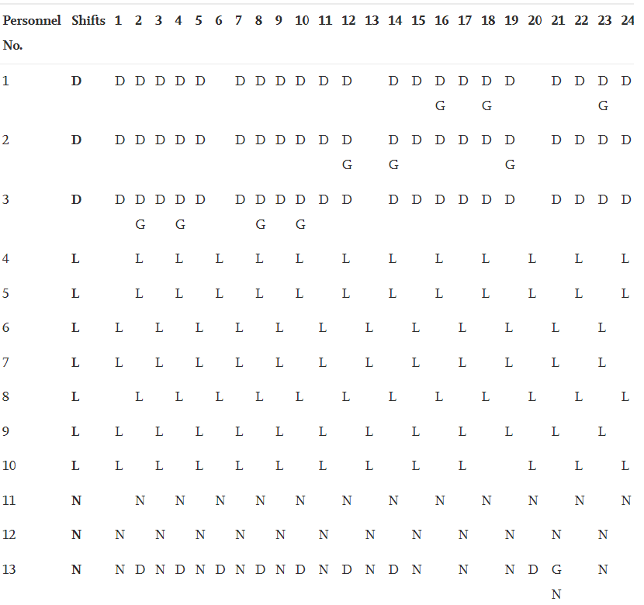
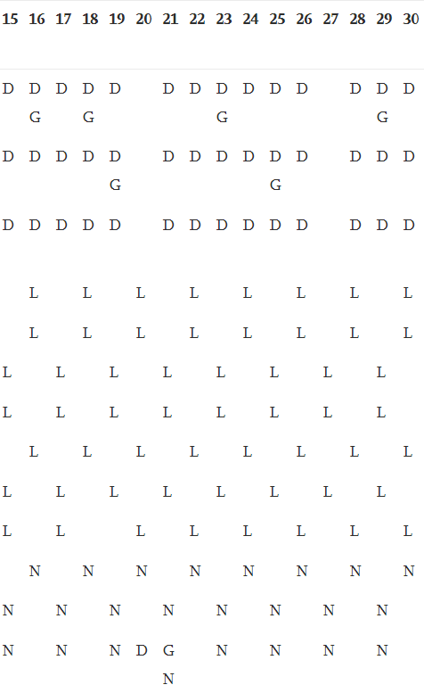

Slide 4
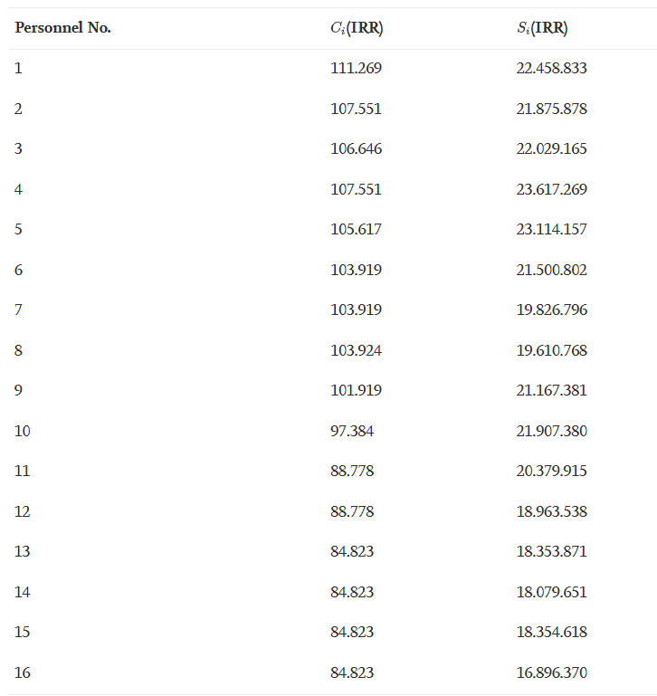
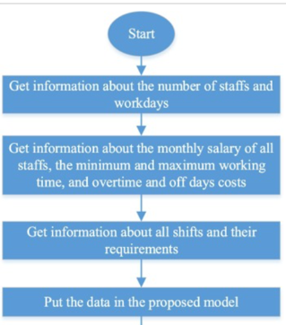
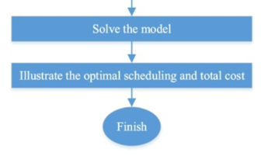

Slide 5
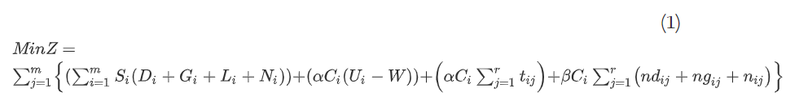
Mathematical model
- 工作 12 小時輪班的人員必須在第二天休息，即工作 12 小時和休假 24 小時。
- 通宵工作時間為晚上 10 點至早上 7 點。
- 每個員工每月必須工作 180 小時。
- 總加班時間100小時和每班最大加班時間。
Notes:
- 確定加班費、假期和過夜工資成本。

Slide 6
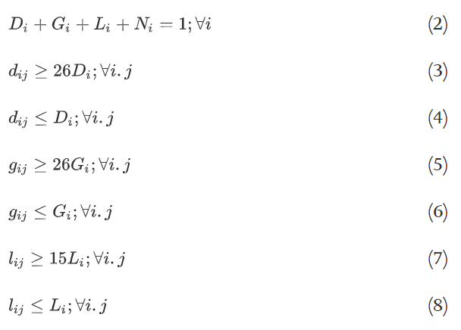
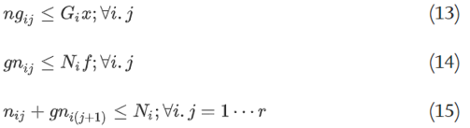
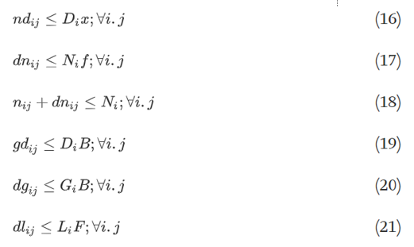
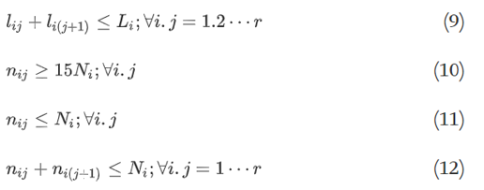

Slide 7
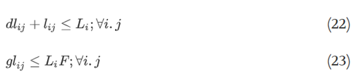
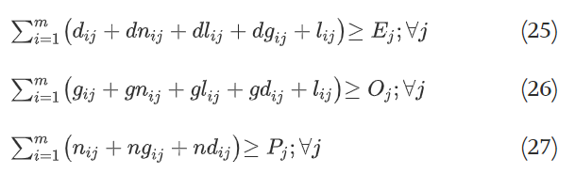
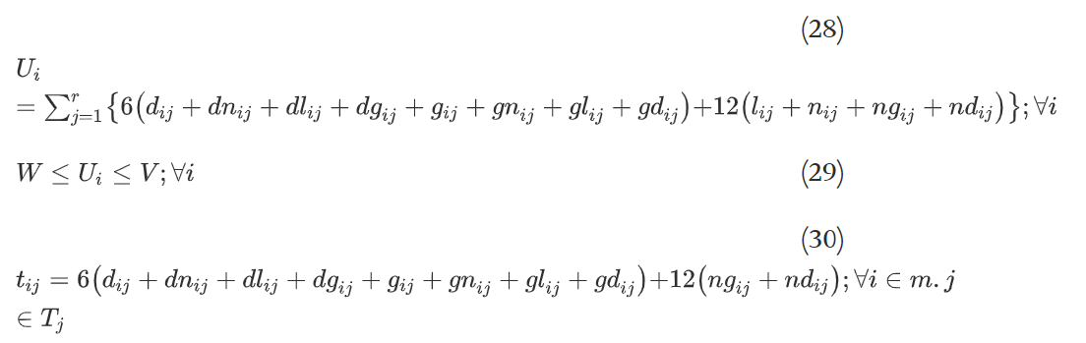

Slide 8
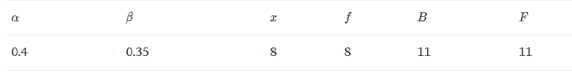
Variables
月薪1200美金。加班一小時20美金。
60=W：每位員工的最短工作時間 。100=V：每位員工的最長工作時間
3=Ej：第 j 天早上所需的最少員工人數
2=Oj：第 j 天晚上所需的最少員工人數。
2=Pj：第 j 天夜間所需的最少員工人數
4=F：L型員工可以在早班和/或晚班加班的最大天數
4=B：D/G 類員工可以在早班和/或晚班加班的最長天數
3=x：D/G類員工可以加班的最大天數
3=f：N 型員工可以在早班和/或晚班加班的最大天數
0/4=APLHA加班或假期加班到基本工資的百分比
0/35=BETA加班到基本工資的百分比
Notes:
。 需要的工作日早、晚、夜班人數分別為7、4、和 3，分別。休息日，早班、晚班、夜班所需人數分別為5人、4人、3人。人員可能的最大加班工時為 100 小時。
。 Ej、Oj 和 Pj 對總加班時間值的變化高度敏感。另一方面，Si、alpha 和 beta 對總加班時間值的變化不敏感或通常略敏感。但每月工資對總成本有很大影響。

Slide 9
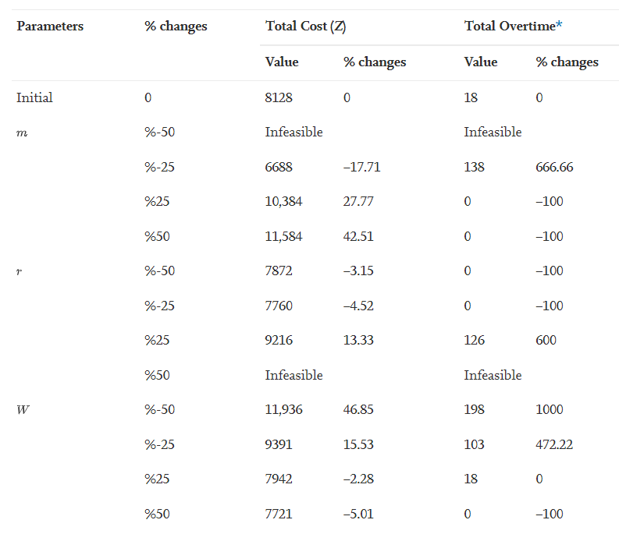
Experiments
Notes:
人員可能的最大加班工時為 100 小時

Slide 10
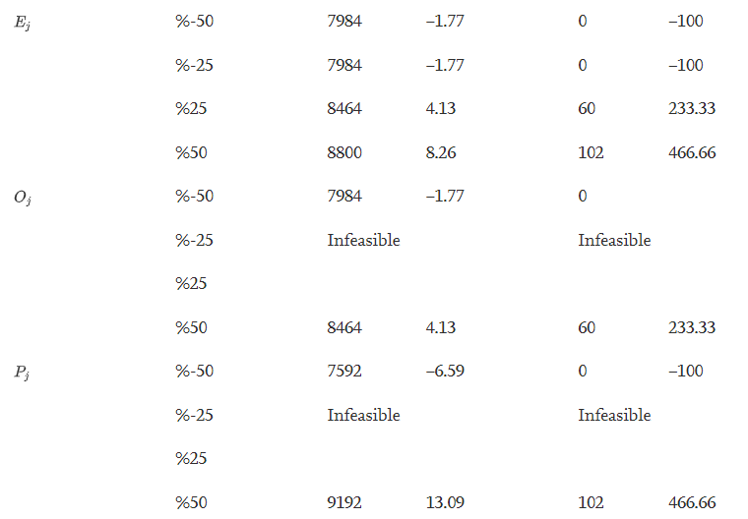

Slide 11
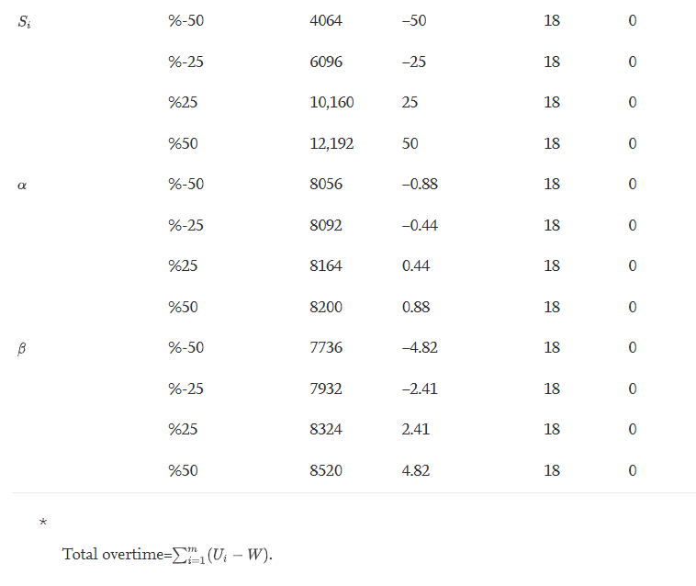

Slide 12
Conclution
The purpose of this study is to optimize the scheduling of personnel with the same skills to minimize variable hospital costs.
Objective function is proposed to determine homogeneous personnel shift scheduling so that the constraints of the number of personnel per shift are met.
The results indicate a reduction in the costs by 10 percent in comparison with the manual current schedule.
Important assumption embedded in the model is the physical endurance and satisfaction of the personnel.
Notes:
健康方面的應用正在增加。重要假設是人員的身體耐力和滿意度。
這個問題也可以通過考慮異質人員（具有不同技能）、輪班人員的動態需求、員工工作的質量。們自己國家和地區的工作規則和條件。

Slide 13
Thanks for listening.

