Slide 1
Prediction of Drug-Disease Associations for Drug Repositioning Through Drug-miRNA-Disease Heterogeneous Network
Hailin Chen, Zuping Zhang
IEEE Access, Volume 6, Pages 45281 - 45287, 2018
Speaker: Jheng-Yan Lyu
Date: Oct. 15, 2019

Slide 2
Abstract (1/2)
Drug repositioning, which refers to the identification of new clinical indications for existing drugs, has become an important strategy for drug discovery. The most recent studies in pharmacogenomics have demonstrated that drugs can target microRNAs (miRNAs) and regulate their expression levels. Given the intriguing fact that the inappropriate expression of miRNAs is related to many kinds of human diseases, developing small-molecule drugs to target specific miRNAs and modulate their activities would be a promising approach to disease treatment, which offers an innovative insight for drug repositioning. In this paper, we proposed a miRNA-based computational method HNBI to infer novel drug-disease associations for drug repositioning. Similarity measurements and experimentally supported association information were first integrated to construct a three-layer drug-miRNA-disease heterogeneous network. Our method then updated the strength of weight between unlinked drug-miRNA, miRNA-disease, and drug-disease pairs iteratively till stabilized. Based on information flow on the heterogeneous network, the final weight of drug-disease associations was received by summarizing the values of paths connecting the two types of nodes.

Slide 3
Abstract (2/2)
We prioritized the potential drug-disease associations according to the new weight. When applied to the collected data set for cross-validation experiments, our method showed superior performance in drug-disease association predictions compared with two state-of-the-art methods. Furthermore, our method HNBI incorporated information of target miRNAs to understand the mechanisms of action of drugs and the molecular mechanisms of diseases. A case study on the drug Terazosin indicated that some predicted indications with high ranks were supported by the recent literature, which further illustrated the practical usefulness of our method. Finally, comprehensive predictions of associations between drugs and diseases were released for future drug repositioning studies.

Slide 4
Similarities
Drug-drug similarities
chemical structures : The similarity score between two drugs is computed based on their fingerprints
functional consistency
side effects : drug side effects associations extracted from package inserts using text mining methods.
the similarity between drugs according to the Jaccard score between either their known side effects or top 10 predicted side effects in case they are unknown.
miRNA-miRNA similarities
Disease-disease similarities

Slide 5




Disease similarity measurement

Slide 6
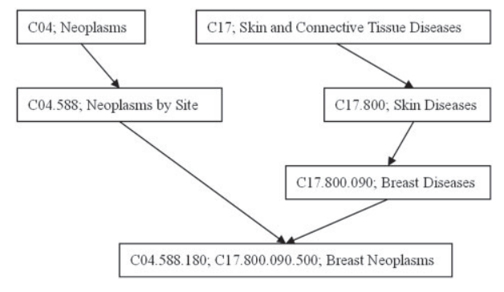
Disease similarity measurement
The DV value of ‘breast neoplasms’ is 1.0 (breast neoplasms) + 0.5 (breast diseases) + 0.5 (neoplasms by site) + 0.5 × 0.5 (neoplasms) + 0.5 × 0.5 (skin diseases) + 0.5 × 0.5 × 0.5 (skin and connective tissue diseases) = 2.6250

Slide 7


MiRNA similarity measurement
MiRNA ma is associated with diseases d1, d2, d3, d4 and d8
MiRNA mb is associated with d1, d2, d5 and d8.
DTa={d1,d2,d3,d4,d8}
DTb={d1,d2,d5,d8}

Slide 8
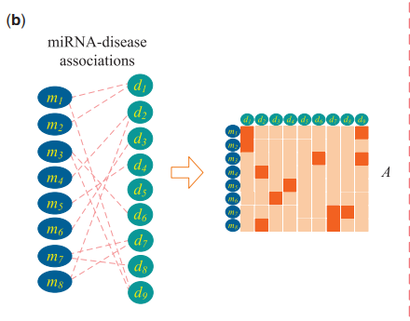
Associations
Drug-miRNA associations
miRNA-disease associations
Drug-disease associations

Slide 9



Method
R={r1,r2,…,rm}, drug nodes
T={t1,t2,…,tn}, miRNA nodes
D={d1,d2,…,dk}, disease nodes
α is a decay factor

Slide 10
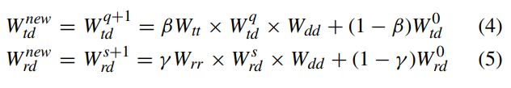

Method
R={r1,r2,…,rm}, drug nodes
T={t1,t2,…,tn}, miRNA nodes
D={d1,d2,…,dk}, disease nodes

Slide 11
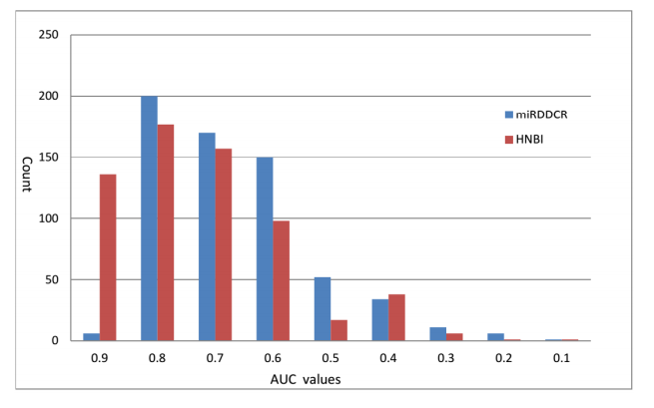
Results

