Slide 1
Polynomial-Delay Enumeration of Maximal Common Subsequences
Alessio Conte, Roberto Grossi, Giulia Punzi and Takeaki Uno
String Processing and Information Retrieval, 26th International Symposium,
SPIRE 2019, Segovia, Spain, October 7–9, 2019, pp. 189-202
Presenter: Du-Cheng Wu
Date: Oct. 15, 2019

Slide 2
Abstract
A Maximal Common Subsequence (MCS) between two strings X and Y is an inclusion-maximal subsequence of both X and Y. MCSs are a natural generalization of the classical concept of Longest Common Subsequence (LCS), which can be seen as a longest MCS. We study the problem of efficiently listing all the distinct MCSs between two strings. As discussed in the paper, this problem is algorithmically challenging as the same MCS cannot be listed multiple times: for example, dynamic programming [Fraser et al., CPM 1998] incurs in an exponential waste of time, and a recent algorithm for finding an MCS [Sakai, CPM 2018] does not seem to immediately extend to listing. We follow an alternative and novel graph-based approach, proposing the first output-sensitive algorithm for this problem: it takes polynomial time in n per MCS found, where n=max{|X|,|Y|} , with polynomial preprocessing time and space.

Slide 3
Maximal common subsequence(MCS)
X = ACEDF
Y = AEDCF
LCS = AEDF
MCS = AEDF, ACF

Slide 4
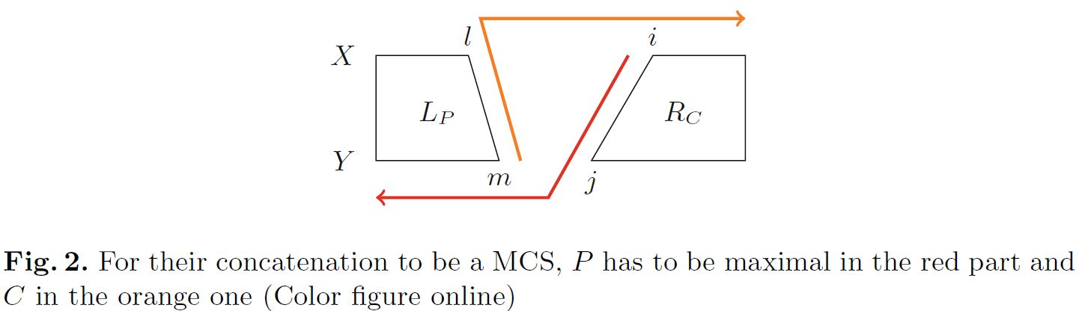
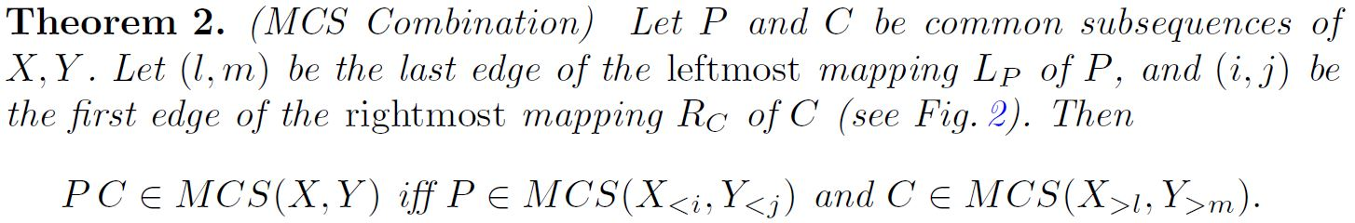
MCS as a Graph Problem

Slide 5
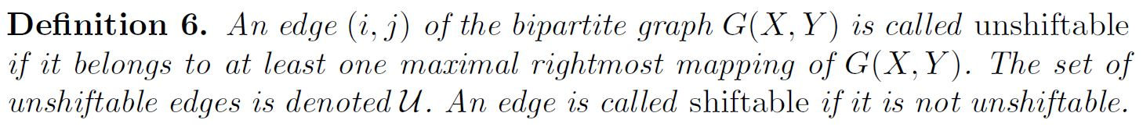
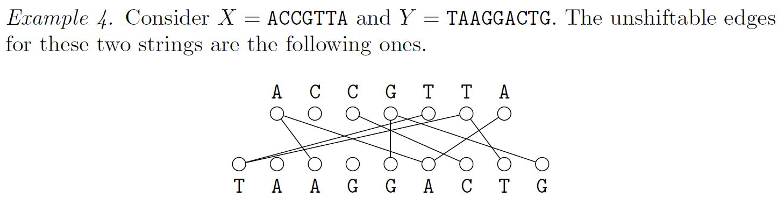
Unshiftable Edge

Slide 6
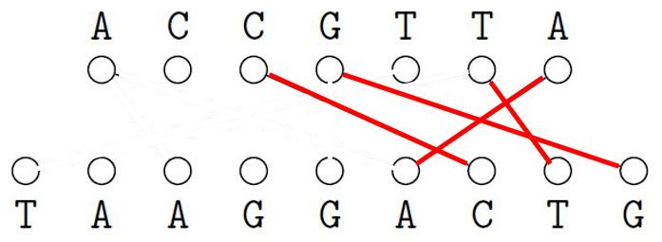
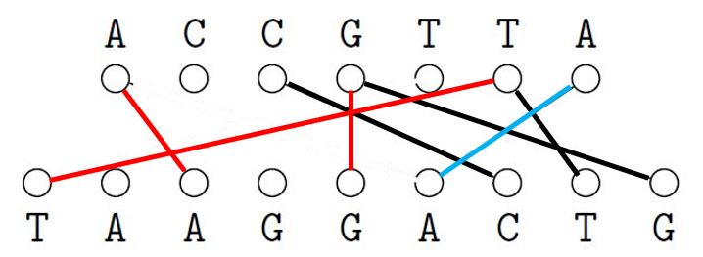
Unshiftable Edge

Slide 7
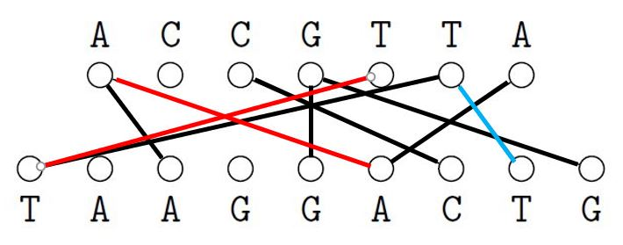
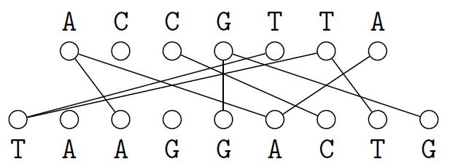
Unshiftable Edge

Slide 8
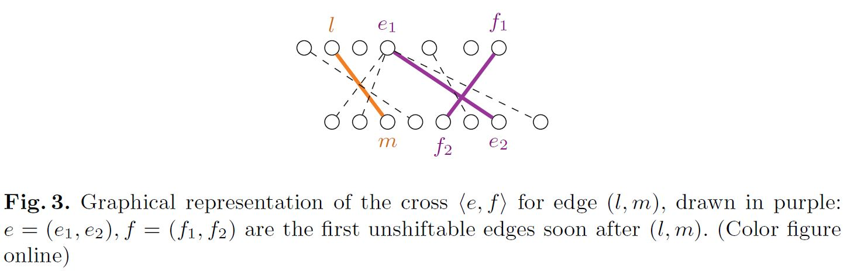
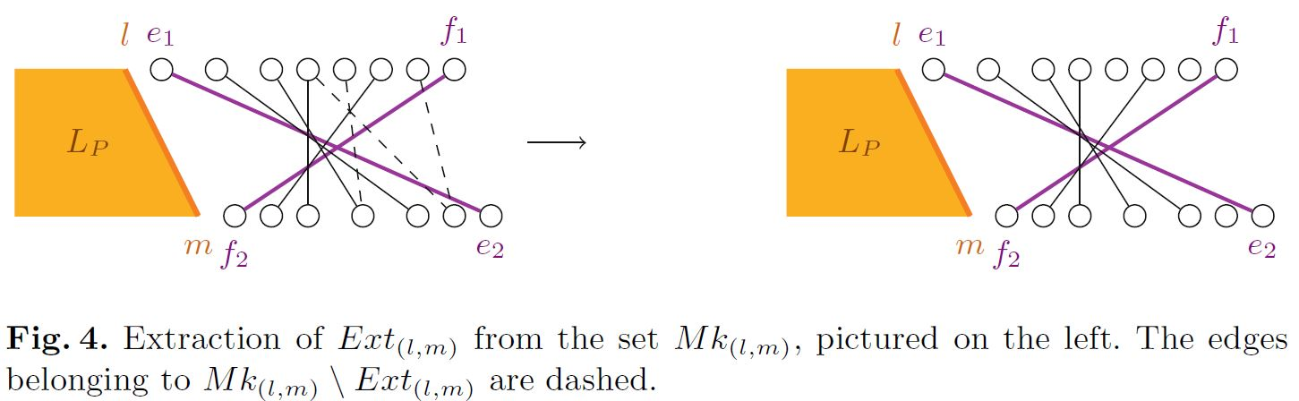
Candidate Extensions

Slide 9
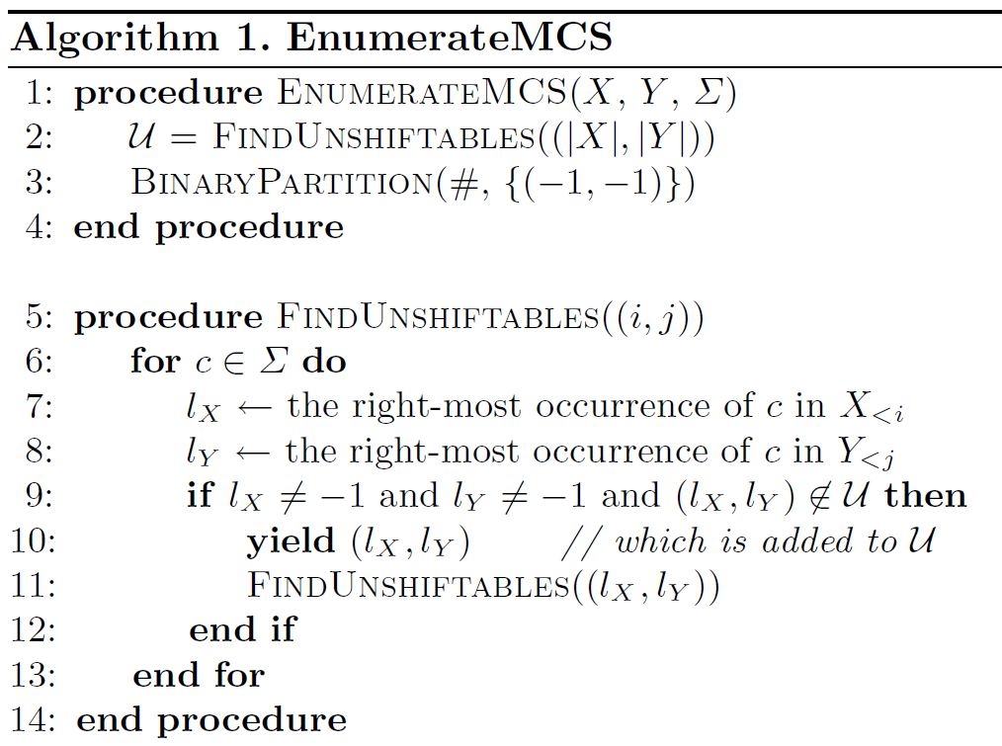
EnumerateMCS algorithm

Slide 10
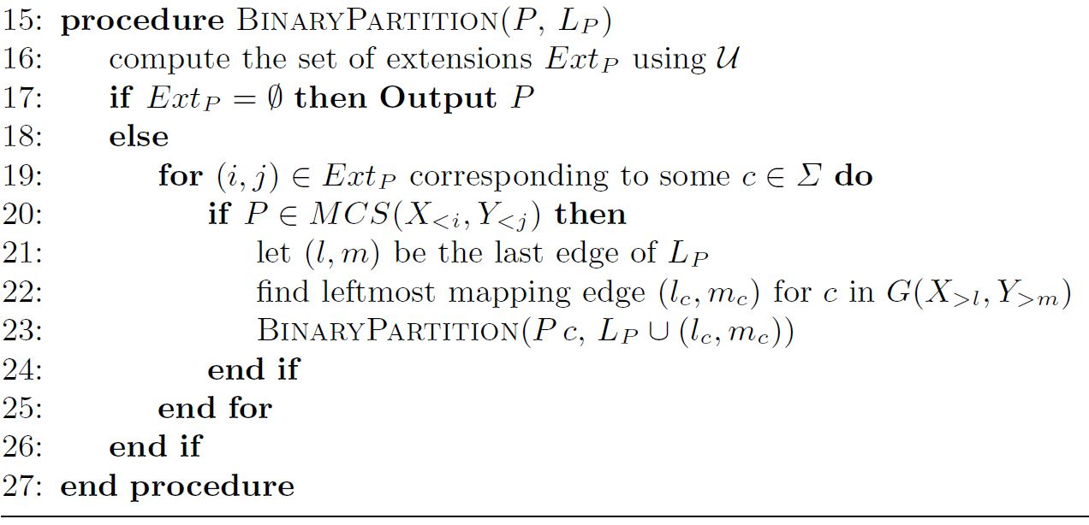
EnumerateMCS algorithm

Slide 11
Complexity
O(nσ(σ+log n)) polynomial delay
O(n²(σ+log n)) preprocessing time
O(n²) space

