Slide 1
Time Series Analysis Based on Enhanced NLCS
Dacheng Nie, Yan Fu, Junlin Zhou, Yuke Fang, Hu Xia
The 3rd International Conference on Information Sciences and Interaction Sciences, 292 – 295, Guanzhou, China
June, 2010
Presenter: EN-AN SONG
Date: October 22, 2019

Slide 2
Abstract
Similarity analysis plays a key role in clustering of time series. Normalized longest common subsequence (NLCS) is a similarity measurement widely used in comparing character sequences. In this paper, we developed the NLCS and present a novel algorithm to precisely calculate the similarity of time series. The algorithm used the sum of all common subsequence instead of longest common subsequence which can not represent the similarity of sequences accurately. The experiments based on synthetic and real-life datasets shown that the proposed algorithm performed better in comparing the similarity of time series. Comparing with Euclidean distance on four cluster validity indices, the results lead to a better performance by k-means or self-organize map.

Slide 3
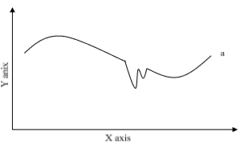
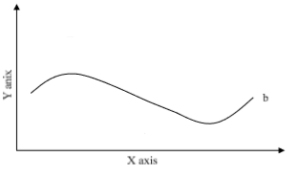
NLCS Methodology
Symbolized
abcdefabcedcba
NLCS
Similarity
Symbolized
abcdefcbaedcba

Slide 4
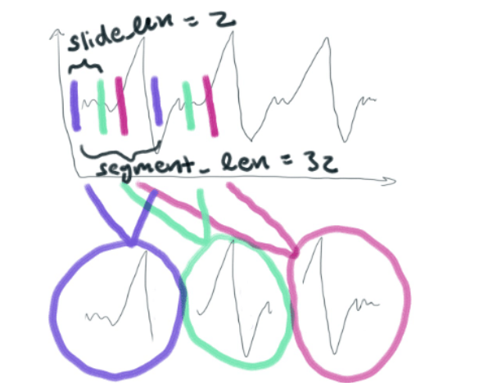
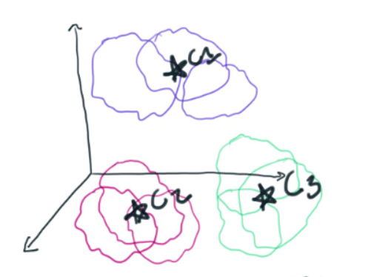
Symbolized The Time Series (K-means)
(a1,a2,….a32)
(b1,b2,….b32)
(c1,c2,….c32)
https://www.influxdata.com/blog/why-use-k-means-for-time-series-data-part-two/

Slide 5
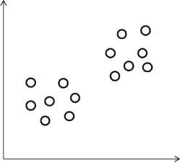
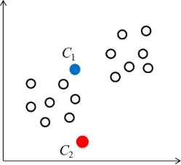
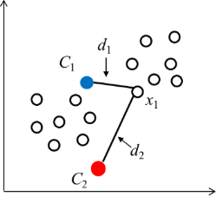
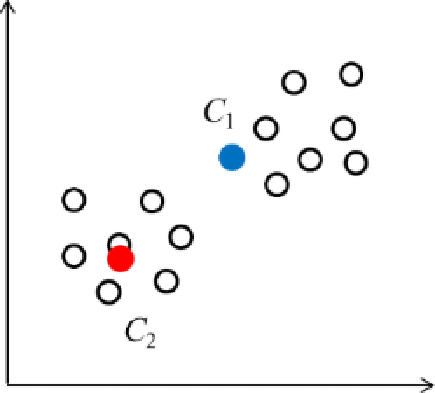
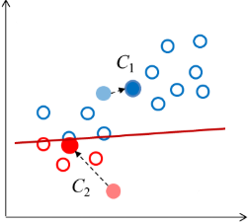
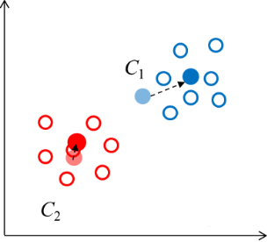
K-means

Slide 6
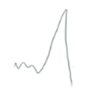
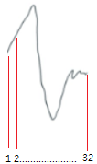
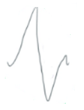

Symbolized the time series (K-means)
(a1,a2,….a32)
Calculate
distance
(b1,b2,….b32)
(x1,x2,….x32)
This cluster
(c1,c2,….c32)
https://www.influxdata.com/blog/why-use-k-means-for-time-series-data-part-two/

Slide 7
Length(LCS)
Numb : stored of the compared character
Num : used to results stored every diagonal climbing element of matrix numb added 1 except the first line and row

Slide 8
Length(LCS)
Numb
A = cabdeba
B = abdcceb
 | a | b | d | c | c | e | b
c
a
b
d
e
b
a
 | a | b | d | c | c | e | b
c
a
b
d
e
b
a
 | a | b | d | c | c | e | b
c | 0 | 0 | 0 | 1 | 1 | 0 | 0
a | 1 | 0 | 0 | 0 | 0 | 0 | 0
b | 0 | 1 | 0 | 0 | 0 | 0 | 1
d | 0 | 0 | 1 | 0 | 0 | 0 | 0
e | 0 | 0 | 0 | 0 | 0 | 1 | 0
b | 0 | 1 | 0 | 0 | 0 | 0 | 1
a | 1 | 0 | 0 | 0 | 0 | 0 | 0

Slide 9
Length(LCS)
Maximum in Num matrix
Num
F=3
a=4
b=3
A = cabdeba
B = abdcceb
 | a | b | d | c | c | e | b
c | 0 | 0 | 0 | 1 | 1 | 0 | 0
a | 1 | 0 | 0 | 0 | 0 | 0 | 0
b | 0 | 2 | 0 | 0 | 0 | 0 | 1
d | 0 | 0 | 3 | 0 | 0 | 0 | 0
e | 0 | 0 | 0 | 0 | 0 | 1 | 0
b | 0 | 1 | 0 | 0 | 0 | 0 | 1
a | 1 | 0 | 0 | 0 | 0 | 0 | 0
 | a | b | d | c | c | e | b
c | 0 | 0 | 0 | 1 | 1 | 0 | 0
a | 1 | 0 | 0 | 0 | 0 | 0 | 0
b | 0 | 2 | 0 | 0 | 0 | 0 | 1
d | 0 | 0 | 3 | 0 | 0 | 0 | 0
e | 0 | 0 | 0 | 0 | 0 | 1 | 0
b | 0 | 1 | 0 | 0 | 0 | 0 | 2
a | 1 | 0 | 0 | 0 | 0 | 0 | 0
 | a | b | d | c | c | e | b
c | 0 | 0 | 0 | 1 | 1 | 0 | 0
a | 1 | 0 | 0 | 0 | 0 | 0 | 0
b | 0 | 2 | 0 | 0 | 0 | 0 | 1
d | 0 | 0 | 3 | 0 | 0 | 0 | 0
e | 0 | 0 | 0 | 0 | 0 | 1 | 0
b | 0 | 1 | 0 | 0 | 0 | 0 | 2
a | 1 | 0 | 0 | 0 | 0 | 0 | 0
 | a | b | d | c | c | e | b
c | 0 | 0 | 0 | 1 | 1 | 0 | 0
a | 1 | 0 | 0 | 0 | 0 | 0 | 0
b | 0 | 1 | 0 | 0 | 0 | 0 | 1
d | 0 | 0 | 1 | 0 | 0 | 0 | 0
e | 0 | 0 | 0 | 0 | 0 | 1 | 0
b | 0 | 1 | 0 | 0 | 0 | 0 | 1
a | 1 | 0 | 0 | 0 | 0 | 0 | 0
 | a | b | d | c | c | e | b
c | 0 | 0 | 0 | 1 | 1 | 0 | 0
a | 1 | 0 | 0 | 0 | 0 | 0 | 0
b | 0 | 2 | 0 | 0 | 0 | 0 | 1
d | 0 | 0 | 1 | 0 | 0 | 0 | 0
e | 0 | 0 | 0 | 0 | 0 | 1 | 0
b | 0 | 1 | 0 | 0 | 0 | 0 | 1
a | 1 | 0 | 0 | 0 | 0 | 0 | 0
 | a | b | d | c | c | e | b
c | 0 | 0 | 0 | 1 | 1 | 0 | 0
a | 1 | 0 | 0 | 0 | 0 | 0 | 0
b | 0 | 1 | 0 | 0 | 0 | 0 | 1
d | 0 | 0 | 1 | 0 | 0 | 0 | 0
e | 0 | 0 | 0 | 0 | 0 | 1 | 0
b | 0 | 1 | 0 | 0 | 0 | 0 | 1
a | 1 | 0 | 0 | 0 | 0 | 0 | 0
 | a | b | d | c | c | e | b
c | 0 | 0 | 0 | 1 | 1 | 0 | 0
a | 1 | 0 | 0 | 0 | 0 | 0 | 0
b | 0 | 2 | 0 | 0 | 0 | 0 | 1
d | 0 | 0 | 1 | 0 | 0 | 0 | 0
e | 0 | 0 | 0 | 0 | 0 | 1 | 0
b | 0 | 1 | 0 | 0 | 0 | 0 | 1
a | 1 | 0 | 0 | 0 | 0 | 0 | 0

Slide 10
NLCS
Length(LCS) = 3
m=7
n =7
$$NLCS=\frac{length(LCS)}{\sqrt{m∙n}}=\frac{3}{\sqrt{7∙7}}=0.4286$$

Slide 11
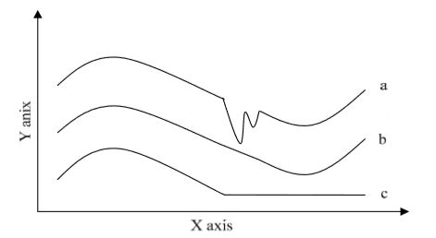
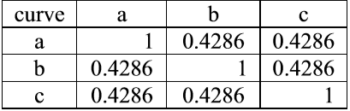
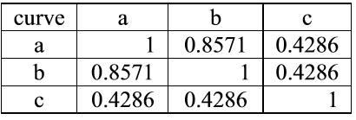
NLCS vs Enhanced NLCS
The Similarity Of Use NLCS Algorithm
a = abcdefabcedcba
b = abcdefcbaedcba
c = abcdefgggggggg
The Similarity Of Use Modify NLCS Algorithm

Slide 12
Enhanced NLCS
a | b | d | c | c | e | b
Numb
F=3
a=4
b=3
A = cabdeba
B = abdcceb
c | a | b | d | e | b | a
 | a | b | d | c | c | e | b
c | 0 | 0 | 0 | 1 | 1 | 0 | 0
a | 1 | 0 | 0 | 0 | 0 | 0 | 0
b | 0 | 1 | 0 | 0 | 0 | 0 | 1
d | 0 | 0 | 1 | 0 | 0 | 0 | 0
e | 0 | 0 | 0 | 0 | 0 | 1 | 0
b | 0 | 1 | 0 | 0 | 0 | 0 | 1
a | 1 | 0 | 0 | 0 | 0 | 0 | 0
 | a | b | d | c | c | e | b
c | 0 | 0 | 0 | 1 | 1 | 0 | 0
a | 1 | 0 | 0 | 0 | 0 | 0 | 0
b | 0 | 1 | 0 | 0 | 0 | 0 | 1
d | 0 | 0 | 1 | 0 | 0 | 0 | 0
e | 0 | 0 | 0 | 0 | 0 | 1 | 0
b | 0 | 1 | 0 | 0 | 0 | 0 | 1
a | 1 | 0 | 0 | 0 | 0 | 0 | 0
 | a | b | d | c | c | e | b
c | 0 | 0 | 0 | 1 | 1 | 0 | 0
a | 1 | 0 | 0 | 0 | 0 | 0 | 0
b | 0 | 1 | 0 | 0 | 0 | 0 | 1
d | 0 | 0 | 1 | 0 | 0 | 0 | 0
e | 0 | 0 | 0 | 0 | 0 | 1 | 0
b | 0 | 1 | 0 | 0 | 0 | 0 | 1
a | 1 | 0 | 0 | 0 | 0 | 0 | 0
 | a | b | d | c | c | e | b
c | 0 | 0 | 0 | 0 | 0 | 0 | 0
a | 0 | 0 | 0 | 0 | 0 | 0 | 0
b | 0 | 0 | 0 | 0 | 0 | 0 | 0
d | 0 | 0 | 0 | 0 | 0 | 0 | 0
e | 0 | 0 | 0 | 0 | 0 | 1 | 0
b | 0 | 0 | 0 | 0 | 0 | 0 | 1
a | 0 | 0 | 0 | 0 | 0 | 0 | 0
 | a | b | d | c | c | e | b
c | 0 | 0 | 0 | 1 | 1 | 0 | 0
a | 1 | 0 | 0 | 0 | 0 | 0 | 0
b | 0 | 1 | 0 | 0 | 0 | 0 | 1
d | 0 | 0 | 1 | 0 | 0 | 0 | 0
e | 0 | 0 | 0 | 0 | 0 | 1 | 0
b | 0 | 1 | 0 | 0 | 0 | 0 | 1
a | 1 | 0 | 0 | 0 | 0 | 0 | 0

Slide 13
Enhanced NLCS
Num
F=3+2
a=6
b=7
A = cabdeba
B = abdcceb
Maximum in Num matrix
 | a | b | d | c | c | e | b
c | 0 | 0 | 0 | 0 | 0 | 0 | 0
a | 0 | 0 | 0 | 0 | 0 | 0 | 0
b | 0 | 0 | 0 | 0 | 0 | 0 | 0
d | 0 | 0 | 0 | 0 | 0 | 0 | 0
e | 0 | 0 | 0 | 0 | 0 | 1 | 0
b | 0 | 0 | 0 | 0 | 0 | 0 | 1
a | 0 | 0 | 0 | 0 | 0 | 0 | 0
 | a | b | d | c | c | e | b
c | 0 | 0 | 0 | 0 | 0 | 0 | 0
a | 0 | 0 | 0 | 0 | 0 | 0 | 0
b | 0 | 0 | 0 | 0 | 0 | 0 | 0
d | 0 | 0 | 0 | 0 | 0 | 0 | 0
e | 0 | 0 | 0 | 0 | 0 | 1 | 0
b | 0 | 0 | 0 | 0 | 0 | 0 | 1
a | 0 | 0 | 0 | 0 | 0 | 0 | 0
 | a | b | d | c | c | e | b
c | 0 | 0 | 0 | 0 | 0 | 0 | 0
a | 0 | 0 | 0 | 0 | 0 | 0 | 0
b | 0 | 0 | 0 | 0 | 0 | 0 | 0
d | 0 | 0 | 0 | 0 | 0 | 0 | 0
e | 0 | 0 | 0 | 0 | 0 | 1 | 0
b | 0 | 0 | 0 | 0 | 0 | 0 | 2
a | 0 | 0 | 0 | 0 | 0 | 0 | 0

Slide 14
Enhanced NLCS
a | b | d | c | c | e | b
c | a | b | d | e | b | a
Numb
F=3+2
a=6
b=7
A = cabdeba
B = abdcceb
 | a | b | d | c | c | e | b
c | 0 | 0 | 0 | 0 | 0 | 0 | 0
a | 0 | 0 | 0 | 0 | 0 | 0 | 0
b | 0 | 0 | 0 | 0 | 0 | 0 | 0
d | 0 | 0 | 0 | 0 | 0 | 0 | 0
e | 0 | 0 | 0 | 0 | 0 | 1 | 0
b | 0 | 0 | 0 | 0 | 0 | 0 | 1
a | 0 | 0 | 0 | 0 | 0 | 0 | 0
 | a | b | d | c | c | e | b
c | 0 | 0 | 0 | 0 | 0 | 0 | 0
a | 0 | 0 | 0 | 0 | 0 | 0 | 0
b | 0 | 0 | 0 | 0 | 0 | 0 | 0
d | 0 | 0 | 0 | 0 | 0 | 0 | 0
e | 0 | 0 | 0 | 0 | 0 | 1 | 0
b | 0 | 0 | 0 | 0 | 0 | 0 | 1
a | 0 | 0 | 0 | 0 | 0 | 0 | 0
 | a | b | d | c | c | e | b
c | 0 | 0 | 0 | 0 | 0 | 0 | 0
a | 0 | 0 | 0 | 0 | 0 | 0 | 0
b | 0 | 0 | 0 | 0 | 0 | 0 | 0
d | 0 | 0 | 0 | 0 | 0 | 0 | 0
e | 0 | 0 | 0 | 0 | 0 | 1 | 0
b | 0 | 0 | 0 | 0 | 0 | 0 | 1
a | 0 | 0 | 0 | 0 | 0 | 0 | 0
 | a | b | d | c | c | e | b
c | 0 | 0 | 0 | 0 | 0 | 0 | 0
a | 0 | 0 | 0 | 0 | 0 | 0 | 0
b | 0 | 0 | 0 | 0 | 0 | 0 | 0
d | 0 | 0 | 0 | 0 | 0 | 0 | 0
e | 0 | 0 | 0 | 0 | 0 | 1 | 0
b | 0 | 0 | 0 | 0 | 0 | 0 | 1
a | 0 | 0 | 0 | 0 | 0 | 0 | 0
 | a | b | d | c | c | e | b
c | 0 | 0 | 0 | 0 | 0 | 0 | 0
a | 0 | 0 | 0 | 0 | 0 | 0 | 0
b | 0 | 0 | 0 | 0 | 0 | 0 | 0
d | 0 | 0 | 0 | 0 | 0 | 0 | 0
e | 0 | 0 | 0 | 0 | 0 | 0 | 0
b | 0 | 0 | 0 | 0 | 0 | 0 | 0
a | 0 | 0 | 0 | 0 | 0 | 0 | 0

Slide 15
Enhanced NLCS
∑Length(LCS) = 5
m=7
n =7
$$sNLCS=\frac{∑length(LCS)}{\sqrt{m∙n}}=\frac{5}{\sqrt{7∙7}}=0.71$$

Slide 16
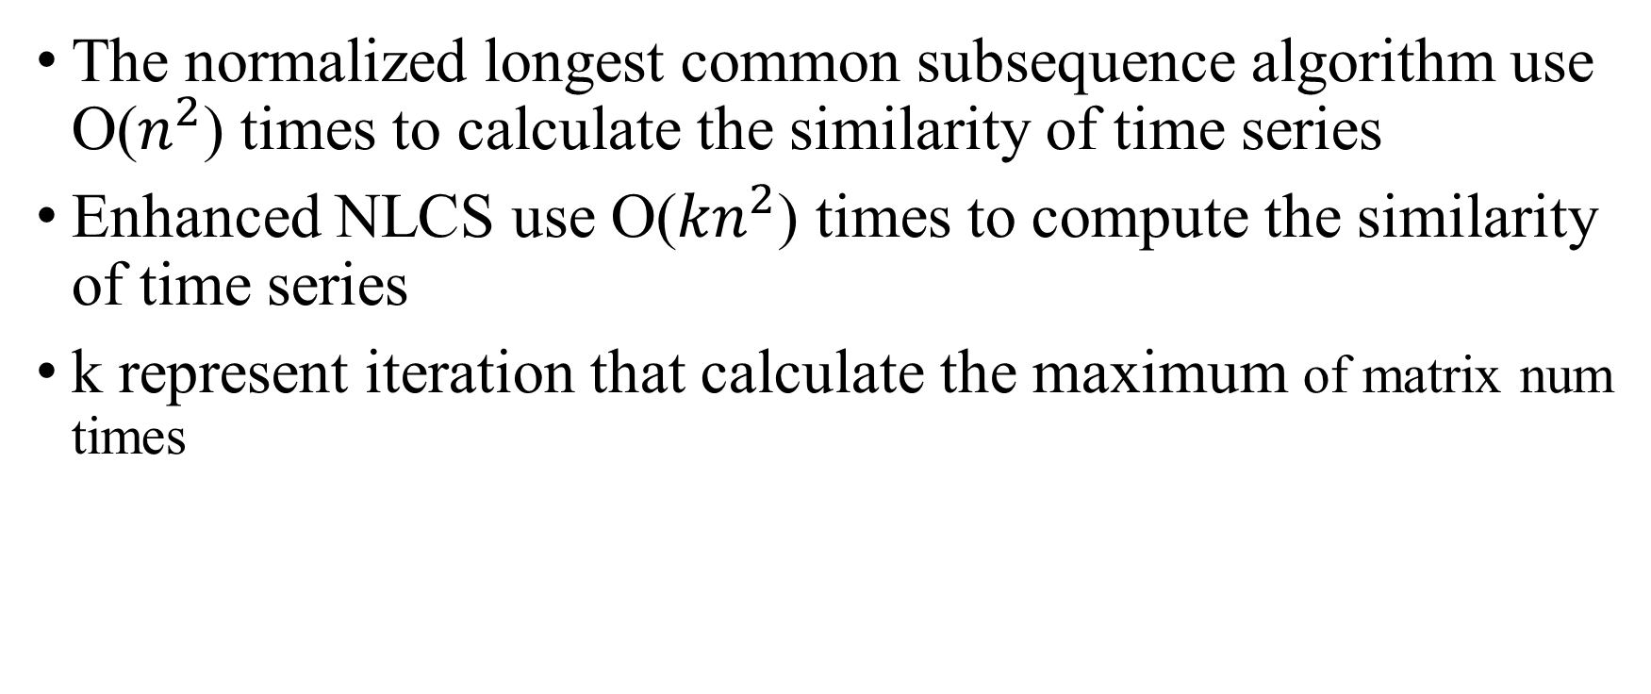
Enhanced NLCS Time Complexity
The normalized longest common subsequence algorithm use O($n^{2}$) times to calculate the similarity of time series
Enhanced NLCS use O(${kn}^{2}$) times to compute the similarity of time series
k represent iteration that calculate the maximum of matrix num times

