Slide 1
Heuristic Algorithms for the Longest Filled Common Subsequence Problem
Radu Stefan Mincu and Alexandru Popa
2018 20th International Symposium on Symbolic and Numeric Algorithms for Scientific Computing (SYNASC) at the West University of Timisoara, Romania
Presenter: Chih-Kai Wu
Date: Oct. 22, 2019.

Slide 2
Abstract
At CPM 2017, Castelli et al. define and study a new variant of the Longest Common Subsequence Problem, termed the Longest Filled Common Subsequence Problem (LFCS). For the LFCS problem, the input consists of two strings A and B and a multiset of characters M. The goal is to insert the characters from M into the string B, thus obtaining a new string B∗, such that the Longest Common Subsequence
(LCS) between A and B∗ is maximized. Casteli et al. show that the problem is
NP-hard and provide a 3/5-approximation algorithm for the problem.
In this paper we study the problem from the experimental point of view. We introduce, implement and test new heuristic algorithms and compare them with the approximation algorithm of Casteli et al. Moreover, we introduce an Integer Linear
Program (ILP) model for the problem and we use the state of the art ILP solver, Gurobi, to obtain exact solution for moderate sized instances.

Slide 3
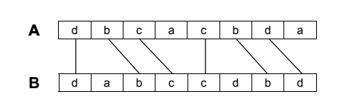
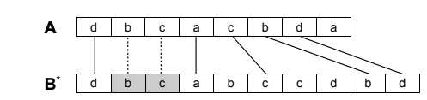
LFCS
Definition
Let there be two strings A and B over alphabet Σ and a multiset M of symbols in Σ.
A filling B* of string B is defined as a sequence obtained from B
by inserting a subset of the symbols from M into B.
Find a filling B* that maximizes the length of the
longest common subsequence of strings A and B* .

Slide 4
LFCS Solution Space
We wish to reason about the solution space of the LFCS problem to offer some insights into its nature. To begin with, we may consider the extreme where M = ∅. Then, the solution for LFCS is the same as the LCS value of inputs
A and B. Conversely, if M contains A entirely, then we can just pick as a filling
B∗ = AB, and the solution for LFCS is of size |A|. Clearly, the difficult cases to solve are when M is in the middle-ground. If M is very small, then there are few insertions to consider. Moreover, if M is too extensive, then the same situation occurs. To better
understand the solution space, let us consider an alternative formulation of LFCS:

Slide 5

LFCS (alt.)
Definition
Let there be two strings A and B over alphabet Σ and a multiset M of symbols in Σ.
Let $A^{′}$be string A from which we have removed a subset of symbols, no more than the amount contained in M. Find $A^{′}$that maximizes the sum between |A| − |$A^{′}$| and the length of the longest common subsequence of strings $A^{′}$and B.

Slide 6
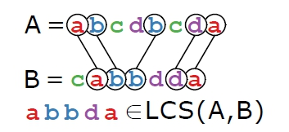
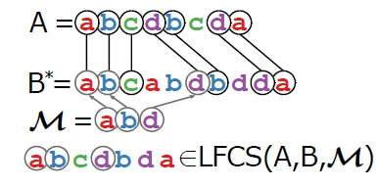
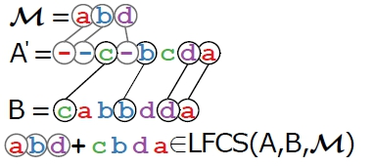

Slide 7
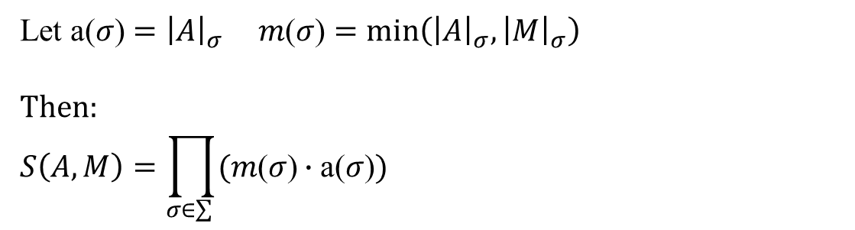
Going back to last Figure, we wish to
compute the size of the search space S(A,M). We see that
we can match d, a and b each in two places in A , yielding
a total of 8 combinations.
In the general case, we go though M and for each distinct symbol we calculate all the possible ways to match the occurrences in A with exactly the amount available in M. If we do this for each symbol, we get a product of combinations.
Let ${\text{a}\text{(}σ\text{)}=\left|A\right|}_{σ} m\text{(}σ\text{)}=\min\left({\left|A\right|}_{σ},{\left|M\right|}_{σ}\right)$
$$Then:$$
$$S\left(A,M\right)=\prod_{σ∈\sum{ }}{(m\text{(}σ\text{)}∙\text{a}\text{(}σ\text{)})}$$

Slide 8
Euristic algorithms for the LFCS problem
Uniformly Sampled Solutions
Local Search Algorithm
We dub our algorithm Sk, where the parameter k is the length of the window.

Slide 9
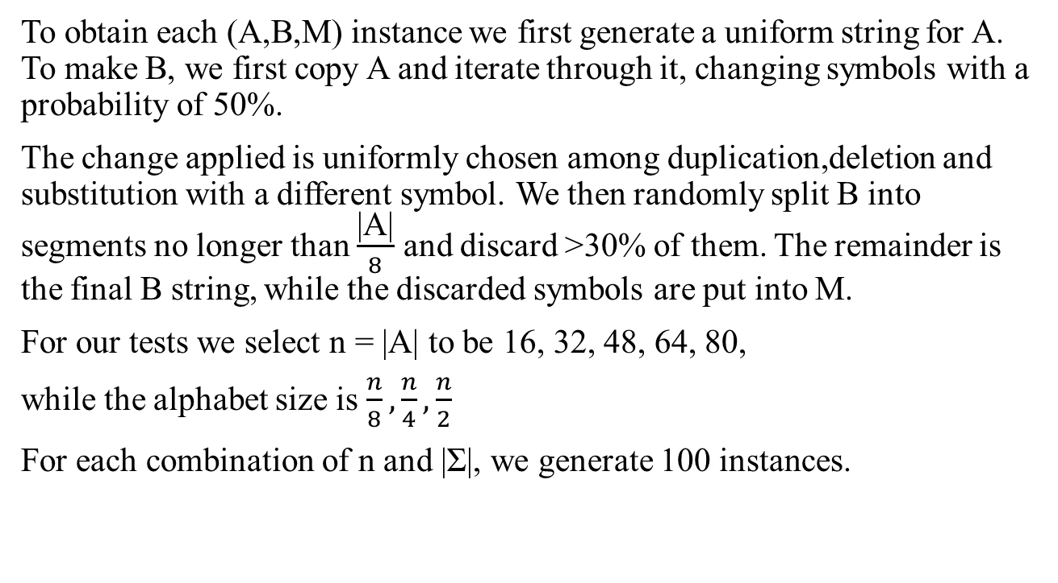
Experimental results
To obtain each (A,B,M) instance we first generate a uniform string for A. To make B, we first copy A and iterate through it, changing symbols with a probability of 50%.
The change applied is uniformly chosen among duplication,deletion and substitution with a different symbol. We then randomly split B into segments no longer than $\frac{\text{|}\text{A}\text{|}}{8}$ and discard >30% of them. The remainder is the final B string, while the discarded symbols are put into M.
For our tests we select n = |A| to be 16, 32, 48, 64, 80,
while the alphabet size is $\frac{n}{8},\frac{n}{4},\frac{n}{2}$
For each combination of n and |Σ|, we generate 100 instances.

Slide 10
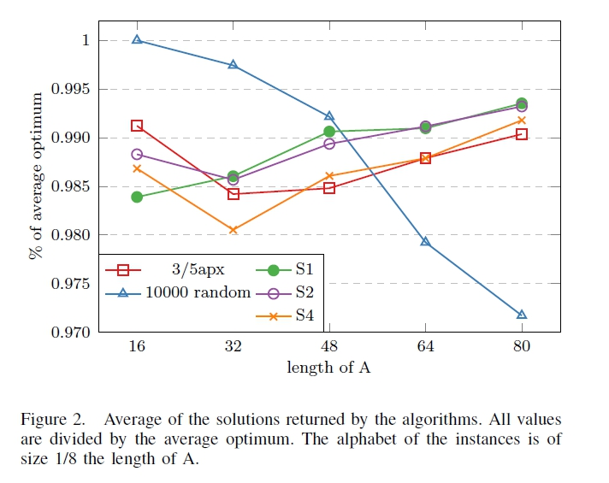

Slide 11
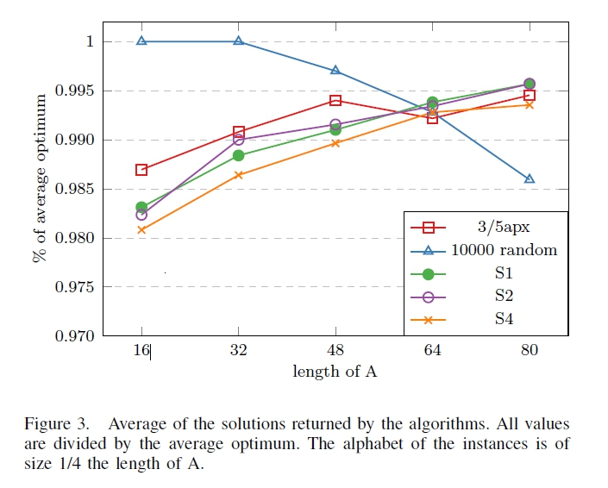

Slide 12
