Slide 1
Minimum Common String Partition Revisited
Haitao Jiang, Binhai Zhu, Daming Zhu, and Hong Zhu
International Workshop on Frontiers in Algorithmics
Frontiers in Algorithmics
FAW, Wuhan, China, 11-13 August 2010, pp. 45-52
Presenter: Yuan-Hsiu Tsai
Date: Oct. 22, 2019

Slide 2
Abstract
Minimum Common String Partition (MCSP) has drawn much attention due to its application in genome rearrangement. In this paper, we investigate three variants of MCSP: MCSP^{c} , which requires that there are at most c symbols in the alphabet; d-MCSP, which requires the occurrence of each symbol to be bounded by d; and x-balance MCSP, which requires the length of blocks not being x away from the average length. We show that MCSPc is NP-hard when c ≥ 2. As for d-MCSP, we present an FPT algorithm which runs in O∗((d!)k) time. As it is still unknown whether an FPT algorithm only parameterized on k exists for the general case of MCSP, we also devise an FPT algorithm for the special case x-balance MCSP parameterized on both k and x.

Slide 3
Introduction
MCSP (Minimum Common String Partition) :
There are two string X and Y, they must have some condition: 1.the length of X and Y are same. 2.X and Y have the same alphabet 3.the number of any letter in X is same in Y
Then MCSP will partition X and Y such that they will have the same substring set, but the same set in X could not in same position of Y

Slide 4
Introduction
MCSP example there are two string
X = beabcdb
Y = abdbebc
MCSP(X,Y) =>partition of X=(b,e,ab,c,db)
=>partition of Y=(ab,db,e,b,c)
➔X and Y have same substring set, X can be transform to Y

Slide 5
Introduction
We will introduce three MCSP deform
d-MCSP: any letter at most occur d times.
MCSP^{c}: the alphabet at most c size
x-balance MCSP: if the number of partition is k, the length of every block is from (n/k –x) to (n/k +x)

Slide 6
Hardness for MCSP^{c}
1. MCSP² is NP-complete. using 3-PARTITION is NP-complete reduce to MCSP²
2. MCSP^{c} is NP-complete for c ≧ 2.

Slide 7
On d-MCSP
Using FPT algorithm for d-MCSP
Lemma 1. Each duo appears the same number of times in X and Y in the common partition. 2. If each duo appears the same number of times in a partition of X and a partition of Y , then two matches are conflict if and only if the specific duos are continuous in one string and not continuous in the other. 3. Given a pair of partition π = (P,Q) for X and Y , if all specific duos are matched and all matches are not conflict then π is a common partition.

Slide 8
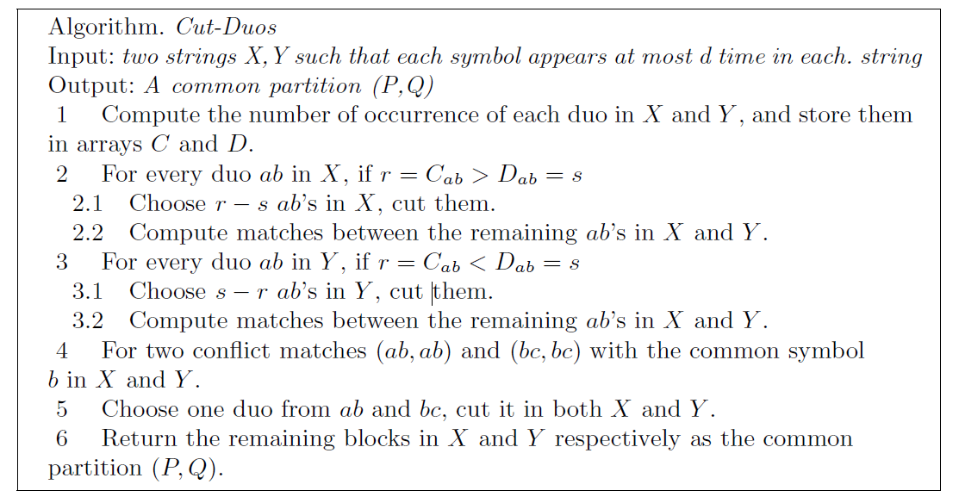
On d-MCSP
Theroem Algorithm Cut-Duos runs in O((d!)^{k}) time.

Slide 9
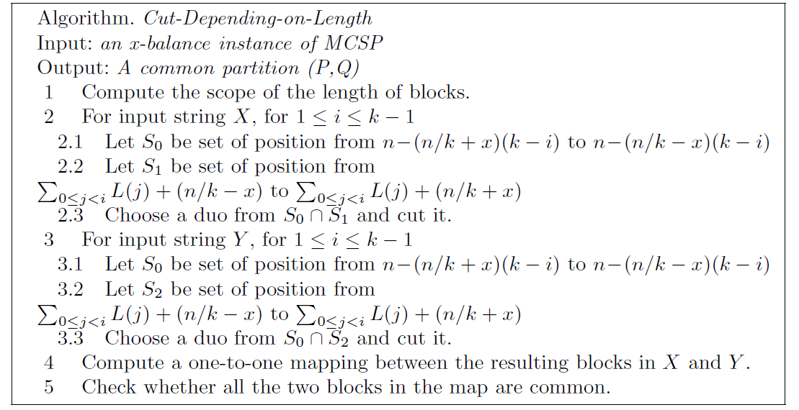
On x-Balance MCSP
Theorem Algorithm Cut-Depending-on-Length runs in O((2x)^{k} k!n) time.

Slide 10
Concludeing
Prove MCSPc is NP-complete when c ≧ 2.
devise FPT algorithm for d-MCSP and x-balance MCSP since original MCSP problem is difficult to solve with an FPT alogorithm only on the parameter k.

