Slide 1
Computing the longest topological common subsequence of a symbol-wise totally ordered directed acyclic graph and a sequence
Yoshifumi Sakai
Theoretical Computer Science, Vol. 410, pp. 2759-2766, 2009
Presenter: Dong-Jian Lin
Date: May 18, 2010

Slide 2
Abstract
Let G be a directed acyclic graph, each vertex of which is labeled
with a symbol, and having, for any such symbol, a path in which
all of the vertices labeled with the symbol appear with vertices
labeled with other symbols. Let B be a sequence of symbols. This
article proposes a polynomial-time algorithm for computing one
of the longest possible common subsequences of a sequence
specified by any topological sort of G and the sequence B.

Slide 3
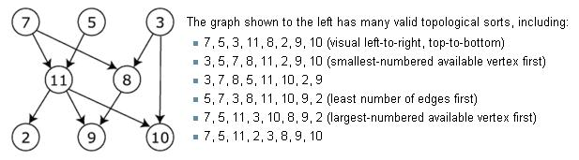
Topological Sort
A topological sort of a dag (directed acyclic graph) is a sequence
consisting of all vertices of the dag such that any vertex appears
exactly once, and u occurs before v if the dag has an edge from u
to v.

Slide 4
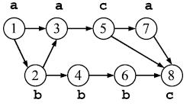
symbol-wise totally ordered
Symbol : a Symbol : b
Path : a a c a Path: a b b b c

Slide 5
Problem
Let G be a symbol-wise totally ordered dag, and let B be a
sequence. Let us refer to a pair (v, j) of any vertex v of G and any
index j, 1≦ j ≦ |B|, as a matching pair of (G, B) if G[v] = B[j]
holds.

Slide 6
Problem
There exists an l-length topological common subsequence of
(G, B) if and only if there exist a topological sort T of G, l indices
i₁, i₂, …, i_{l}, 1 ≦ i₁ < i₂ < … < i_{l} ≦ |G|, and l indices j₁, j₂, … j_{l},
1≦ j₁ < j₂ < < j_{l} ≦ |B|, such that G[T[i_{p}]] = B[j_{p}] for any index
p, 1 ≦ p ≦ l, where T[i_{p}]denotes the i_{p}th vertex of T .
The set consisting of matching pairs (T[i₁], j₁), (T[i₂], j₂), …,
(T[i_{l}], j_{l}) represents a topological common subsequence of (G, B).

Slide 7
G :
B : a b b a c a c
Topological common subsequence :
(1:a, 1)(2:b, 2)(4:b, 3)(3:a, 4)(5:c, 5)(7:a, 6)
(8:c, 7)

Slide 8
Independe Set
For any matching pairs y = (u, j) and z = (v, k) of (G, B), let
y precede z if both u → v and j ≧ k hold but y ≠z.
eg. (1:a, 1) precede (3:a, 1)
A set of matching pairs is independent if y does not precede z for
any matching pairs y and z in the set. Let an independent set be
maximal if the size of that set is maximal among all independent
sets.
eg. (1:a, 1)(2:b, 2)(4:b, 3)

Slide 9
Independe Set(Cont.)
Lemma 1. For any set Z of matching pairs of (G, B), Z represents
a topological common subsequence of (G, B) if and only if Z is
independent.

Slide 10
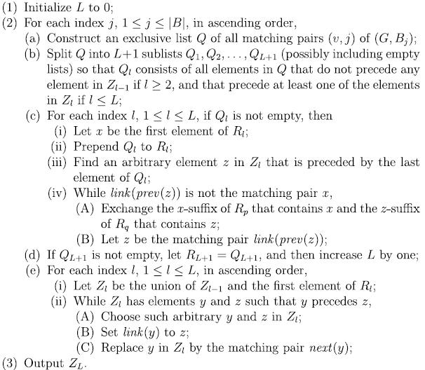

Slide 11
Algorithm
Let any list z₁, z₂, …, z_{l} of matching pairs satisfying z₁ ＜ z₂ ＜
… ＜ z_{l} be called exclusive, because such a list and any
independent set of matching pairs cannot have more than one
common elements.
It follows from the pigeon hole principle that, if the set of all
matching pairs of (G, B) can be partitioned into L exclusive lists
R₁, …, R_{L}, then the size of any independent set is at most L, and
hence, if there exist independent sets in R₁ ×… × R_{L}, then any such
independent set is maximal.

Slide 12
a tuple R_{j} = (R_{j,1}, R_{j,2},…, R_{j,Lj} )
(1) R_{j,1}, R_{j,2}, …, R_{j,Lj} partition the set of all matching pairs of
(G, B_{j}), and
(2) R_{j,1} × … × R_{j,Lj} has at least one independent set,
for each index j, 1 ≦ j ≦ |B|, in ascending order, where we recall
that B_{j} denotes the prefix of B of length j.
Since G is symbol-wise totally ordered, there exists a unique
exclusive list Q_{j} that consistsof all matching pairs (v, j) of (G, B_{j}).
For each index l, 1 ≦ l ≦ L_{j-1}, R_{j,l} is initialized to the
concatenation Q_{j,l} followed by R_{j-1,l}.

Slide 13
G :
B : a b b a c a c
Topological common subsequence :
(1:a, 1)(2:b, 2)(4:b, 3)(3:a, 4)(5:c, 5)(7:a, 6)
(8:c, 7)

Slide 14
j = 1:
Q₁ = (1:a, 1)(3:a, 1)(7:a, 1)
R_{1,1} = (1:a, 1)(3:a, 1)(7:a, 1)
Z_{1,1} = Z₀+(1:a, 1)
j = 2:
Q₂ = (2:b, 2)(4:b, 2)(6:b, 2)
R_{2,1} = R_{1,1} = (1:a, 1)(3:a, 1)(7:a, 1)
R_{2,2} = (2:b, 2)(4:b, 2)(6:b, 2)
Z_{2,1} = Z₀ + (1:a, 1) = (1:a, 1)
Z_{2,2} = Z₁ + (2:b, 2) = (1:a, 1) (2:b, 2)

Slide 15
j = 3:
Q₃ = (2:b, 3)(4:b, 3)(6:b, 3)
R_{3,1} = R_{2,1} = (1:a, 1)(3:a, 1)(7:a, 1)
R_{3,2} = (2:b, 3) + R_{2,2} = (2:b, 3)(2:b, 2)(4:b, 2)(6:b, 2)
R_{3,3} = (4:b, 3)(6:b, 3)
Z_{3,1} = Z₀ + (1:a, 1) = (1:a, 1)
Z_{3,2} = Z_{3,1} + (2:b, 3) = (1:a, 1)(2:b, 3)
Z_{3,3} = Z_{3,2} + (4:b, 3) = (1:a, 1)(2:b, 3)(4:b, 3)
= (1:a, 1)(2:b, 2)(4:b, 3)

Slide 16
j = 4:
Q₄ = (1:a, 4)(3:a, 4)(7:a, 4)
R_{4,1} = (1:a, 4)(1:a, 1)(3:a, 1)(7:a, 1)
R_{4,2} = (2:b, 3)(2:b, 2)(4:b, 2)(6:b, 2)
R_{4,3} = (4:b, 3)(6:b, 3)
R_{4,4} = (3:a, 4)(7:a, 4)
Z_{4,1} = (1:a, 4)
Z_{4,2} = (1:a, 4)(2:b, 3) = (1:a, 1)(2:b, 3)
Z_{4,3} = (1:a, 1)(2:b, 3)(4:b, 3) = (1:a, 1)(2:b, 2)(4:b, 3)
Z_{4,4} = (1:a, 1)(2:b, 2)(4:b, 3)(3:a, 4)

Slide 17
j = 5
Q₅ = (5:c, 5)(8:c, 5)
R_{5,1} = (1:a, 4)(1:a, 1)(3:a, 1)(7:a, 1)
R_{5,2} = (2:b, 3)(2:b, 2)(4:b, 2)(6:b, 2)
R_{5,3} = (4:b, 3)(6:b, 3)
R_{5,4} = (3:a, 4)(7:a, 4)
R_{5,5} = (5:c, 5)(8:c, 5)
Z_{5,1} = (1:a, 4)
Z_{5,2} = (1:a, 4)(2:b, 3) = (1:a, 1)(2:b, 3)
Z_{5,3} = (1:a, 1)(2:b, 3)(4:b, 3) = (1:a, 1)(2:b, 2)(4:b, 3)
Z_{5,4} = (1:a, 1)(2:b, 2)(4:b, 3)(3:a, 4)
Z_{5,5} = (1:a, 1)(2:b, 2)(4:b, 3)(3:a, 4)(5:c, 5)

Slide 18
j = 6:
Q₆ = (1:a, 6)(3:a, 6)(7:a, 6)
R_{6,1} = (1:a, 6)(1:a, 4)(1:a, 1)(3:a, 1)(7:a, 1)
R_{6,2} = (2:b, 3)(2:b, 2)(4:b, 2)(6:b, 2)
R_{6,3} = (4:b, 3)(6:b, 3)
R_{6,4} = (3:a, 6)(3:a, 4)(7:a, 4)
R_{6,5} = (5:c, 5)(8:c, 5)
R_{6,6} = (7:a, 6)
Z_{6,1} = (1:a, 6)
Z_{6,2} = (1:a, 6)(2:b, 3) = (1:c, 4)(2:b, 3) = (1:a, 1)(2:b, 3)
Z_{6,3} = (1:a, 1)(2:b, 3)(4:b, 3) = (1:a, 1)(2:b, 2)(4:b, 3)
Z_{6,4} = (1:a, 1)(2:b, 2)(4:b, 3)(3:a, 6)
Z_{6,5} = (1:a, 1)(2:b, 2)(4:b, 3)(3:a, 6)(5:c, 5) = (1:a, 1)(2:b, 2)(4:b, 3)
(3:a, 4)(5:c, 5)
Z_{6,6} = (1:a, 1)(2:b, 2)(4:b, 3)(3:a, 4)(5:c, 5)(7:a, 6)

Slide 19
j = 7:
Q₇ = (5:c, 7)(8:c, 7)
R_{7,1} = (1:c, 6)(1:a, 4)(1:a, 1)(3:a, 1)(7:a, 1)
R_{7,2} = (2:b, 3)(2:b, 2)(4:b, 2)(6:b, 2)
R_{7,3} = (4:b, 3)(6:b, 3)
R_{7,4} = (3:a, 6)(3:a, 4)(7:a, 4)
R_{7,5} = (5:c, 7)(5:c, 5)(8:c, 5)
R_{7,6} = (7:c, 6)
R_{7,7} = (8:c, 7)

Slide 20
Z_{7,1} = (1:c, 6)
Z_{7,2} = (1:c, 6)(2:b, 3) = (1:c, 4)(2:b, 3) = (1:c, 1)(2:b, 3)
Z_{7,3} = (1:c, 1)(2:b, 3)(4:b, 3) = (1:c, 1)(2:b, 2)(4:b, 3)
Z_{7,4} = (1:c, 1)(2:b, 2)(4:b, 3)(3:a, 6)
Z_{7,5} = (1:c, 1)(2:b, 2)(4:b, 3)(3:a, 6)(5:c, 7)
Z_{7,6} = (1:c, 1)(2:b, 2)(4:b, 3)(3:a, 6)(5:c, 7)(7:a, 6)
= (1:c, 1)(2:b, 2)(4:b, 3)(3:a, 6)(5:c, 5)(7:a, 6)
Z_{7,7} = (1:c, 1)(2:b, 2)(4:b, 3)(3:a, 6)(5:c, 5)(7:a, 6)(8:c, 7)
= (1:c, 1)(2:b, 2)(4:b, 3)(3:a, 4)(5:c, 5)(7:a, 6)(8:c, 7)
independent set &
topological common subsequence

Slide 22
(1)O(|G|²)
(2)
(a) O(|G|)
(b) O(L_{j-1} ² + |G|)
(c) O(|G| |B_{j}|)
(d) O(|1|)
(e) O (|G| |B_{j}| * L_{j-1})
Total ︰ O(|G|²) + |B| * O(|G|² |B|) = O(|G|² |B|²)

Slide 23
Thank you for listening!

