Slide 1
Feature Fusion Using Locally Linear Embedding for Classification
Bing-Yu Sun[孫丙宇], Xiao-Ming Zhang[張曉明],
Jiuyong Li[李洪奇], and Xue-Min Mao[毛學民]
IEEE TRANSACTIONS ON NEURAL NETWORKS, VOL. 21, NO. 1, JANUARY 2010

Slide 2
Abstract
In most complex classification problems, many types of features have been captured or extracted. Feature fusion is used to combine features for better classification and to reduce data dimensionality. Kernel based feature fusion methods are very effective for classification, but they do not reduce data dimensionality. In this brief, we propose an effective feature fusion method using locally linear embedding (LLE). The proposed method overcomes the limitations of LLE, which could not handle different types of features and is inefficient for classification.

Slide 3
Abstract
We propose an efficient algorithm to solve the optimization problem in obtaining weights of different features, and design an efficient method for LLE-based classification. In comparison to other kernel-based feature fusion methods, the proposed method fuses features to a significantly lower dimensional feature space with the same discriminant power. We have conducted experiments to demonstrate the effectiveness of the proposed feature fusion method.

Slide 4
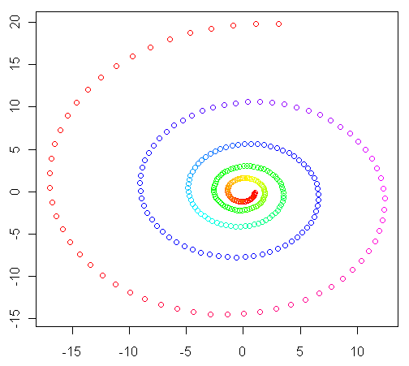
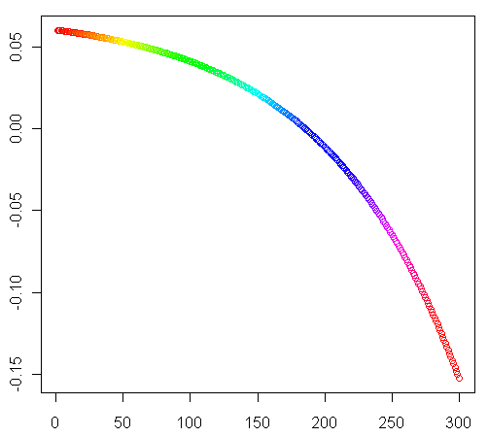
LLE (local linear embedding)
2D (x_{1i},x_{2i}) data, i=1~300
高維度資料
1D (i,y_{i}) data , i=1~300
低維度資料

Slide 5
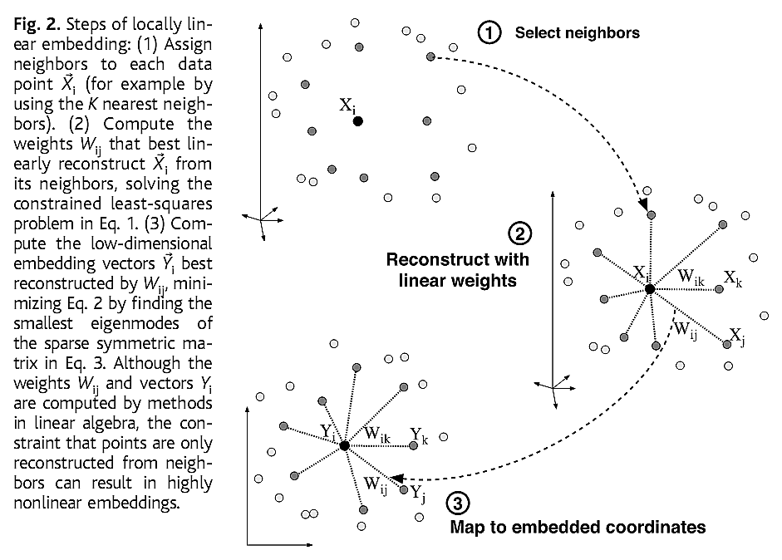


LLE (local linear embedding)
無論高或低維資料點，均是由其周圍鄰居加權平均而成

Slide 6


LLE step 1
Locally fitting hyperplanes around each samples x based on its K nearest neighbors
待求
已知
已知

Slide 7
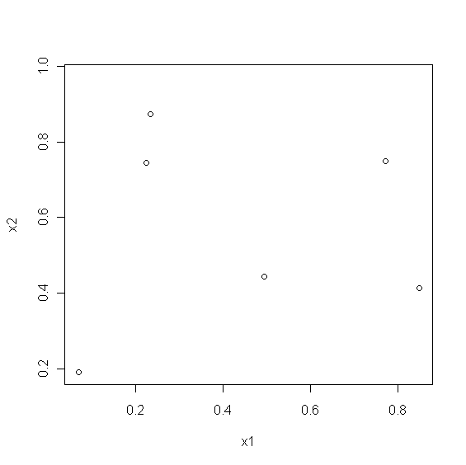
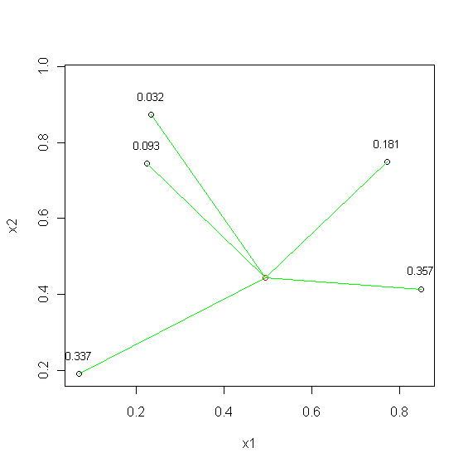
[,1] [,2]
[1,] 0.772 0.749
[2,] 0.848 0.414
[3,] 0.069 0.191
[4,] 0.234 0.872
[5,] 0.224 0.744
[1,] 0.494 0.445(中心)
[,1] [,2] weights
[1,] 0.772 0.749 x 0.181
[2,] 0.848 0.414 x 0.357
[3,] 0.069 0.191 x 0.337
[4,] 0.234 0.872 x 0.032
[5,] 0.224 0.744 x 0.093
+)---------------------
[1,] 0.494 0.445 1.0
資料點由其周圍鄰居加權平均而成

Slide 8
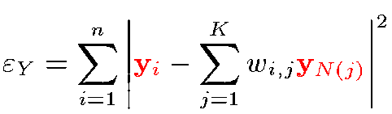
LLE step 2
The weight matrix W is fixed and new m-dimensional vectors yi are calculated by minimizing:
待求
待求
已知

Slide 9
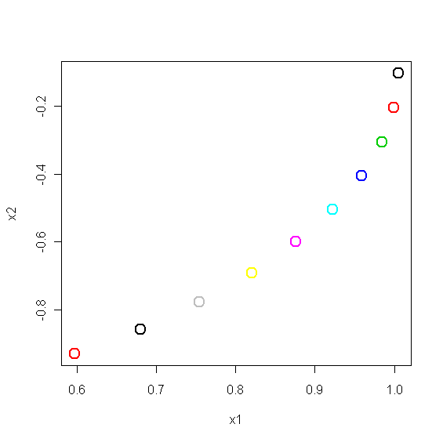
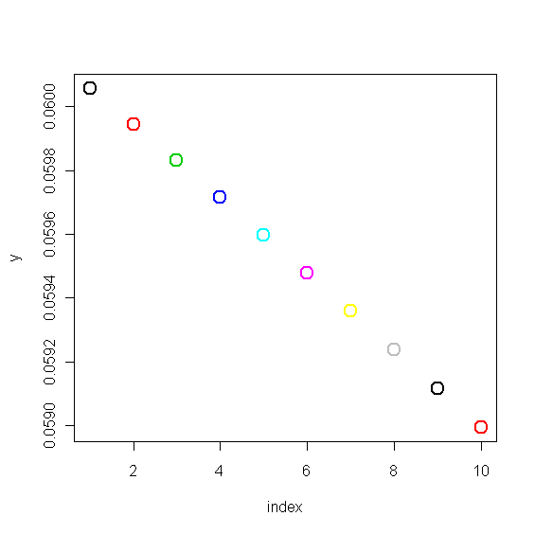
x
[1,] 1.0050041 -0.1008368
[2,] 0.9998652 -0.2026827
[3,] 0.9844308 -0.3045201
...
y
0.06005792
0.05994486
0.05983020
0.05971438
...
W
0.0000000 1.9851037 -0.9851037 ...
0.5025062 0.0000000 0.4974938 ...
0.0000000 0.5025062 0.0000000 ...
...

Slide 10
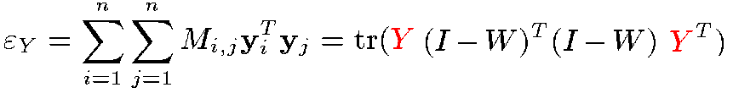
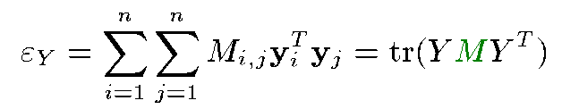
Y 的求法：
This is an eigenvalue problem. All eigenvectors of M are solutions, but the eigenvectors corresponding to the smallest eigenvalues minimize the objective function.

Slide 11

W
0.0000000 1.9851037 -0.9851037 0.0000000 ...
0.5025062 0.0000000 0.4974938 0.0000000 ...
0.0000000 0.5025062 0.0000000 0.4974938 ...
0.0000000 0.0000000 0.5025062 0.0000000 ...
...
M
1.252513 -2.4876099 1.235097 0.0000000 ...
-2.487610 5.1931493 -2.955533 0.2499937 ...
1.235097 -2.9555330 2.470442 -1.0000000 ...
0.000000 0.2499937 -1.000000 1.5000126 ...
...
My=λy
M
1.252513 -2.4876099 1.235097 0.0000000 ...
-2.487610 5.1931493 -2.955533 0.2499937 ...
1.235097 -2.9555330 2.470442 -1.0000000 ...
0.000000 0.2499937 -1.000000 1.5000126 ...
...
y
0.06005792
0.05994486
0.05983020
0.05971438
...
λ
2.486408e-11
y
0.06005792
0.05994486
0.05983020
0.05971438
...
*
=
*

Slide 12

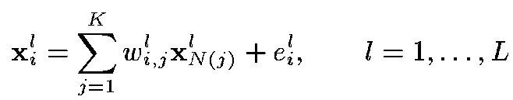
Simple feature fusion
Training sample: (x₁,x₂,…,x_{n})
Each sample x_{i} can be represented by L feature subsets
The local neighbor structure is
The L weight matrices: W¹,W²,…,W^{n}

Slide 13
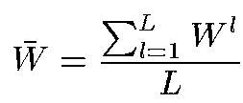
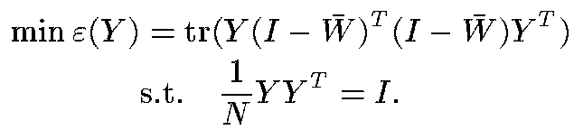
Simple feature fusion
To summarize the neighborhood information, the L weight matrices are combined
The new coordinates are derived by solving

Slide 14
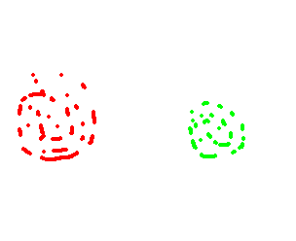



Within & between class scatter
Within-class
Within-class
Class 1
Class 2
Between-class
Within-class scatter指的是同一類別內資料的分散程度
Between-class scatter指的是不同類別間資料的分散程度

Slide 15


Fisher Linear Discriminant (FLD)
Suppose we have n d-dimensional samples x₁, x₂, …, x_{n} belonging to c different classes with n_{i} samples in the subset Di labeled ω_{i}.
The objective of FLD is seek the direction w not only maximizing the between-class scatter of the projected samples but also minimizing the within-class scatter.

Slide 16
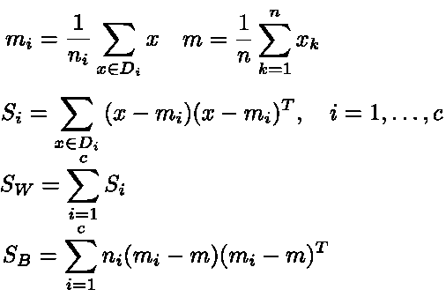
Fisher Linear Discriminant (FLD)
m_{i}: sample mean for class ω_{i}
m: sample mean for the whole set
S_{B}: between-class scatter matrix
S_{i}: scatter matrix corresponding to ω_{i}
S_{w}: within-class scatter matrix

Slide 17
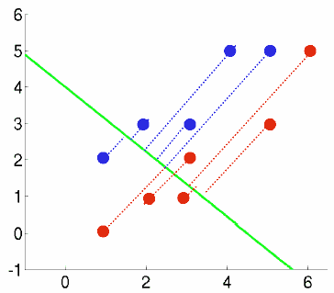
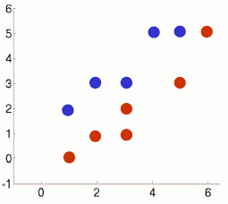
FLD example
Class 1 has 5 samples c1 = [(1,2),(2,3),(3,3),(4,5),(5,5)]
Class 2 has 6 samples c2 = [(1,0),(2,1),(3,1),(3,2),(5,3),(6,5)]
m1=(3,3.6), m2=(3.3,2),m=(3.2,2.7)
S1=[10,8;8,7.2],S2=[17.3,16;16,16],Sw=S1+S2=[27.3,24;24,23.2],Sb=[0.3,-1.5;-1.5,7]
w=(-0.67,0.75), λ1=4.6
λ2=0, 這表示二維資料最多取得一個最佳旋轉方向=>傳統FLD缺點
Notes:
c1=[1 2;2 3;3 3;4 5;5 5]’
c2=[1 0;2 1;3 1;3 2;5 3;6 5]‘
m1=mean(c1,'c')
m2=mean(c2,'c')
m=(m1*5+m2*6)/11
c1_m1=c1-mtlb_repmat(m1,1,5)
S1=c1_m1*c1_m1’
c2_m2=c2-mtlb_repmat(m2,1,6)
S2=c2_m2*c2_m2’
Sw=S1+S2
Sb=5*(m1-m)*(m1-m)'+6*(m2-m)*(m2-m)‘
[V,D] = mtlb_eig(inv(Sw)*Sb)

Slide 18
FLD example 1
FLD分析後，兩類別分得更開，但各自類別卻縮的較近
Notes:
c1=[1 2;2 3;3 3;4 5;5 5]’
c2=[1 0;2 1;3 1;3 2;5 3;6 5]‘
m1=mean(c1,'c')
m2=mean(c2,'c')
m=(m1*5+m2*6)/11
c1_m1=c1-mtlb_repmat(m1,1,5)
S1=c1_m1*c1_m1’
c2_m2=c2-mtlb_repmat(m2,1,6)
S2=c2_m2*c2_m2’
Sw=S1+S2
Sb=5*(m1-m)*(m1-m)'+6*(m2-m)*(m2-m)‘
[V,D] = mtlb_eig(inv(Sw)*Sb)

Slide 19
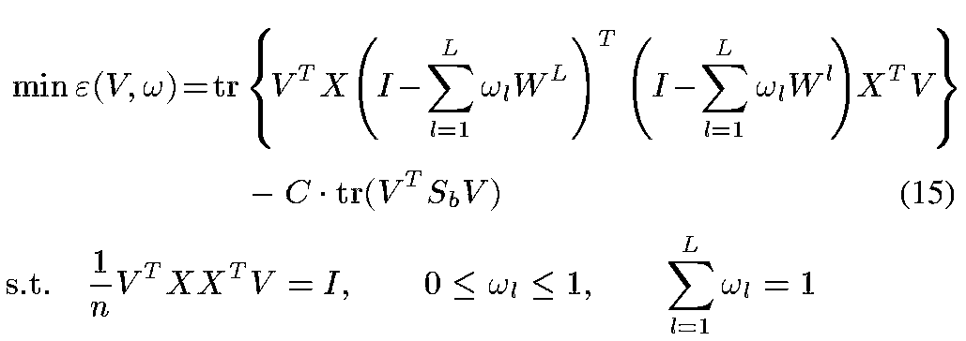
LLE for classification
原來
simple fusion
不變
線性轉換
改進
Between-class variance
越大越好

Slide 20
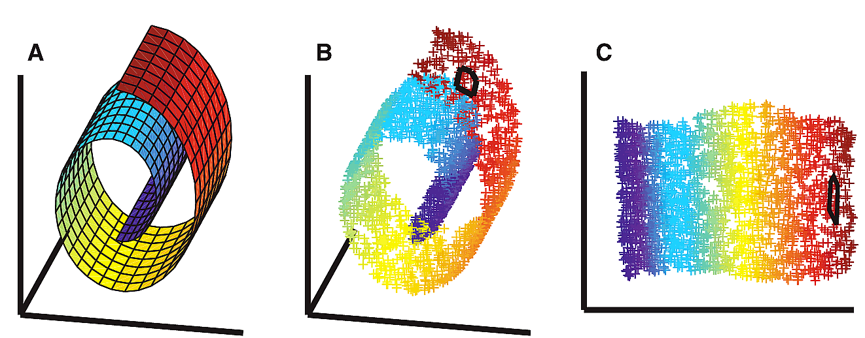
Estimation of Intrinsic Dimension
Manifold’s dimension

Slide 21
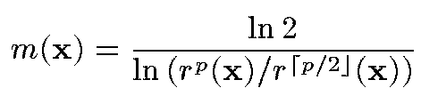
Estimation of Intrinsic Dimension
Estimation of the manifold’s dimension
(用以估算縮減之後的維度)
the distance to the p’th nearest neighbor of x
the rounded value of p/2

Slide 22
Experiment 1(作者採用)
Data: UCI Handwritten Digit Data Set
200 patterns x 10 classes
Feature subsets: 1) profile correlations (FA); 2) Fourier coefficients of the character shapes (FO); 3) Karhunen–Loeve (KA) coefficients; 4) morphological features (MO); 5) pixel averages in 23 windows (PI); and 6) Zernike moments (ZE)
50 randomly drawn samples per class are trained

Slide 23
Experiment 1(原始數據)
Data: UCI Handwritten Digit Data Set
http://archive.ics.uci.edu/ml/datasets/Optical+Recognition+of+Handwritten+Digits
Number of Attributes 64 input+1 class attribute
Number of Instances
  Training 3823
  Testing 1797
Accuracy on the testing set with k-nn using Euclidean distance as the metric
k = 1 : 98.00
k = 2 : 97.38
k = 3 : 97.83
k = 4 : 97.61
k = 5 : 97.89
k = 6 : 97.77
k = 7 : 97.66
k = 8 : 97.66
k = 9 : 97.72
k = 10 : 97.55
k = 11 : 97.89

Slide 24
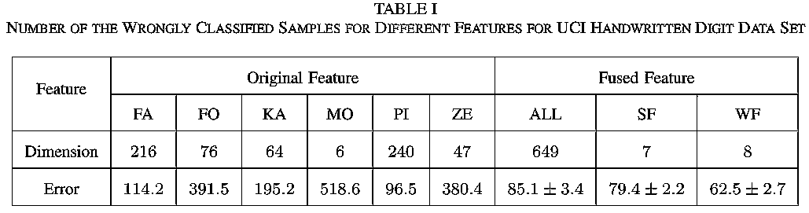
Experiment 1
Feature subsets
Simple feature fusion
Weighted feature fusion
Nearest neighbor classifier are used for evaluation

Slide 25
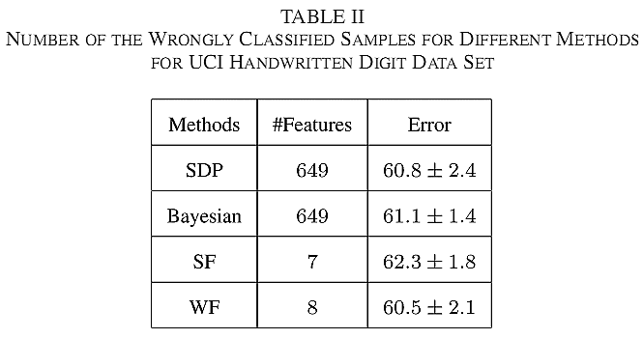
Experiment 1
本篇論文方法
One-versus-all SVMs are used for evaluation

Slide 26
Experiment 2 (作者採用)
Data: Texture Image Data Set
200 patterns x 9 classes
Feature subsets: 1) autocorrelation (ACF), 2) edge frequency (EF), wavelet transform(WT), 3) discrete cosine transform(DCT), and 4) Gabor transform (GB)
50 randomly drawn samples per class are trained

Slide 27
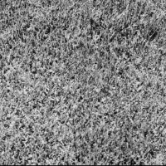
Experiment 2 (原始數據)
Data: Texture Image Data Set
http://sipi.usc.edu/database/database.cgi?volume=textures
Filename Description Size Type
--------------------------------------------------------------------
1.1.01 Brodatz - Grass (D9) 512 Mono
1.1.02 Brodatz - Bark (D12) 512 Mono
1.1.03 Brodatz - Straw (D15) 512 Mono
1.1.04 Brodatz - Herringbone weave (D15) 512 Mono
1.1.05 Brodatz - Woolen cloth (D19) 512 Mono
1.1.06 Brodatz - Pressed calf leather (D24) 512 Mono
1.1.07 Brodatz - Beach sand (D29) 512 Mono
1.1.08 Brodatz - Water (D38) 512 Mono
1.1.09 Brodatz - Wood grain (D68) 512 Mono
1.1.10 Brodatz - Raffia (D84) 512 Mono
1.1.11 Brodatz - Pigskin (D92) 512 Mono
1.1.12 Brodatz - Brick wall (D94) 512 Mono
1.1.13 Brodatz - Plastic bubbles (D112) 512 Mono
1.2.01 Brodatz - Grass (D9 H.E.) 512 Mono
1.2.02 Brodatz - Bark (D12 H.E.) 512 Mono
1.2.03 Brodatz - Straw (D15 H.E.) 512 Mono
1.2.04 Brodatz - Herringbone weave (D16 H.E.) 512 Mono
1.2.05 Brodatz - Woolen cloth (D19 H.E.) 512 Mono
1.2.06 Brodatz - Pressed calf leather (D24 H.E.) 512 Mono
1.2.07 Brodatz - Beach sand (D29 H.E.) 512 Mono
1.2.08 Brodatz - Water (D38 H.E.) 512 Mono
1.2.09 Brodatz - Wood grain (D68 H.E.) 512 Mono
1.2.10 Brodatz - Raffia (D84 H.E.) 512 Mono
1.2.11 Brodatz - Pigskin (D92 H.E.) 512 Mono
1.2.12 Brodatz - Brick wall (D94 H.E.) 512 Mono
1.2.13 Brodatz - Plastic bubbles (D112 H.E.) 512 Mono

Slide 28
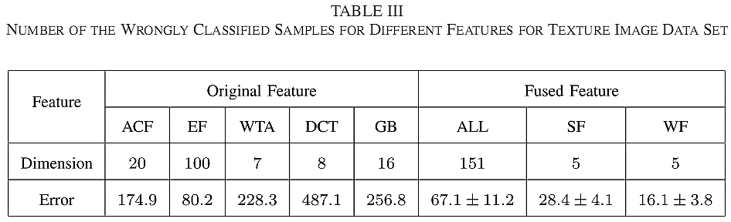
Experiment 2
Feature subsets
Simple feature fusion
Weighted feature fusion
Nearest neighbor classifier are used for evaluation

Slide 29
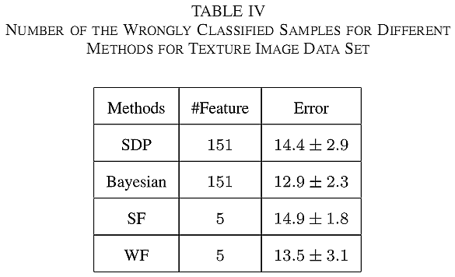
Experiment 2
本篇論文方法
One-versus-all SVMs are used for evaluation

