Slide 1
HHsvm: fast and accurate classification of profile–profile matches identified by HHsearch
Mensur Dlakić
Bioinformatics, Vol. 25, No. 23, pages 3071–3076, 2009
Speaker: Chong-Jie Wang
Date: June 7, 2010

Slide 2
Abstract
Motivation: Recently developed profile–profile methods rival structural comparisons in their ability to detect homology between distantly related proteins. Despite this tremendous progress, many genuine relationships between protein families cannot be recognized as comparisons of their profiles result in scores that are statistically insignificant.
Results: Using known evolutionary relationships among proteinsuperfamilies in SCOP database, support vector machines were trained on four sets of discriminatory features derived from the output of HHsearch. Upon validation, it was shown that the automatic classification of all profile–profile matches was superior to fixed threshold-based annotation in terms of sensitivity and specificity. The effectiveness of this approach was demonstrated by annotating several domains of unknown function from the Pfam database.

Slide 3
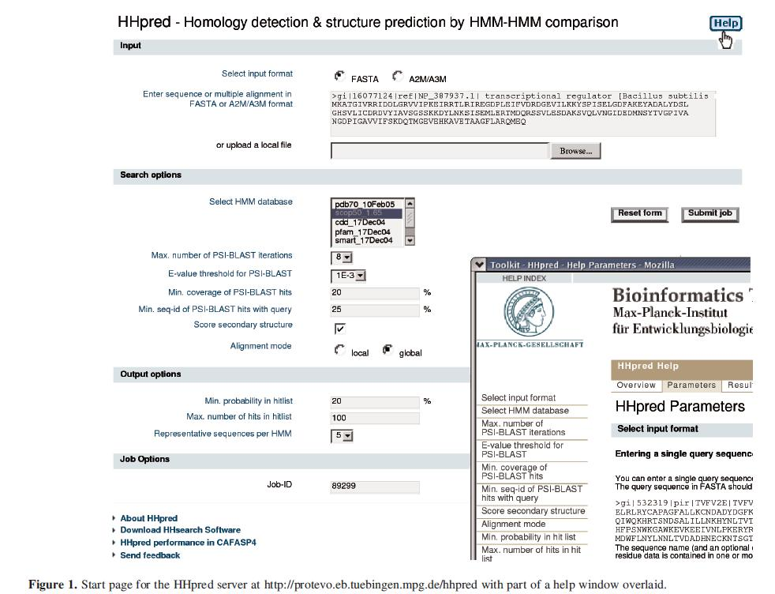
HHpred
http://toolkit.tuebingen.mpg.de/hhpred

Slide 4
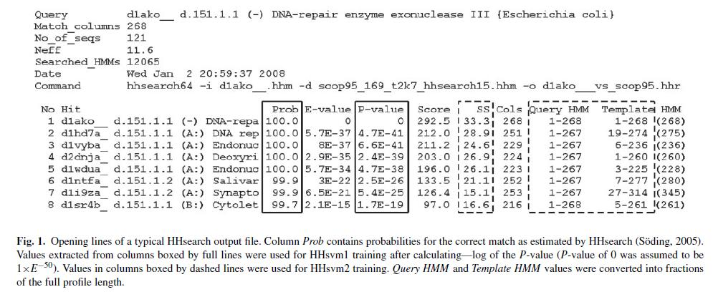

Slide 5
Training and testing datasets
SCOP database (v1.69)
E-value threshold of 100
The probability of correct hits (switch −p) set at 0.001

Slide 6
Features of 4 HHsvm(1/2)
HHsvm1 : probability and p-value
HHsvm2 : HHsvm1 with SS and coverage fractions of the query and its matches
HHsvm3 : HHsvm2 with average information contents of the complete query and its match

Slide 7
Features of 4 HHsvm(1/2)
HHsvm4 : HHsvm3 without probability as its feature

Slide 8
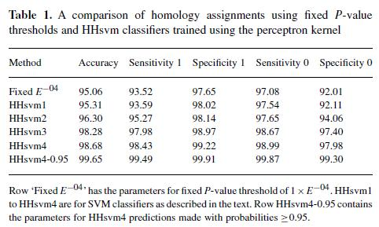

Slide 9
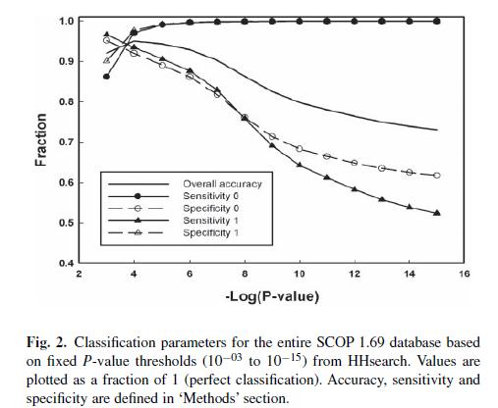

Slide 10
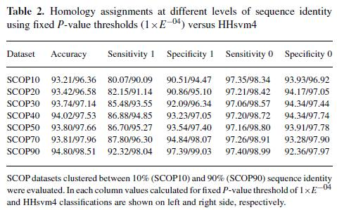

Slide 11
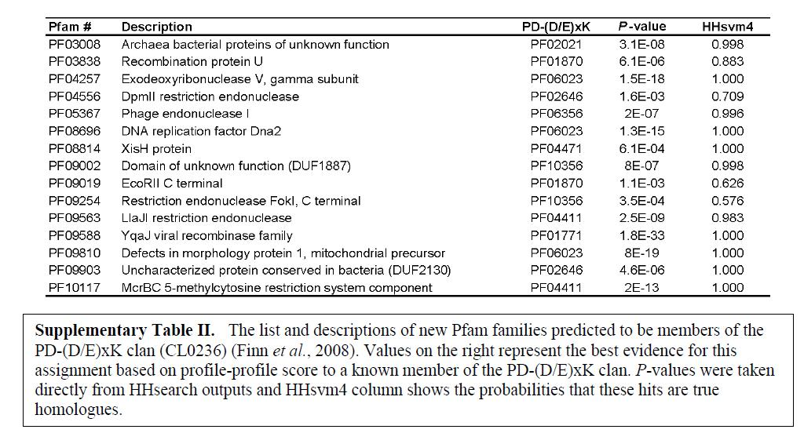
Using HHsvm to annotate protein domains of unknown function as PD-(D/E)xK nucleases

Slide 12
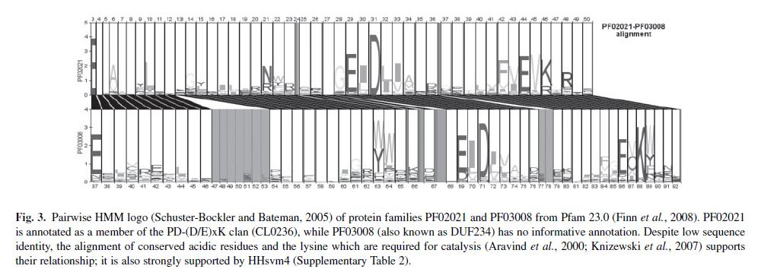

Slide 13
Thank you!

