Slide 1
Genome analysis with inter-nucleotide distances
Vera Afreixo, Carlos A. C. Bastos,
Armando J. Pinho, Sara P. Garcia
and Paulo J. S. G. Ferreira
BIOINFORMATICS, Vol. 25, pp. 3064–3070, 2009
Presenter: Dong-Jian Lin
Date: June 28, 2010

Slide 2
Abstract(1/3)
Motivation: DNA sequences can be represented by
sequences of four symbols, but it is often useful to convert
the symbols into real or complex numbers for further
analysis. Several mapping schemes have been used in the
past, but they seem unrelated to any intrinsic characteristic
of DNA. The objective of this work was to find a mapping
scheme directly related to DNA characteristics and that
would be useful in discriminating between different species.
Mathematical models to explore DNA correlation structures
May contribute to a better knowledge of the DNA and to
find a concise DNA description.

Slide 3
Abstract(2/3)
Results: We developed a methodology to process DNA
sequences based on inter-nucleotide distances. Our main
contribution is a method to obtain genomic signatures for
complete genomes, based on the inter-nucleotide
distances, that are able to discriminate between different
species. Using these signatures and hierarchical clustering,
it is possible to build phylogenetic trees(動植物種類史樹).
Phylogenetic trees lead to genome differentiation and allow
the inference of phylogenetic relations. The phylogenetic
trees generated in this work display related species close
to each other, suggesting that the inter-nucleotide
distances are able to capture essential information about
the genomes.

Slide 4
Abstract(3/3)
To create the genomic signature, we construct a vector
which describes the inter-nucleotide distance distribution
of a complete genome and compare it with the reference
distance distribution, which is the distribution of a sequence
where the nucleotides are placed randomly and
independently. It is the residual or relative error between
the data and the reference distribution that is used to
compare the DNA sequences of different organisms.

Slide 5
Inter-nucleotide distance
Introduced by Nair and Mahalakshmi(2005)
a new DNA numerical methodology profile and a new
mapping to explore the correlation structure of DNA
converts any DNA sequence into a unique numerical
sequence with the same length, where each number
represents the distance of a symbol to the next occurrence of the same symbol

Slide 6
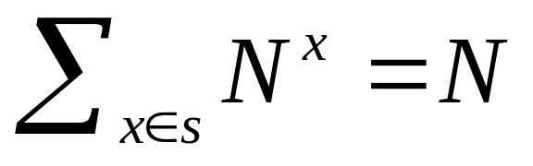
the alphabet S = {A,C,G,T} and let s = (s_{k} ),k∈{1,...,N} be a symbolic sequence defined in S
a numerical sequence, d^{x} , that represents the inter-
nucleotide distances to the symbol x∈S
The length (N) of the global distance sequence, d, is equal to the sum of the lengths of the four inter-nucleotide distance sequences (N^{A},N^{C},N^{G} and N^{T}). Thus,

Slide 7
a short DNA fragment :
AAACCCGTGTCAGTT
d^{A} = (1,1,9,4)
d^{C} = (1,1,5,8)
d^{G} = (2,4,9)
d^{T} = (2,4,1,8),
d = (1,1,9,1,1,5,2,2,4,4,8,4,9,1,8)
N = 60

Slide 8
Distribution of distance sequence
Goal: The term reference distribution, applied to a DNA
sequence, describes the distribution that the inter-
nucleotide distances for that sequence would follow
Consider p^{A}, p^{C}, p^{G} and p^{T} as the occurrence probabilities
of nucleotides A, C, G and T, respectively.
To estimate the nucleotide occurrence probability, p^{x} , we
use relative frequencies, N^{x} / N, computed from the original
nucleotide sequence.

Slide 9
If the nucleotide sequences were generated by an
independent and identically distributed (i.i.d.)
random process.
if its nucleotides were randomly determined, with
probabilities equal to the relative frequencies,
independently of each other.

Slide 10
the probability distribution of the inter-nucleotide distances
of the symbol x is
f^{x}(k)=P(d^{x} =k)
=P(d=k|x)
=p^{x}(1−p^{x})^{k−1}, k=1,2,...,
its distribution function is
F^{x}(k)=P(d^{x} ≤k)=1−(1−p^{x})^{k}

Slide 11
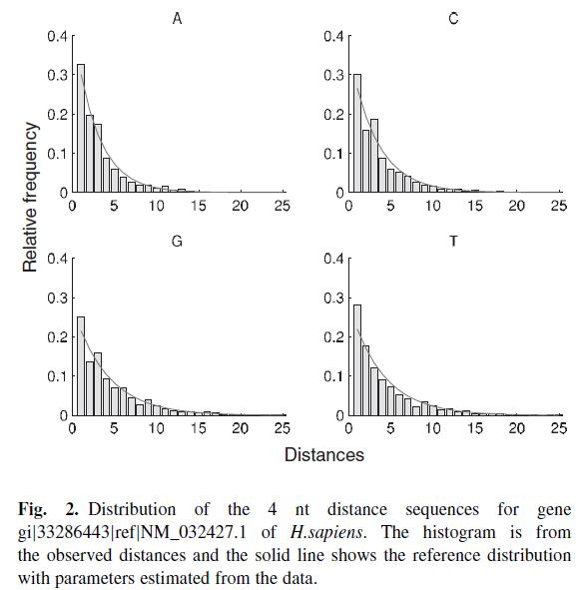

Slide 12
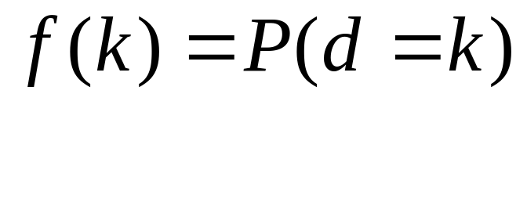
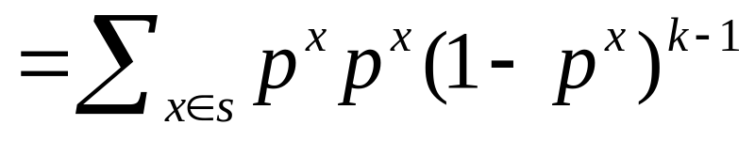
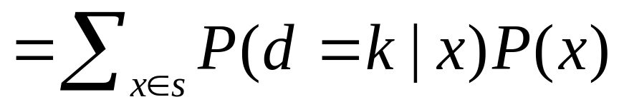
The corresponding global distance sequence
distribution is given by

Slide 13
DNA sequence
In this study, we used the complete DNA sequences of 28
species:
26 were from the National Center for Biotechnology Information (NCBI)
Populus trichocarpa from Joint Genome Insitue
Xenopus tropicalis from Xenbase

Slide 14
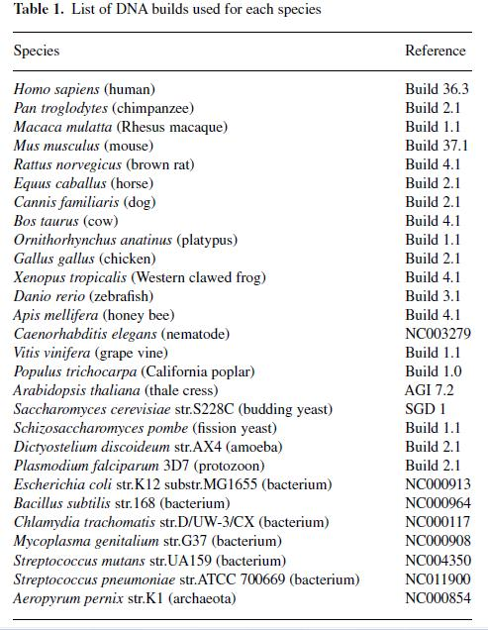
DNA sequences

Slide 15
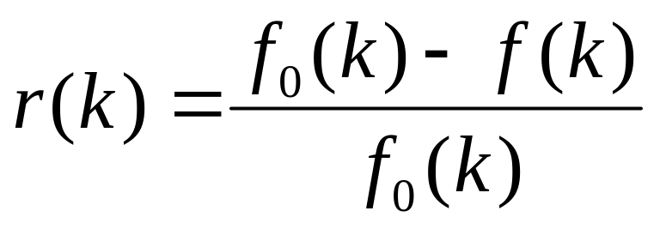
Experimental procedure
For large genomes, the sequences were divided into blocks of 500,000 symbols
In order to compare the various distance distributions with the theoretical one, we used the relative error
f₀(k) is the observed relative frequency of the distance
k, and f(k) is the relative frequency of the reference
distribution

Slide 16
Result: inter-nucleotide distacne analysis
Only the first 100 distances were used in all experiments described in this article.

Slide 17
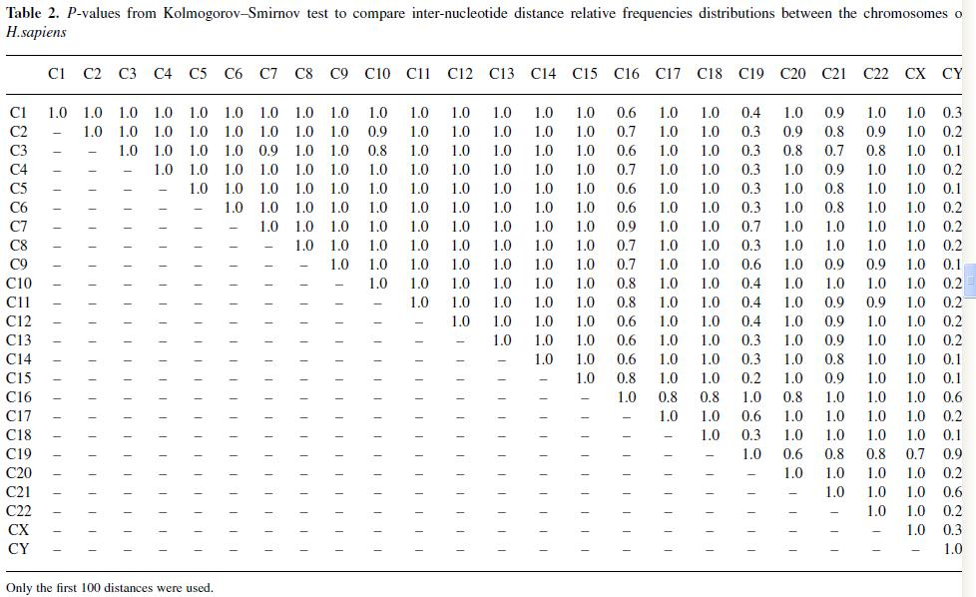

Slide 18
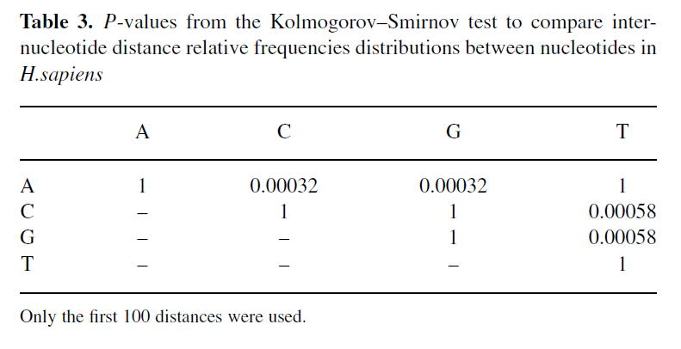

Slide 19
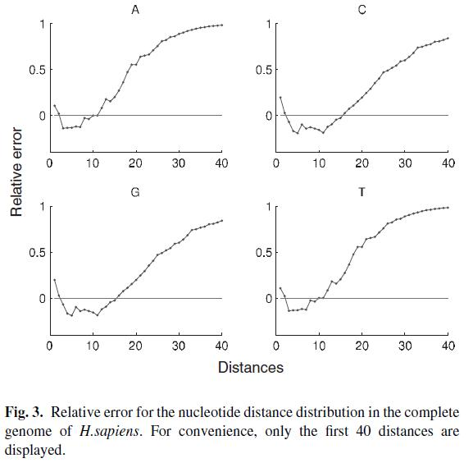

Slide 20
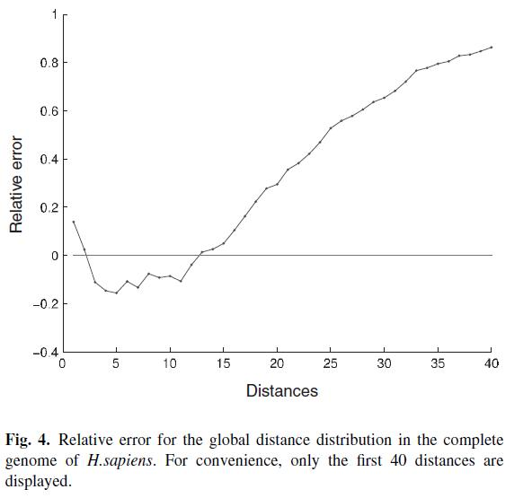

Slide 21
Result: analysis of multiple organisms
The relative error vectors of each complete
genome may be used as a genomic signature that
identifies each species, thus allowing the
comparison of species.

Slide 22
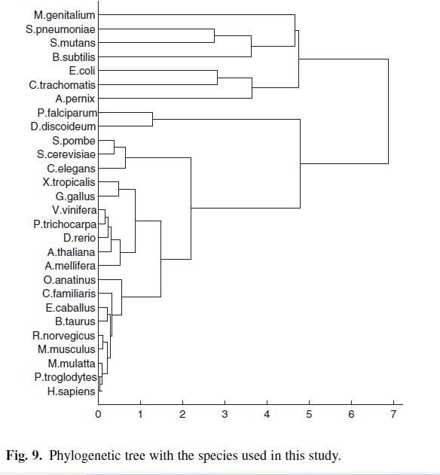

Slide 23
Thanks for your listening!

