Slide 1
SCANMOT: searching for similar sequences using a simultaneous scan of multiple sequence motifs
Saikat Chakrabarti, A. Prem Anand, Nitin Bhardwaj, Ganesan Pugalenthi and R. Sowdhamini
Nucleic Acids Research, 2005, Vol. 33, Web Server issue
Speaker: Chong-Jie Wang
Date: June 28, 2010

Slide 2
Abrstract
Establishment of similarities between proteins is very important for the study of the relationship between sequence, structure and function and for the analysis of evolutionary relationships. Motif-based search methods play a crucial role in establishing the connections between proteins that are particularly useful for distant relationships. This paper reports SCANMOT, a web-based server that searches for similarities between proteins by simultaneous matching of multiple motifs. SCANMOT searches for similar sequences in entire sequence databases using multiple conserved regions and utilizes intermotif spacing as restraints. The SCANMOT server is available via http://www.ncbs.res.in/~faculty/mini/scanmot/scanmot.html.

Slide 3
SCANMOT(1)
Works in three different steps to find similar proteins with the specified motifs.
The first step is to scan the motifs within the query sequence itself to record the inter-motif spacing for all possible combinations of the specified motifs. The order of occurrence of the motif within the query sequence is also recorded.

Slide 4
SCANMOT(2)
Next, the program scans the motifs into a sequence database and reports the sequences with a specified number of motifs in a similar order to the query sequence.

Slide 5
SCANMOT(3)
The third step is to align the query sequence and each of the ‘hits’ using an algorithm which fixes the motif regions between the query and hit and aligns the rest by dividing them into several parts.
Sequeces ranked by two grading methods:
motif spacing
alignment score

Slide 6
Motif spacer
For N motifs for a given query protein, N · (N - 1)/2 combinations of inter-motif spacing are possible.
30% relaxation of equivalent motif spacing provides optimal results with high specificity.
Grade A(< 20%), B(20~40%), C(40~60%) and D(> 60%).

Slide 7
Percentile alignment score
Using a pairwise fixed motif alignment algorithm.
the alignment score is represented as a measure of similarity between the two.

Slide 8
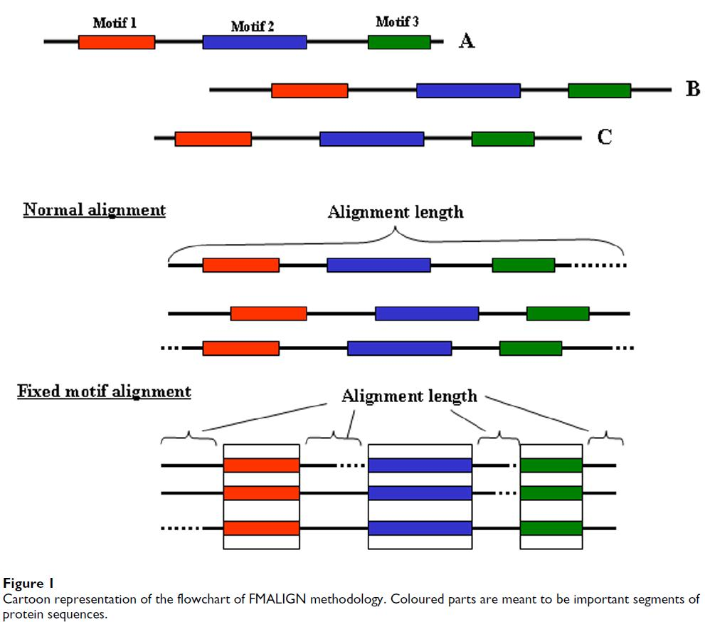

Slide 9
SCANMOT functions
Scanning similar sequences in custom databases
Filtering and validating PSI-BLAST outputs

Slide 10
Results and applications
Large-scale benchmarking studies using structural motifs for 110 superfamilies from the SMoS database yielded very high specificity (86%) and 70% coverage.

Slide 11
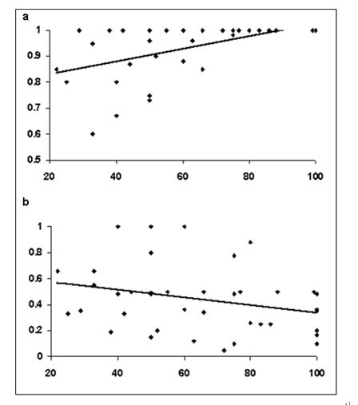

Slide 12
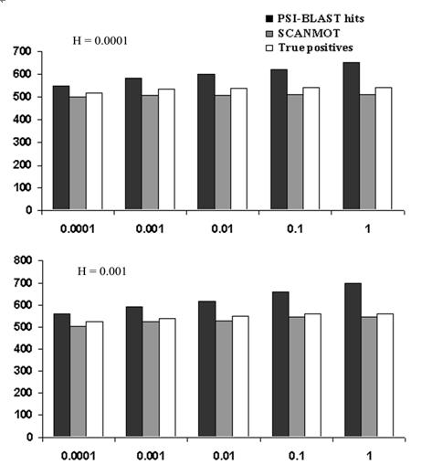

Slide 13
Thank you!

