Slide 1
A New Bioinformatics Tool for Prediction with Confidence
D. Devetyarov, M. J Woodward, N. G Coldham,
M. F Anjum and A. Gammerman
The 2010 International Conference on Bioinformatics & Computational Biology
Presenter: Chiou-Ting Tseng
Date: July 26, 2010

Slide 2
Abstract
Complementing each prediction with the measure of its reliability is crucial for domains with high misclassification costs. Conformal predictors represent a new flexible bioinformatics tool that can output predictions with a single value of confidence assigned to each prediction. Conformal predictors can also guarantee the error rate of region predictions by setting the confidence level. In this work, we applied different types of conformal predictors to high dimensional veterinary and medical microarray data.

Slide 3
Abstract
Implemented predictors resulted in the accuracy as high as provided by conventional machine learning methods, but in addition, they complemented each prediction with the measure of confidence. Validity of these predictions was also empirically confirmed: the ratio of mistakes made by region predictors was close to the preset level.

Slide 4
Main Idea
當無法確定何者是正確答案時就給出很多個答案，但是可以保證正確率。

Slide 5
Conformal Predictors
Try every possible label y as a candidate for x_{n}’s label and see how random the resulting example (x_{n}, y) is in comparison to (x₁, y₁), . . . , (x_{n−1}, y_{n−1}).

Slide 6
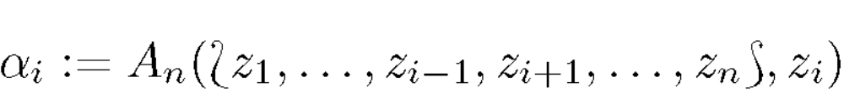
Nonconformity Score
Assign some value i (nonconformity scores) to every example in the sequence {z_{i} := (x_{i}, y_{i}), i = 1, . . . , n} including a new example and will evaluate ‘nonconformity’ between a set and its element:
A nonconformity measure can be based on many well-known machine learning algorithms.

Slide 7
我的理解
假如我們用K-NN來計算nonconformity score
例如認為新的data是class 1那就看它的K-NN裡面屬於class 1的比例跟training set比較起來是否算是高的。

Slide 8
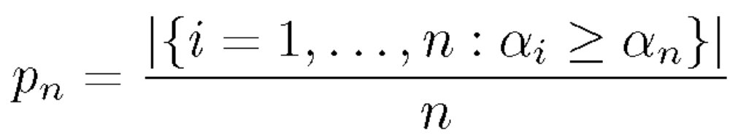
p-value
We can compliment each label with a p-value that shows how random the example with this label is in comparison with all previous examples, that is, how well a new example with this label conforms with the rest of the sequence.

Slide 9
Conformal Predictor
The set of all labels y ∈ Y such that p_{n} > ε.
So we may output zero, one or many classes.
We can force the predictor to output single label by outputting the class with highest p-value

Slide 10
Dataset
Two high-dimensional microarray data sets were used: veterinary(獸醫) data of Salmonella(沙門氏菌) subtypes and medical data of human cancers.
Human cancers data set was provided in the ICMLA 2009 Challenge

Slide 11
Salmonella
Each strain is represented by at least two replicates.
There are 56 strains (120 replicates) in total.
Each replicate has 3858 features — real numbers between 0 and 1.
Features were normalized, averaged across replicates, and rounded to 0 and 1.

Slide 12
Human Cancer
We analyzed the training set of 400 samples, comprising 70 lung cancers, 130 colon(直腸) cancers, and 200 breast cancers.
The aim was to predict the type of cancer. 447 features were preselected out of initial 54613 to reduce the processing time.

Slide 13
International Conference on Machine Learning and Applications
2008
  Automated Microarray Classification
2009
  Functional Clustering of Gene Expression Profiles in Human Cancers
  Cats vs. Dogs Classification Challenge
2010
  Speaker Clustering Challenge

Slide 14
Implement
We used several types of non-conformity measures in microarray data analysis:
  kNN algorithm
  SVM with different kernels
  random forests
  kNN applied to random forest proximities

Slide 15
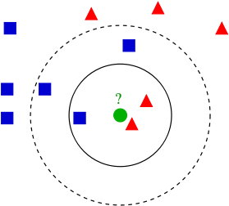
k-NN

Slide 16
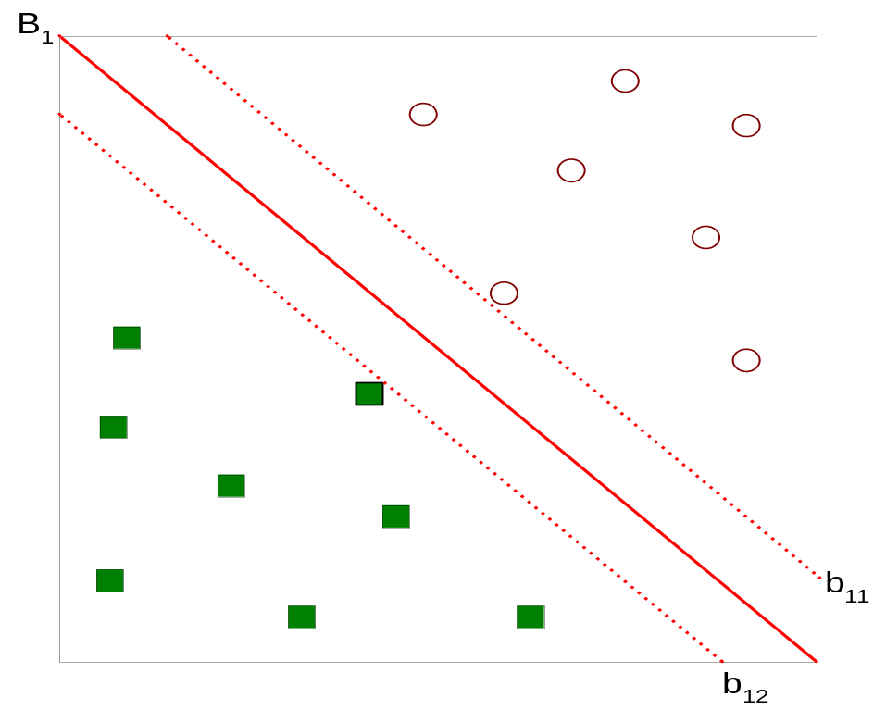



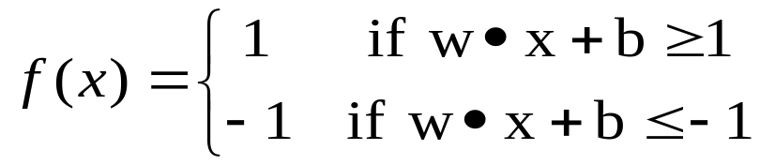
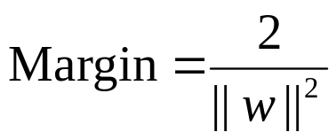
Support Vector Machines
SVM seeks a maximal margin separating hyper-plane to separate two groups of data.
Taken from the textbook: Introduction to Data Mining

Slide 17
Random Forest
隨機森林的機制與決策樹(decision tree)相似，但它還作了表決(voting)的處理。其實就是由許多決策樹構成隨機森林，由決策樹的判斷作表決，得到最後的結果。要訓練隨機森林中的每個決策樹，對訓練樣品要作隨機選取，在各結點(node)做分裂時也是隨機方式處理。一個最佳分裂的決定，只由D 維度特徵向量中隨機取d 個子維度作判斷，如此的結點分裂反覆進行，直到所有的葉結點(leaf node)有最大純度，甚至只剩一個特徵向量，對一個測試向量，經過每一個決策樹而得到分類標記，再由投票決定其分類結果。

Slide 18
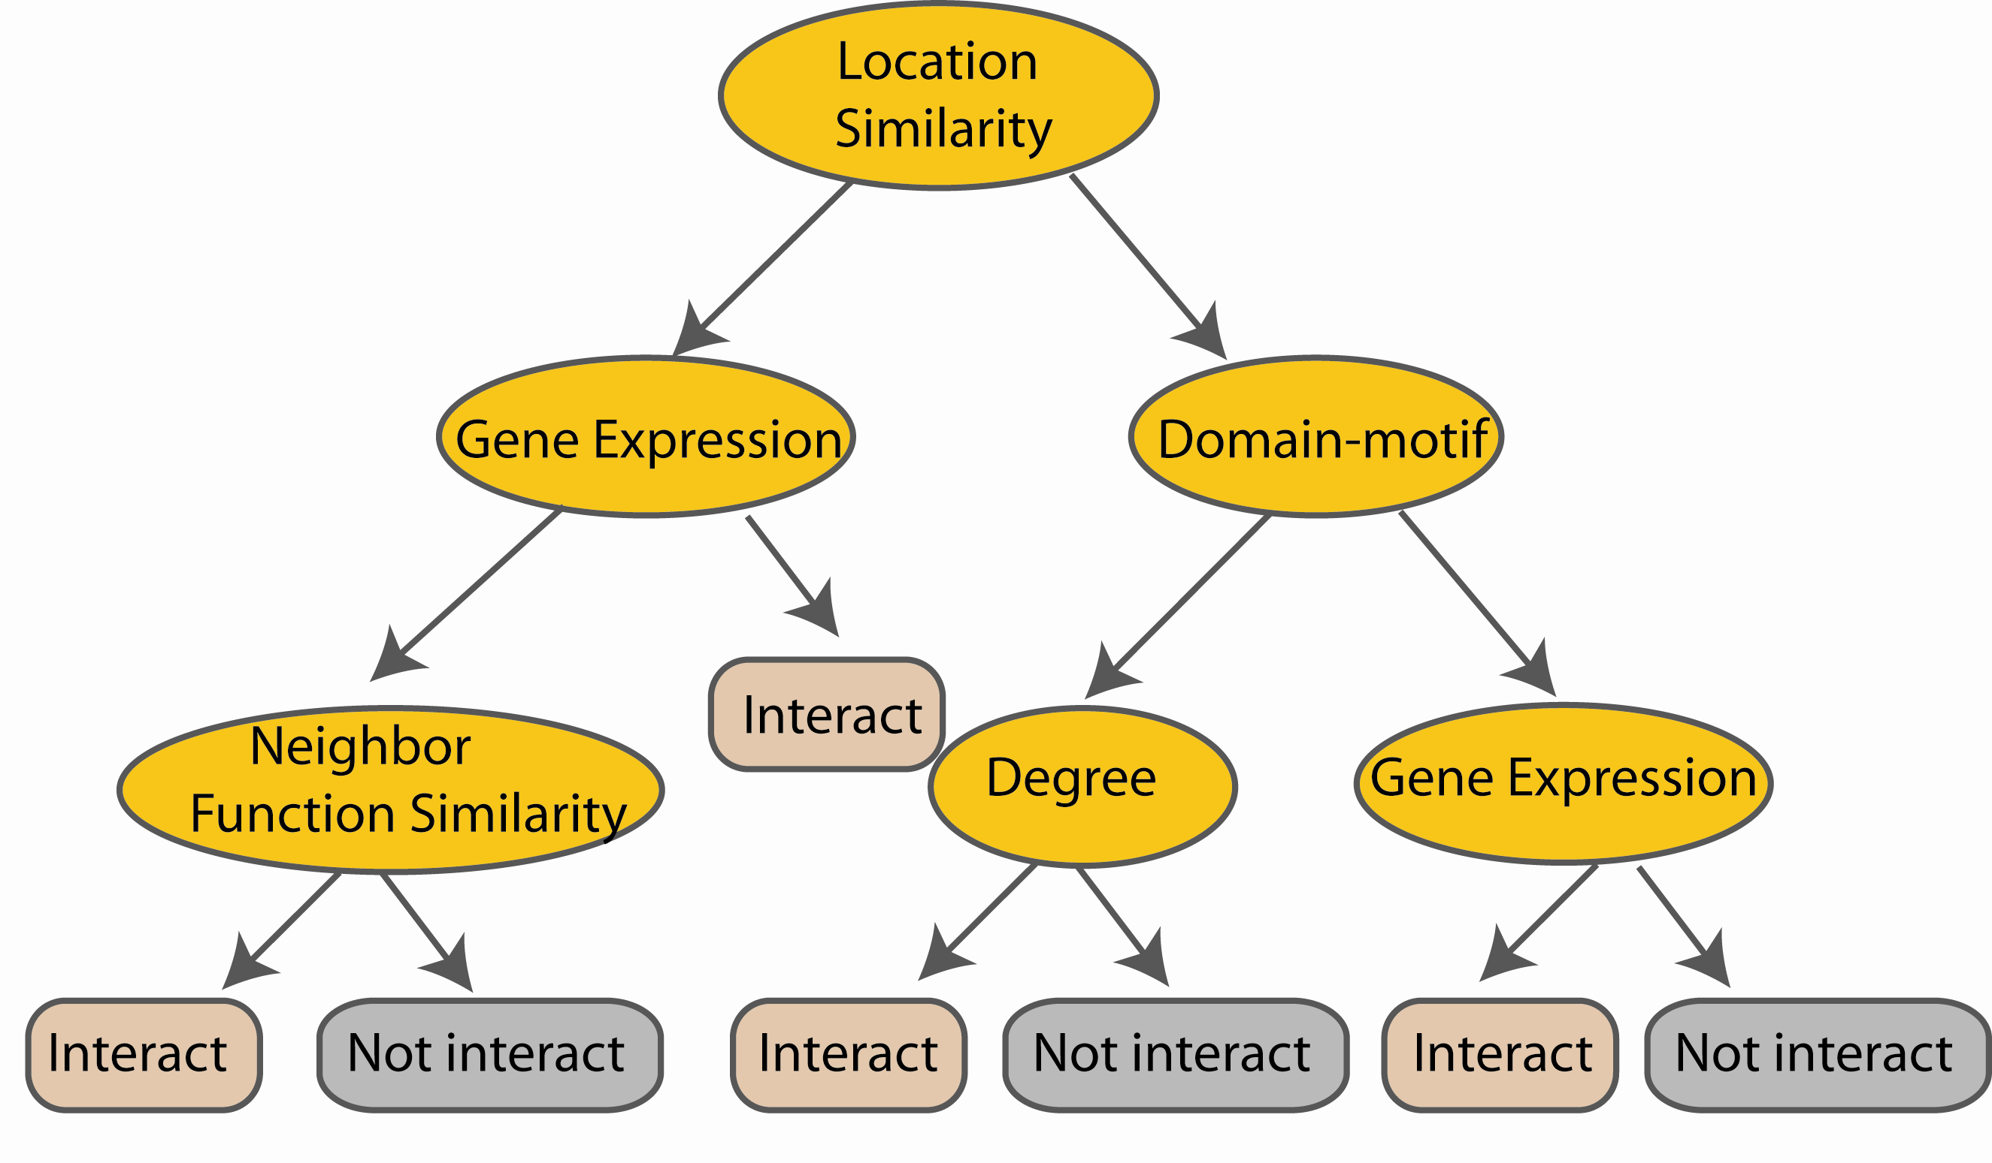
Random Forest Classifier
At each node in choosing the split feature
choose only among m<M features
M features
N examples
....…
Notes:
Different from the regular decision trees in random forest, when the splitting feature is chosen from only a subset of allf eatures.
The robostness of the classifier arises from
bootsraping of the training data and the random selection of features, the the random choose of features.

Slide 19
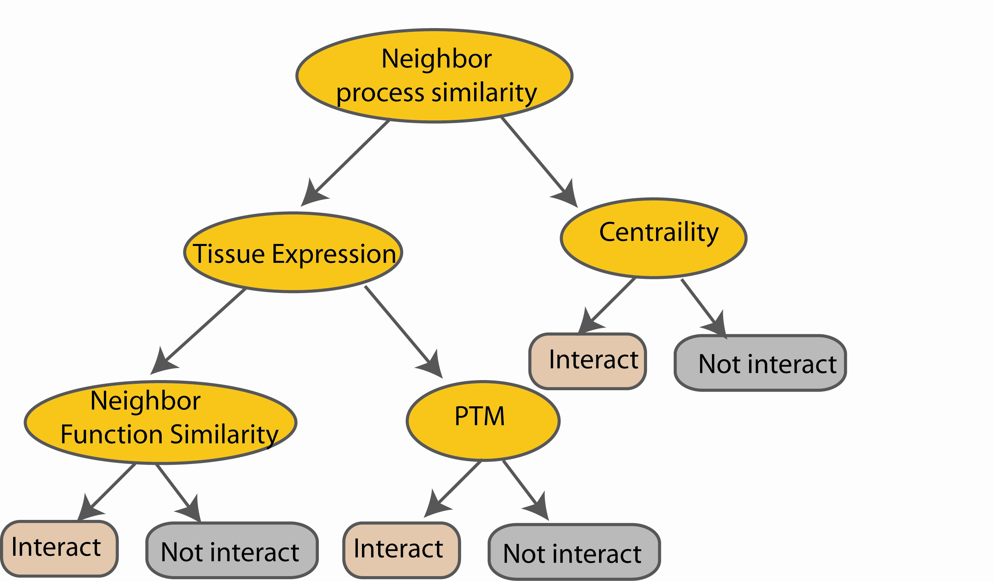
Random Forest Classifier
Create decision tree
from each bootstrap sample
M features
N examples
....…
....…

Slide 20
Random Forest Classifier
M features
N examples
Take he majority vote
....…
....…
Notes:
Finally the given an input data the decision is made as follows given an input data,

Slide 21
預測顯著性
For each object one can calculate confidence and credibility.
Credibility is a maximum value of all possible p-values.
Confidence equals 1 − the second maximum p-value.
High confidence means that the alternative hypothesis is excluded by having a low p-value, high credibility checks whether the prediction itself does not have too small a p-value.

Slide 22
Result 1-1
No. | p-value for 1 | p-value for 2 | p-value for 3 | Confidence | Credibility | Predicted label | True Label
3 | 100.0% | 66.7% | 100.0% | 0.0% | 100.0% | Tie | 1
4 | 75.0% | 75.0% | 75.0% | 25.0% | 75.0% | Tie | 2
5 | 40.0% | 100.0% | 40.0% | 60.0% | 100.0% | 2 | 2
6 | 33.3% | 50.0% | 33.3% | 66.7% | 50.0% | 2 | 1
7 | 28.6% | 28.6% | 14.3% | 71.4% | 28.6% | Tie | 3
8 | 75.0% | 12.5% | 12.5% | 87.5% | 75.0% | 1 | 1
9 | 11.1% | 11.1% | 11.1% | 88.9% | 11.1% | Tie | 1
10 | 70.0% | 10.0% | 10.0% | 90.0% | 70.0% | 1 | 1
11 | 9.1% | 9.1% | 45.5% | 90.9% | 45.5% | 3 | 3
12 | 8.3% | 8.3% | 8.3% | 91.7% | 8.3% | Tie | 2
13 | 7.7% | 7.7% | 84.6% | 92.3% | 84.6% | 3 | 3
14 | 7.1% | 7.1% | 100.0% | 92.9% | 100.0% | 3 | 3

Slide 23
Result 1-2
No. | p-value for 1 | p-value for 2 | p-value for 3 | Confidence | Credibility | Predicted label | True Label
15 | 6.7% | 26.7% | 6.7% | 93.3% | 26.7% | 2 | 2
16 | 81.3% | 6.3% | 6.3% | 93.8% | 81.3% | 1 | 1
17 | 5.9% | 41.2% | 5.9% | 94.1% | 41.2% | 2 | 2
18 | 5.6% | 5.6% | 100.0% | 94.4% | 100.0% | 3 | 3
19 | 5.3% | 15.8% | 5.3% | 94.7% | 15.8% | 2 | 2
20 | 10.0% | 5.0% | 5.0% | 95.0% | 10.0% | 1 | 1
21 | 4.8% | 4.8% | 95.2% | 95.2% | 95.2% | 3 | 3
22 | 4.5% | 4.5% | 9.1% | 95.5% | 9.1% | 3 | 3
23 | 30.4% | 4.3% | 4.3% | 95.7% | 30.4% | 1 | 1
24 | 4.2% | 4.2% | 50.0% | 95.8% | 50.0% | 3 | 3
25 | 4.0% | 4.0% | 68.0% | 96.0% | 68.0% | 3 | 3

Slide 24
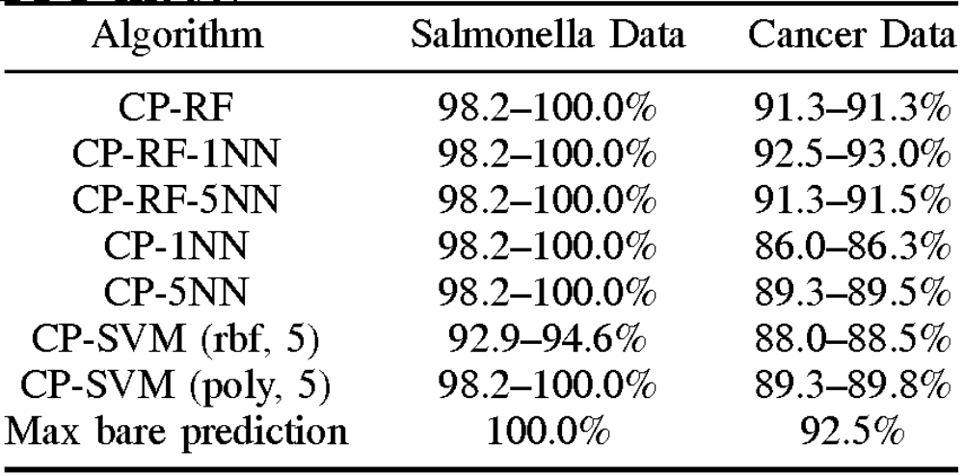
Result 2

Slide 25
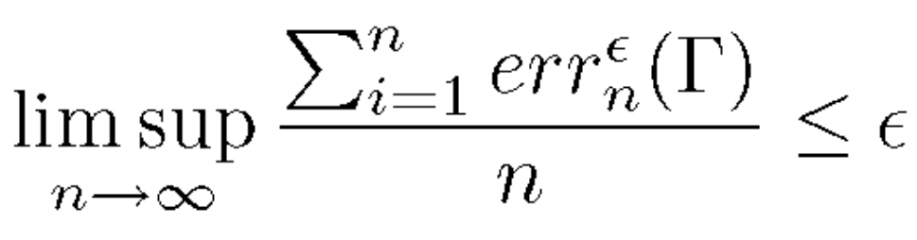
Validity of Conformal Predictor
with probability 1

Slide 26
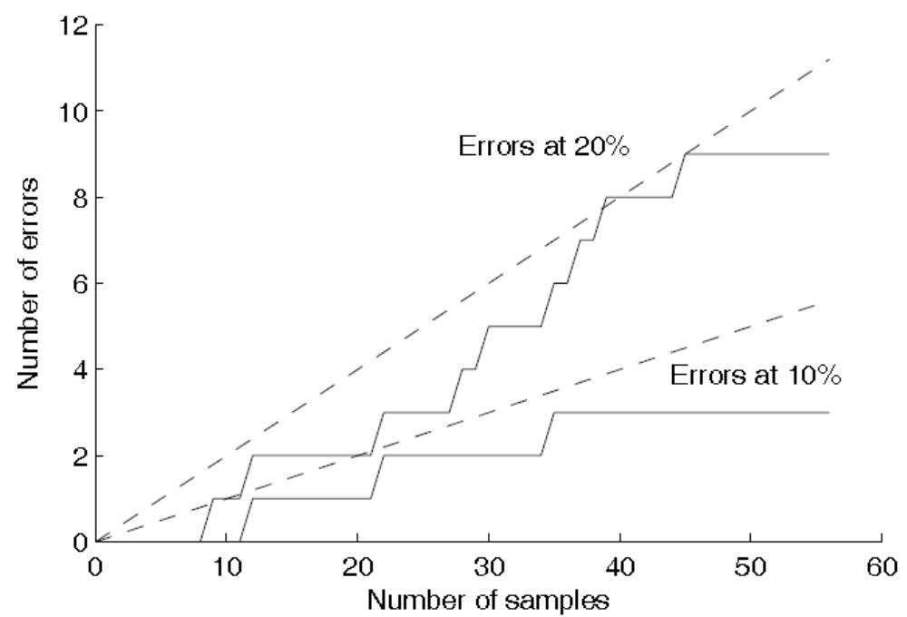
Result 3-1

Slide 27
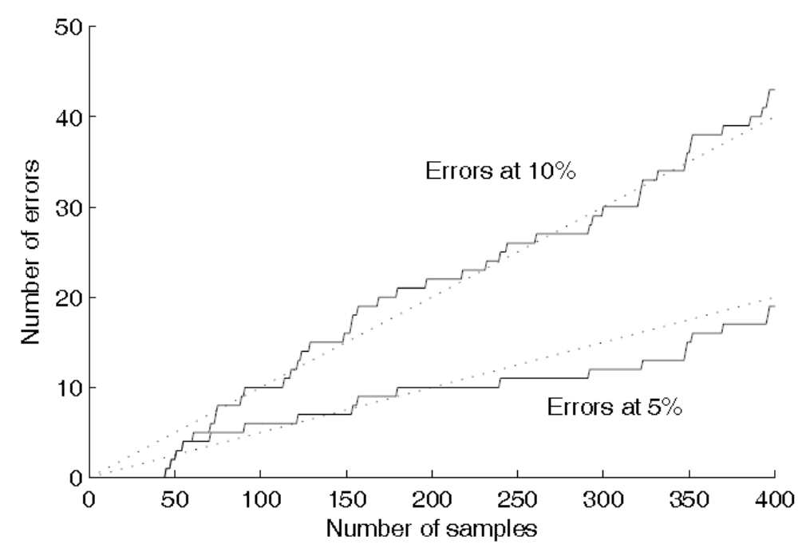
Result 3-2

Slide 28
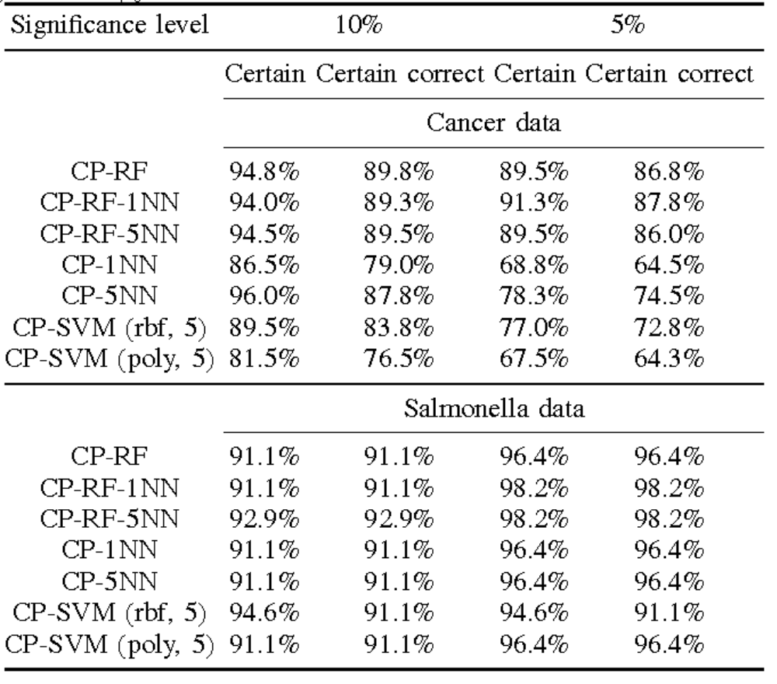
預測個數

Slide 29
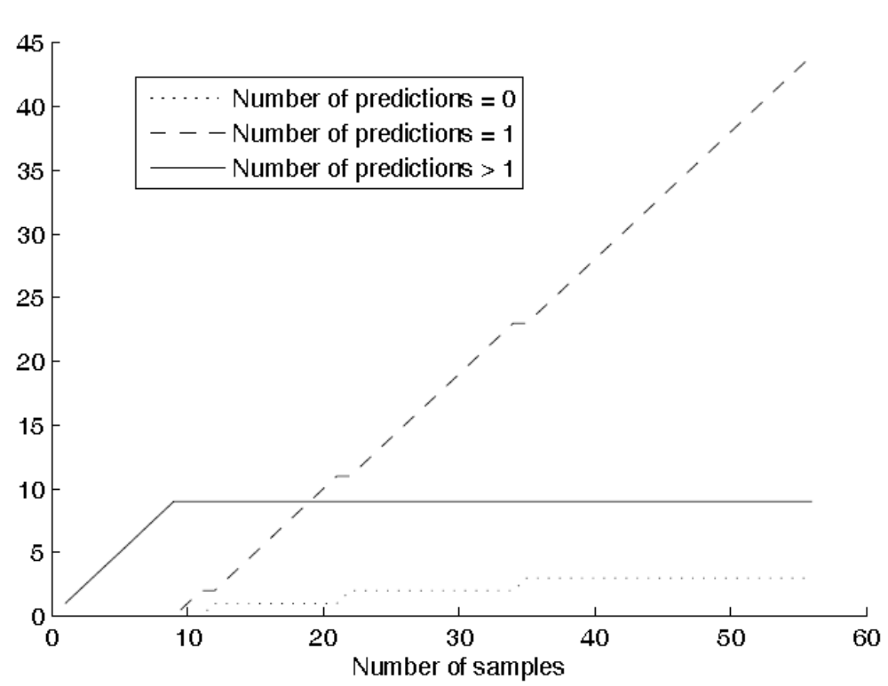
預測個數

Slide 30
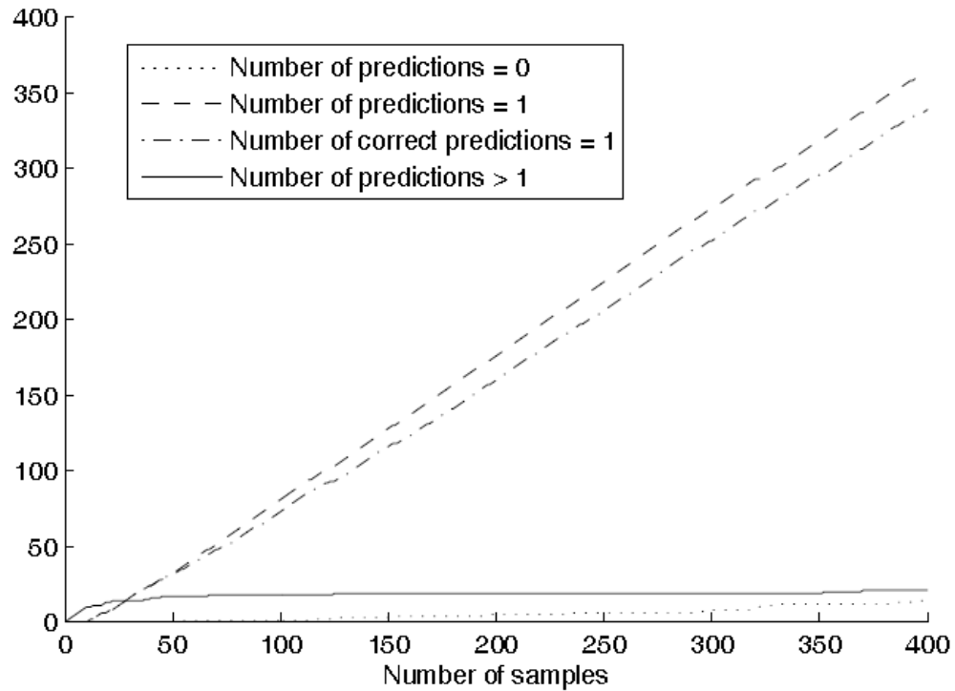
預測個數

