Slide 1
Hubba: hub objects analyzer— a framework of interactome hubs identification for network biology
Chung-Yen Lin(林中彥), Chia-Hao Chin(金家豪), Hsin-Hung Wu(吳新宏),
Shu-Hwa Chen(陳書華),
Chin-Wen Ho(何錦文), and Ming-Tat Ko(高明達)
Nucleic Acids Research, 2008, Vol. 36, Web Server issue
pages 438-443
Presenter:Zih-Jie Yang
Date: July 26,2010

Slide 2
Abstract(1/3)
One major task in the post-genome era is to reconstruct proteomic and genomic interacting networks using high-throughput experiment data. To identify essential nodes/hubs in these interactomes is a way to decipher the critical keys inside biochemical pathways or complex networks. These essential nodes/hubs may serve as potential drug-targets for developing novel therapy of human diseases, such as cancer or infectious disease caused by merging pathogens.

Slide 3
Abstract(2/3)
Hub Objects Analyzer (Hubba) is a web-based service for exploring important nodes in an interactome network generated from specific small- or large-scale experimental methods based on graph theory. Two characteristic analysis algorithms, Maximum Neighborhood Component (MNC) and Density of Maximum Neighborhood Component (DMNC) are developed for exploring and identifying hubs/essential nodes from interactome networks. Users can submit their own interaction data in PSI format (Proteomics Standards Initiative, version 2.5 and 1.0), tab format and tab with weight values. User will get an email notification of the calculation complete in minutes or hours, depending on the size of submitted dataset.

Slide 4
Abstract(3/3)
Hubba result includes a rank given by a composite index, a manifest graph of network to show the relationship amid these hubs, and links for retrieving output files. This proposed method (DMNC || MNC) can be applied to discover some unrecognized hubs from previous dataset. For example, most of the Hubba high-ranked hubs (80% in top 10 hub list, and >70% in top 40 hub list) from the yeast protein interactome data (Y2H experiment) are reported as essential proteins. Since the analysis methods of Hubba are based on topology, it can also be used on other kinds of networks to explore the essential nodes, like networks in yeast, rat, mouse and human. The website of Hubba is freely available at http://hub.iis.sinica.edu.tw/Hubba.

Slide 5
必要性蛋白質（essential protein）
必要性蛋白質（essential protein）為當此蛋白質在蛋白質複合體中遭到基因剔除式突變(null mutation)去除後，會危及很多重要的生化反應路徑(biologically important pathways)，進而造成蛋白質複合體的功能喪失，致使生物體無法生存(inviable)。因此瞭解必要性蛋白質的特性，並預測某些蛋白質是否為必要性蛋白質是很重要的課題。

Slide 6
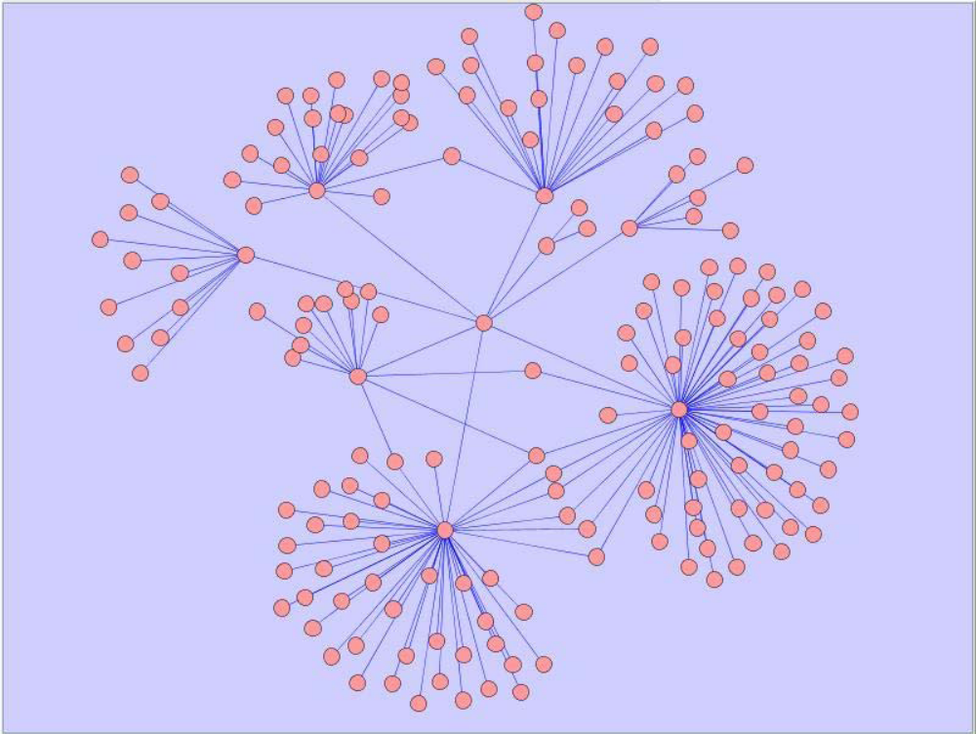
蛋 白 質 交 互 作 用 (Protein-protein interaction)
每一個點為一個蛋白質，每一個邊所連結的兩的點則代表這兩個蛋白質之間有交互作用。

Slide 7
Methods
1. Degree
2. BottleNeck (BN)
3. Edge percolated component (EPC)
4. Subgraph centrality (SC)
5. MNC
6. DMNC

Slide 8
1. Degree
The score of a node v is assigned as the degree of v, D(v), the number of links incident to this node.

Slide 9
BottleNeck (BN)
For each node v in an interaction network, a tree of shortest paths starting from v is constructed. Taking v as the root of the tree T_{v}, the weight of a node w in the tree T_{v} is the number of descendants of w, that is to say, equal to the number of shortest paths starting from v passing through w. A node w is called a bottle-neck node in T_{v} if the weight of w is no less than n/4, where n is the number of nodes in T_{v}. The score of node w, BN(v), is defined to be the number of node v such that w is a bottle-neck node in T_{v}.

Slide 10
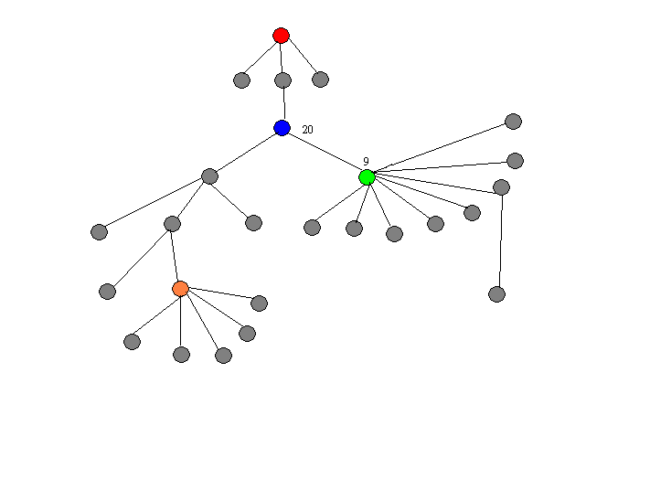
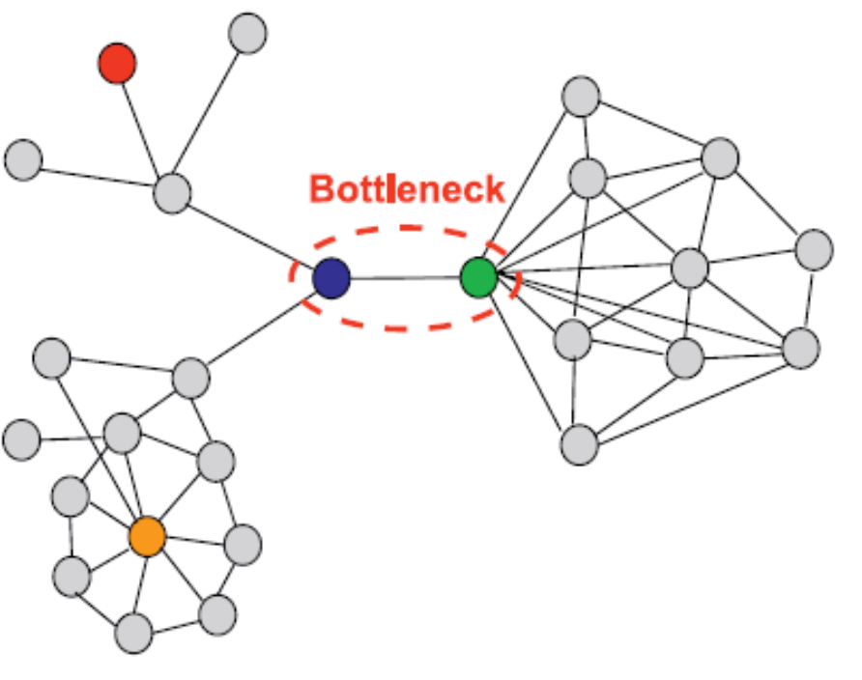
Example
n=26, n/4=6.5

Slide 11

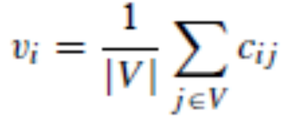
Edge percolated component (EPC)
For an interaction network G, assign a removing probability p to every edge. Let G₀ be a realization of the random edge removing from G. If nodes i and j are connected in G₀, set δ_{ij} be 1, otherwise set δ_{ij} be 0. The percolated connectivity of i and j, c_{ij}, is defined to be the average of δ_{ij} over realizations.
The size of percolated component containing node v, v_{i}, is defined to be the sum of c_{ij} over nodes j. The score of node v, EPC(v), is defined to be v_{i}.

Slide 12
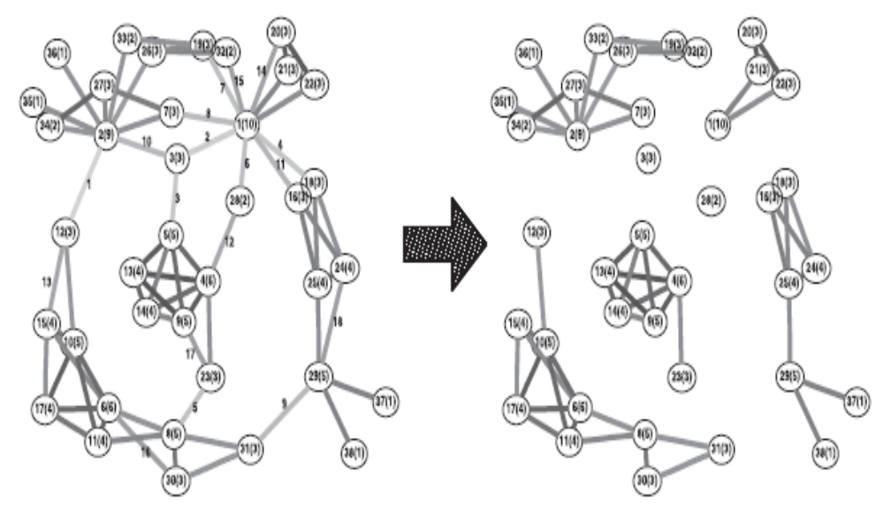
Example
p = 0.43

Slide 13
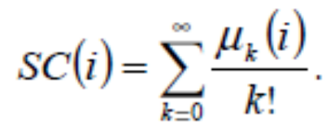
Subgraph centrality (SC)
For a node i, the number of close walks of i of length k is denoted as μ_{k}(i). The subgraph centrality of i, SC(i), is defined to be

Slide 14
MNC
The neighborhood of a node v, nodes adjacent to v, induce a subnetwork N(v). The score of node v, MNC(v), is defined to be the size of the maximum connected component of N(v). The neighborhood N(v) is the set of nodes adjacent to v and does not contain node v.

Slide 15
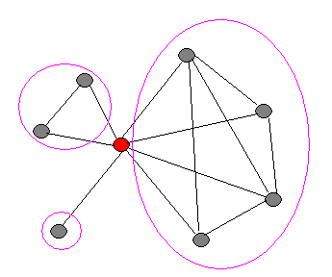
Example
MNC(v)=4

Slide 16
DMNC
for a node v, let N be the node number and E be the edge number of MNC(v), respectively. The score of node v, DMNC(v), is defined to be E/N^{ε} for some 1<ε< 2.

Slide 17
Example
DMNC(v)=5/4^{ε}

Slide 18
The double screening scheme (DSS)
For n, most possible essential proteins are expected in the output, the 2n top ranked proteins by method A are selected firstly. The selected 2n proteins are further ranked by method B and the n top ranked proteins are output. The number 2n is an empirical value for this double screening method.

Slide 19
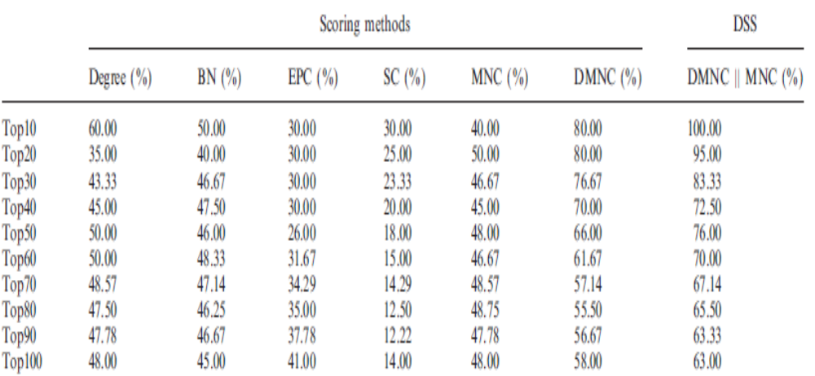
Experiment result
The percentage of top n ranked proteins, identified from the yeast protein interaction dataset (yeast20070107.lst) by six scoring methods and by the double screening scheme (DMNC || MNC, Hubba algorithm), to be yeast essential proteins. For example, 8 of the top 10 proteins found by DMNC has been identified as yeast essential proteins [%=(8/10)100%].

