Slide 1
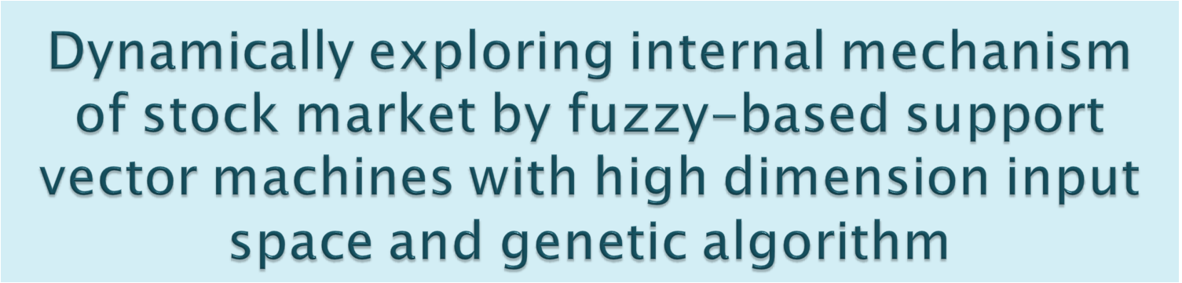
Deng-Yiv Chiu, Ping-Jie Chen
Expert Systems with Applications 36 (2009) 1240–1248
Presenter: Siao-ming Jhou
Date: Aug. 22, 2010

Slide 2

In the study, a new dynamic fuzzy model is proposed in combination with support vector machine (SVM) to explore stock market dynamism. The fuzzy model integrates various factors with influential degree as the input variables, and the genetic algorithm (GA) adjusts the influential degree of each input variable dynamically. SVM then serves to predict stock market dynamism in the next phase. In the meanwhile, the multiperiod experiment method is designed to simulate the volatility of stock market.

Slide 3

The input variables in the study include a total of 61 variables, including technical indicators in stock market, technical indicators in futures market, and the macroeconomic variables. To evaluate the performance of the new integrated model, we compare it with the traditional forecast methods and design different experiments to testify. In the experiment results, the model from the study does generate better accuracy rate than others.

Slide 4

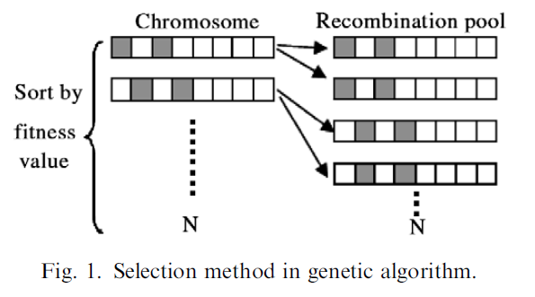
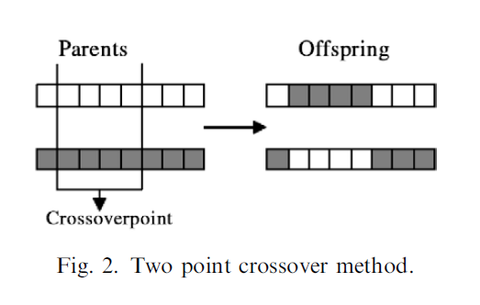
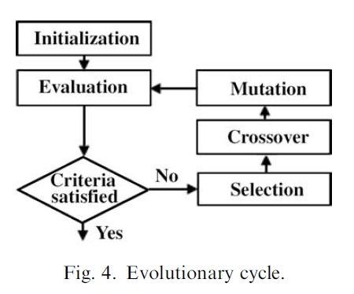
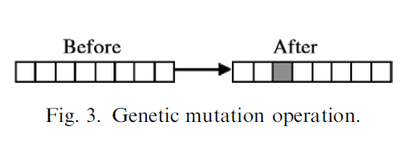
(1) Initialization
(2) Selection
(3) Crossover
(4) Mutation
(5) Evolutionary cycle

Slide 5


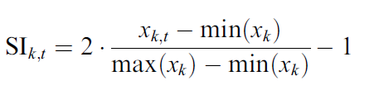
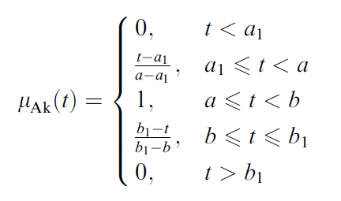
Each influential degree of input variable, ID, is determined by the adjusted scaled index, SI, and the confidence of the variable changing with time, μ_{Ak}(t) , where t is moment, k is an input factor.

Slide 6
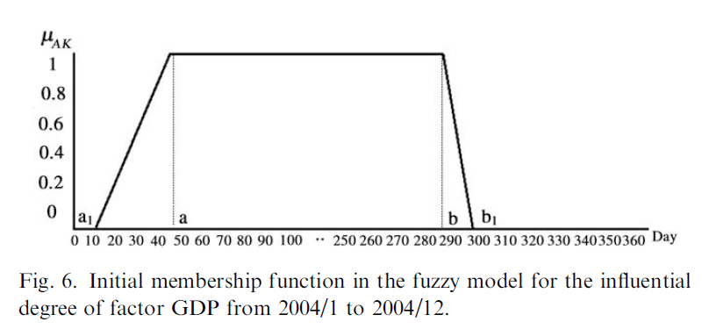

Slide 7


Taking time and accuracy rate into consideration, crossover in the experiment adopts two-point crossover with the probability of 0.8 and mutation rate of 0.02.
Within 100 generations with change rate below 0.02, the evolution stops.

Slide 8
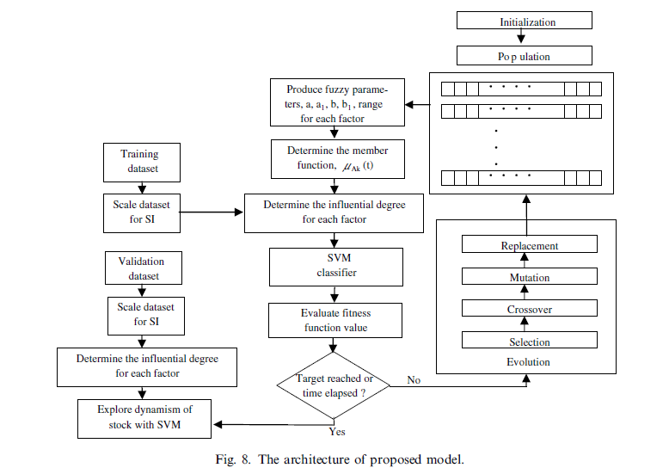

Slide 9

The input variables in the study include a total of 61 variables, including technical indicators in stock market, technical indicators in futures market and the macroeconomic variables in Taiwan.
The historical data are for two years from January, 2003 to December, 2004 for a total of 714 pieces of data. Among which, 378 pieces go up while the rest go down.

Slide 10

On balance volume (OBV)
Demand index (DI)
Momentum (MTM)
Relative strength index (RSI)
Moving average convergence and divergence (MACD)
Total amount per weighted stock price index (TAPI)
Psychological line (PSY)
Advance decline ratio (ADR)
Williams (WMS)
BIAS

Slide 11
Oscillator(OSC)
Moving average (MA)
K line (K)
D line (D)
Perform criteria (PC),
Autoregressive (AR)
Different (DIF)
Consistency ratio (CR)
Relative strength volume (RSV)
Exponential moving average (EMA)

Slide 12

Annual change in wholesale price index (WPC)
Annual change in export price index (EPC)
Annual change in industrial production index (IPC)
Annual change in employees on payrolls(EMPC)
Gross national production (GNP) (國民生產毛額)
Approved outward investment by industry (AOI)
Gross domestic product (GDP) (國內生產毛額)
Import by key trading partners (IKT)
Export by key trading partners (EKT)
Long term interest rate (LT)

Slide 13
Consumer price index (CPI)
Government consumption (GC)
MFGs’ New Orders (MNO)
Average monthly working hours (AMWH)
Average monthly wages and salaries(AMWS)
Bank clearings (BC)
Manufacturing sales (MS)
Quantum of domestic traffic (QDT)
Monetary aggregate (M1B)
Term architecture of interest rate (TS)
Short term interest rate (ST)

Slide 14

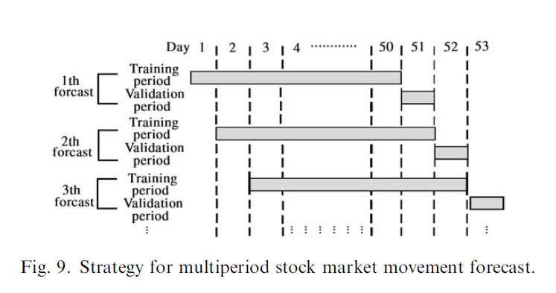
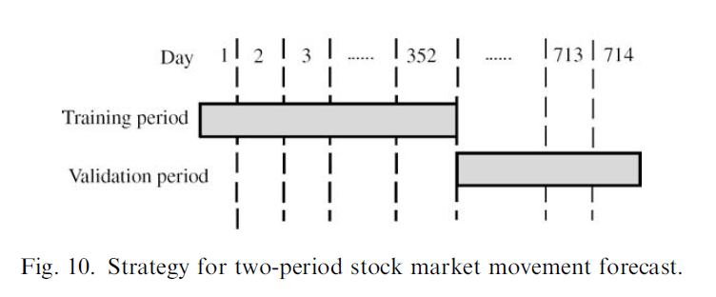
multiperiod:
two-period:

Slide 15

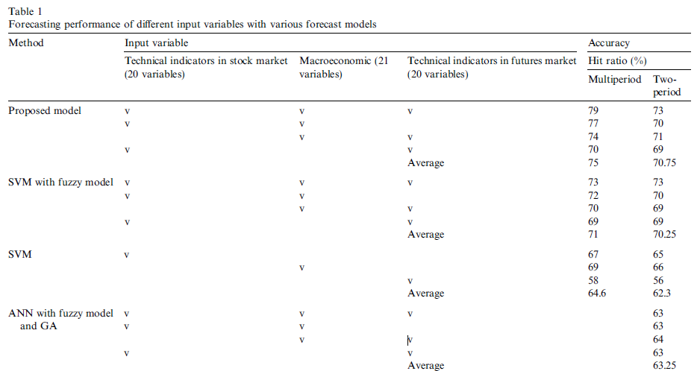

Slide 16

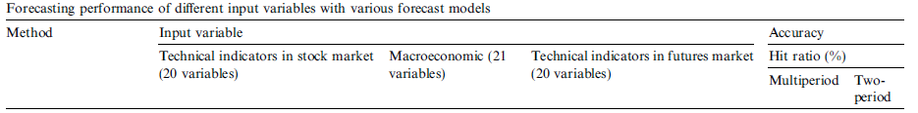
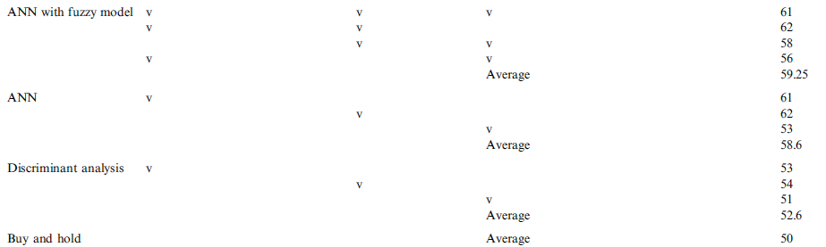

Slide 17


