Slide 1
Compressed Indexes for Approximate String Matching
Algorithmica, Vol. 58, No. 2, pp. 263-281, 2010
Ho-Leung Chan(陳昊樑), Tak-Wah Lam(林德華), Wing-Kin Sung(宋永健), Siu-Lung Tam, Swee-Seong Wong
Presentor： Chiou-Ting Tseng
Date：Aug. 30, 2010

Slide 2
Abstract
Abstract. We revisit the problem of indexing a string S[1..n] to support searching all substrings in S that match a given pattern P[1..m] with at most k errors. Previous solutions either require an index of size exponential in k or need Ω(m^{k}) time for searching. Motivated by the indexing of DNA sequences, we investigate space efficient indexes that occupy only O(n) space. For k = 1, we give an index to support matching in O(m+occ+log n log log n) time. The previously best solution achieving this time complexity requires an index of size O(n log n). This new index can be used to improve existing indexes for k ≥ 2 errors. Among others, it can support matching with k = 2 errors in O(mlog n log log n + occ) time.

Slide 3
Suffixes
Suffixes for S=“ATCACATCATCA”
ATCACATCATCA | S₍₁₎
TCACATCATCA | S₍₂₎
CACATCATCA | S₍₃₎
ACATCATCA | S₍₄₎
CATCATCA | S₍₅₎
ATCATCA | S₍₆₎
TCATCA | S₍₇₎
CATCA | S₍₈₎
ATCA | S₍₉₎
TCA | S₍₁₀₎
CA | S₍₁₁₎
A | S₍₁₂₎

Slide 4
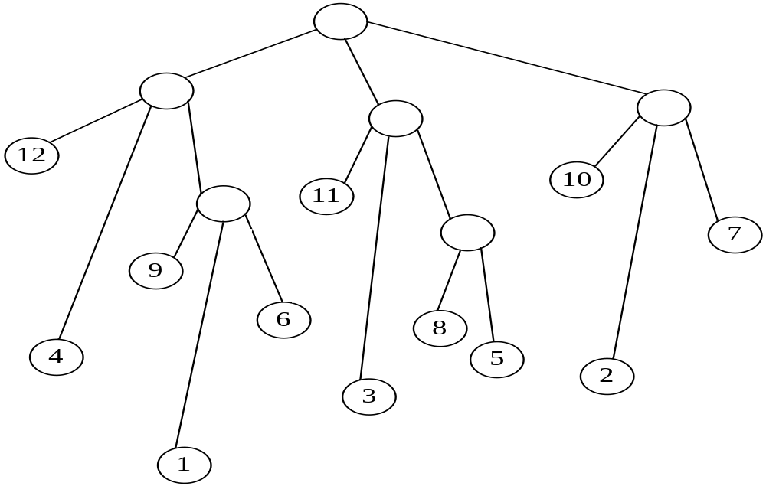
Suffix Trees
A suffix Tree for S=“ATCACATCATCA”
Suffix array
12 | 4 | 9 | 1 | 6 | 11 | 3 | 8 | 5 | 10 | 2 | 7
Inverse suffix array
4 | 11 | 7 | 2 | 9 | 5 | 12 | 8 | 3 | 10 | 6 | 1

Slide 5
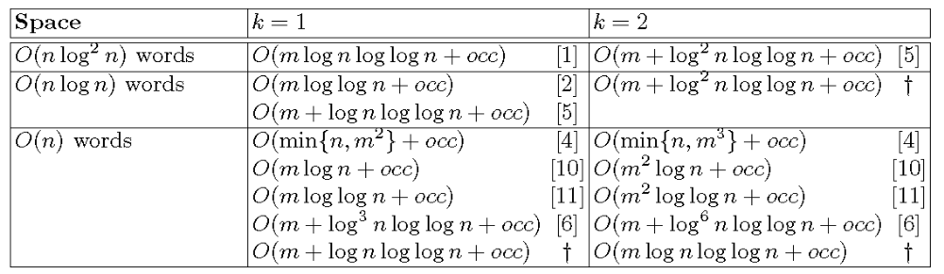
Recent Result

Slide 6
Exact String Matching
Suffix trees use O(n)-word space and achieve the optimal matching time, i.e. O(m+occ), where occ is the number occurrences of P in S.
Suffix arrays also using O(n)-word space but with a smaller constant, give an O(m+occ+log n) matching time
CSA and FM-index require only O(n)-bit space and support matching in O(m + occlog^{ε} n) time, for any constant ε> 0.

Slide 7
One Error Matching
The simplest solution is to search the suffix tree of S for every 1-error modification of the query pattern, this requires O(m² + occ) time.

Slide 8
K Error Matching
Cole et al. devised a recursive solution to build an index that occupies O(n log^{k} n) space and supports k-error matching in O(m + log^{k} n log log n + occ) time for Hamming distance. The term occ is replaced with occ · 3^{k} for edit distance.
This paper reduced the space to O(n log^{k-1} n) with the same time complexity.

Slide 9
Assumption
In this paper, we assume the alphabet size |Σ| is a constant and hence does not affect the asymptotic analysis.
If |Σ| is huge or unbounded, we remark that our data structures takes O(n) space (i.e., does not involve |Σ|); the 1-error matching time is O(m + |Σ| log n log log n + occ), the 2-error matching time is O(|Σ|²mlog n log log n + occ), and the k-error matching time, k > 2, is O(|Σ|^{k}m^{k−1} log n log log n + occ).

Slide 10
Centroid Path Decomposition
For every internal node u, let v be the child of u with the most number of leaves (ties broken arbitrarily).
The edge uv is called a core edge.
Edges other than core edges are called side edges.
A centroid path C is a maximal path connecting consecutive core edges.

Slide 11
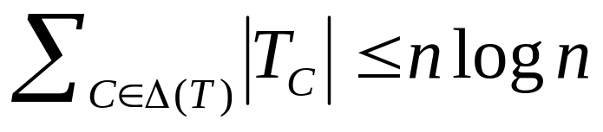
Facts
For any leaf x in T, the path from root of T to x has at most log n side edges, and x belongs to at most log n centroid paths.
For any two centroid paths C₁ and C₂ of the same level, T_{C1} and T_{C2} are disjoint, i.e., they do not have common leaves.

Slide 12
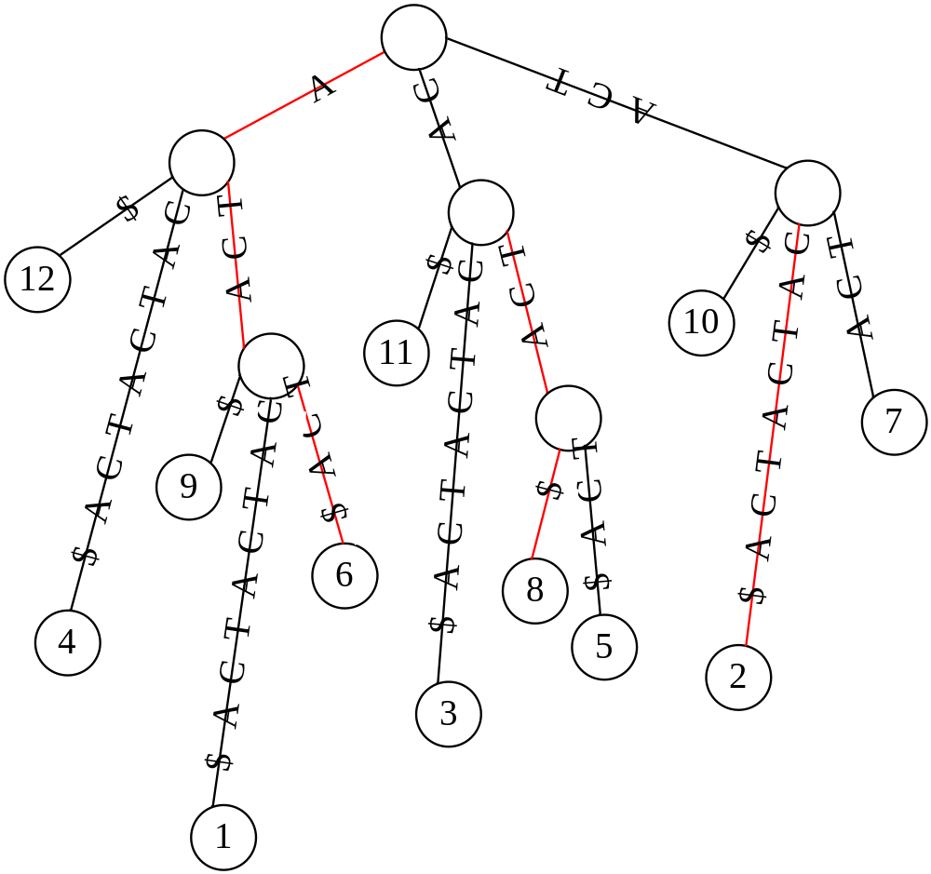
Centroid Path Decomposition

Slide 13
Side-tree Rank of a Leaf
Consider a centroid path C. The leaves in T_{C} are partitioned among the side trees, and our compressed index needs the association between the leaves and the side trees. To save space, we rank the side trees hanging from C in descending order of their size (i.e., the number of leaves), and we store, for each leaf x, the rank of the side tree containing x, which is denoted st-rank_{C}(x).

Slide 14
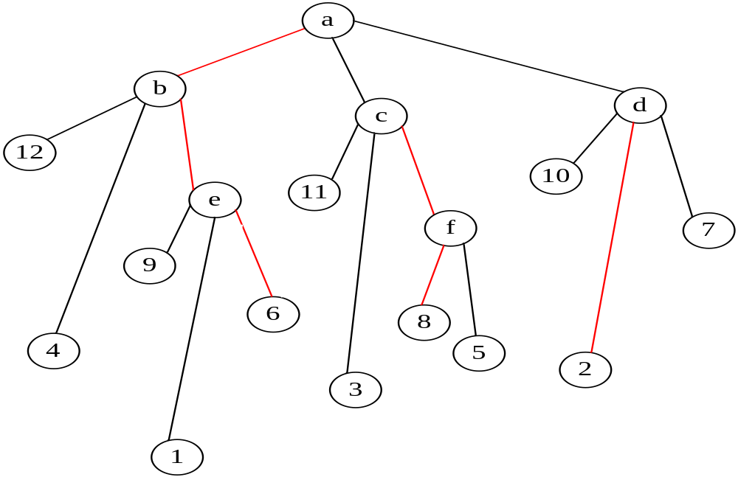
Side-tree Rank of a Leaf
Node | 12 | 4 | 9 | 1 | 11 | 3 | 8 | 5 | 10 | 2 | 7
Rank | 6 | 4 | 3 | 5 | 1 | 1 | 1 | 1 | 2 | 2 | 2

Slide 15
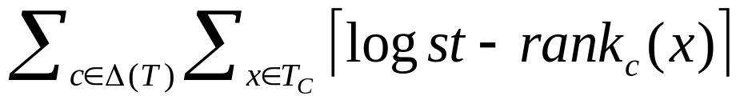
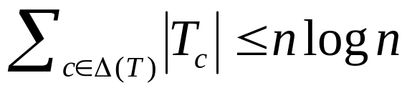
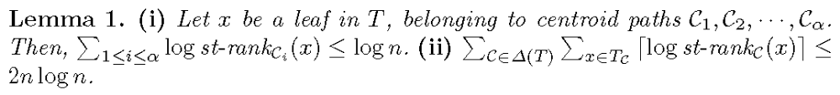
Side-tree Rank of a Leaf
To store such side-tree ranks for all controid paths, we need
bits, which is naively at most n log² n bits (because
and st-rank_{C}(x)≤n).

Slide 16
The y-fast trie
Let A[1..l] be a sorted integers in [1, n], we can build a y-fast trie for A using O(l log n) bits to support the predecessor query in O(log log n) time.

Slide 17
The LCP data structure
Given a pattern P[1..m], an integer i ≤ m and a location u in T’, the query LCP(P, i, u) asks for the location at which the suffix P[i..m] diverges from T’, when P[i..m] is aligned to T’ starting from u.
Let T’ be a compact trie comprising l suffixes of S[1..n]. We can build an O(l log n)-bit LCP data structure for T’. Given any pattern P[1..m], we can preprocess P in O(m) time. Each subsequent LCP query can be answered in O(log log n) time.

Slide 18
The LCP data structure
LCP(“ATCATA”, c, 2)=TCAT

Slide 19
Modified Suffix
Let s be a suffix in T passing through the root of C, and diverging from C at a node u on C. We create a modified suffix s’ by modifying s at the first character after u, replacing it with the first character on the core edge out of u. We say that s generates s’ according to C. We assume the suffix corresponding to C itself is also a modified suffix generated according to C.

Slide 20
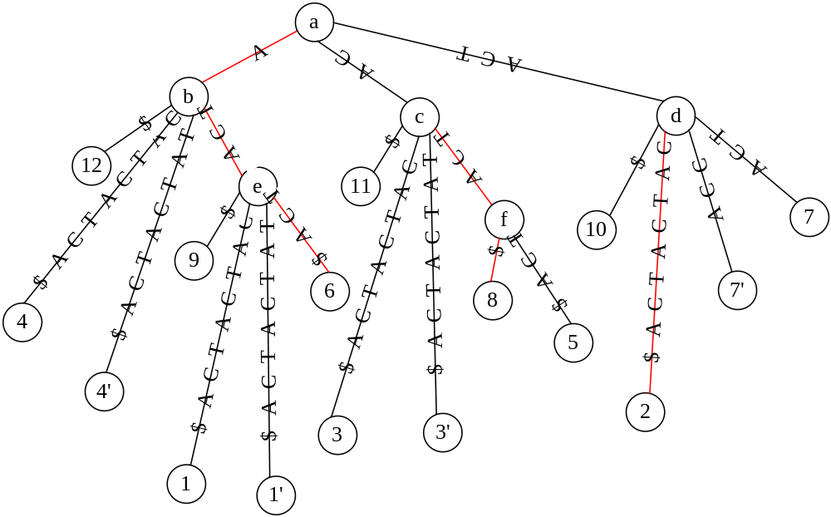
Modified Siffix
AA開頭和ACA開頭沒畫

Slide 21
Prefix matching query for modified suffixes
Let T be the suffix tree of S and P be a pattern. For any centroid path C of T, let φ_{C} be the set of modified suffixes generated according to C with P as a prefix. The prefix matching query, denoted prefix(C), reports the set Φ_{C} of suffixes in T that generate the modified suffixes in φ_{C}.

Slide 22
Prefix matching query for modified suffixes
Let T be the suffix tree of S[1..n]. We can build an O(n log n)-bit index for T. For any pattern P[1..m], we can preprocess P in O(m) time; then prefix(C), for any centroid path C in T, can be answered in O(log log n+|Φ_{C}|+e_{C}) time, where e_{C} is non-negative and the sum of e_{C} over all centroid paths in T is at most 2 log n.

Slide 23
Conclusion
By using the framework of Cole et al., we can exploit our indexes for the prefix matching queries and LCP queries to obtain an O(n log n)-bit index for the 1- error matching problem.
Theorem 1. We can build an O(n log n)-bit index for S[1..n] that finds the 1-error matches of any P[1..m] in O(m + occ + log n log log n) time, where occ is the number of matches found.

Slide 24
Prefix matching query
--O(n log² n)-bits
For each centroid path C, we simply store two arrays of integers. Let s’₁, s’ ₂, . . . , s’_{l} be the modified suffixes generated according to C, in increasing lexicographical order. We store (1) lex-order_{C}, where lex-order_{C}[i] is the lexicographical order of s’_{i} among all modified suffixes in U. (2) label_{C}, where label_{C}[i] = j if s’_{i} is generated by the suffix S[j..n].

Slide 25
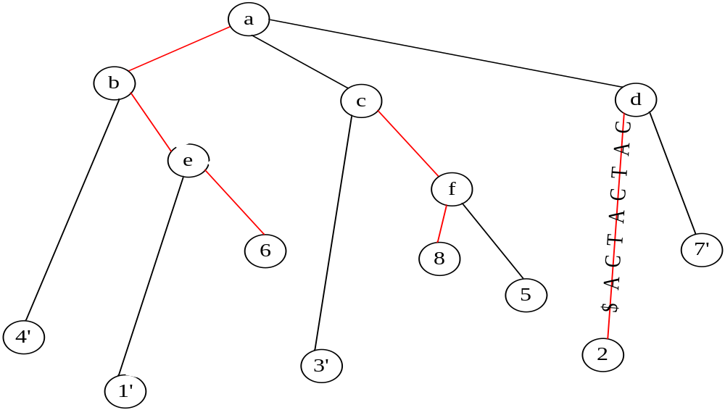
Prefix matching query
--O(n log² n)-bits
S=“ATCACATCATCA”, P=“AT”
Merge?
Node | 4’ | 1’ | 6
lex-order | 1 | 2 | 3
Node | 4’ | 1’ | 6
label | 5 | 5 | 6

Slide 26
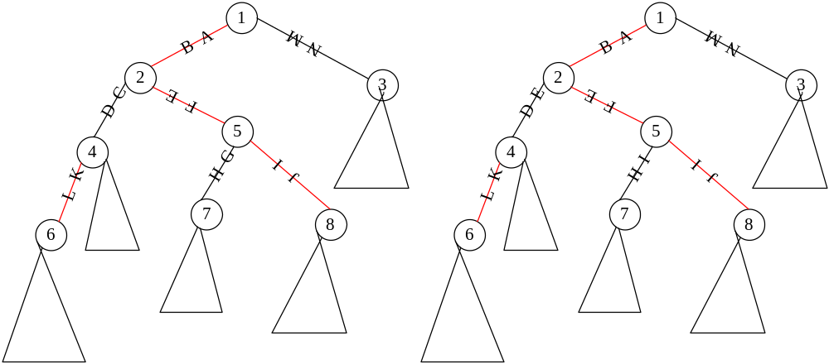
Prefix matching query
--O(n log² n)-bits
Node | 2 | 7 | 8
lex-order | 1-8 | 9-13 | 14-21

Slide 27
Prefix matching query
--O(n log² n)-bits
We store a compact trie M for the set of all the O(n log n) modified suffixes generated according to all the centroid paths.
Given any pattern P, we preprocess P by aligning P with M starting from the root. It determines the range [d, e] such that all modified suffixes with lexicographical order in [d, e] (w.r.t. U) have P as a prefix.
Given any centroid path C of T, the prefix matching query is done by a range search query on lex-order_{C}. For each i such that d≤lex-order_{C}[i]≤e, we report label_{C}[i]. The range search on lex-order_{C} takes O(log log n) time by storing a y-fast trie on lex-order_{C}. Thus, finding the C takes O(log log n + |C|) time. The total space requirement is O(n log² n) bits.

Slide 28
Prefix matching query
--O(n log n)-bits
Sampling
Constant time verification
Concise representation

Slide 29
Sampling
Instead of M, we store a compact trie containing only one in every log n leaves of M.
With this approximation, answering the prefix matching query on a centroid path C requires extra verification on the suffixes before reporting it as C.
Let e_{C} be the number of suffixes that require verification. We show that the sum of e_{C} is at most 2 log n over all centroid paths.

Slide 30
Constant time verification
Given the pattern P, a centroid path C and a suffix s = S[j..n], we need to verify whether s generates a modified suffix s’ according to C with P as a prefix.

Slide 31
Concise representation
The lex-order_{C} and label_{C} arrays take totally O(n log² n) bits if stored directly.
We replace their entries with integers of smaller values, by exploiting the properties of the centroid path decomposition.
Then, we use variable size encoding to represent the arrays in O(n log n) bits.

Slide 32
Preprocess P
Given a pattern P, we show how to preprocess P in O(m) time such that for any centroid path C, the prefix matching query prefix(C) can be answered in O(log log n + |C| + e_{C}) time, and the sum of e_{C} over all centroid paths C is at most 2 log n.

Slide 33
Error-bounded candidate generation
We align P with N starting from the root in O(m) time to find the range [d, e] corresponding to leaves in N with P as a prefix. Then, for any centroid path C, we can find C as follows.
Find the maximal range [p..q] such that d−1≤ lex-order_{C}[p] ≤ lex-order_{C}[q] ≤ e + 1 by a range search query on the lex-order_{C} array.
For each i in [p..q], let j = label_{C}[i]. If lex-order_{C}[i] is not d − 1 or e + 1, report S[j..n] in Φ_{C}; otherwise, call S[j..n] a candidate and verify whether S[j..n] is in Φ_{C}.

Slide 34
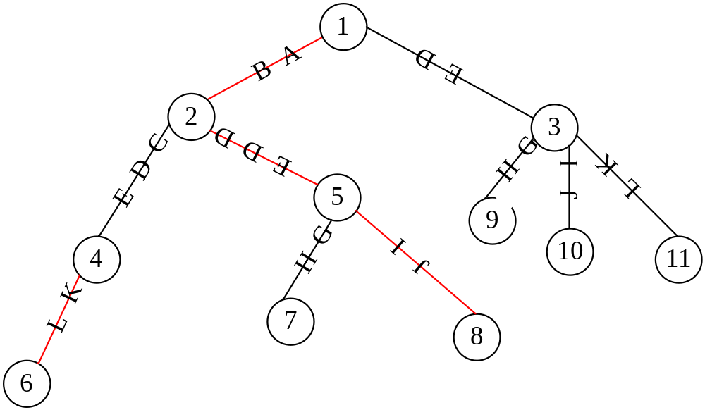
Error-bounded candidate generation
P=“ABDDE”
v

Slide 35
Constant Time Verification
We can preprocess P in O(m) time. Then, for any centroid path C and candidate S[j..n], we can verify in O(1) time whether S[j..n] is in C, i.e., S[j..n] generates a modified suffix according to C with P as a prefix.

Slide 36
Constant Time Verification -- Preprocess
For each suffix P[r..m], we store the range [d_{r}, e_{r}] such that all leaves with lexicographical order (w.r.t. T) in [d_{r}, e_{r}] have P[r..m] as a prefix.

Slide 37
Constant Time Verification -- Verify
To verify a suffix S[j..n], let v be the node in T that S[j..n] diverges from the path of P. v can be found in constant time using an O(n log n)-bit LCA data structure for T.
Let P[1..r] be the path label from the root to v. S[j..n] is in C if (1) v is on C, (2) the first character on the core edge out of v is P[r+1], and (3) S[j+r+1..n] has a prefix matching P[r+2..m]. The last condition can be checked in constant time by comparing SA⁻¹[j + r + 1] with the range [d_{r+2}, e_{r+2}] obtained during the preprocessing.

Slide 38
Compressed representation of the lexicographical information
Compressing the lex-order arrays
Compressing the label arrays

Slide 39
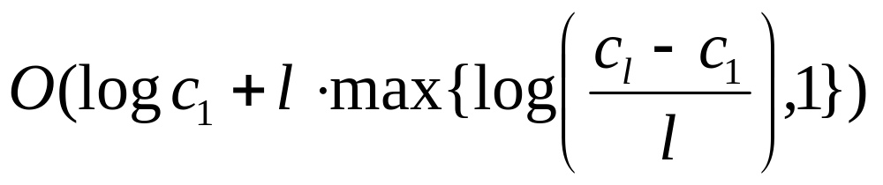
Compressing the lex-order arrays
Let c₁≤c₂ ≤. . . ≤ c_{l} be a sequence of positive integers. We can store the sequence in
bits and support O(1) retrieval time for each c_{i}.

Slide 40
Compressing the lex-order arrays
We can store the lex-order arrays of all centroid paths in O(n log n)-bit space and support O(1) retrieval time to each entry.

Slide 41
Compressing the label arrays
Unlike lex-order, the label array is not an increasing sequence.
We store the following information.
st-rank_{C}[1..l]: Suppose s’_{i} is generated by the suffix s in T. Then st-rank_{C}[i] stores the side-tree-rank of s, i.e., the rank of the side tree containing s.

Slide 42
Compressing the label arrays
tree pointer_{C}[1..t]: tree pointer_{C}[j] points to the j-th largest side tree of C in T, ties are broken arbitrarily.
modified_rank_{C,v}[1..|T_{v}|], for each side-tree T_{v} of C in T: modified_rank_{C,v}[j] = i if the j-th suffix in T_{v} generates s’_{i}.

Slide 43
Compressing the label arrays
S₂’
S₁’
S₃’
st-rank | 1 | 5 | 3
tree-pointer | c | d | 1 | 9 | 4 | 12
modified_rank_{C,1} |  |  | 1

Slide 44
Compressing the label arrays
To find label_{C}[i], note that tree pointer_{C}[st-rank_{C}[i]] returns the side tree T_{v} hanging from C which contains the suffix that generates s’_{i}. We perform a rank(i) query on unmodifed_rank_{C,v}, where rank(i) returns j if modified rank_{C,v}[j] = i. Thus, label_{C}[i] is the j-th suffix in T_{v}. Let w_{v} be the number suffixes on the left of v in T. Then label_{C}[i] = SA[w_{v} + j].

Slide 45
By Lemma 1, the st-rank_{C} arrays for all centroid paths C can be represented in O(n log n) bits using variable size encoding. We can build a select data structure on the arrays, which uses O(n log n) bit, to support O(1) time access to each entry. The tree pointer arrays contain only n pointers in total and take O(n log n) bits over all centroid paths.

Slide 46
Extend to Edit Distance
We create an insertion suffix s’ by inserting a character c to s after u, where c is the first character on the core edge out of u. We find all 1-error matches for insertion in the O(m + occ’ + log n log log n) time.
Handling deletion is identical
The total space for the data structures is O(n log n) bits.

Slide 47
An O(n log n)-bit index for 2-error
Omitted

