Slide 1
Function Matching: Algorithms, Applications and a Lower Bound
A. Amir, Y. Aumann, R. Cole,
M. Lewenstein and E. Porat
In Proceedings of the 30th International Colloquium on Automata, Languages and Programming (ICALP),
pp. 929-942, 2003
Date: Nov. 21, 2007
Introducer: Hsing-Yen Ann
From: Moshe Lewenstein

Slide 2
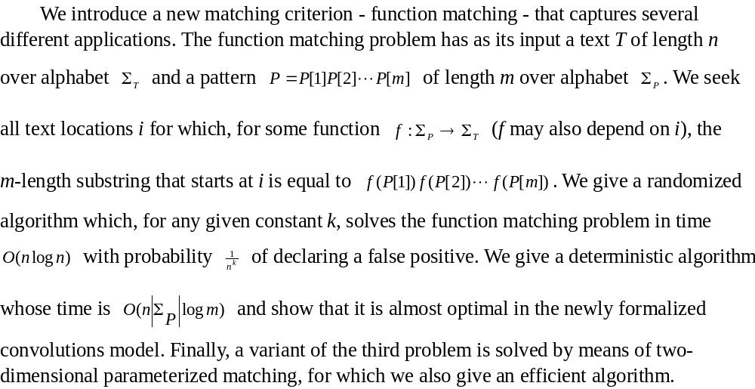
Abstract

Slide 3
Parameterized Matching
Prog.c
int a,b;
a=1;
a = g(a)*5+f(a);
b=2;
a = func(a,b);
a = a*g(b);
b=1;
b = g(b)*5+f(b);
….
c=1;
c = g(c)*5+f(c);
Pattern

Slide 4





2-D Parameterized Matching
pattern

Slide 5
Problem Definition – Function Matching (1/5)
Input:
  A text T = t₁ t₂ … t_{n} , over alphabet Σ_{T}
  A pattern P = p₁ p₂ … p_{m}, over alphabet Σ_{P}
Output:
  Locations i of T, where function f :Σ_{P} →Σ_{T} exists s.t.
  f(P) = f(p₁) f(p₂) … f(p_{m}) = t_{i} t_{i+1} … t_{i+m-1}
P = h e h a e h
T = a b c b a c b a d a b d a d d a d

Slide 6
Problem Definition – Function Matching (2/5)
Input:
  A text T = t₁ t₂ … t_{n} , over alphabet Σ_{T}
  A pattern P = p₁ p₂ … p_{m}, over alphabet Σ_{P}
Output:
  Locations i of T, where function f :Σ_{P} →Σ_{T} exists s.t.
  f(P) = f(p₁) f(p₂) … f(p_{m}) = t_{i} t_{i+1} … t_{i+m-1}
f(h) = b
f(e) = c
f(a) = a
P = h e h a e h
T = a b c b a c b a d a b d a d d a d

Slide 7
Problem Definition – Function Matching (3/5)
Input:
  A text T = t₁ t₂ … t_{n} , over alphabet Σ_{T}
  A pattern P = p₁ p₂ … p_{m}, over alphabet Σ_{P}
Output:
  Locations i of T, where function f :Σ_{P} →Σ_{T} exists s.t.
  f(P) = f(p₁) f(p₂) … f(p_{m}) = t_{i} t_{i+1} … t_{i+m-1}
f(h) = a
f(e) = d
f(a) = b
P = h e h a e h
T = a b c b a c b a d a b d a d d a d

Slide 8
Problem Definition – Function Matching (4/5)
Input:
  A text T = t₁ t₂ … t_{n} , over alphabet Σ_{T}
  A pattern P = p₁ p₂ … p_{m}, over alphabet Σ_{P}
Output:
  Locations i of T, where function f :Σ_{P} →Σ_{T} exists s.t.
  f(P) = f(p₁) f(p₂) … f(p_{m}) = t_{i} t_{i+1} … t_{i+m-1}
f(h) = d
f(e) = a
f(a) = d
P = h e h a e h
T = a b c b a c b a d a b d a d d a d

Slide 9
Problem Definition – Function Matching (5/5)
Input:
  A text T = t₁ t₂ … t_{n} , over alphabet Σ_{T}
  A pattern P = p₁ p₂ … p_{m}, over alphabet Σ_{P}
Output:
  Locations i of T, where function f :Σ_{P} →Σ_{T} exists s.t.
  f(P) = f(p₁) f(p₂) … f(p_{m}) = t_{i} t_{i+1} … t_{i+m-1}
no match !
f(h) = ??
P = h e h a e h
T = a b c b a c b a d a b d a d d a d

Slide 10
Function Matching vs.
Parameterized Matching
P p-matches t_{i} t_{i+1} … t_{i+m-1} iff
1. P f-matches t_{i} t_{i+1} … t_{i+m-1} and
2. # of symbols in t_{i} t_{i+1} … t_{i+m-1} = # of symbols in P
(the function f is a bijection)
f(h) = b
f(e) = c
f(a) = a
f(h) = d
f(e) = a
f(a) = d
P = h e h a e h h e h a e h
T = a b c b a c b a d a b d a d d a d

Slide 11
Function Matching with Don’t Cares
Input:
  A text T = t₁ t₂ … t_{n} , over alphabet Σ_{T} ∪ {?}
  A pattern P = p₁ p₂ … p_{m}, over alphabet Σ_{P}
Output:
  Locations i of T, where function f :Σ_{P} →Σ_{T} exists s.t.
  f(P) = f(p₁) f(p₂) … f(p_{m}) = t_{i} t_{i+1} … t_{i+m-1}
  f(?) - wildcard
P = h e ? ? e h
T = a b c b a c b c d b c d a d d a d

Slide 12
Polynomial Multiplication - Convolutions (1/3)
t₁ t₂ t₃ t₄ . . . t_{n-2} t_{n-1} t_{n}
p_{m} p_{m-1} . . . p₂ p₁
p₁t₁ p₁t₂ . . . p₁t_{n-2} p₁t_{n-1} p₁t_{n}
p₂t₁ p₂t₂ p₂t₃ . . . p₂t_{n-2} p₂t_{n-1} p₂t_{n}
p₃t₁ p₃t₂ p₃t₃ p₃t₃ . . . p₃t_{n-1} p₃t_{n}
. . .
..
. . .
p_{m}t₁ . . . p_{m}t_{m} p_{m}t_{m+1} . . p_{m}t_{n-1} p_{m}t_{n}
. . .
. . .
Running time: O(n log m)

Slide 13
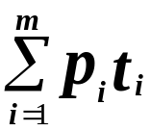
Polynomial Multiplication - Convolutions (2/3)
p₁ p₂ p₃ p₄ . . . p_{m}
t₁ t₂ t₃ t₄ . . . t_{n-2} t_{n-1} t_{n}
p_{m} p_{m-1} . . . p₂ p₁
p₁t₁ p₁t₂ . . . p₁t_{n-2} p₁t_{n-1} p₁t_{n}
p₂t₁ p₂t₂ p₂t₃ . . . p₂t_{n-2} p₂t_{n-1} p₂t_{n}
p₃t₁ p₃t₂ p₃t₃ p₃t₄ . . . p₃t_{n-1} p₃t_{n}
. . .
..
. . .
p_{m}t₁ . . . p_{m}t_{m} p_{m}t_{m+1} . . p_{m}t_{n-1} p_{m}t_{n}
. . .
. . .

Slide 14
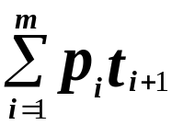
Polynomial Multiplication - Convolutions (3/3)
p₁ p₂ p₃ p₄ . . . p_{m}
t₁ t₂ t₃ t₄ . . . t_{n-2} t_{n-1} t_{n}
p_{m} p_{m-1} . . . p₂ p₁
p₁t₁ p₁t₂ . . . p₁t_{n-2} p₁t_{n-1} p₁t_{n}
p₂t₁ p₂t₂ p₂t₃ . . . p₂t_{n-2} p₂t_{n-1} p₂t_{n}
p₃t₁ p₃t₂ p₃t₃ p₃t₄ . . . p₃t_{n-1} p₃t_{n}
. . .
..
. . .
p_{m}t₁ . . . p_{m}t_{m} p_{m}t_{m+1} . . p_{m}t_{n-1} p_{m}t_{n}
. . .
. . .

Slide 15
T = a b c b a c b a c a b d a d d a d e a
P = h e h a e h ? e P^{R} = e ? h e a h e h
h in P vs.
a in T
T_{a} = 1 0 0 0 1 0 0 1 0 1 0 0 1 0 0 1 0 0 1
P^{R}_{h} = 0 0 1 0 0 1 0 1
Choose a symbol in P and a symbol in T.
Using convolution to check all occurrences of the symbol in P are mapping to the same symbol in T.

Slide 16
h e h a e h ? e
T = a b c b a c b a c a b d a d d a d e a
P = h e h a e h ? e P^{R} = e ? h e a h e h
h - a
T_{a} = 1 0 0 0 1 0 0 1 0 1 0 0 1 0 0 1 0 0 1
P^{R}_{h} = 0 0 1 0 0 1 0 1
1 0 0 0 1 0 0 1 0 1 0 0 1 0 0 1 0 0 1
0 0 0 0 0 0 0 0 0 0 0 0 0 0 0 0 0 0 0
1 0 0 0 1 0 0 1 0 1 0 0 1 0 0 1 0 0 1
0 0 0 0 0 0 0 0 0 0 0 0 0 0 0 0 0 0 0
0 0 0 0 0 0 0 0 0 0 0 0 0 0 0 0 0 0 0
1 0 0 0 1 0 0 1 0 1 0 0 1 0 0 1 0 0 1
0 0 0 0 0 0 0 0 0 0 0 0 0 0 0 0 0 0 0
0 0 0 0 0 0 0 0 0 0 0 0 0 0 0 0 0 0 0
0 0 1 0 0 1 1 1 0 2 0 2 1 0 3 0 1 2 0 1 2 0 1 1 0 1

Slide 17
T = a b c b a c b a c a b d a d d a d e a
P = h e h a e h ? e P^{R} = e ? h e a h e h
h - a
1 0 2 0 2 1 0 3 0 1 2 0
h - b
0 3 0 1 1 1 1 0 1 0 1 0
h - c
2 0 1 2 0 1 1 0 1 0 0 0
h - d
0 0 0 0 0 0 1 0 1 2 0 3
Match(h)
0 1 0 0 0 0 0 1 0 0 0 1
There are |Σ_{P}| |Σ_{T}| pairs
➔ in O(|Σ_{P}| |Σ_{T}| n log m) time!!

Slide 18

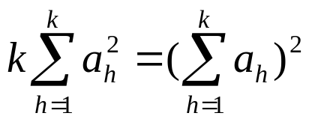
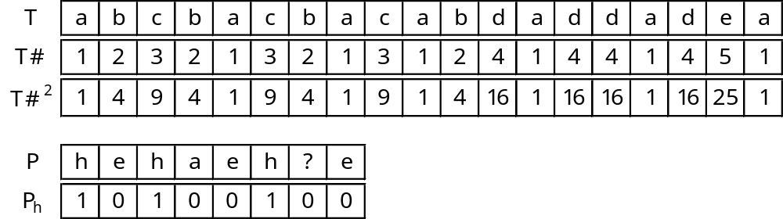
Improvement (1/3)
Lemma: Let , then
iff for all i,j, a_{i} = a_{j}

Slide 19
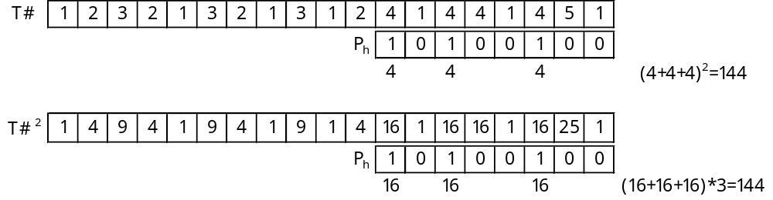
Improvement (2/3)
Lemma: Let , then
iff for all i,j, a_{i} = a_{j}

Slide 20
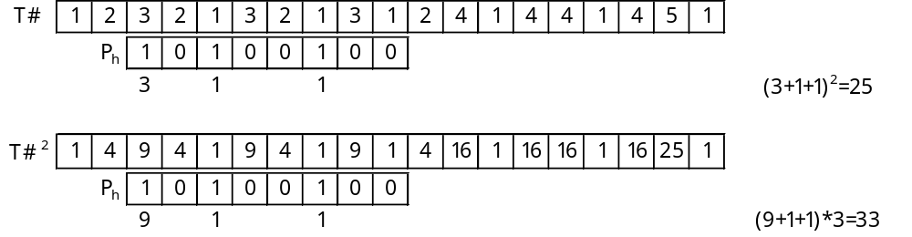
Improvement (3/3)
Lemma: Let , then
iff for all i,j, a_{i} = a_{j}
no match !
In O(|Σ_{P}| n log m) time!!

Slide 21
For Large Alphabets?
O(|Σ_{P}| n log m) time is not good enough for big alphabets !!
Can be solved by an O(n log²m) randomized convolutions based algorithm.

Slide 22

Paired Function Matching
Def: A pattern is paired string if every character
appears at most twice in the pattern.
Lemma: Let P be a pattern and T a text.
paired string patterns P₁ and P₂ s.t. at loc. i of T
P f-matches iff P₁ and P₂ f-match.
Example:
P = a b c b c c b b
P₁ = a₁ b₁ c₁ b₁ c₁ c₂ b₂ b₂ (even pairs)
P₂ = a₁ b₁ c₁ b₂ c₂ c₂ b₂ b₃ (odd pairs)

Slide 23
New Randomized Algorithm (1/3)
For each symbol δ in T, replaced by an integer v_{δ} randomly chosen from [0, 2n^{k+1}], then forms T’.
For each symbol δ in P₁ and P₂, choose a random integer u_{δ} from [0, 2n^{k+1}], then forms P₁’ and P₂’.
  If δ occurs once, replaced by 0.
  The first occurrence of δ is replaced by u_{δ}.
  The second occurrence of δ is replaced by -u_{δ}.
If there is a function matching of P with T, both the convolution of P₁’ with T’ and P₁’ with T’ will be 0.

Slide 24
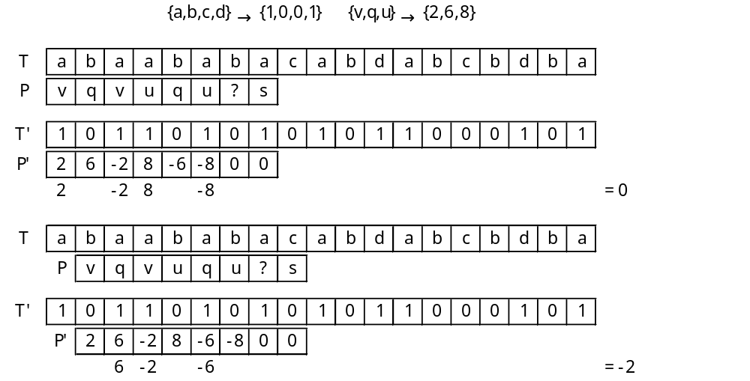
New Randomized Algorithm (2/3)

Slide 25
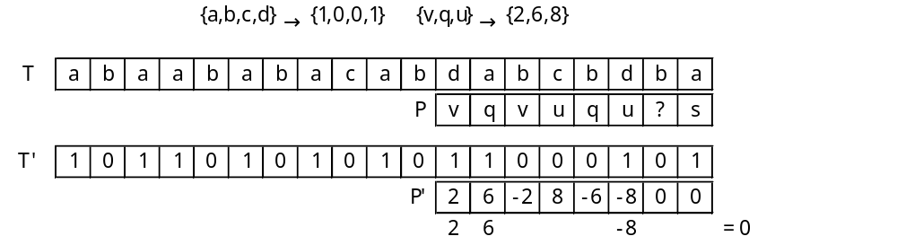
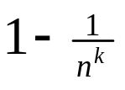
New Randomized Algorithm (3/3)
false positive !
Theorem 3
There is a randomized algorithm for function matching that, given a constant k, runs in time O(kn log m); it reports all function matches and, with probability at least
reports no mismatches as matches.

Slide 26
Summary of Part I
There is an O(|Σ_{P}| n log m) time deterministic algorithm for 1-D function matching.
There is a randomized algorithm for 1-D function matching that, given a constant k, runs in time
O(kn log m).

Slide 27
2-D Parameterized Matching
pattern

Slide 28
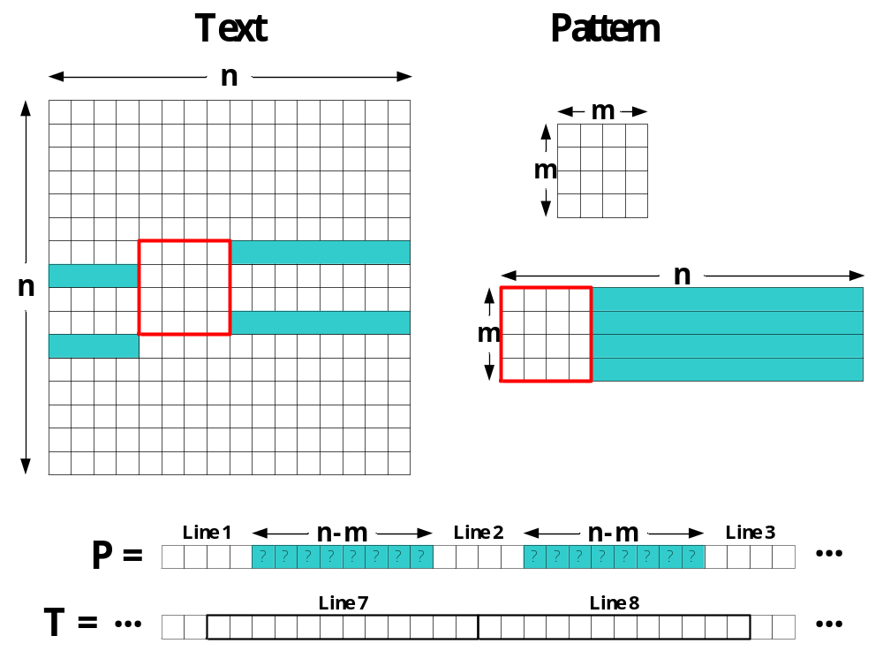
Linearized Text and Pattern

Slide 29
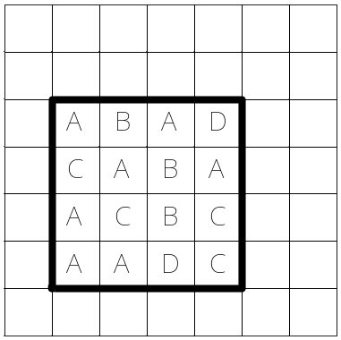
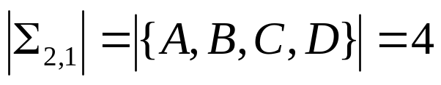
Randomized Algorithm for 2-D Function / Parameterized Matching
Randomized algorithm for function matching:
  1-D: given a constant k, runs in time O(kn log m)
  2-D: runs in time O(kn² log(nm) ) = O(kn² log n)
For parameterized matching:
  Check 2-D function matching.
  For each m × m sub-array of the text, determine the number of distinct characters. O(kn² log n) time.

Slide 30
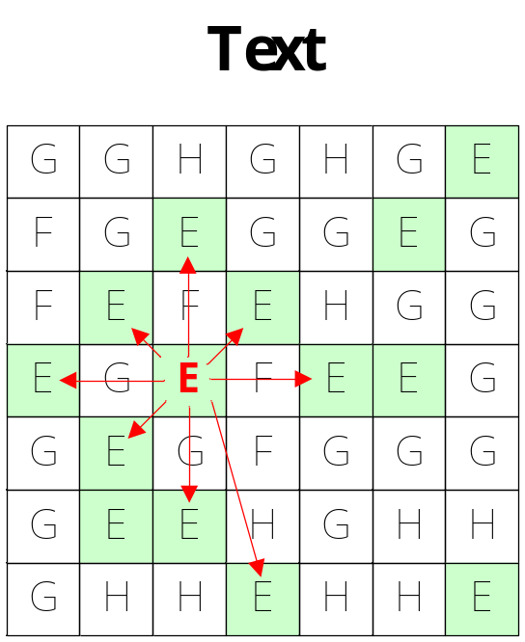
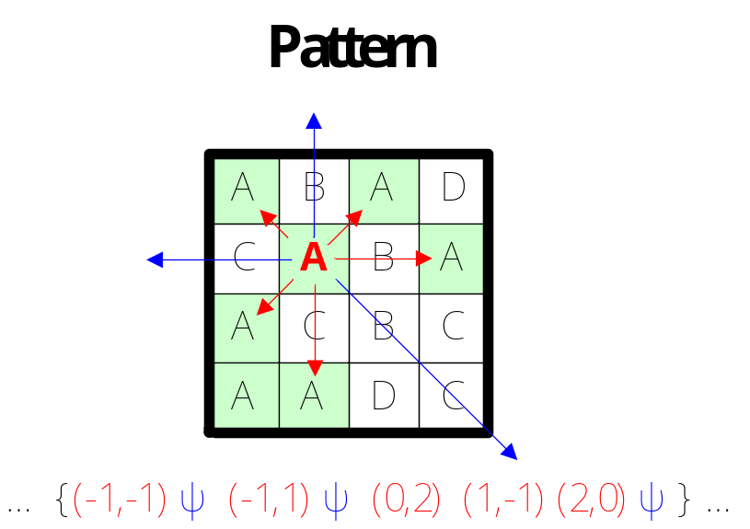
Deterministic Algorithm for 2-D Parameterized Matching
For each symbol, choose logm neighbors.
  nm-symbol pattern ➔ nmlogm-pair pattern.
  n²-symbol text ➔ n²logm-pair text.
String matching with don’t cares (convolution).

Slide 31
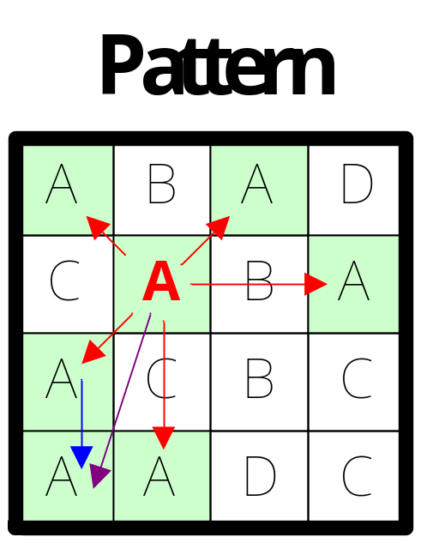
Correctness
For each two locations (w, y), (x, z) holding the same symbol a, they are linked.
For each relationship, it can be checked by the convolution.

Slide 32
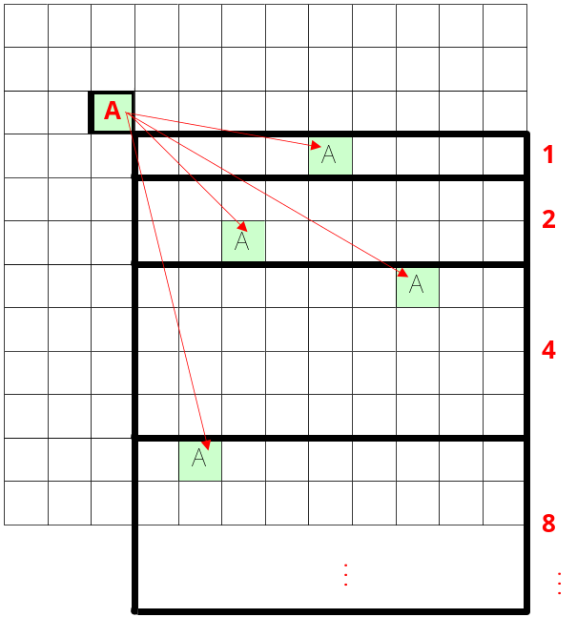
Identifying the Neighbors
The total O(m² log m) neighbors in the pattern can be identified in O(m² log²m) time.
The total O(n² log m) neighbors in the text can be identified in O(n² log²m) time.

Slide 33
Conclusion
There is an O(|Σ_{P}| n log m) time deterministic algorithm for 1-D function matching.
There is a randomized algorithm for 1-D function matching that, given a constant k, runs in time
O(kn log m).
There is an O(n² log²m) time deterministic algorithm for 2-D parameterized matching.

