Slide 1
An Efficient Multi-modal 2D-3D Hybrid
Approach to Automatic Face Recognition
Ajmal S. Mian, Mohammed Bennamoun, and Robyn Owens
IEEE TRANSACTIONS ON IMAGE PROCESSING,
Vol. 29, No. 11, Nov. 2007
Reporter: Chiou-Yi Hor
Date: Dec. 12, 2007

Slide 2
Abstract-1
We present a fully automatic face recognition algorithm and demonstrate its performance on the FRGC v2.0 data. Our
algorithm is multi-modal (2D and 3D) and performs hybrid (feature based and holistic) matching in order to achieve efficiency and robustness to facial expressions. The pose of a 3D face along with its texture is automatically corrected using a novel approach based on a single automatically detected point and the Hotelling transform.

Slide 3
Abstract-2
A novel 3D Spherical Face Representation (SFR) is used in conjunction with the Scale-Invariant Feature Transform (SIFT) descriptor to form a rejection classifier, which quickly eliminates a large number of candidate faces at an early stage for efficient recognition in case of large galleries. The remaining faces are then verified using a novel region-based matching approach, which is robust to facial expressions.

Slide 4
Abstract-3
This approach automatically segments the eyes-forehead and the nose regions, which are relatively less sensitive to expressions and matches them separately using a modified Iterative Closest Point (ICP) algorithm. The results of all the matching engines are fused at the metric level to achieve higher accuracy. We use the FRGC benchmark to compare our results to other algorithms that used the same database.

Slide 5
Abstract-4
Our multi-modal hybrid algorithm performed better than others by achieving 99.74 percent and 98.31 percent verification rates at a 0.001 false acceptance rate (FAR) and identification rates of 99.02 percent and 95.37 percent for probes with a neutral and a non-neutral expression, respectively.

Slide 6
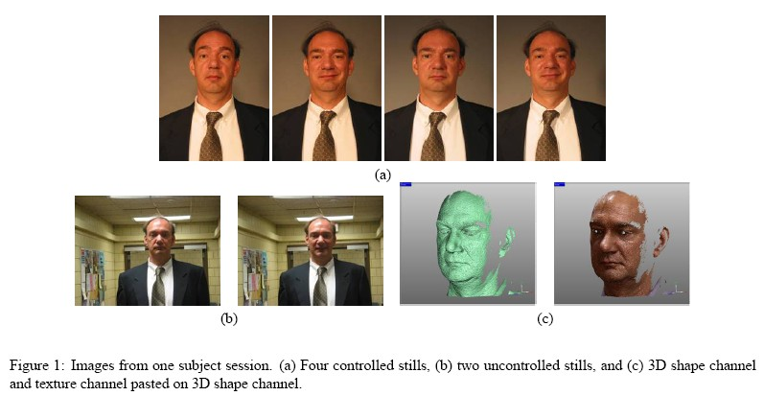
FRGC(Face Recognition Grand Challenge) v2.0 data set

Slide 7
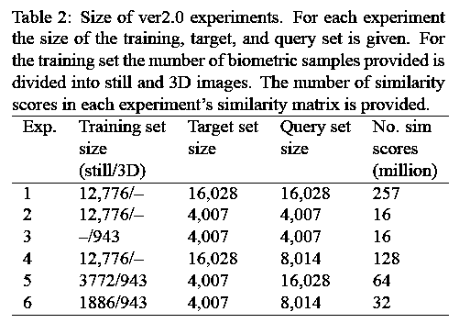
FRGC(Face Recognition Grand Challenge) v2.0 data set

Slide 8
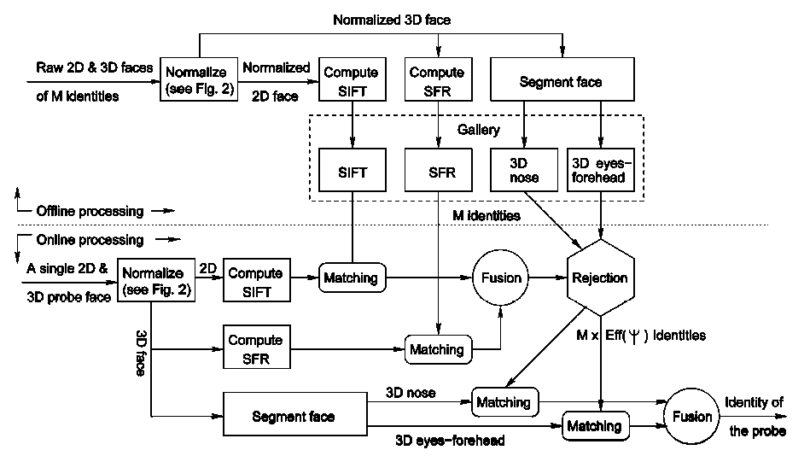
Overall block diagram of the recognition algorithm
Gallery
Probe

Slide 9
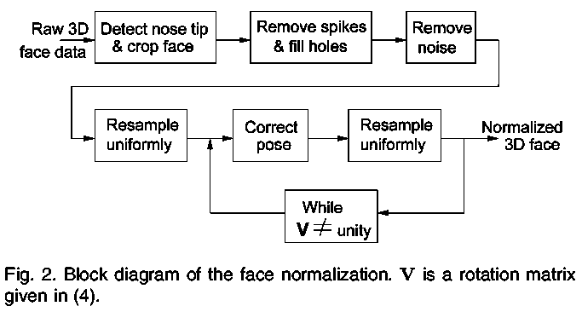
Face Normalization

Slide 10
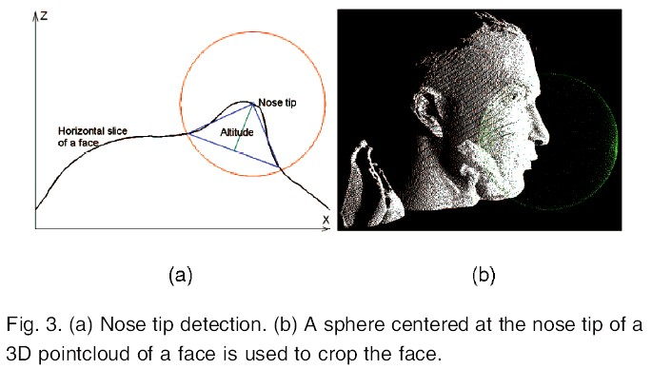
Nose tip detection and face localization
Horizontal slices at different intervals (coarse to fine) are taken recursively.
The point that has the maximum altitude triangle associated with it is considered to be a potential nose tip on the slice and is assigned a confidence value equal to the altitude.The one that has the maximum confidence is taken as the nose tip.

Slide 11
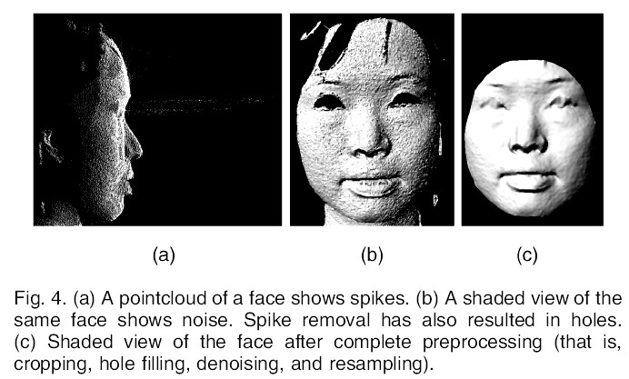
De-noising(去除雜訊) and face cropping (分割出臉)

Slide 12
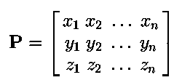





Pose correction (將臉轉正) with
Hotelling transformation
Point cloud
Mean
Covariance
Eigen-Decomposition
Rotation

Slide 13
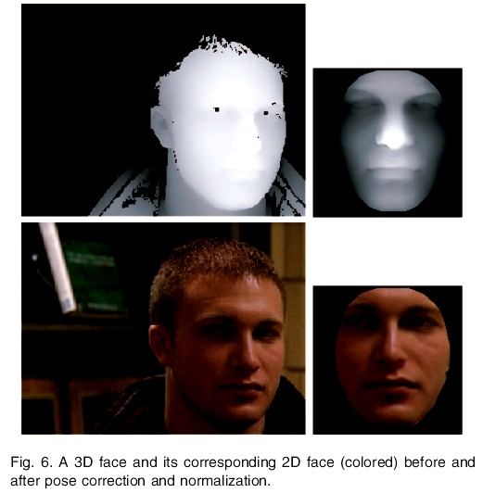
Pose correction results
Note: a 3D face is a vector [xi,yi,zi] of the x, y, and z-coordinates of the point cloud of a face (i=1~n) where n is the number of points. The 2D face is a 5-D vector [ui,vi,Ri,Gi,Bi], where u and v are the pixel coordinates, and R, G, and B are their corresponding red, green, and blue components. Since the 3D and 2D faces are registered in most cases, the pixel coordinates u and v of the 2D face can be replaced with the absolute coordinates x and y of its corresponding 3D face.

Slide 14
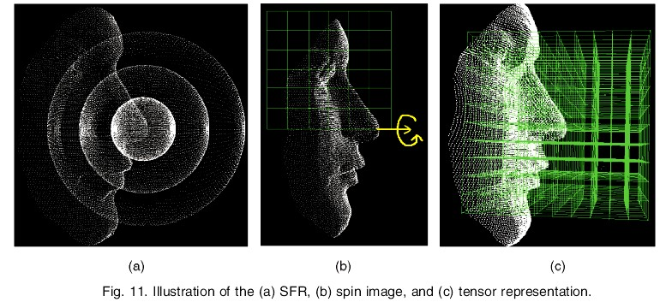
SFR (Sphere face representation)

Slide 15
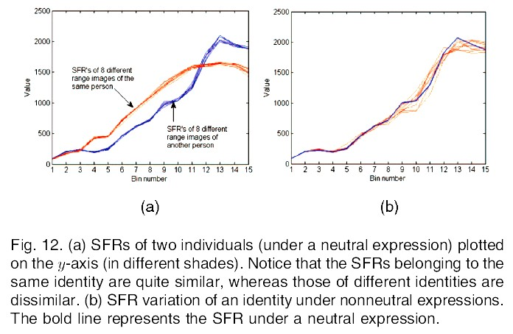
SFR (Sphere face representation)

Slide 16
SFR (Sphere face representation)
An SFR can be imagined as the quantization of the pointcloud of a face into spherical bins centered at the nose tip. The distance of all points from the origin is calculated. These distances are then quantized into a histogram of n + 1 bins.
A spin image is generated by spinning an image around the normal of a point and summing the face points as they pass through the bins of the image.
The tensor representation is the quantization of the surface area of a face into a 3D grid.
Higher descriptiveness of a representation makes it more sensitive to nonrigid deformations (eg. expression). The descriptiveness of the SFR intuitively appears to be the lowest of the three. (最不易受表情變化影響)

Slide 17
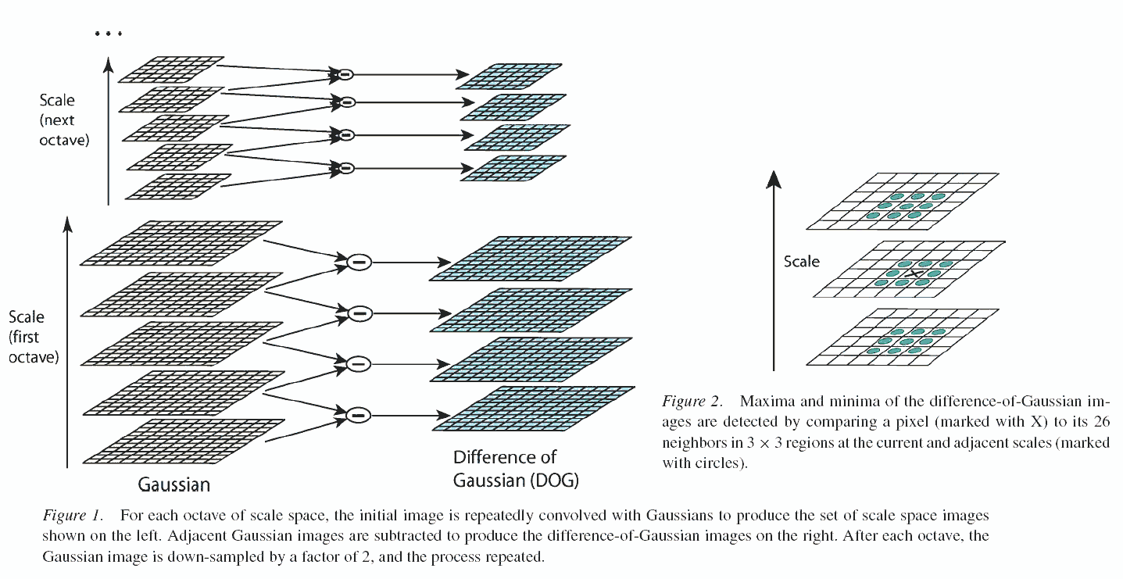



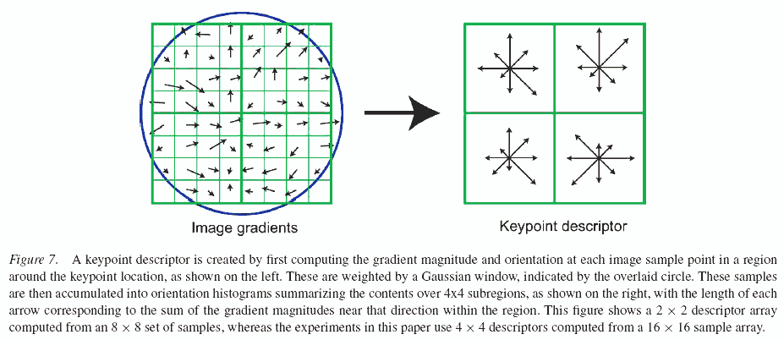
SIFT (Scale invariant feature transform)
1.Scale-space extrema detection
2.key-point localization
3.Orientation assignment
4.key-point descriptor

Slide 18
SIFT (Scale invariant feature transform)
The SIFT descriptors were extracted from the 2D texture maps of faces after normalization with respect to pose and scale.
It performs reliable matching between different views of an object or scene. The extracted features are quite invariant to image scale, rotation, affine distortion, change in 3D viewpoint, addition of noise, and change in illumination.

Slide 19
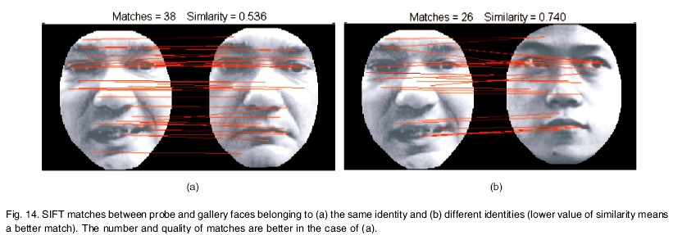

SIFT (Scale invariant feature transform)
To calculate the similarity between a gallery and probe face, their SIFT descriptors were matched using the Euclidean distance and then normalized.

Slide 20
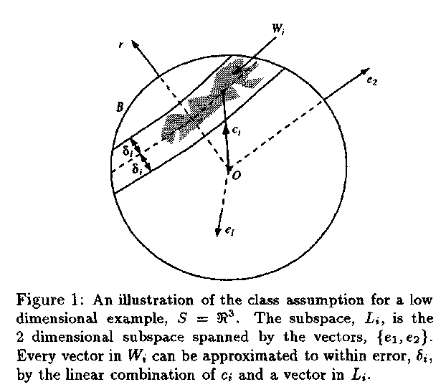
Pattern rejectors

Slide 21
Pattern rejectors
A rejector is a classifier, that quickly eliminates a large fraction of the candidate classes or inputs. This allows a recognition algorithm to dedicate its efforts to a much smaller number of possibilities.
A collection of rejectors may be combined to form a composite rejector, which is shown to be far more effective than any of its individual components.
In this paper, both 3D SFR and 2D SIFT are used for rejectors. Gallery faces whose similarity is above a threshold are rejected.

Slide 22
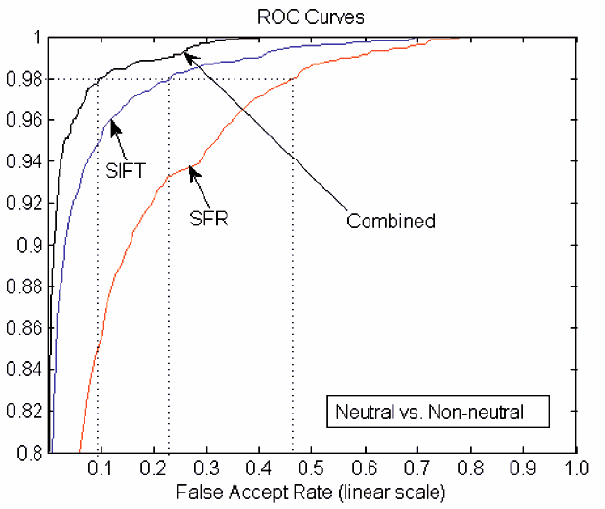
Pattern rejectors
Weighted sum of SIFT & SFR

Slide 23
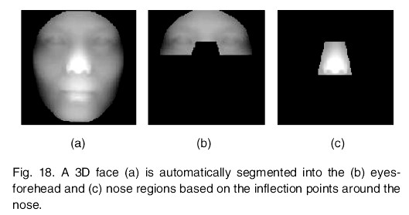
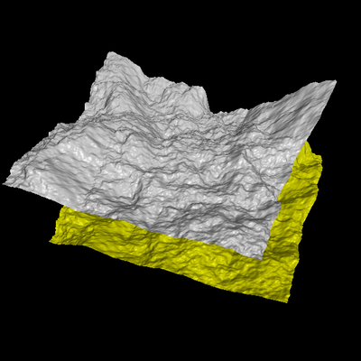
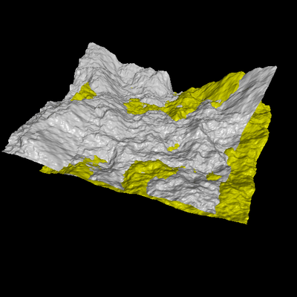
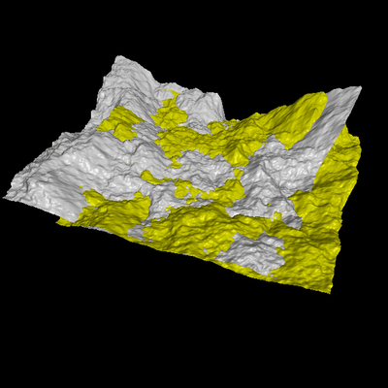
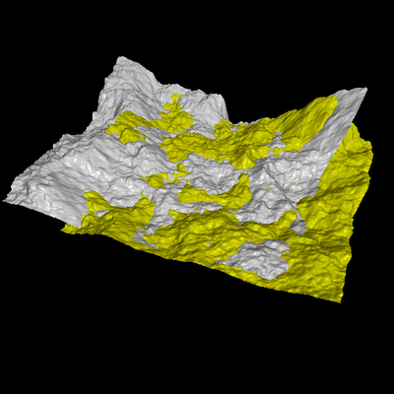
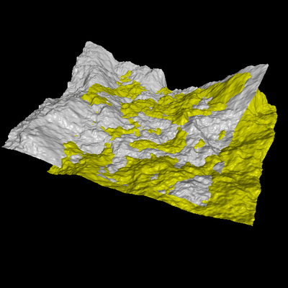
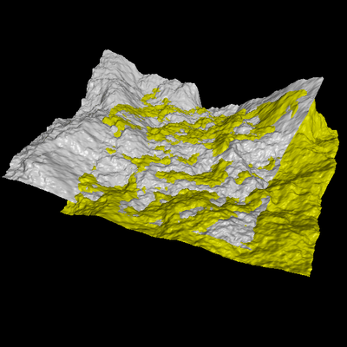
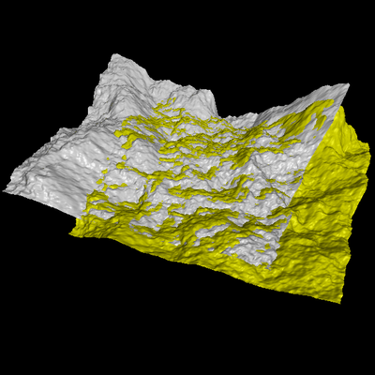

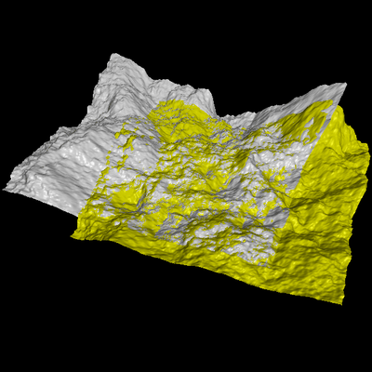
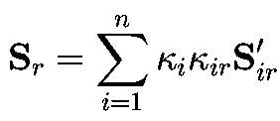
Face recognition
Expression-invariant region segmentation
ICP (iterative closest point) matching
Matching result fusion

Slide 24
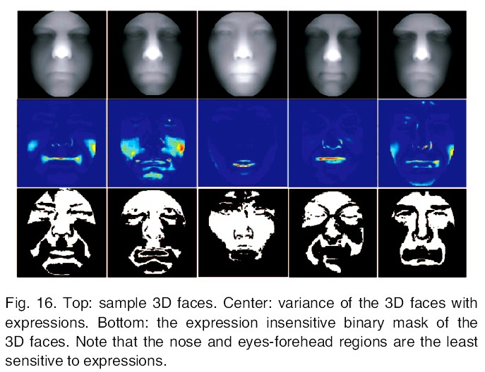
Expression-invariant region segmentation
Insensitive regions

Slide 25



ICP for aligning 3D Data
… and iterate to find alignment
  Iterated Closest Points (ICP) [Besl & McKay 92]
Converges if starting position “close enough“

Slide 26




Fusing all matching results
normalization
i:modality, r:probe,
weighting
min₂:the 2nd minimum
weighted sum
normalization

Slide 27
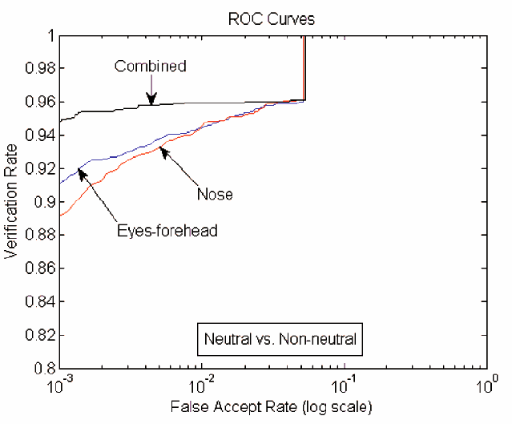
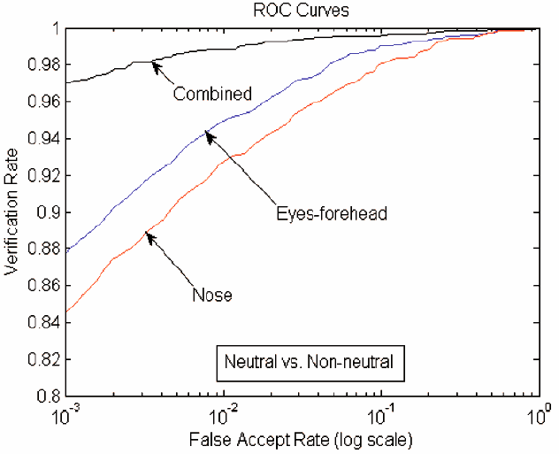
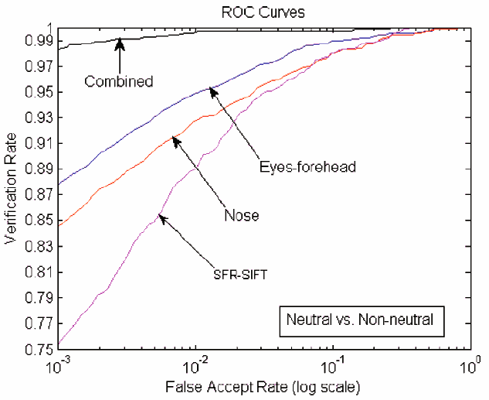
Matching results
Matching with pattern rejectors
Matching with 3D features
Matching with 2D & 3D features

Slide 28
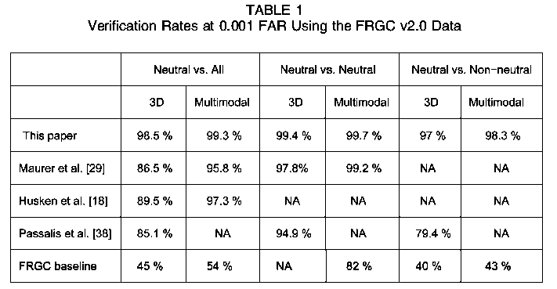
Comparison with other methods

