Slide 1
An Introduction to the Conjugate Gradient Method without the Agonizing Pain
Jonathan Richard Shewchuk, 1994
Oct. 17, 2007

Slide 2
Abstract
The Conjugate Gradient Method is the most prominent iterative method for solving sparse systems of linear equations. Unfortunately, many textbook treatments of the topic are written with neither illustrations nor intuition, and their victims can be found to this day babbling senselessly in the corners of dusty libraries. For this reason, a deep, geometric understanding of the method has been reserved for the elite brilliant few who have painstakingly decoded the mumblings of their forebears. Nevertheless, the Conjugate Gradient Method is a composite of simple, elegant ideas that almost anyone can understand. Of course, a reader as intelligent as yourself will learn them almost effortlessly.

Slide 3
Abstract
The idea of quadratic forms is introduced and used to derive the methods of Steepest Descent, Conjugate Directions, and Conjugate Gradients. Eigenvectors are explained and used to examine the convergence of the Jacobi Method, Steepest Descent, and Conjugate Gradients. Other topics include preconditioning and the nonlinear Conjugate Gradient Method. I have taken pains to make this article easy to read. Sixty-six illustrations are provided. Dense prose is avoided. Concepts are explained in several different ways. Most equations are coupled with an intuitive interpretation.

Slide 4
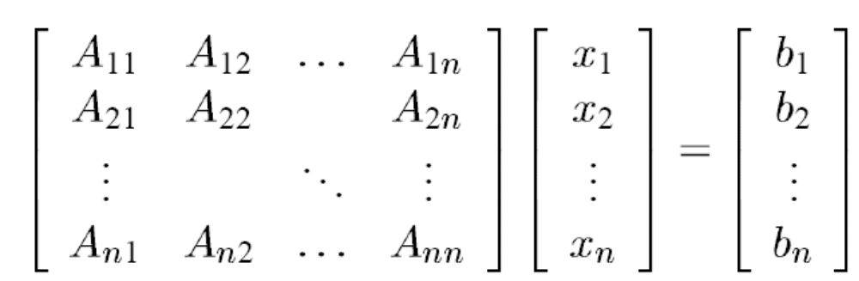
Introduction
Solve the equation Ax = b

Slide 5
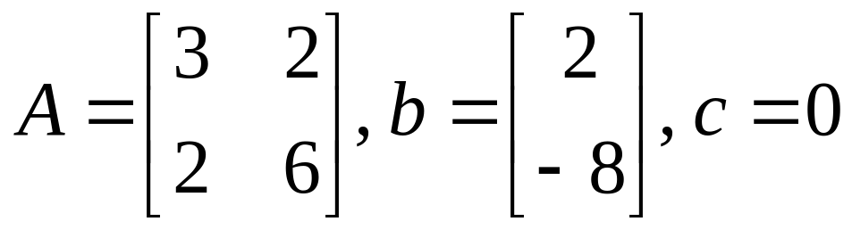
Example
Eigenvalue: 7, 2

Slide 6
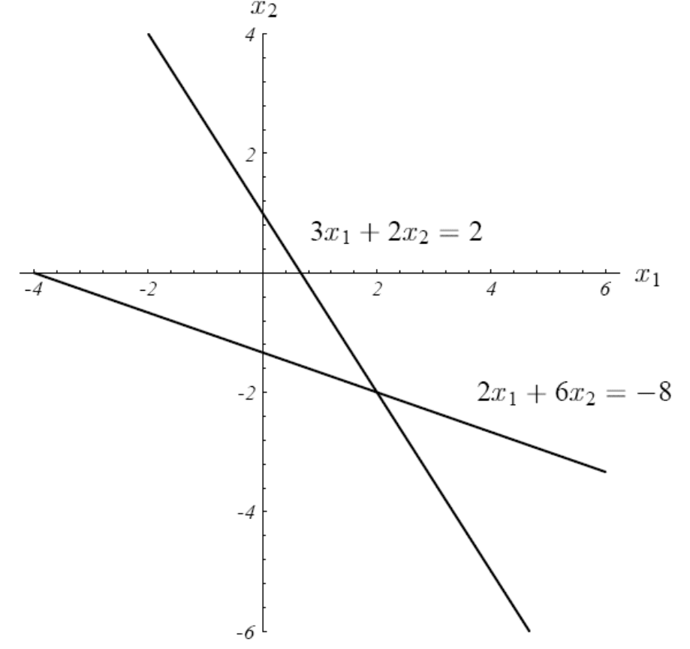
Introduction

Slide 7

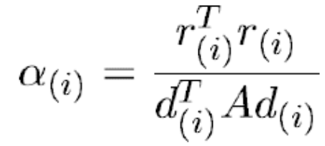
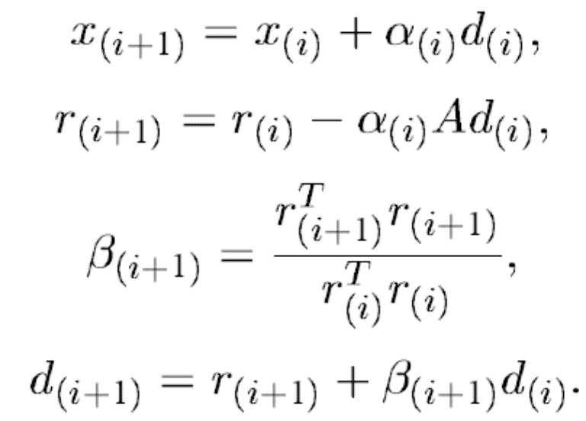
Conjugate Gradient Method

Slide 8
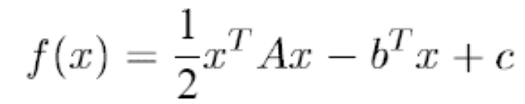
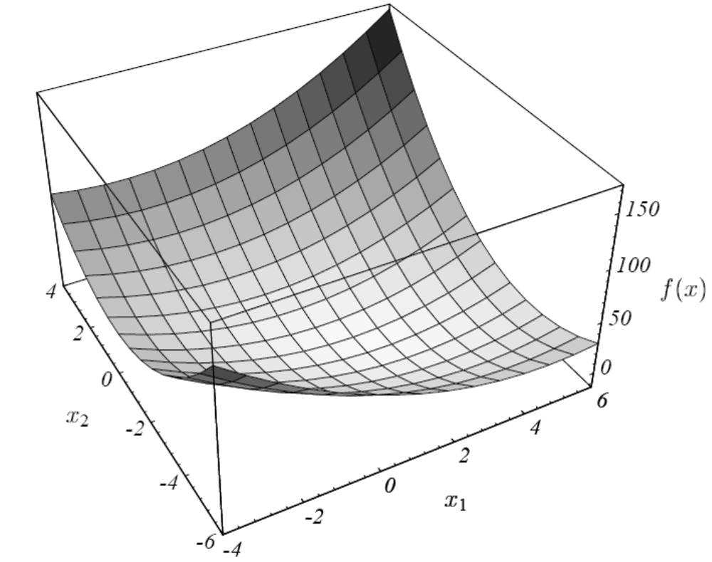
Quadratic Form(1/2)

Slide 9
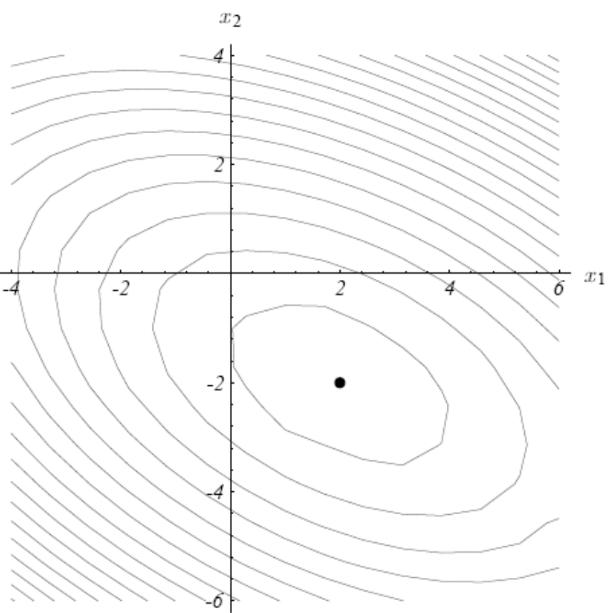
Quadratic Form(2/2)

Slide 10
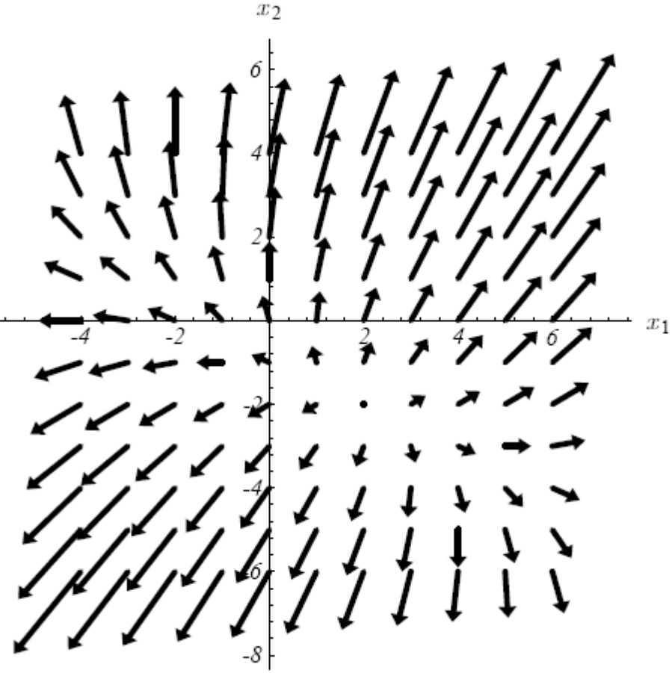
Gradient(1/3)

Slide 11
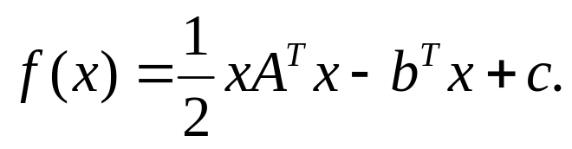
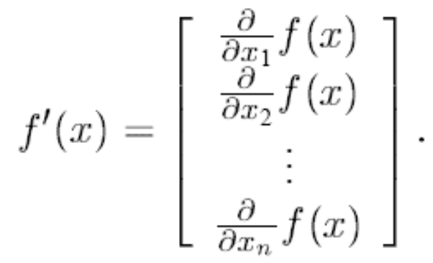
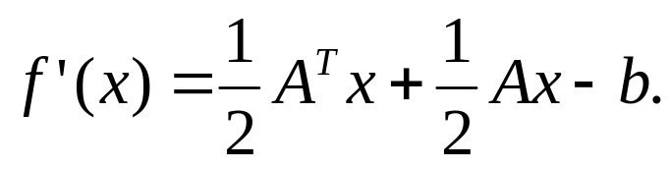

Gradient(2/3)
If A is symmetric,

Slide 12
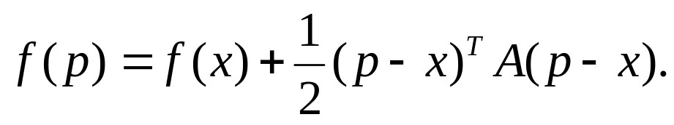
Gradient(3/3)
If A is symmetric,
The solution to Ax = b is to find f’(x) = Ax - b = 0, which is when f(x) has minimal value if A is symmetric and positive definite.

Slide 13
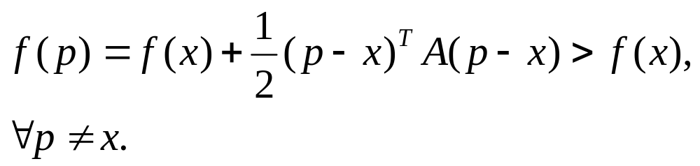
Positive-definite
A matrix is positive-definite if, for every nonzero vector x, x^{T}Ax > 0
If A is positive definite,

Slide 14
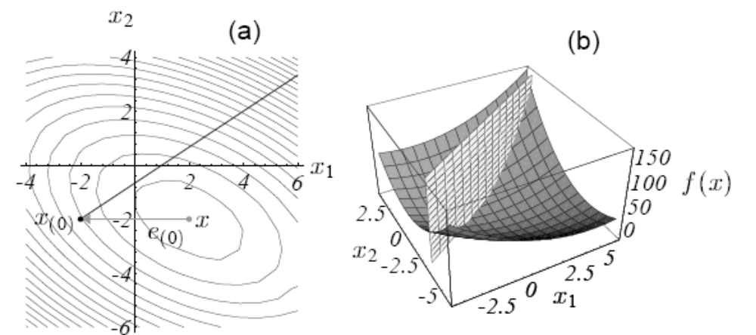
Steepest Descent

Slide 15
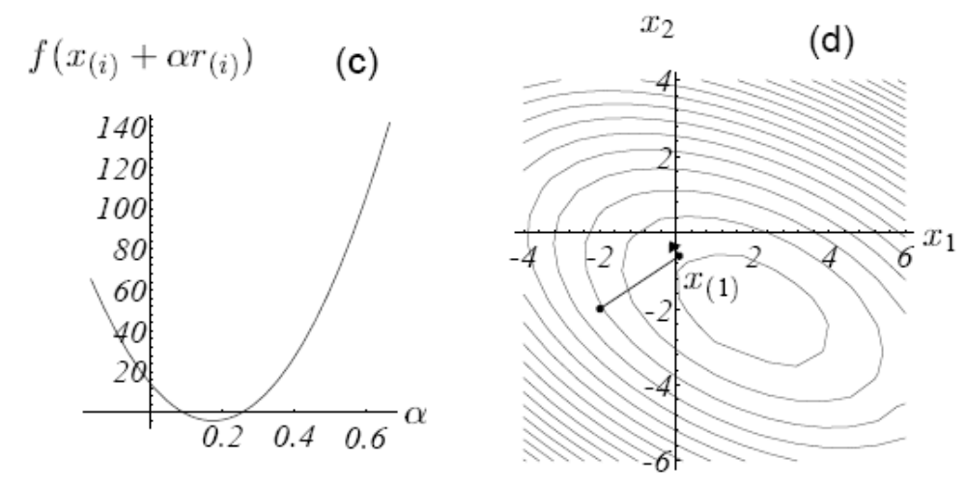
Steepest Descent

Slide 16
Steepest Descent
e_{(i)}=x_{(i)}-x (unknown!)
r_{(i)}=b-Ax_{(i)}
r_{(i)}=-Ae_{(i)}
r_{(i)}=-f’(x_{(i)})
x(1)=x(0)+αr₍₀₎

Slide 17
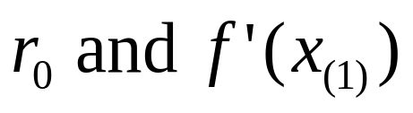
Steepest Descent
soαshould be chosen so that
are orthogonal

Slide 18
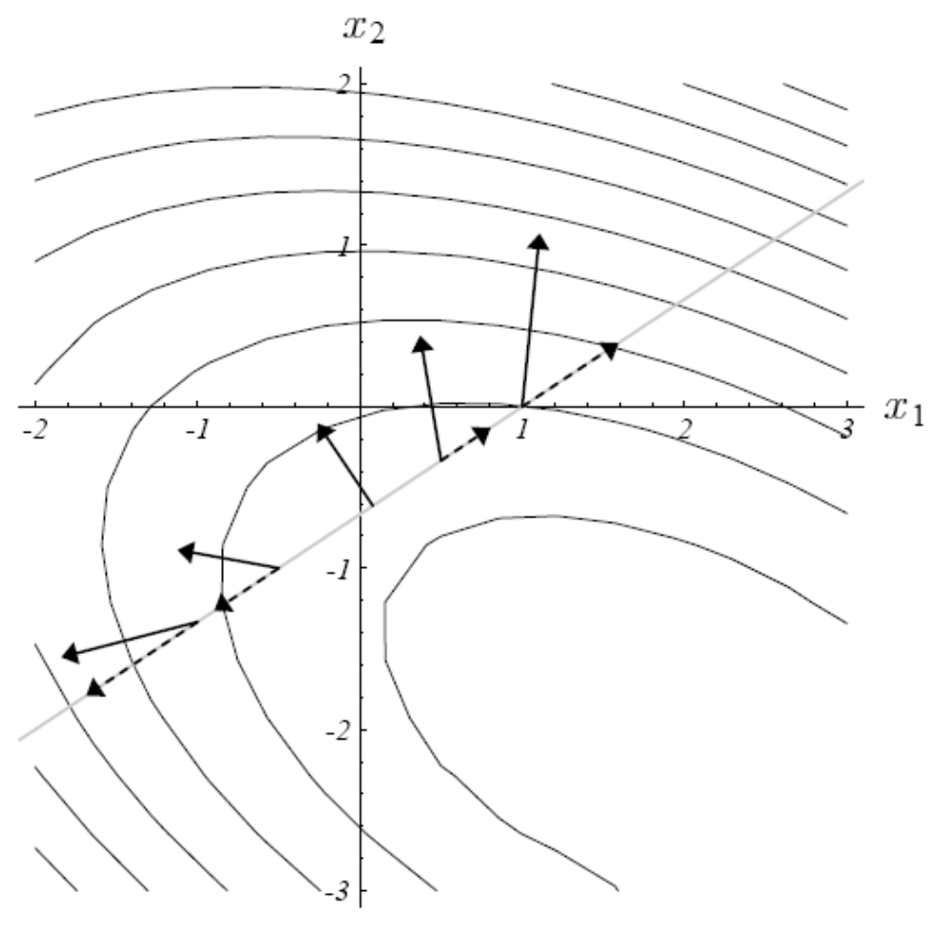
Steepest Descent

Slide 19
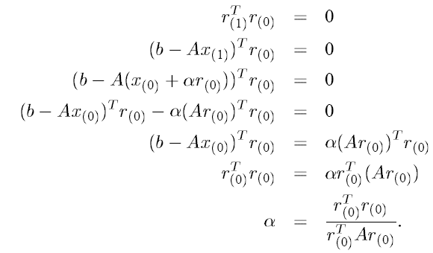
Steepest Descent

Slide 20
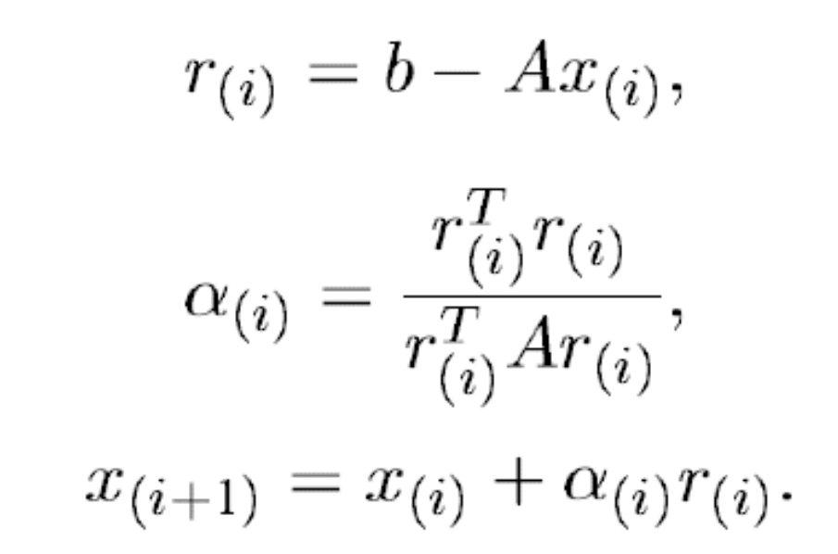
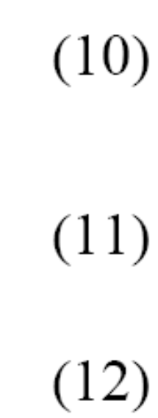
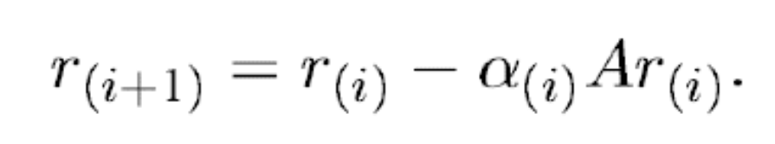
Steepest Descent
(10)*(-A)+b
Accuracy Problem!

Slide 21
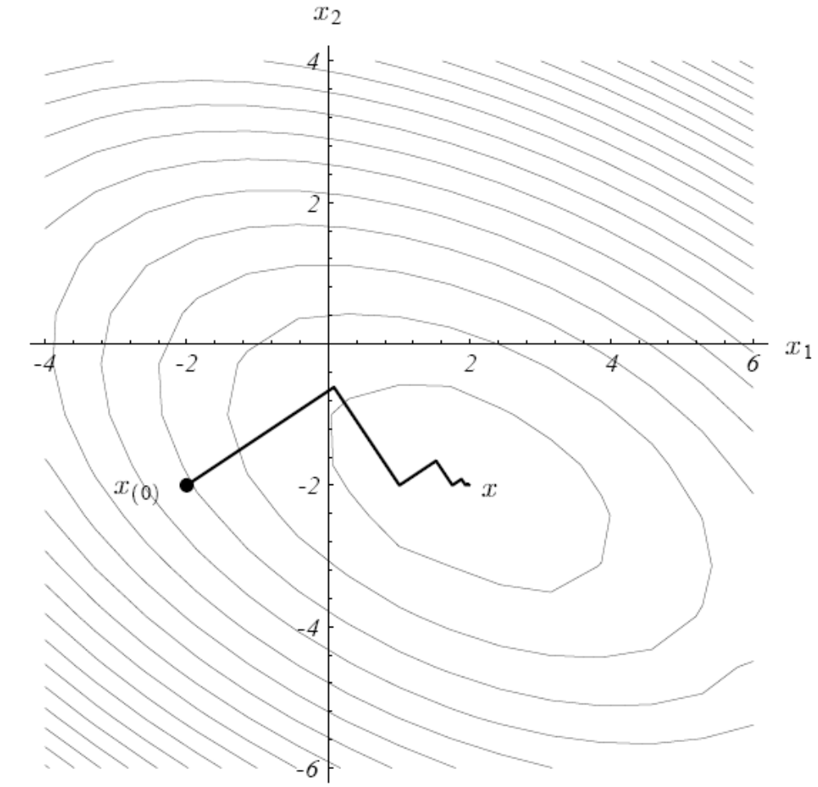
Steepest Descent

Slide 22
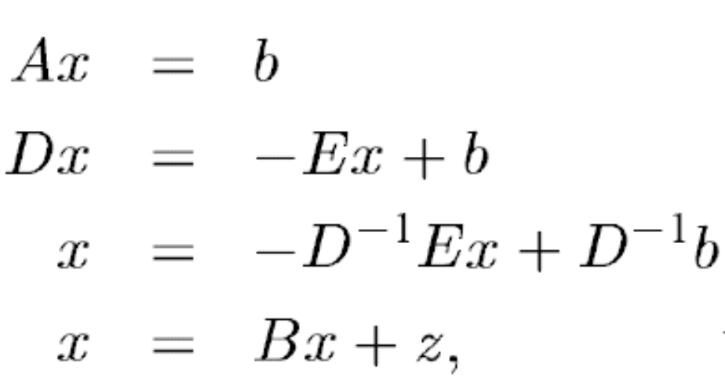
Jacobi Method
A=D+E
E
D
E
There are many different kinds of decomposition.

Slide 23
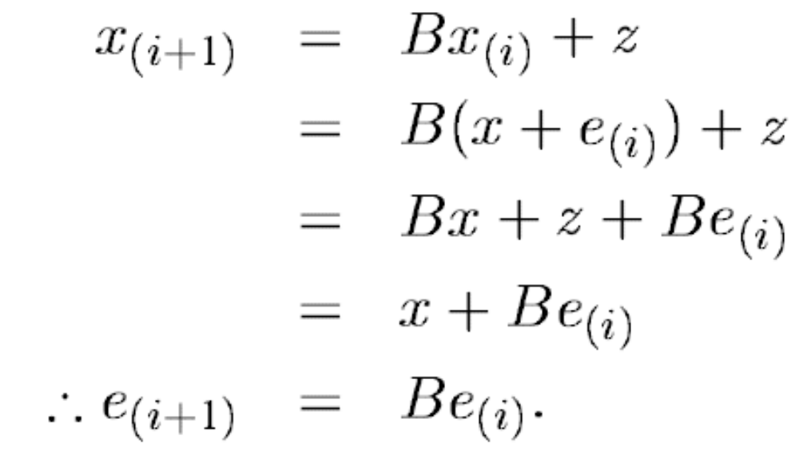
Jacobi Method

Slide 24

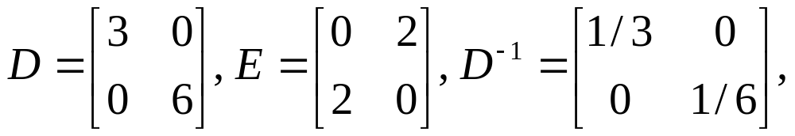
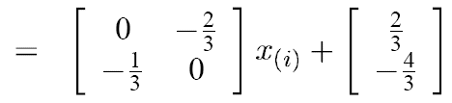

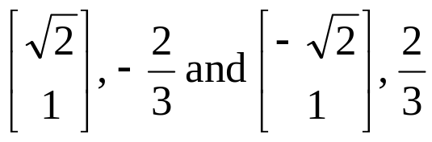
Example

Slide 25
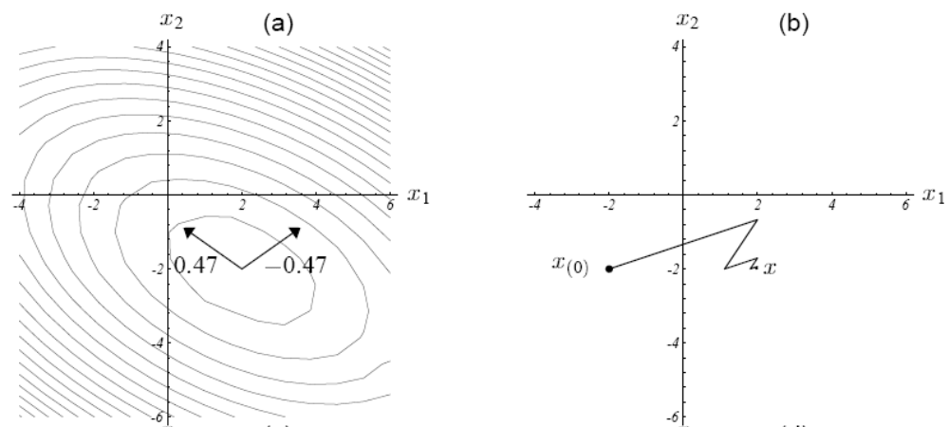
Jacobi Method

Slide 26
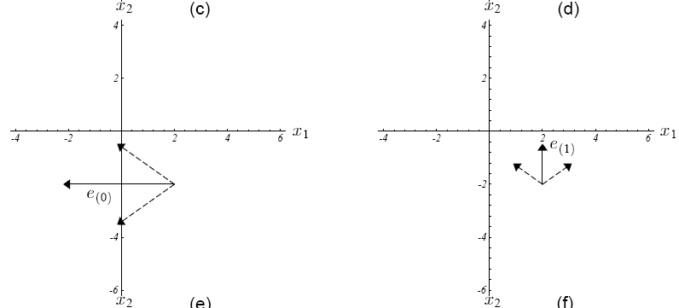
Jacobi Method

Slide 27
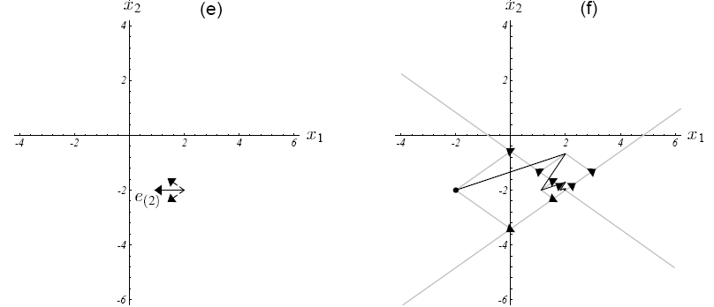
Jacobi Method

Slide 28
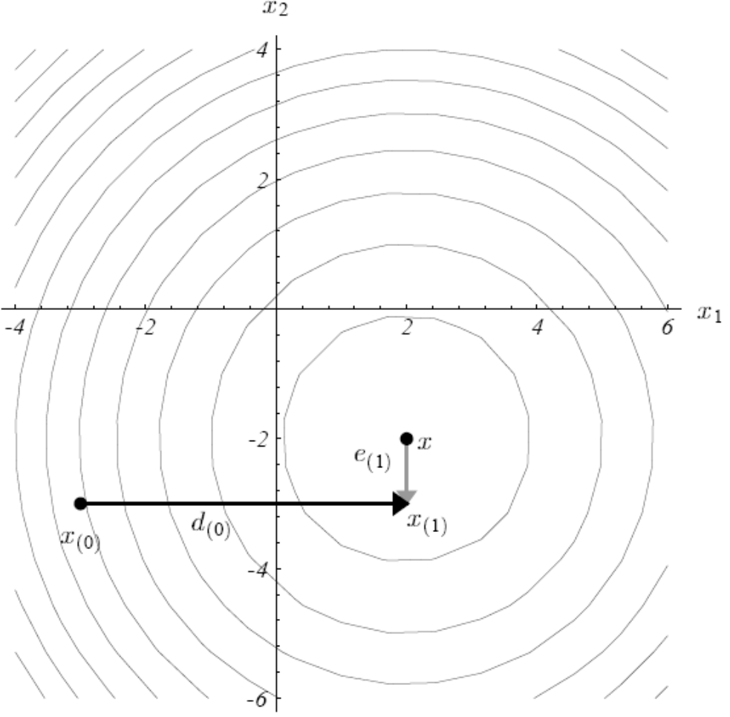
Conjugate Direction
d_{(i)}⊥e_{(i)}

Slide 29
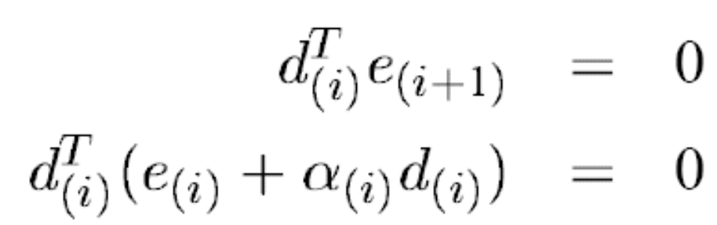
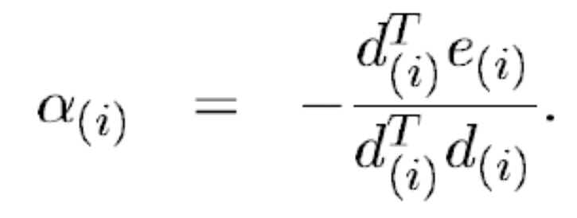
Conjugate Direction
A orthogonal instead of orthogonal.

Slide 30
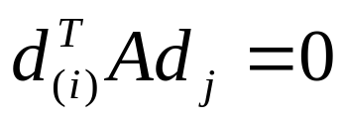
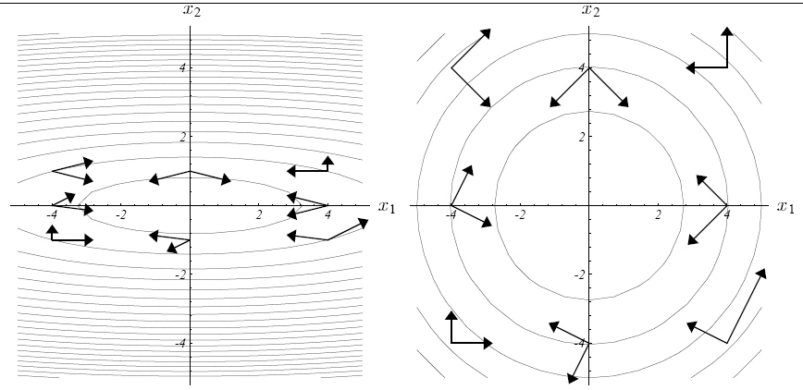
A Orthogonal / Conjugate

Slide 31
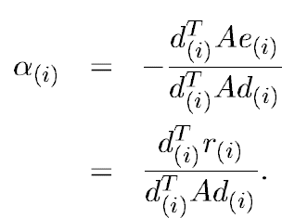
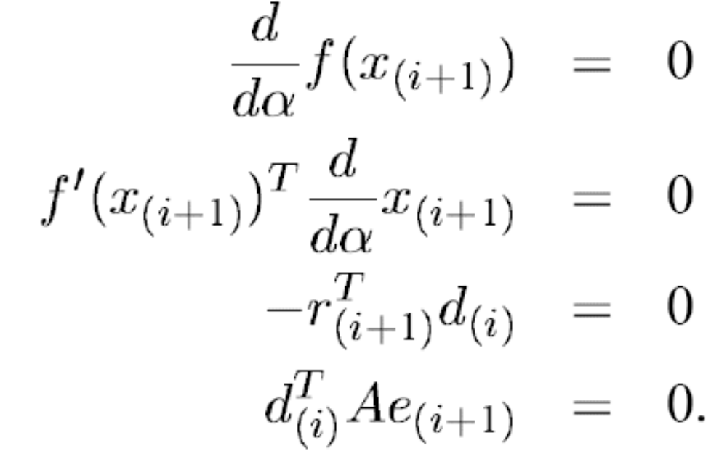
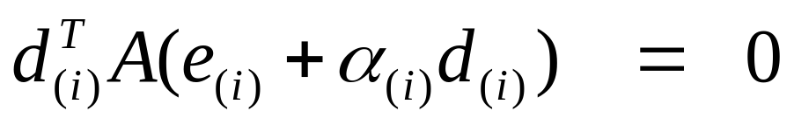
Conjugate Direction

Slide 32
Conjugate Direction
Each iteration eliminates the error term in one of the conjugate directions.

Slide 33
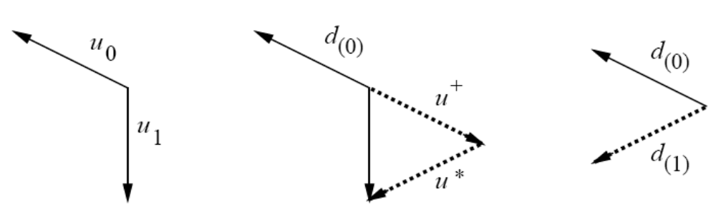
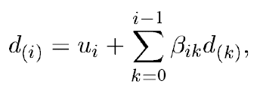
Gram-Schmidt Conjugation

Slide 34
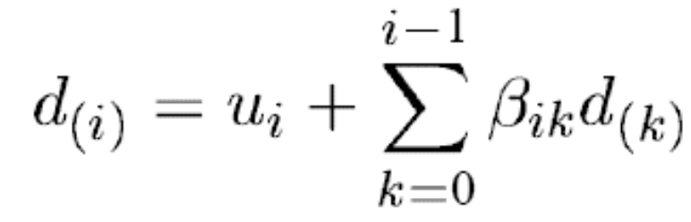
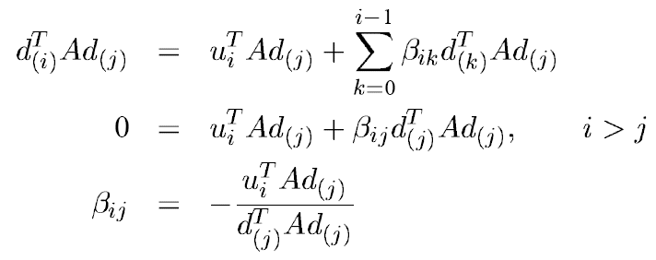
Gram-Schmidt Conjugation
O(n³) time

Slide 35
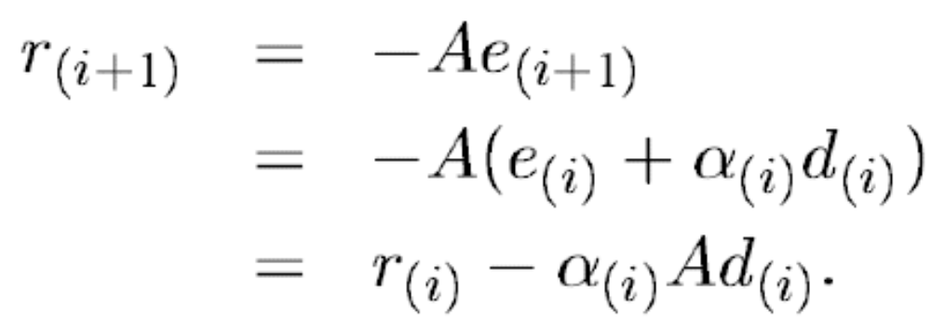
Gram-Schmidt Conjugation

Slide 36
Conjugate Gradient Method
Set u = r
The residual has the nice property that it’s orthogonal to the previous search directions, so it’s guaranteed always to produce a new, linearly independent search direction unless the residual is zero, in which case the problem is already solved.

Slide 37
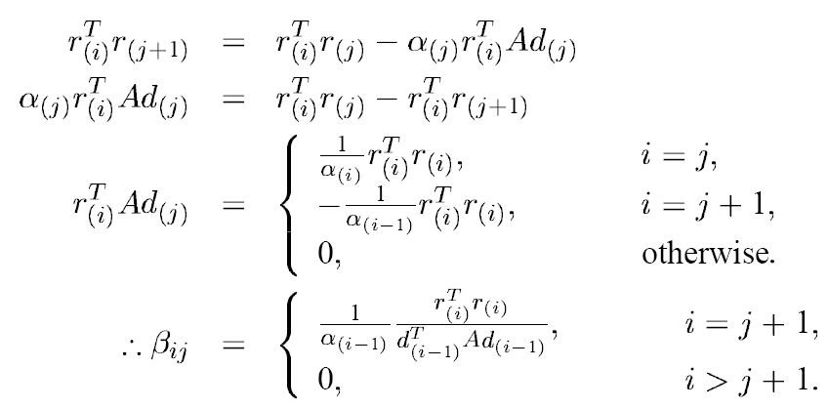
Conjugate Gradient Method
O(nm) time and space
β_{(i)=} β_{i,i-1}

Slide 38
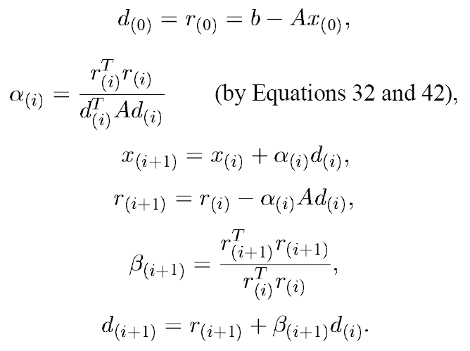
Conjugate Gradient Method

