Slide 1
Dynamic Programming Treatment of the Travelling Salesman Problem
Richard Bellman
Journal of the ACM, Vol.9, pp.61-63 (1962)
Presenter: Hsuan-Tsung Chiu
Date:2017/08/01

Slide 2


Travelling Salesman Problem

Slide 3
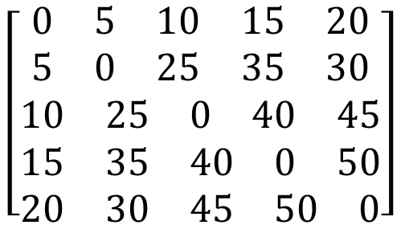
Dynamic Programming
$$\left[\begin{aligned}\begin{matrix}0 & 5 & 10 & 15 & 20\end{matrix} \\ \begin{matrix}5 & 0 & 25 & 35 & 30\end{matrix} \\ \begin{matrix}10 & 25 & 0 & 40 & 45\end{matrix} \\ \begin{matrix}15 & 35 & 40 & 0 & 50\end{matrix} \\ \begin{matrix}20 & 30 & 45 & 50 & 0\end{matrix}\end{aligned}\right]$$

Slide 4


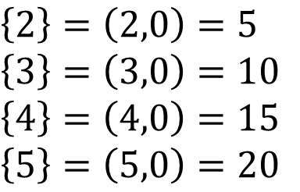
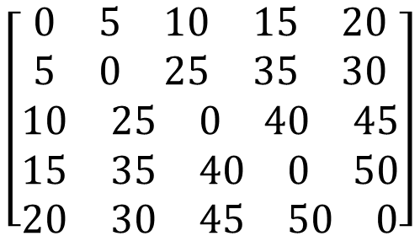
$$\left[\begin{aligned}\begin{matrix}0 & 5 & 10 & 15 & 20\end{matrix} \\ \begin{matrix}5 & 0 & 25 & 35 & 30\end{matrix} \\ \begin{matrix}10 & 25 & 0 & 40 & 45\end{matrix} \\ \begin{matrix}15 & 35 & 40 & 0 & 50\end{matrix} \\ \begin{matrix}20 & 30 & 45 & 50 & 0\end{matrix}\end{aligned}\right]$$
1
5
2
4
$\left\{2\right\}=\left(2,0\right)=5$
$\left\{3\right\}=\left(3,0\right)=10$
$\left\{4\right\}=\left(4,0\right)=15$
$\left\{5\right\}=\left(5,0\right)=20$
3

Slide 5

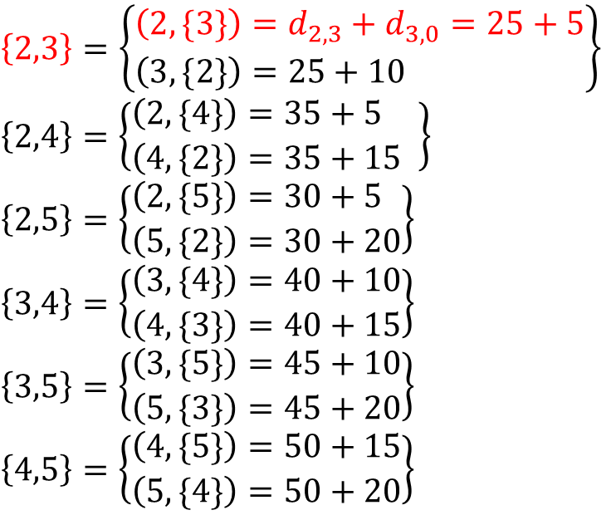
$$\left[\begin{aligned}\begin{matrix}0 & 5 & 10 & 15 & 20\end{matrix} \\ \begin{matrix}5 & 0 & 25 & 35 & 30\end{matrix} \\ \begin{matrix}10 & 25 & 0 & 40 & 45\end{matrix} \\ \begin{matrix}15 & 35 & 40 & 0 & 50\end{matrix} \\ \begin{matrix}20 & 30 & 45 & 50 & 0\end{matrix}\end{aligned}\right]$$
1
5
2
4
$\left\{2,3\right\}=\left\{\begin{aligned}&\left(2,\{3\}\right)=d_{2,3}+d_{3,0}=25+5 \\ &\left(3,\{2\}\right)=25+10\end{aligned}\right\}$
$\left\{2,4\right\}=\left\{\begin{aligned}&\left(2,\{4\}\right)=35+5 \\ &\left(4,\{2\}\right)=35+15 \end{aligned}\right\}$
$\left\{2,5\right\}=\left\{\begin{aligned}&\left(2,\{5\}\right)=30+5 \\ &\left(5,\{2\}\right)=30+20\end{aligned}\right\}$
$\left\{3,4\right\}=\left\{\begin{aligned}&\left(3,\{4\}\right)=40+10 \\ &\left(4,\{3\}\right)=40+15\end{aligned}\right\}$
$\left\{3,5\right\}=\left\{\begin{aligned}&\left(3,\{5\}\right)=45+10 \\ &\left(5,\{3\}\right)=45+20\end{aligned}\right\}$
$\left\{4,5\right\}=\left\{\begin{aligned}&\left(4,\{5\}\right)=50+15 \\ &\left(5,\{4\}\right)=50+20\end{aligned}\right\}$
3

Slide 6



1
5
2
4
$\left\{2,3,4\right\}=\left\{\begin{aligned}\left(2,\left\{3,4\right\}\right)=min\left\{\begin{matrix}d_{2,3}+(3,\{4\}) \\ d_{2,4}+(4,\{3\})\end{matrix}\right\} \\ \left(3,\left\{2,4\right\}\right)=min\left\{\begin{matrix}d_{3,2}+(2,\{4\}) \\ d_{3,4}+(4,\{2\})\end{matrix}\right\} \\ \left(4,\left\{2,3\right\}\right)=min\left\{\begin{matrix}d_{4,2}+(2,\{3\}) \\ d_{4,3}+(3,\{2\})\end{matrix}\right\}\end{aligned}\right\}$
$\left\{2,3,5\right\}$
$\left\{2,4,5\right\}$
$\left\{3,4,5\right\}$
$\left\{2,3,4\right\}=\left\{\begin{aligned}\left(2,\left\{3,4\right\}\right)=min\left\{\begin{matrix}d_{2,3}+(3,\{4\}) \\ d_{2,4}+(4,\{3\})\end{matrix}\right\} \\ \left(3,\left\{2,4\right\}\right)=min\left\{\begin{matrix}d_{3,2}+(2,\{4\}) \\ d_{3,4}+(4,\{2\})\end{matrix}\right\} \\ \left(4,\left\{2,3\right\}\right)=min\left\{\begin{matrix}d_{4,2}+(2,\{3\}) \\ d_{4,3}+(3,\{2\})\end{matrix}\right\}\end{aligned}\right\}$
$\left\{2,3,5\right\}$
$\left\{2,4,5\right\}$
$\left\{3,4,5\right\}$
3

Slide 7
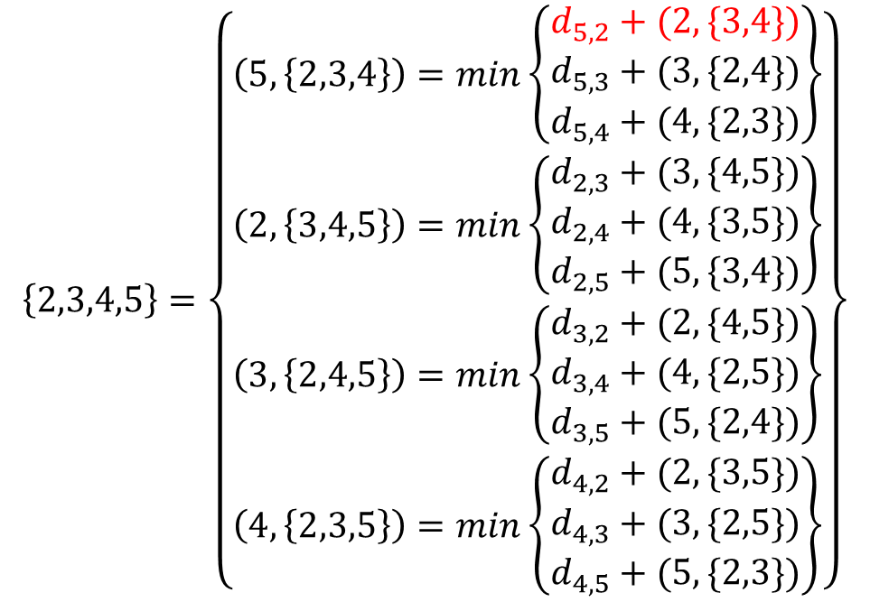
1
5
$$\left\{2,3,4,5\right\}=\left\{\begin{aligned}&\left(5,\left\{2,3,4\right\}\right)=min\left\{\begin{aligned}\begin{matrix}d_{5,2}+(2,\{3,4\}) \\ d_{5,3}+(3,\{2,4\})\end{matrix} \\ d_{5,4}+(4,\{2,3\})\end{aligned}\right\} \\ &\left(2,\left\{3,4,5\right\}\right)=min\left\{\begin{aligned}\begin{matrix}d_{2,3}+(3,\{4,5\}) \\ d_{2,4}+(4,\{3,5\})\end{matrix} \\ d_{2,5}+(5,\{3,4\})\end{aligned}\right\} \\ &\left(3,\left\{2,4,5\right\}\right)=min\left\{\begin{aligned}\begin{matrix}d_{3,2}+(2,\{4,5\}) \\ d_{3,4}+(4,\{2,5\})\end{matrix} \\ d_{3,5}+(5,\{2,4\})\end{aligned}\right\} \\ &\left(4,\left\{2,3,5\right\}\right)=min\left\{\begin{aligned}\begin{matrix}d_{4,2}+(2,\{3,5\}) \\ d_{4,3}+(3,\{2,5\})\end{matrix} \\ d_{4,5}+(5,\{2,3\})\end{aligned}\right\}\end{aligned}\right\}$$
2
4
3

Slide 8

1
5
2
4
$$\left\{1,2,3,4,5\right\}=\left(1,\left\{2,3,4,5\right\}\right)$$
3

Slide 9

Time Complexity
$n−1$
$\left(\begin{aligned}n−1 \\ 2\end{aligned}\right)×2×1$
$\left(\begin{aligned}n−1 \\ 3\end{aligned}\right)×3×2$
$\left(\begin{aligned}n−1 \\ 4\end{aligned}\right)×4×3$
$1×(n−1)$
$O\left(2^{n}×n^{2}\right)$

