Slide 1
FOGSAA: Fast Optimal Global Sequence Alignment Algorithm
Angana Chakraborty , Sanghamitra Bandyopadhyay
Scientific reports 3 : 1746 (2013)
Presenter : Shie-Yan Lee
2017/8/1

Slide 2
Abstract
In this article we propose a Fast Optimal Global Sequence Alignment Algorithm, FOGSAA, which aligns a pair of nucleotide/protein sequences faster than any optimal global alignment method including the widely used Needleman-Wunsch (NW) algorithm. FOGSAA is applicable for all types of sequences, with any scoring scheme, and with or without affine gap penalty. Compared to NW, FOGSAA achieves a time gain of (70–90)% for highly similar nucleotide sequences (> 80% similarity), and (54–70)% for sequences having (30–80)% similarity. For other sequences, it terminates with an approximate score. For protein sequences, the average time gain is between (25–40)%. Compared to three heuristic global alignment methods, the quality of alignment is improved by about 23%–53%. FOGSAA is, in general, suitable for aligning any two sequences defined over a finite alphabet set, where the quality of the global alignment is of supreme importance

Slide 3






Problem definition
$$S_{1}$$
ACCGTCAA
$$n$$
$$S_{2}$$
ACATCAGATA
$$m$$
$$S_{1}$$
A
C
C
G
T
-
-
-
C
A
A
$$S_{2}$$
A
-
C
A
T
C
A
G
C
T
A

Slide 4



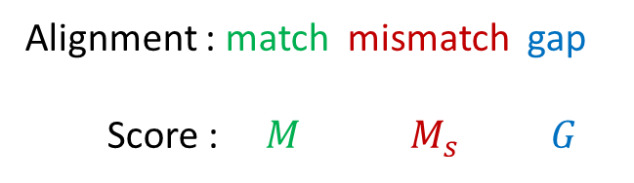
Scoring scheme
$$S_{1}$$
A
C
C
G
T
-
-
-
C
A
A
$$S_{2}$$
A
-
C
A
T
C
A
G
C
T
A
Alignment : match mismatch gap
Score : $M$ $M_{s}$ $G$
Score of this alignment : $4M+{2M}_{s}+4G$

Slide 5
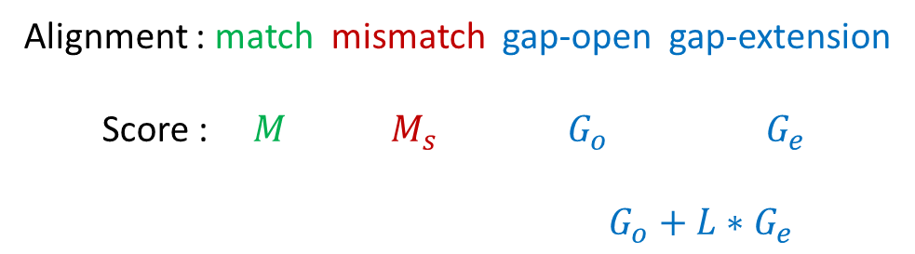
Scoring scheme : affine gap penalty
$$S_{1}$$
A
C
C
G
T
-
-
-
C
A
A
$$S_{2}$$
A
-
C
A
T
C
A
G
C
T
A
Alignment : match mismatch gap-open gap-extension
Score : $M$ $M_{s}$ $G_{o}$ $G_{e}$
$G_{o}+L∗G_{e}$
Score of this alignment : $4M+{2M}_{s}+G_{o}+G_{o}+2G_{e}$

Slide 6
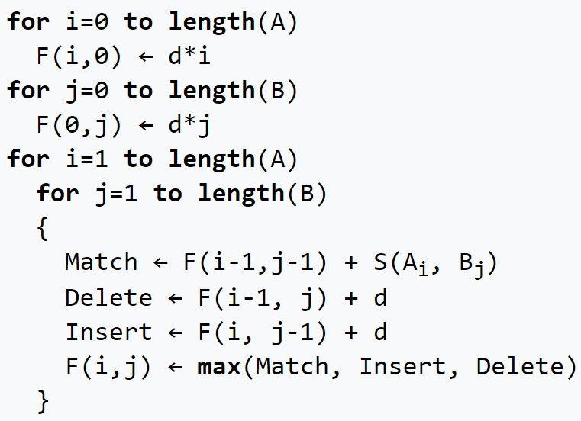
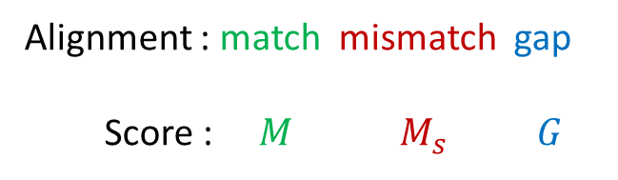
Needleman–Wunsch algorithm(1970)
Global sequence alignment
Dynamic Programming
Alignment : match mismatch gap
Score : $M$ $M_{s}$ $G$

Slide 7
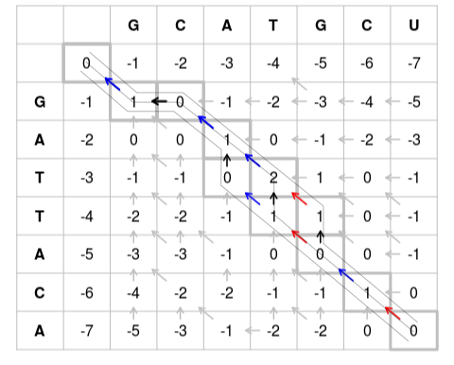
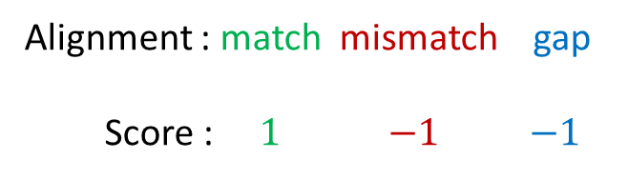
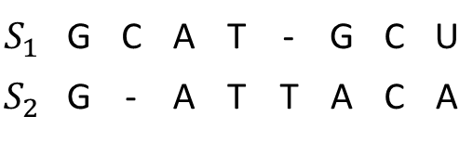
Needleman–Wunsch algorithm(1970)
Global sequence alignment
Alignment : match mismatch gap
Score : $1$ $−1$ $−1$
$$S_{1}$$ | G | C | A | T | - | G | C | U
$$S_{2}$$ | G | - | A | T | T | A | C | A

Slide 8
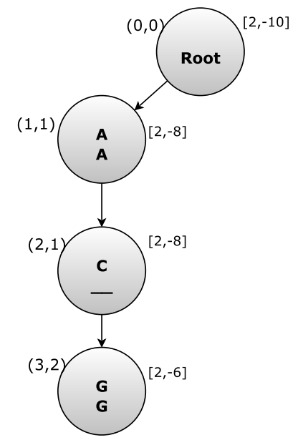

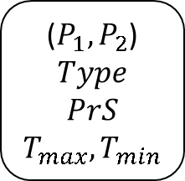


FOGSAA Fast Optimal Global Sequence Alignment Algorithm
Branch and bound tree
root
A path from the root to the leaf represents
a way to align the sequences.
($P_{1},P_{2}$)
$$Type$$
$$PrS$$
$$T_{max}, T_{min}$$
Match | 1
Mismatch | -1
Gap | -2
($P_{1},P_{2}$)
$$Type$$
$$PrS$$
$$T_{max}, T_{min}$$
($P_{1},P_{2}$)
$$Type$$
$$PrS$$
$$T_{max}, T_{min}$$
($P_{1},P_{2}$)
$$Type$$
$$PrS$$
$$T_{max}, T_{min}$$
A | C | G
A | - | G
($P_{1},P_{2}$)
$$Type$$
$$PrS$$
$$T_{max}, T_{min}$$

Slide 9

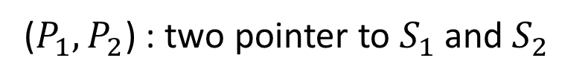





FOGSAA Fast Optimal Global Sequence Alignment Algorithm
Branch and bound tree
root
($P_{1},P_{2}$) : two pointer to $S_{1}$ and $S_{2}$
($P_{1},P_{2}$)
$$Type$$
$$PrS$$
$$T_{max}, T_{min}$$
$$P_{1}$$
$$S_{1}$$
ACCGTCAA
$$n$$
$$P_{2}$$
$$S_{2}$$
ACATCAGATA
$$m$$

Slide 10
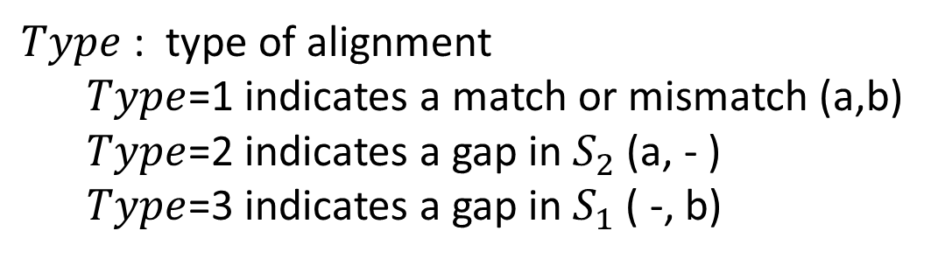
FOGSAA Fast Optimal Global Sequence Alignment Algorithm
Branch and bound tree
root
$Type$ : type of alignment
$Type$=1 indicates a match or mismatch (a,b)
$Type$=2 indicates a gap in $S_{2}$ (a, - )
$Type$=3 indicates a gap in $S_{1}$ ( -, b)
($P_{1},P_{2}$)
$$Type$$
$$PrS$$
$$T_{max}, T_{min}$$

Slide 11
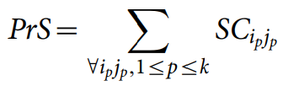
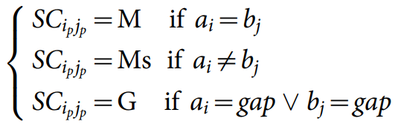
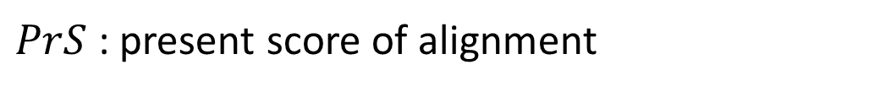
FOGSAA Fast Optimal Global Sequence Alignment Algorithm
Branch and bound tree
root
$PrS$ : present score of alignment
($P_{1},P_{2}$)
$$Type$$
$$PrS$$
$$T_{max}, T_{min}$$

Slide 12
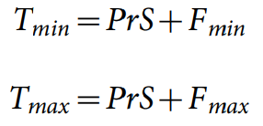
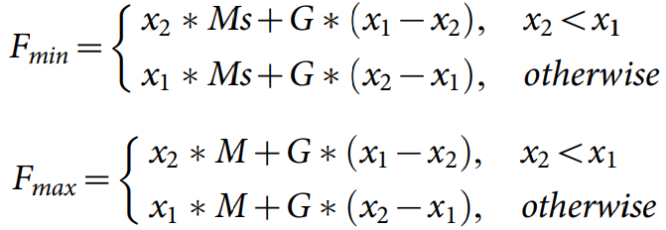

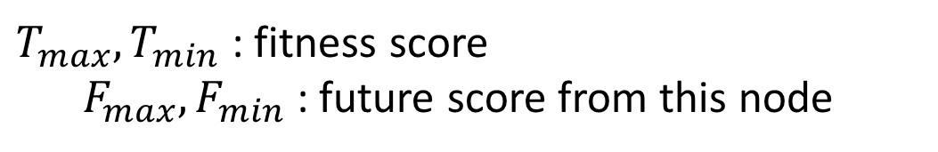



FOGSAA Fast Optimal Global Sequence Alignment Algorithm
Branch and bound tree
root
$T_{max},T_{min}$ : fitness score
$F_{max},F_{min}$ : future score from this node
($P_{1},P_{2}$)
$$Type$$
$$PrS$$
$$T_{max}, T_{min}$$
$$x_{1}$$
$$S_{1}$$
$$x_{2}$$
$$S_{2}$$

Slide 13



FOGSAA Fast Optimal Global Sequence Alignment Algorithm
Branch and bound tree
root
a priority queue ordered by ${ T}_{max}$
($P_{1},P_{2}$)
$$Type$$
$$PrS$$
$$T_{max}, T_{min}$$
($P_{1},P_{2}$)
$$Type$$
$$PrS$$
$$T_{max}, T_{min}$$
($P_{1},P_{2}$)
$$Type$$
$$PrS$$
$$T_{max}, T_{min}$$
($P_{1},P_{2}$)
$$Type$$
$$PrS$$
$$T_{max}, T_{min}$$
($P_{1},P_{2}$)
$$Type$$
$$PrS$$
$$T_{max}, T_{min}$$
($P_{1},P_{2}$)
$$Type$$
$$PrS$$
$$T_{max}, T_{min}$$
($P_{1},P_{2}$)
$$Type$$
$$PrS$$
$$T_{max}, T_{min}$$
($P_{1},P_{2}$)
$$Type$$
$$PrS$$
$$T_{max}, T_{min}$$
($P_{1},P_{2}$)
$$Type$$
$$PrS$$
$$T_{max}, T_{min}$$
($P_{1},P_{2}$)
$$Type$$
$$PrS$$
$$T_{max}, T_{min}$$
($P_{1},P_{2}$)
$$Type$$
$$PrS$$
$$T_{max}, T_{min}$$
($P_{1},P_{2}$)
$$Type$$
$$PrS$$
$$T_{max}, T_{min}$$
($P_{1},P_{2}$)
$$Type$$
$$PrS$$
$$T_{max}, T_{min}$$
best node
($P_{1},P_{2}$)
$$Type$$
$$PrS$$
$$T_{max}, T_{min}$$
($P_{1},P_{2}$)
$$Type$$
$$PrS$$
$$T_{max}, T_{min}$$
($P_{1},P_{2}$)
$$Type$$
$$PrS$$
$$T_{max}, T_{min}$$

Slide 14
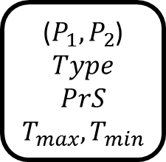
FOGSAA Fast Optimal Global Sequence Alignment Algorithm
Branch and bound tree
root
($P_{1},P_{2}$)
$$Type$$
$$PrS$$
$$T_{max}, T_{min}$$
($P_{1},P_{2}$)
$$Type$$
$$PrS$$
$$T_{max}, T_{min}$$
($P_{1},P_{2}$)
$$Type$$
$$PrS$$
$$T_{max}, T_{min}$$
($P_{1},P_{2}$)
$$Type$$
$$PrS$$
$$T_{max}, T_{min}$$
($P_{1},P_{2}$)
$$Type$$
$$PrS$$
$$T_{max}, T_{min}$$
($P_{1},P_{2}$)
$$Type$$
$$PrS$$
$$T_{max}, T_{min}$$
($P_{1},P_{2}$)
$$Type$$
$$PrS$$
$$T_{max}, T_{min}$$
($P_{1},P_{2}$)
$$Type$$
$$PrS$$
$$T_{max}, T_{min}$$
($P_{1},P_{2}$)
$$Type$$
$$PrS$$
$$T_{max}, T_{min}$$
($P_{1},P_{2}$)
$$Type$$
$$PrS$$
$$T_{max}, T_{min}$$
($P_{1},P_{2}$)
$$Type$$
$$PrS$$
$$T_{max}, T_{min}$$
($P_{1},P_{2}$)
$$Type$$
$$PrS$$
$$T_{max}, T_{min}$$
($P_{1},P_{2}$)
$$Type$$
$$PrS$$
$$T_{max}, T_{min}$$
($P_{1},P_{2}$)
$$Type$$
$$PrS$$
$$T_{max}, T_{min}$$

Slide 15

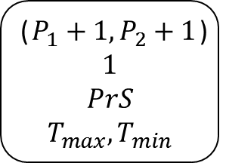
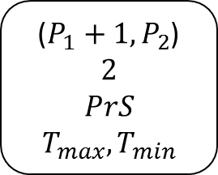
FOGSAA Fast Optimal Global Sequence Alignment Algorithm
Branch and bound tree
root
($P_{1},P_{2}$)
$$Type$$
$$PrS$$
$$T_{max}, T_{min}$$
($P_{1},P_{2}$)
$$Type$$
$$PrS$$
$$T_{max}, T_{min}$$
($P_{1}+1,P_{2}+1$)
$$1$$
$$PrS$$
$$T_{max}, T_{min}$$
($P_{1},P_{2}+1$)
$$3$$
$$PrS$$
$$T_{max}, T_{min}$$
($P_{1},P_{2}$)
$$Type$$
$$PrS$$
$$T_{max}, T_{min}$$
($P_{1},P_{2}$)
$$Type$$
$$PrS$$
$$T_{max}, T_{min}$$
($P_{1}+1,P_{2}$)
$$2$$
$$PrS$$
$$T_{max}, T_{min}$$
($P_{1},P_{2}$)
$$Type$$
$$PrS$$
$$T_{max}, T_{min}$$
($P_{1},P_{2}$)
$$Type$$
$$PrS$$
$$T_{max}, T_{min}$$
($P_{1},P_{2}$)
$$Type$$
$$PrS$$
$$T_{max}, T_{min}$$
($P_{1},P_{2}$)
$$Type$$
$$PrS$$
$$T_{max}, T_{min}$$
($P_{1},P_{2}$)
$$Type$$
$$PrS$$
$$T_{max}, T_{min}$$
($P_{1},P_{2}$)
$$Type$$
$$PrS$$
$$T_{max}, T_{min}$$
($P_{1},P_{2}$)
$$Type$$
$$PrS$$
$$T_{max}, T_{min}$$
($P_{1},P_{2}$)
$$Type$$
$$PrS$$
$$T_{max}, T_{min}$$
($P_{1},P_{2}$)
$$Type$$
$$PrS$$
$$T_{max}, T_{min}$$
($P_{1},P_{2}$)
$$Type$$
$$PrS$$
$$T_{max}, T_{min}$$

Slide 16
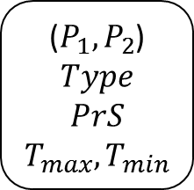
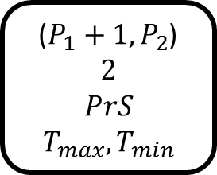
FOGSAA Fast Optimal Global Sequence Alignment Algorithm
Branch and bound tree
root
($P_{1},P_{2}$)
$$Type$$
$$PrS$$
$$T_{max}, T_{min}$$
($P_{1},P_{2}$)
$$Type$$
$$PrS$$
$$T_{max}, T_{min}$$
($P_{1}+1,P_{2}+1$)
$$1$$
$$PrS$$
$$T_{max}, T_{min}$$
($P_{1},P_{2}+1$)
$$3$$
$$PrS$$
$$T_{max}, T_{min}$$
($P_{1},P_{2}$)
$$Type$$
$$PrS$$
$$T_{max}, T_{min}$$
($P_{1},P_{2}$)
$$Type$$
$$PrS$$
$$T_{max}, T_{min}$$
($P_{1}+1,P_{2}$)
$$2$$
$$PrS$$
$$T_{max}, T_{min}$$
($P_{1},P_{2}$)
$$Type$$
$$PrS$$
$$T_{max}, T_{min}$$
($P_{1},P_{2}$)
$$Type$$
$$PrS$$
$$T_{max}, T_{min}$$
($P_{1},P_{2}$)
$$Type$$
$$PrS$$
$$T_{max}, T_{min}$$
($P_{1},P_{2}$)
$$Type$$
$$PrS$$
$$T_{max}, T_{min}$$
($P_{1},P_{2}$)
$$Type$$
$$PrS$$
$$T_{max}, T_{min}$$
($P_{1},P_{2}$)
$$Type$$
$$PrS$$
$$T_{max}, T_{min}$$
($P_{1},P_{2}$)
$$Type$$
$$PrS$$
$$T_{max}, T_{min}$$
($P_{1},P_{2}$)
$$Type$$
$$PrS$$
$$T_{max}, T_{min}$$
($P_{1},P_{2}$)
$$Type$$
$$PrS$$
$$T_{max}, T_{min}$$
($P_{1},P_{2}$)
$$Type$$
$$PrS$$
$$T_{max}, T_{min}$$

Slide 17
FOGSAA Fast Optimal Global Sequence Alignment Algorithm
End of this algorithm
Find a way to align these sequences
If less than 30% similarity,
terminate with an approximate score
(the best score obtained so far).

Slide 18
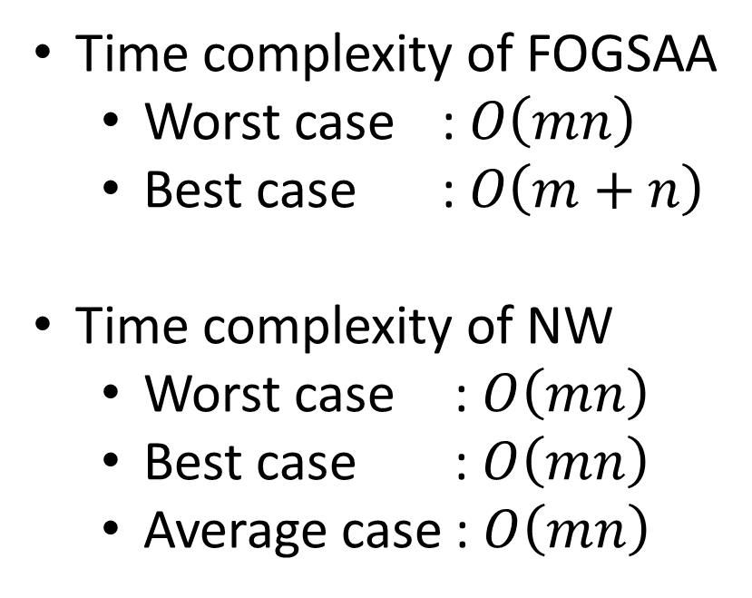
Time complexity
Time complexity of FOGSAA
Worst case : $O\left(mn\right)$
Best case : $O\left(m+n\right)$
Time complexity of NW
Worst case : $O\left(mn\right)$
Best case : $O\left(mn\right)$
Average case : $O\left(mn\right)$

Slide 19
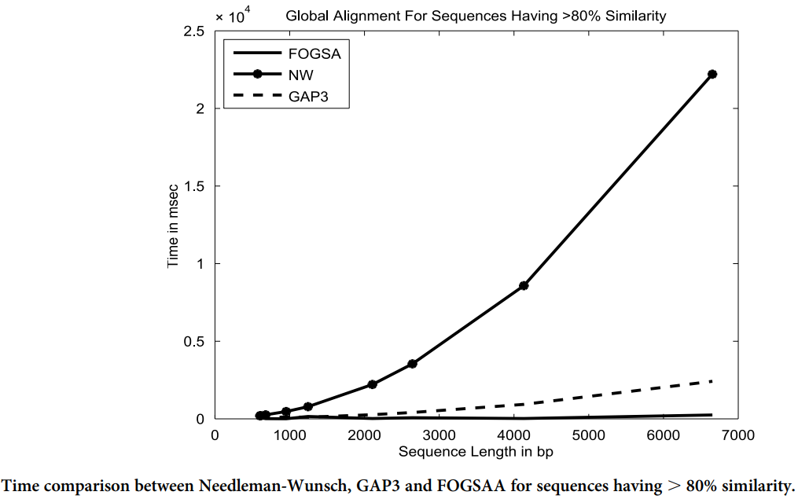
Result

Slide 20
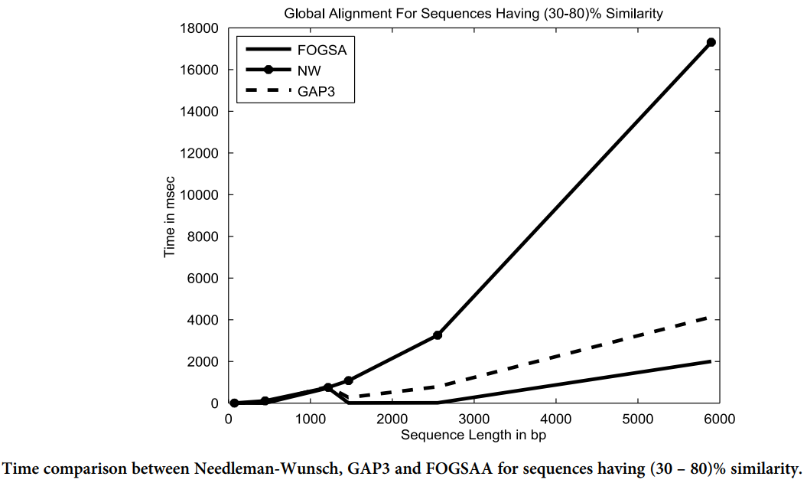
Result

Slide 21
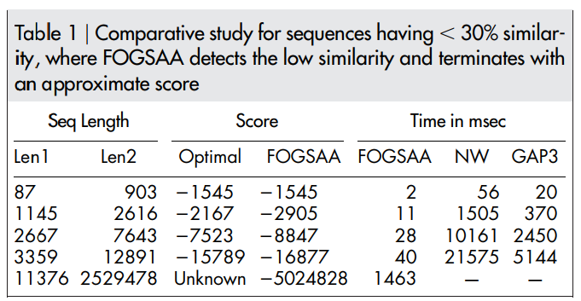
Result

Slide 22
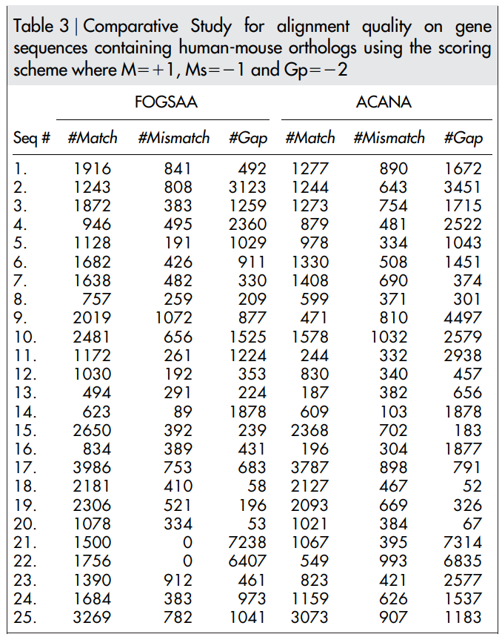
Result

