Slide 1
Deep Direct Reinforcement Learning for Financial Signal Representation and Trading
Yue Deng, Feng Bao, Youyong Kong, Zhiquan Ren, and Qionghai Dai, Senior Member, IEEE
IEEE TRANSACTIONS ON NEURAL NETWORKS AND LEARNING SYSTEMS, VOL. 28, NO. 3, MARCH 2017
Presenter：Jia-Hong Liu
Date：2017/8/1

Slide 2
Abstract(1/2)
Can we train the computer to beat experienced traders for financial assert trading? In this paper, we try to address this challenge by introducing a recurrent deep neural network (NN) for real-time financial signal representation and trading. Our model is inspired by two biological-related learning concepts of deep learning (DL) and reinforcement learning (RL). In the framework, the DL part automatically senses the dynamic market condition for informative feature learning.

Slide 3
Abstract(2/2)
Then, the RL module interacts with deep representations and makes trading decisions to accumulate the ultimate rewards in an unknown environment. The learning system is implemented in a complex NN that exhibits both the deep and recurrent structures. Hence, we propose a task-aware backpropagation through time method to cope with the gradient vanishing issue in deep training. The robustness of the neural system is verified on both the stock and the commodity future markets under broad testing conditions.

Slide 4
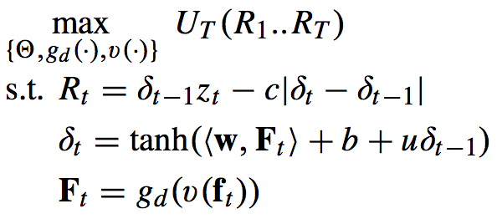


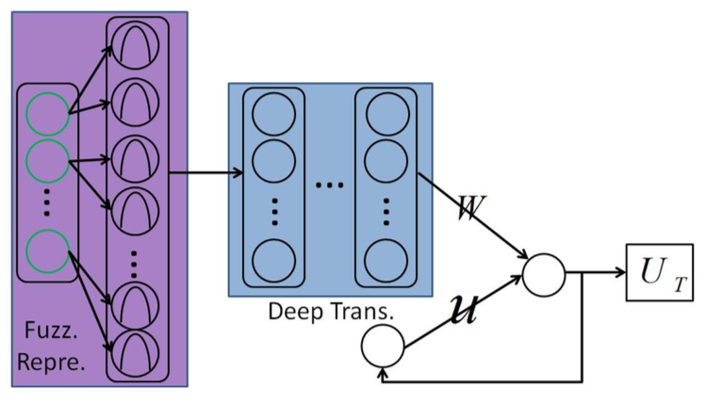
Model
where U_{T}{·} is the accumulated rewards in the period of 1, . . . , T .
Notes:
The raw price changes of the last 45 min and the momentum change to the previous 3 h, 5 h, 1 day, 3 days, and 10 days is directly used as the input of the trading system (ft ∈ R50). In the fuzzy learning part, each of the 50 input nodes are connected with three fuzzy membership functions to seek for the first-level fuzzy representation in R150. Then, the fuzzy layer is sequentially passed through four deep transformation layers with 128, 128, 128, and 20 hidden nodes per layer. The feature representation (Ft ∈ R20) of the final deep layer is connected with the DRL part for trading policy making.

Slide 5
Model
where U_{T}{·} is the accumulated rewards in the period of 1, . . . , T .
1 min
~
45 min
3 h
5 h
…
…
…
…
1 day
…
…
3 days
10 days
50
150
128
128
128
20
Notes:
The raw price changes of the last 45 min and the momentum change to the previous 3 h, 5 h, 1 day, 3 days, and 10 days is directly used as the input of the trading system (ft ∈ R50). In the fuzzy learning part, each of the 50 input nodes are connected with three fuzzy membership functions to seek for the first-level fuzzy representation in R150. Then, the fuzzy layer is sequentially passed through four deep transformation layers with 128, 128, 128, and 20 hidden nodes per layer. The feature representation (Ft ∈ R20) of the final deep layer is connected with the DRL part for trading policy making.

Slide 6
fuzzy part
1 min
~
45 min
<m₁,m₂,…,m_{n-1},m_{n}>
3 h
5 h
…
…
…
…
1 day
…
…
3 days
10 days
<f₁,f₂,…,f_{m-1},f_{m}>
50
150
128
128
128
20

Slide 7
Autoencoder
1 min
~
45 min
3 h
…
…
…
…
…
…
5 h
…
1 day
…
…
3 days
10 days
50
150
128
128
128
20

Slide 8
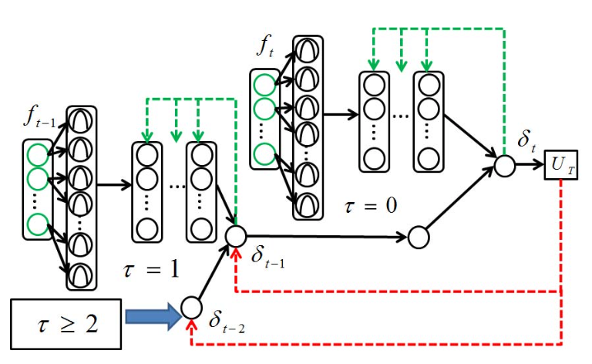
BPTT
Notes:
The system is only trained for 100 epochs with a gradient decreasing parameter be ηc = 0.97

Slide 9
training
initialization
Training set
5000
5000
12000
3000
(min)
5 times
Notes:
we conduct model selection to select a good model for the out-of-sample data. To achieve this goal, 15000 training points are divided into two sets as RDNN training set (first 12 000) and validation set (last 3000). On the first 12000 time points, FDDR is trained for 5 times and the best one is selected on the next 3000 blind points. Such validation helps to exclude some highly overfitted NNs from the training set.

Slide 10
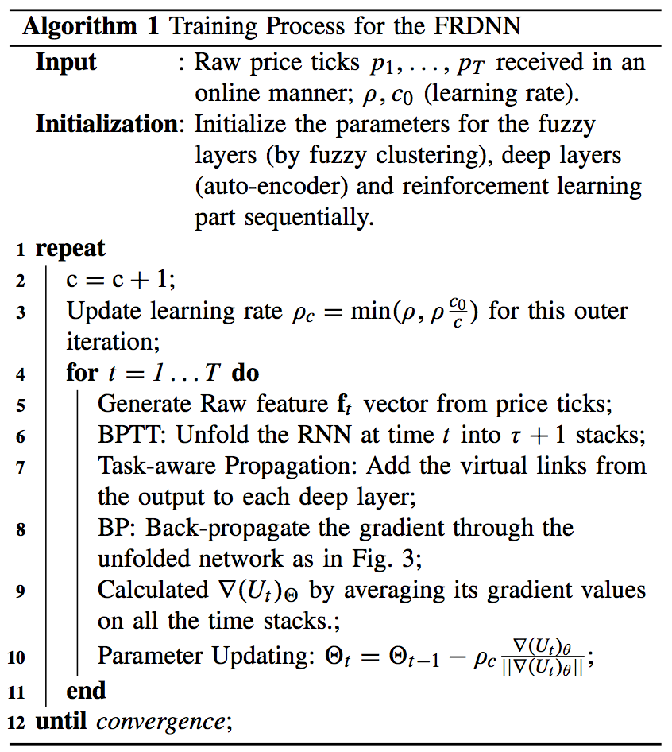

Slide 11


General Evaluations
where U_{T}{·} is the accumulated rewards in the period of 1, . . . , T .

Slide 12
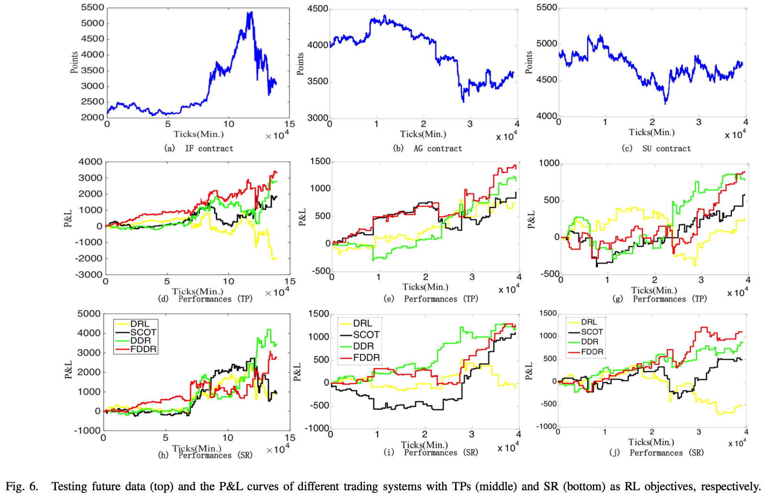
Notes:
Scot: sparse coding model
silver (AG) and sugar (SU)

Slide 13
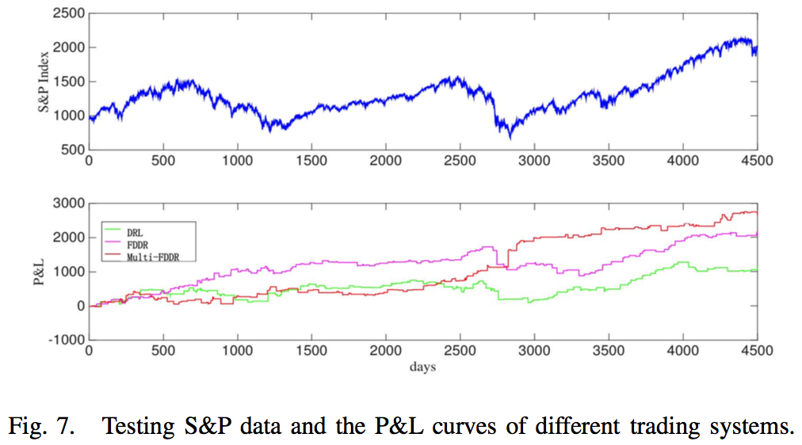
January 1990 to September 2015
Multi-FDDR: FTSE100 index (U.K.), Hangseng Index (Hong Kong), Nikkei 225 (Japan), and Shanghai Stock Index (China).
Notes:
s&p 500: January 1990 to September 2015
In this case, we fix the trading cost to 0.1% of the index value.
The relative indices include the FTSE100 index (U.K.), Hangseng Index (Hong Kong), Nikkei 225 (Japan), and Shanghai Stock Index (China).

Slide 14
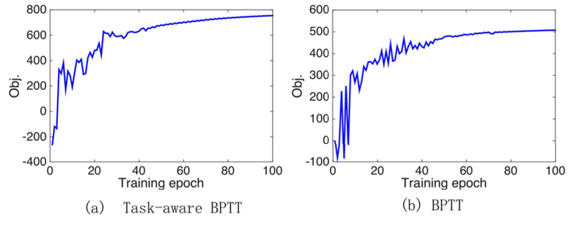

BPTT
Notes:
此學習過程是以一次一個訓練樣本的方式，直到學習完所有的訓練樣 本，稱之為一個循環週期(Epoch)

Slide 15
