Slide 1
Bag-of-Temporal-SIFT-Words for Time Series Classification
Adeline Bailly, Simon Malinowski, Romain Tavenard,
Thomas Guyet, and Ltitia Chapel
Proceedings of 1st International Workshop on Advanced Analytics and Learning on Temporal Data(AALTD), Sept. 2015,<city>
Presenter : Bo-Xian Chen
Date : 2017/8/23

Slide 2
Abstract
Time series classification is an application of particular interest with the increase of data to monitor. Classical techniques for time series classification rely on point-to-point distances. Recently, Bag-of-Words approaches have been used in this context. Words are quantized versions of simple features extracted from sliding windows. The SIFT framework has proved efficient for image classification. In this paper, we design a time series classification scheme that builds on the SIFT frame-work adapted to time series to feed a Bag-of-Words. Experimental results show competitive performance with respect to classical techniques.

Slide 3
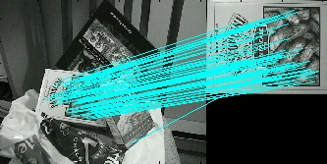

Scale-invariant feature transform(SIFT)
Computer vision $→$ local feature
Location
Scale
rotation
Notes:
David Lowe website :
http://www.cs.ubc.ca/~lowe/keypoints/

Slide 4
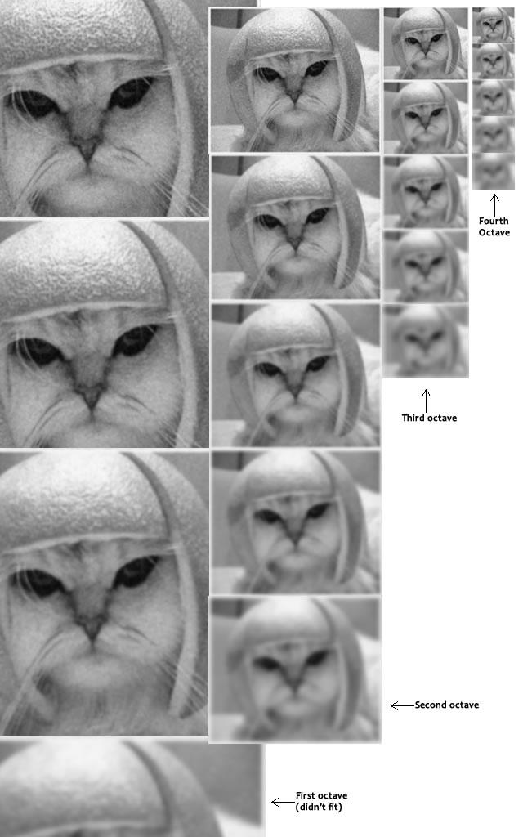
Scale-invariant feature transform(SIFT)
Scale Space
Gaussian Blur
4 octaves and 5 blur level
Notes:
David Lowe website :
http://www.cs.ubc.ca/~lowe/keypoints/

Slide 5
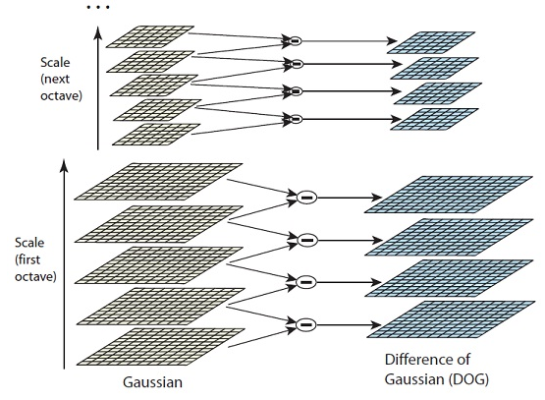
Scale-invariant feature transform(SIFT)
Notes:
David Lowe website :
http://www.cs.ubc.ca/~lowe/keypoints/

Slide 6
Bag-of-Temporal-SIFT-Words(BoTSW)
Detection of keypoints
Description of these keypoints by gradient magnitude
Representation of time series by a BoW

Slide 7
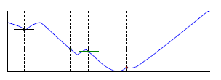
Bag-of-Temporal-SIFT-Words(BoTSW)

Slide 8
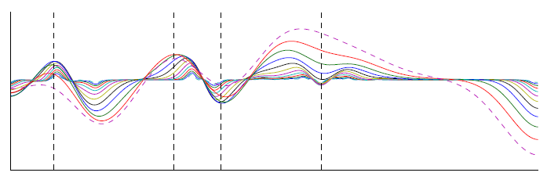
Bag-of-Temporal-SIFT-Words(BoTSW)

Slide 9
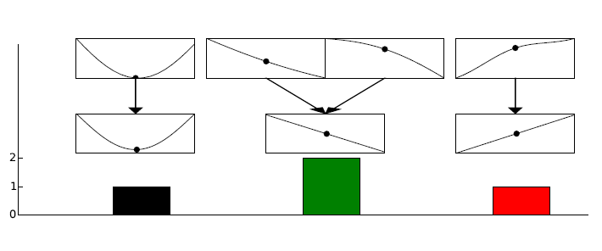
Bag-of-Temporal-SIFT-Words(BoTSW)

Slide 10
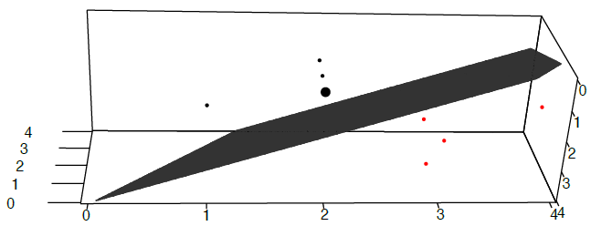
Bag-of-Temporal-SIFT-Words(BoTSW)

Slide 11
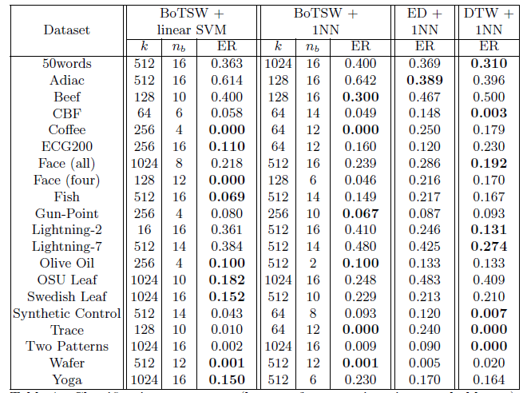
Experimental Results

Slide 13
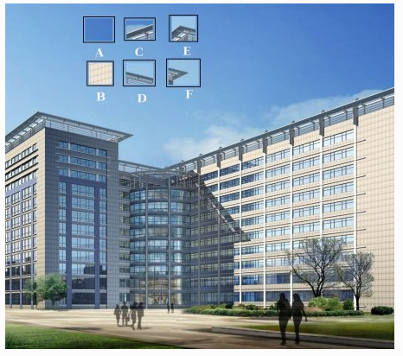
Feature

Slide 14
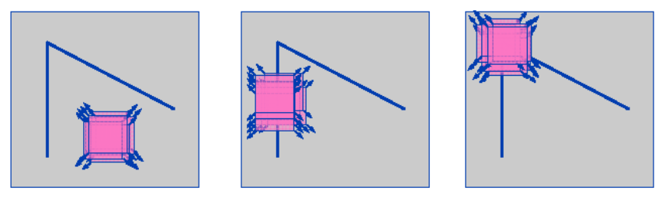
Harris Corner Detector
flat
edge
corner
Notes:
David Lowe website :
http://www.cs.ubc.ca/~lowe/keypoints/

Slide 15


Harris Corner Detector
Notes:
David Lowe website :
http://www.cs.ubc.ca/~lowe/keypoints/

