Slide 1
TAIEX Forecasting Using Fuzzy Time Series and Automatically Generated Weights of Multiple Factors
Shyi-Ming Chen, Fellow, IEEE, Huai-Ping Chu, and Tian-Wei Sheu
IEEE TRANSACTIONS ON SYSTEMS, MAN, AND CYBERNETICS—PART A: SYSTEMS AND HUMANS, VOL. 42, NO. 6, NOVEMBER 2012
Presenter: Shih-jhan Huang
Date: 2017/8/23

Slide 2
Abstract
In this paper, we present a new method to forecast the Taiwan Stock Exchange Capitalization Weighted Stock Index (TAIEX) using fuzzy time series and automatically generated weights of multiple factors. The proposed method uses the variation magnitudes of adjacent historical data to generate fuzzy variation groups of the main factor (i.e., the TAIEX) and the elementary secondary factors (i.e., the Dow Jones, the NASDAQ and the M1B), respectively. Based on the variation magnitudes of the main factor TAIEX and the elementary secondary factors of a particular trading day, it constructs the occurrence vector of the main factor and the occurrence vectors of the elementary secondary factors on the trading day, respectively. By calculating the correlation coefficients between the numerical data series of the main factor and the numerical data series of each elementary secondary factor, respectively, it calculates the relevance degree between the forecasted variation of the main factor and the forecasted variation of each elementary secondary factor.

Slide 3
Based on the correlation coefficients between the numerical data series of the main factor and the numerical data series of each elementary secondary factor on a trading day, it automatically generates the weights of the occurrence vector of the main factor and the occurrence vector of each elementary secondary factor on the trading day, respectively. Then, it calculates the forecasted variation of the main factor and the forecasted variation of each elementary secondary factor on the trading day, respectively, to obtain the final forecasted variation on the trading day. Finally, based on the closing index of the TAIEX on the trading day and the final forecasted variation on the trading day, it generates the forecasted value of the next trading day. The experimental results show that the proposed method outperforms the existing methods.

Slide 4
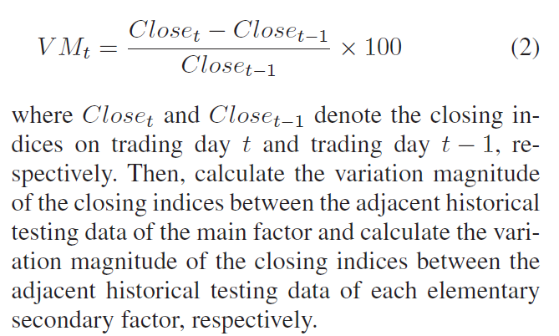
Method
Step 1: Caculate the variation magnitude of the closing indices between the asjacent historical training data
main factor: TAIEX
elementary secondary factors:
Dow Jones, NASDAQ and M1B

Slide 5
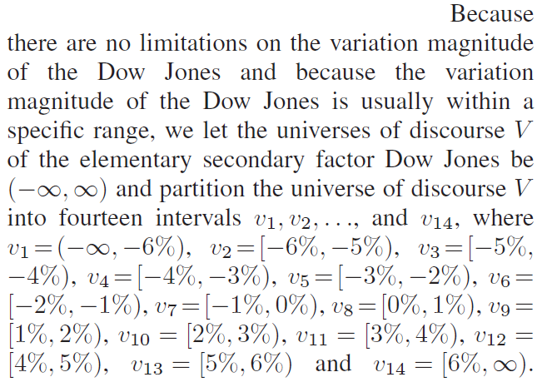
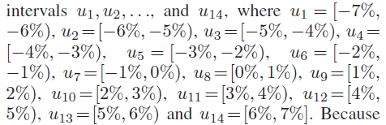
Step 2: Based on the fluctuation of the variation magnitude of each factor, define the universes of discourse of each factor and partition the universes of discourse of each factor into intervals, respectively.
當時台灣漲跌幅規定為7%；
美國各指數則無限制。
TAIEX maximum positive fluctuation: 7% TAIEX maximum negative fluctuation: -7%

Slide 6
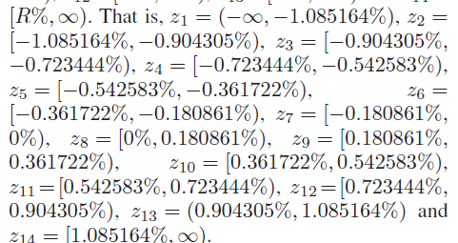
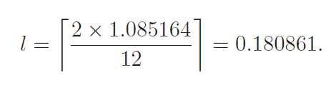
區間可視情況調整:
The variation magnitude of the elementary secondary factor M1B distributes irregularly.
Because the largest variation magnitude between any two consecutive days of the historical training data of the M1B from January 2004 to October 2004 occurred on January 2, 2004, which is equal to −1.085164
其餘Z₂~Z₁₃區間距離(1l)：

Slide 7
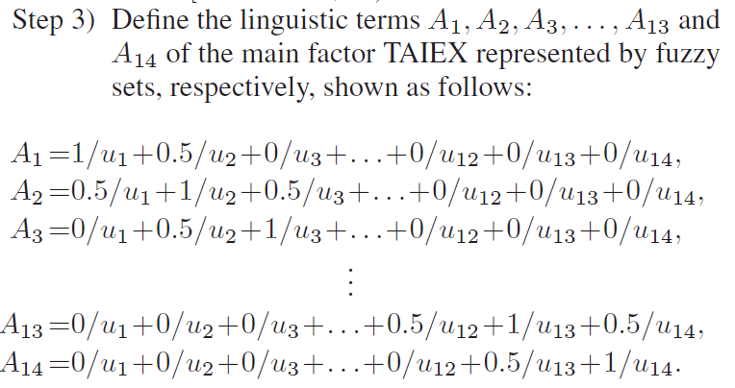
Step 3: 根據步驟2所得之重新分配好的區間來定義模糊集合A_{i}，這裡分成14組

Slide 8

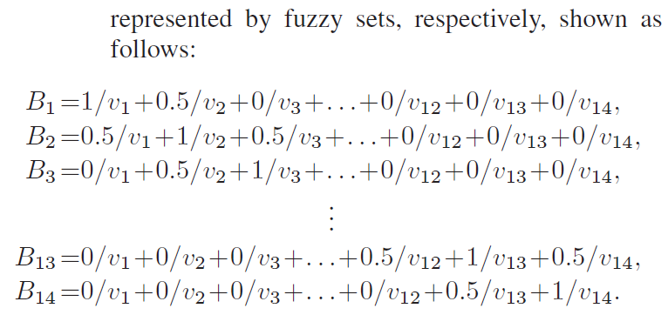

Slide 9
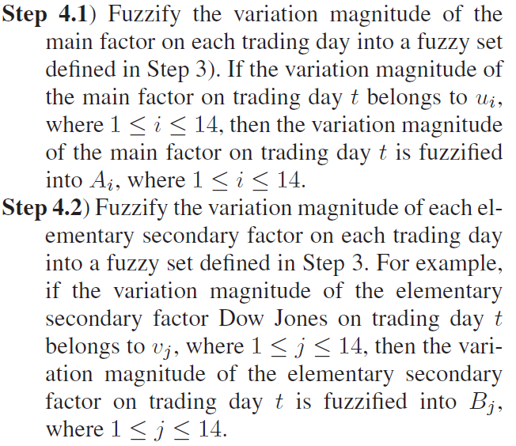
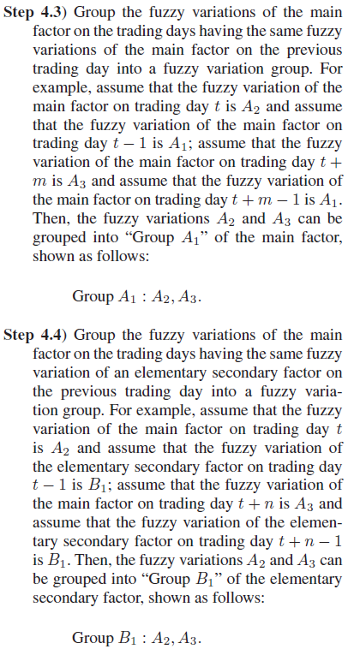






Step 4: Fuzzify the variation magnitude between the adjacent historical training data of the main factor and fuzzify the variation magnitude between the adjacent historical training data of the elementary secondary factors, respectively.
$mt−1$ $→$ $A1$
$μi$ $→$ $Ai$
$mt$ $→$ $A2$
$mt+m−1$ $→$ $A1$
$mt+m$ $→$ $A3$
$vi$ $→$ $Bj$

Slide 10




$st−1$ $→$ $B1$
$mt$ $→$ $A2$
$st+n−1$ $→$ $B1$
$mt+n$ $→$ $A3$

Slide 11
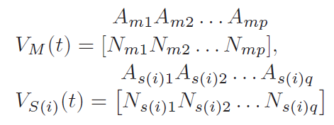
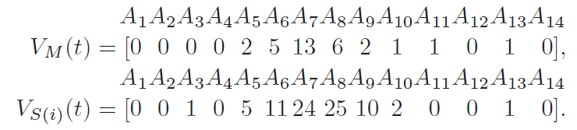
Step 5: construct the occurrence vector V_{M}(t) of the main factor and construct the occurrence vector V_{S(i)}(t) of the ith elementary secondary factor on trading day t, respectively, shown as follows:
A_{mp}: 為A_{p}可能出現在Group A_{m}的項目
N_{mp}: 為A_{p}出現在Group A_{m}的次數
Assume:
FVar_{M}(t-1) → A₉
FVar_{S}(t-1) → B₇
The fuzzy variations appearing in the fuzzy variation group “Group A9”.
The fuzzy variations appearing in the fuzzy variation group “Group B7” of the ith elementary secondary factor

Slide 12
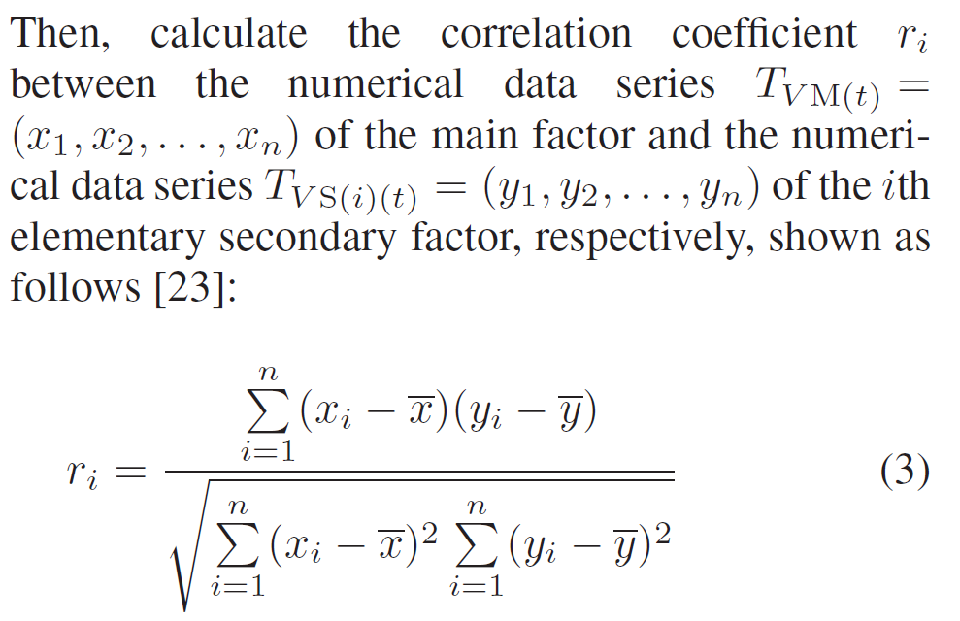
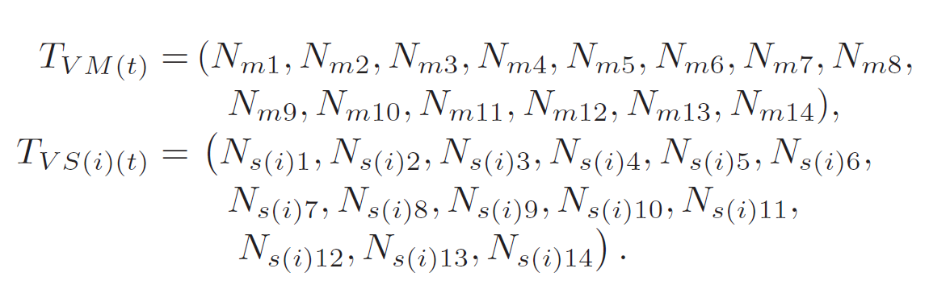
Step 6: Calculate the correlation coefficient between the occurrence vector V_{M}(t) of the main factor on trading day t and the occurrence vector V_{S(i)}(t) of the ith elementary secondary factor on trading day t, respectively.
r_{i} > 0: 兩者正相關，並採納該elementary secondary factor
r_{i} = 0: elementary secondary factor的預測變化量與
main factor的預測變化量無關。
r_{i} < 0: 兩者負相關

Slide 13
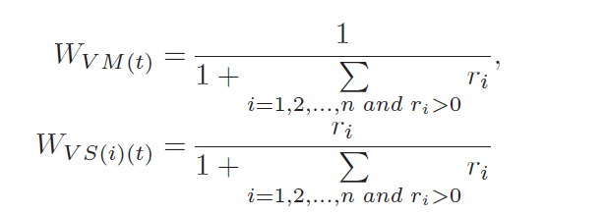
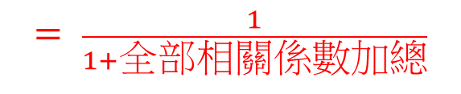
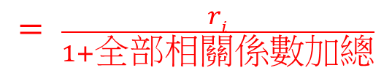
Step 7: Calculate the weight W_{VM(t)} of the occurrence vector V_{M}(t) of the main factor on trading day t, and calculate the weightW_{VS(i)(t)} of the occurrence vector V_{S(i)}(t) of the ith elementary secondary factor on trading day t, respectively. (只採納正相關的elementary secondary factor)
$$= \frac{1}{1+全部相關係數加總}$$
$$= \frac{ri}{1+全部相關係數加總}$$
where n denotes the number of elementary secondary factors, r_{i} denotes the correlation coefficient between the numerical data series TV M(t) and the numerical data series TV S(i)(t).

Slide 14
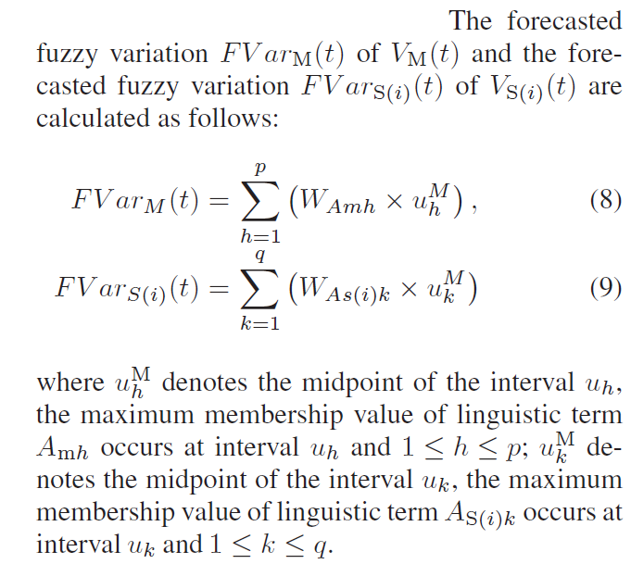
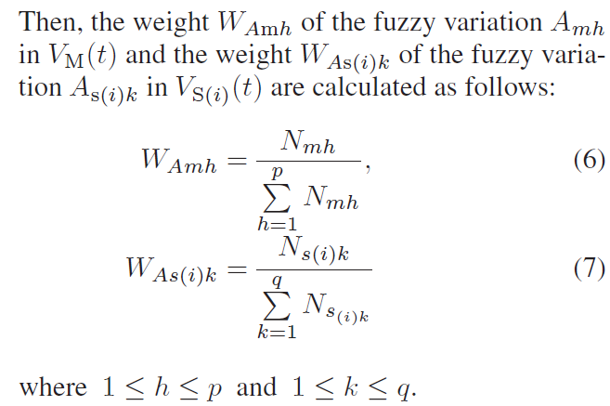
Step 8: Generate the final forecasted variation of the main factor on training day t.

Slide 15
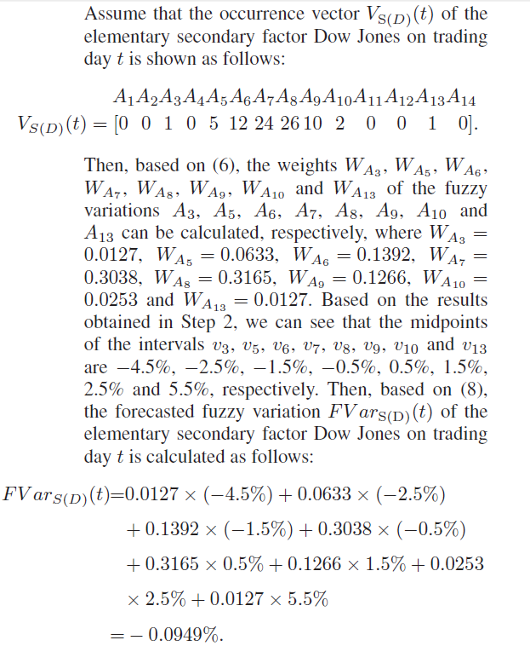

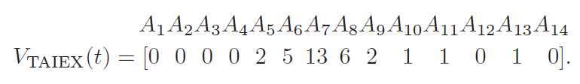
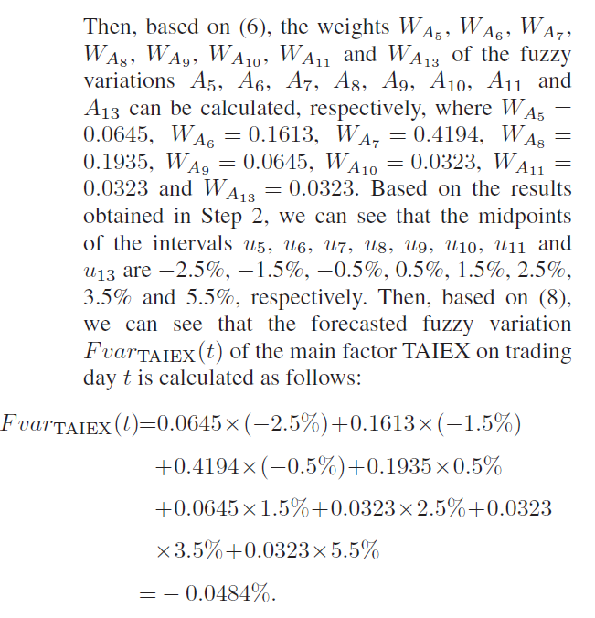
Example

Slide 16
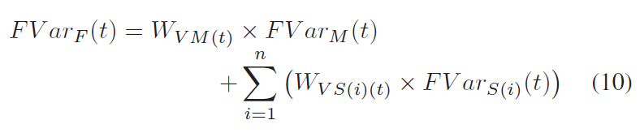
Then, Calculate the final forecasted variation FVar_{F}(t) of the main factor on trading day t.

Slide 17
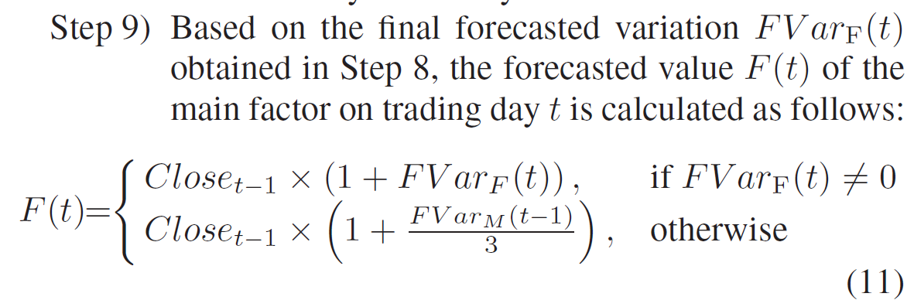
最後預測的點數值

Slide 18
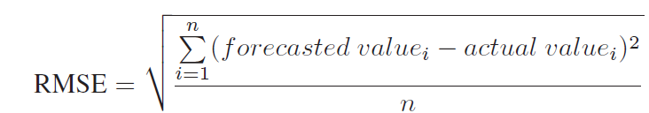
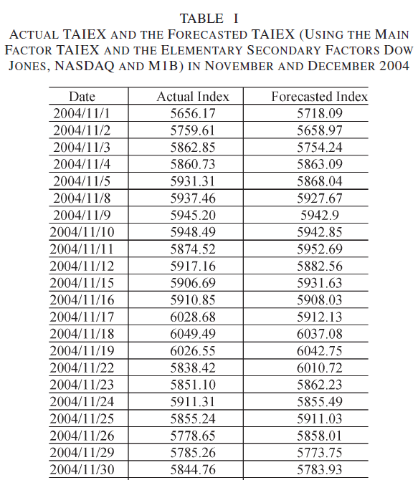
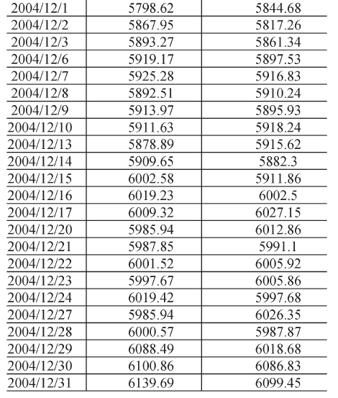
Experimental results
training data: Jan. ~ Oct.
testing data: Nov. ~ Dec.
(Each year)

Slide 19
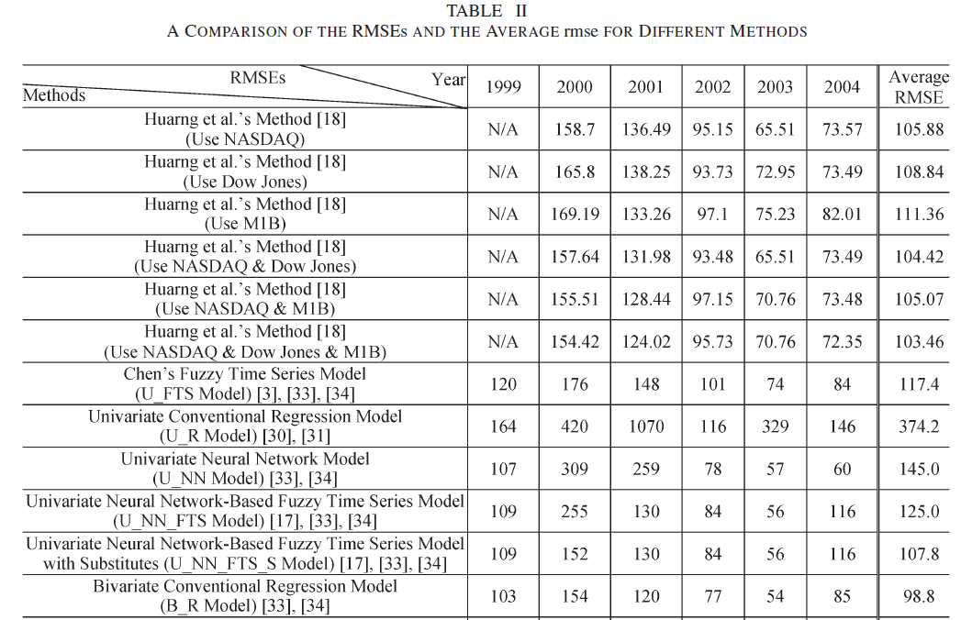

Slide 20
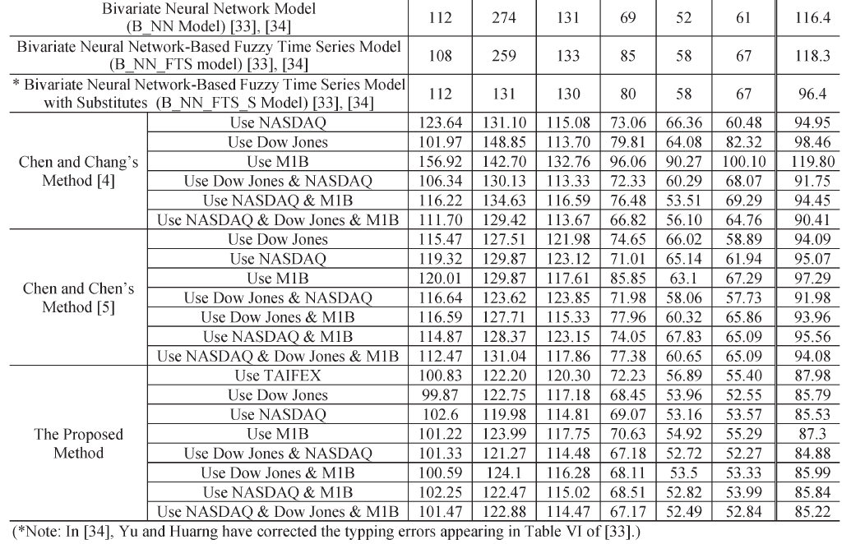

Slide 21
