Slide 1
Time-series Averaging Using Constrained Dynamic Time Warping with Tolerance
Marion Morel, Catherine Achard, Richard Kulpa, S´everine Dubuisson
Pattern Recognition, August, 2017
Presenter : Bo-Xian Chen
Date : 2017/9/20

Slide 2
Abstract
In this paper, we propose an innovative averaging of a set of time-series based on the Dynamic Time Warping (DTW). The DTW is widely used in data mining since it provides not only a similarity measure, but also a temporal alignment of time-series. However, its use is often restricted to the case of a pair of signals. In this paper, we propose to extend its application to a set of signals by providing an average time-series that opens a wide range of applications in data mining process. Starting with an existing well-established method called DBA (for DTW Barycenter Averaging), this paper points out its limitations and suggests an alternative based on a Constrained Dynamic Time Warping. Secondly, an innovative tolerance is added to take into account the admissible variability around the average signal. This new modeling of time-series is evaluated on a classification task applied on several datasets and results show that it outperforms state of the art methods.

Slide 3
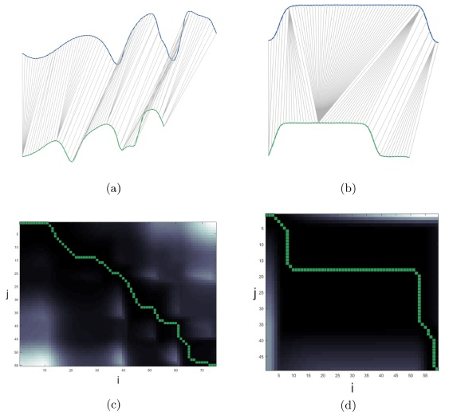

Dynamic Time Warping(DTW)
$$D_{i, j}=d_{i, j}+\min\left\{\begin{aligned}&D_{i, j−1} \\ &D_{i−1, j} i=2, …, M j=2, …, N \\ &D_{i−1, j−1}\end{aligned}\right.$$
Warping Path
$$φ_{xy}=\left\{\begin{aligned}\left[1;K\right]→\left[1;M\right]×[1;N] \\ k→φ_{xy}\left(k\right)=(φ_{xy}^{x}\left(k\right),φ_{xy}^{y}\left(k\right))\end{aligned}\right.$$
$$\max\left(M, N\right)≤K≤M+N−1$$

Slide 4
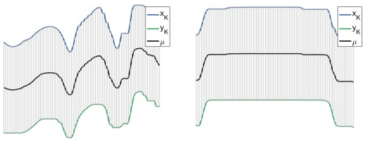

Time-Series averaging
Two new aligned signals $x_{k}(k)$ and $y_{k}(k)$
$$x_{k}\left(k\right)=x\left(φ_{xy}^{x}\left(k\right)\right) k=1,…,K \\ y_{k}\left(k\right)=y\left(φ_{xy}^{y}\left(k\right)\right) k=1,…,K$$

Slide 5

Extension of Time-Series averaging
Nonlinear alignment and averaging filters(NLAAF)
N time series $\left\{x_{1}\left(k\right), …, x_{N}\left(k\right)\right\}$, using DTW recursively.
$\max\left(M, N\right)≤K≤M+N−1→$ $much longer TS$
91
75
55

Slide 6
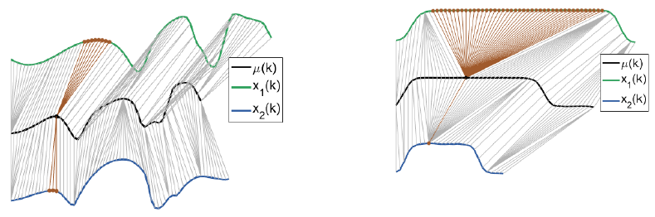

DTW Barycenter Averaging(DBA)(1/2)
Randomly choose a signal $x_{0}\left(k\right)→μ\left(k\right)=x_{0}(k)$
Iterate IT times :
Align all signals $x_{l}\left(k\right) on μ\left(k\right)$ and compute warping paths $φ_{ux_{l}}$
Update every point of the average signal $μ\left(k\right)$

Slide 7
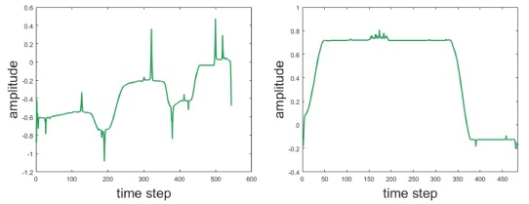
DTW Barycenter Averaging(DBA)(2/2)
4 iterations

Slide 8
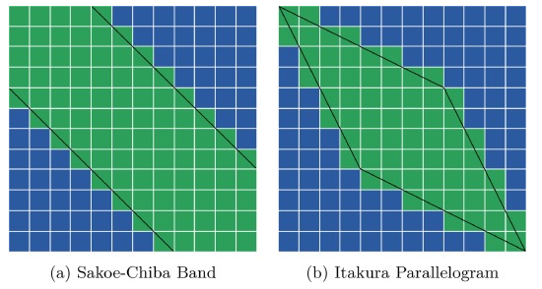
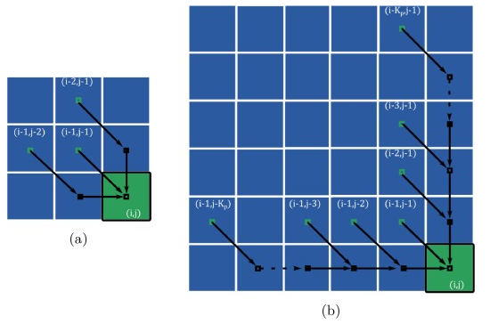
Constrained DTW(CDTW)(1/3)
Warping path
globally
locally

Slide 9
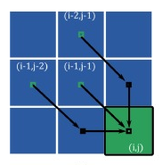


Constrained DTW(CDTW)(2/3)
$$D_{i, j}=\min\left\{\begin{aligned}&D_{i−1, j−2}+d_{i, j−1}+d_{i, j} \\ &D_{i−1, j−1}+d_{i, j} \\ &D_{i−2, j−1}+d_{i−1, j}+d_{i, j}\end{aligned}\right.$$
$$K_{p}=2$$

Slide 10
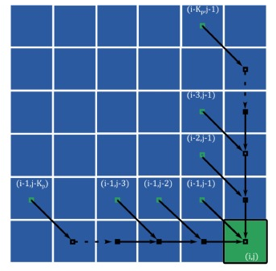
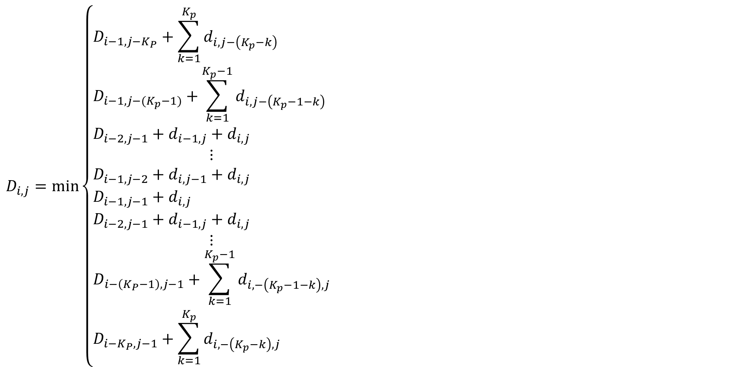

Constrained DTW(CDTW)(3/3)
$$K_{p}$$
$$D_{i, j}=\min\left\{\begin{aligned}&D_{i−1, j−K_{P}}+\sum_{k=1}^{K_{p}}{d_{i, j−\left(K_{p}−k\right)}} \\ &D_{i−1, j−(K_{p}−1)}+\sum_{k=1}^{K_{p}−1}{d_{i, j−\left(K_{p}−1−k\right)}} \\ &D_{i−2, j−1}+d_{i−1, j}+d_{i, j} \\ ⋮ \\ &D_{i−1, j−2}+d_{i,j−1}+d_{i,j} \\ &D_{i−1, j−1}+d_{i,j} \\ &D_{i−2, j−1}+d_{i−1,j}+d_{i, j} \\ ⋮ \\ &D_{i−\left(K_{P}−1\right), j−1}+\sum_{k=1}^{K_{p}−1}{d_{i,−\left(K_{p}−1−k\right), j}} \\ &D_{i−K_{P}, j−1}+\sum_{k=1}^{K_{p}}{d_{i,−\left(K_{p}−k\right), j}}\end{aligned}\right.$$

Slide 11
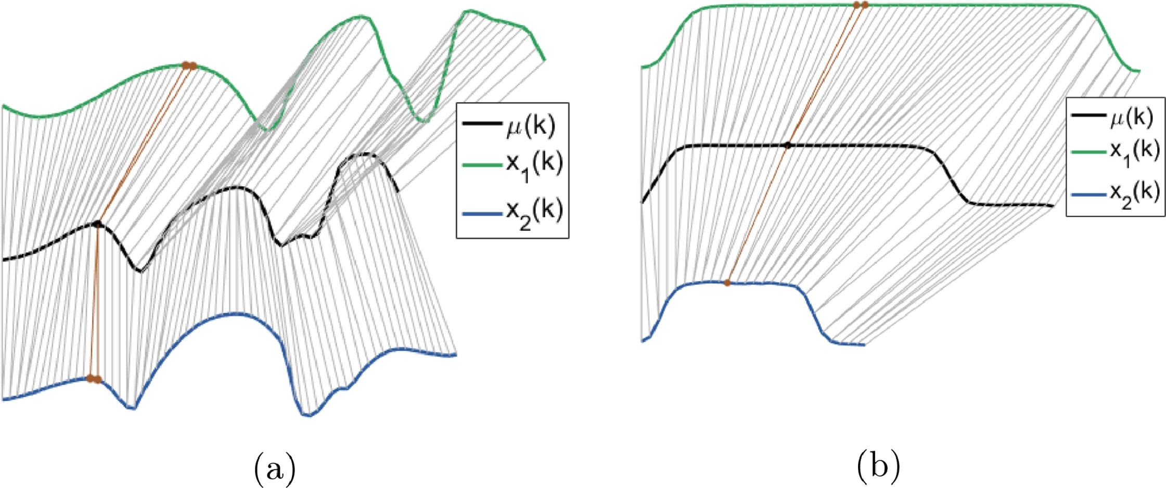
Constrained DTW Barycenter Averaging(CDBA)(1/2)

Slide 12
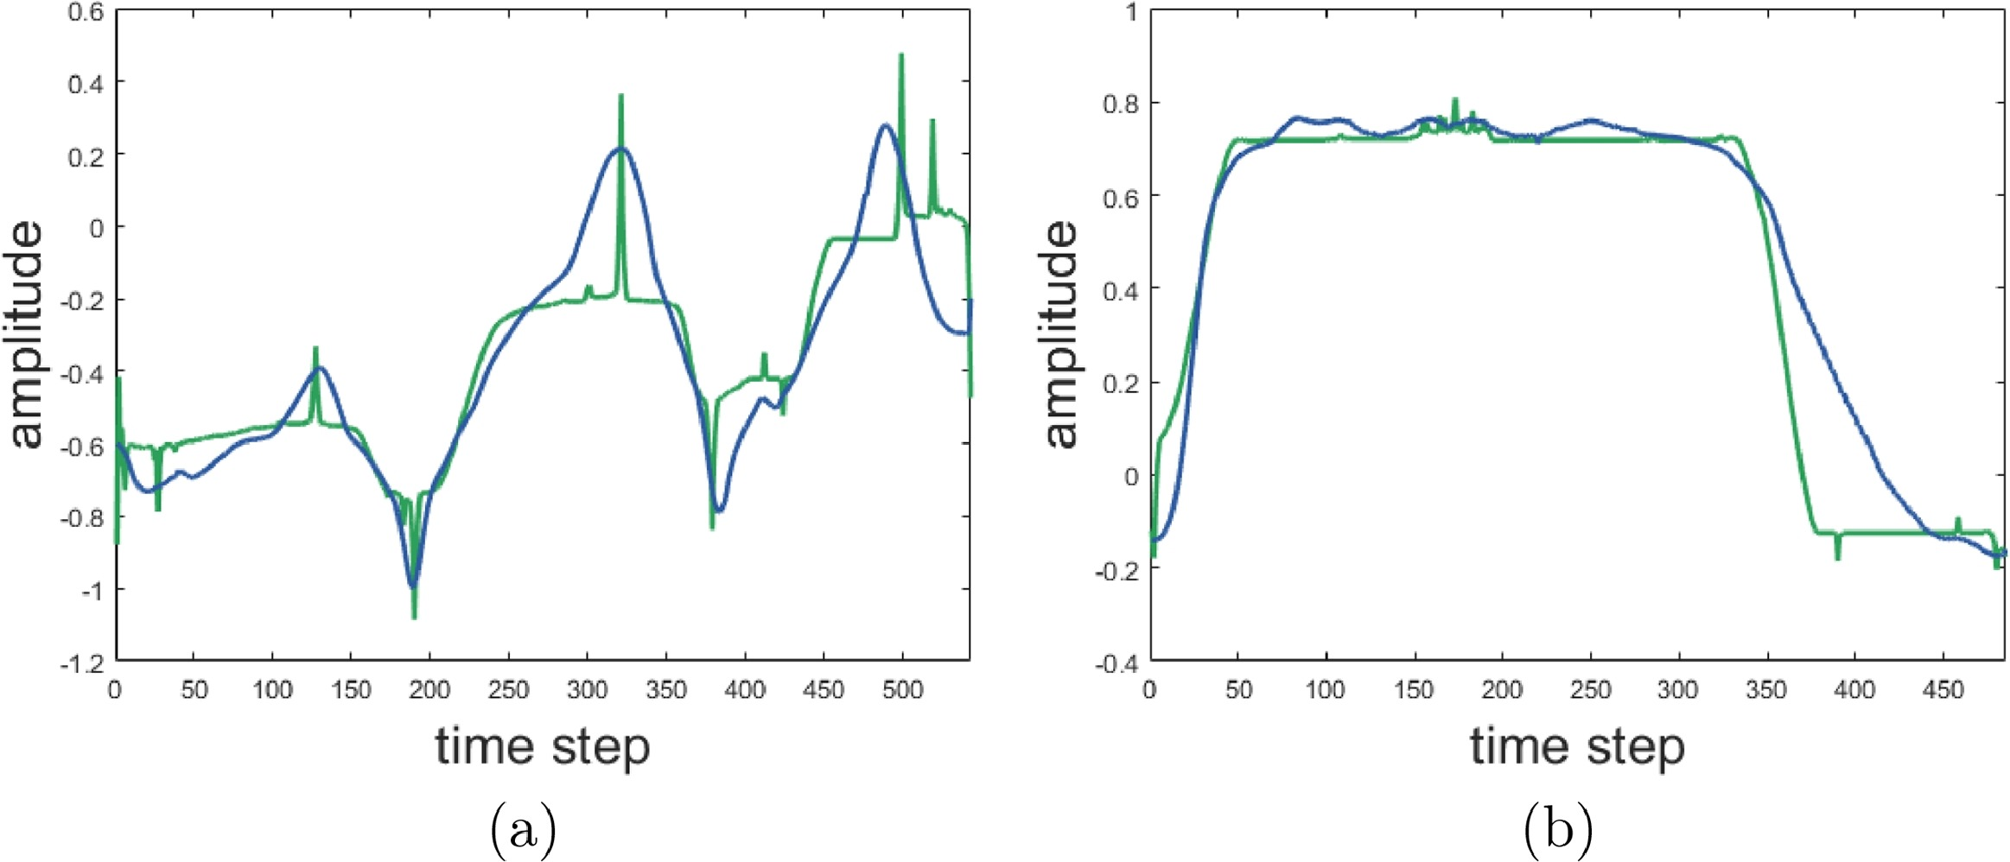
Constrained DTW Barycenter Averaging(CDBA) (2/2)
DBA(in green) and CDBA( in blue)

Slide 13
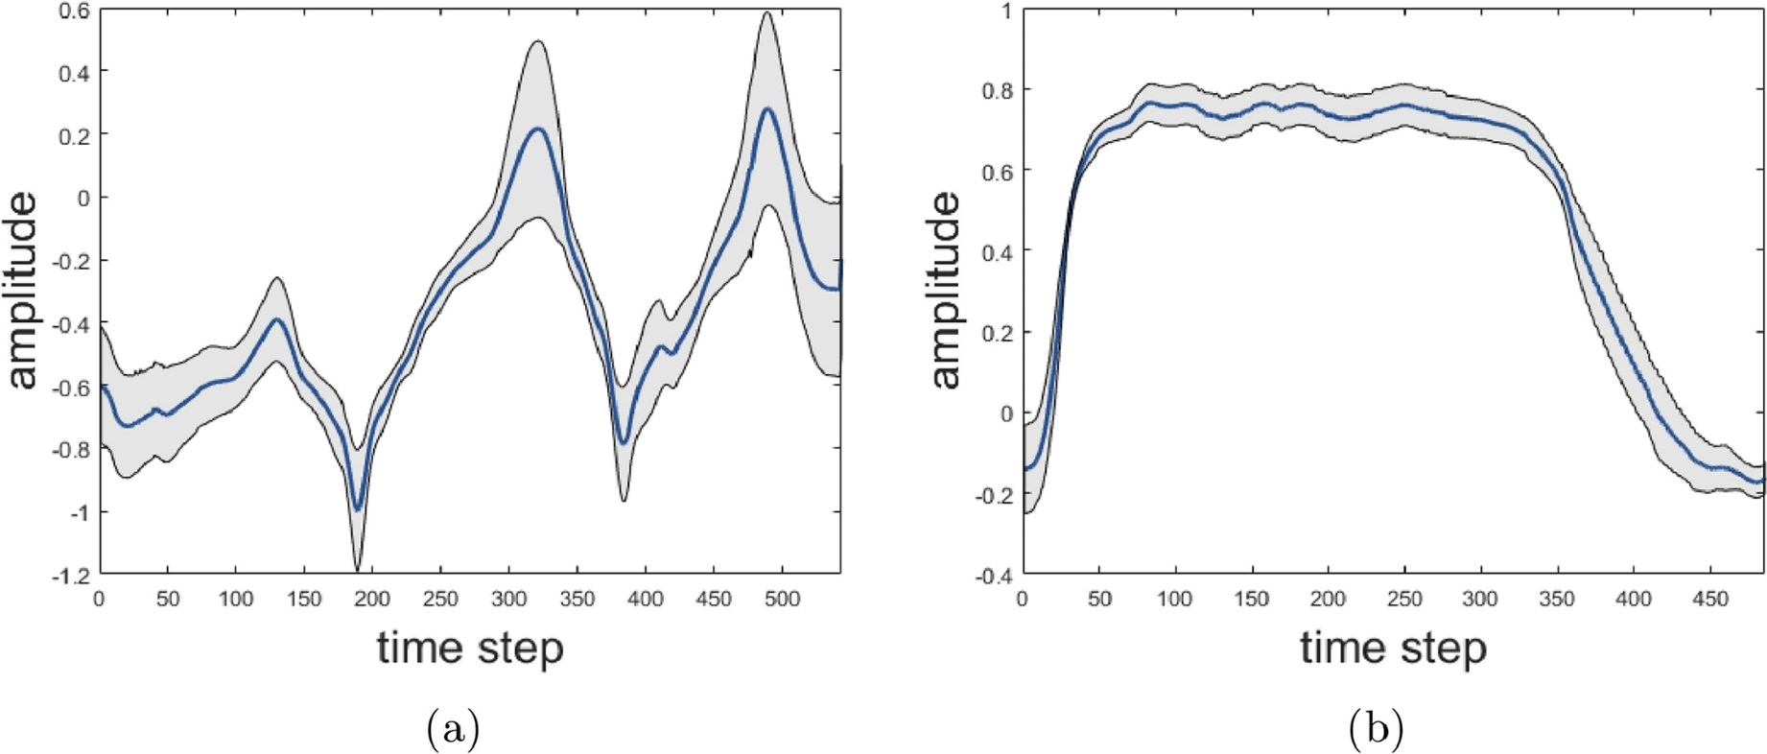
Adding Tolerance to CDBA
Tolerance is $±\left(1×σ\right)$, where$σ$ is the standard deviation

Slide 14
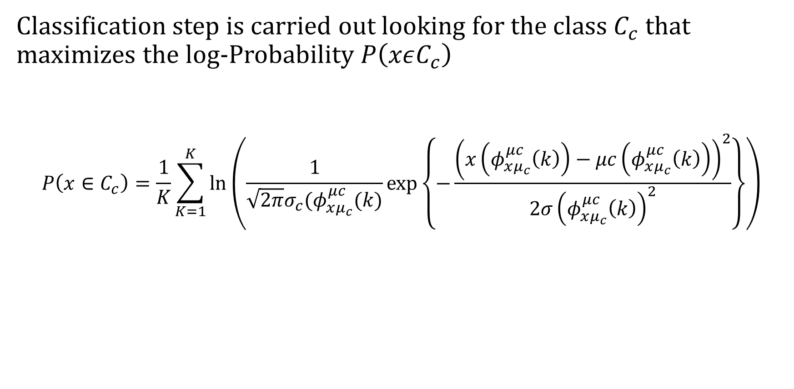
Classification Procedure
Classification step is carried out looking for the class $C_{c}$ that maximizes the log-Probability $P\left(xεC_{c}\right)$
$$P\left(x∈C_{c}\right)=\frac{1}{K}\sum_{K=1}^{K}{ln⁡\left(\frac{1}{\sqrt{2π}σ_{c}(φ_{xμ_{c}}^{μc}(k)}exp⁡\left\{−\frac{{\left(x\left(φ_{xμ_{c}}^{μc}\left(k\right)\right)−μc\left(φ_{xμ_{c}}^{μc}\left(k\right)\right)\right)}^{2}}{2σ{\left(φ_{xμ_{c}}^{μc}\left(k\right)\right)}^{2}}\right\}\right)}$$
Notes:
https://en.wikipedia.org/wiki/Log_probability

Slide 15
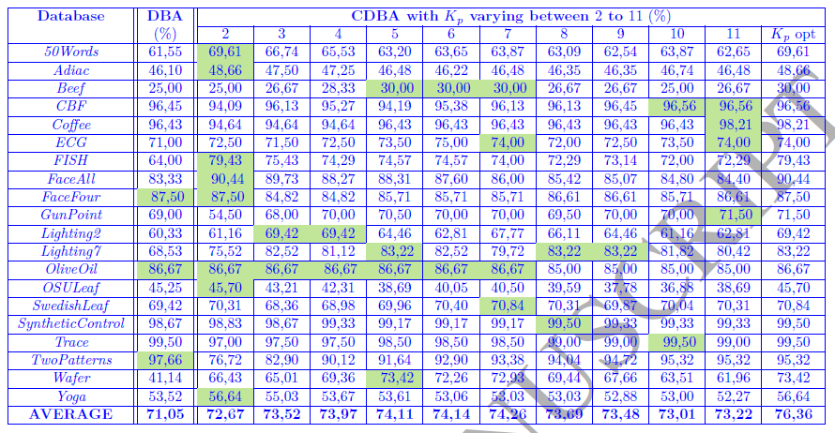
Experimental Results(1/4)

Slide 16
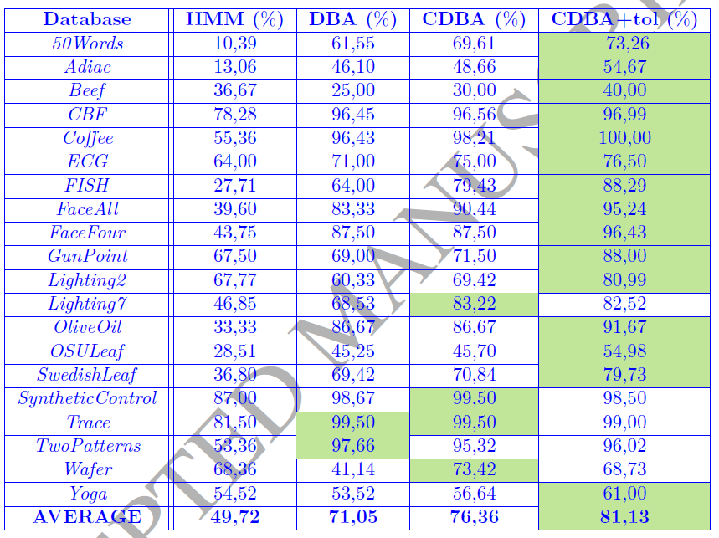
Experimental Results(2/4)

Slide 17
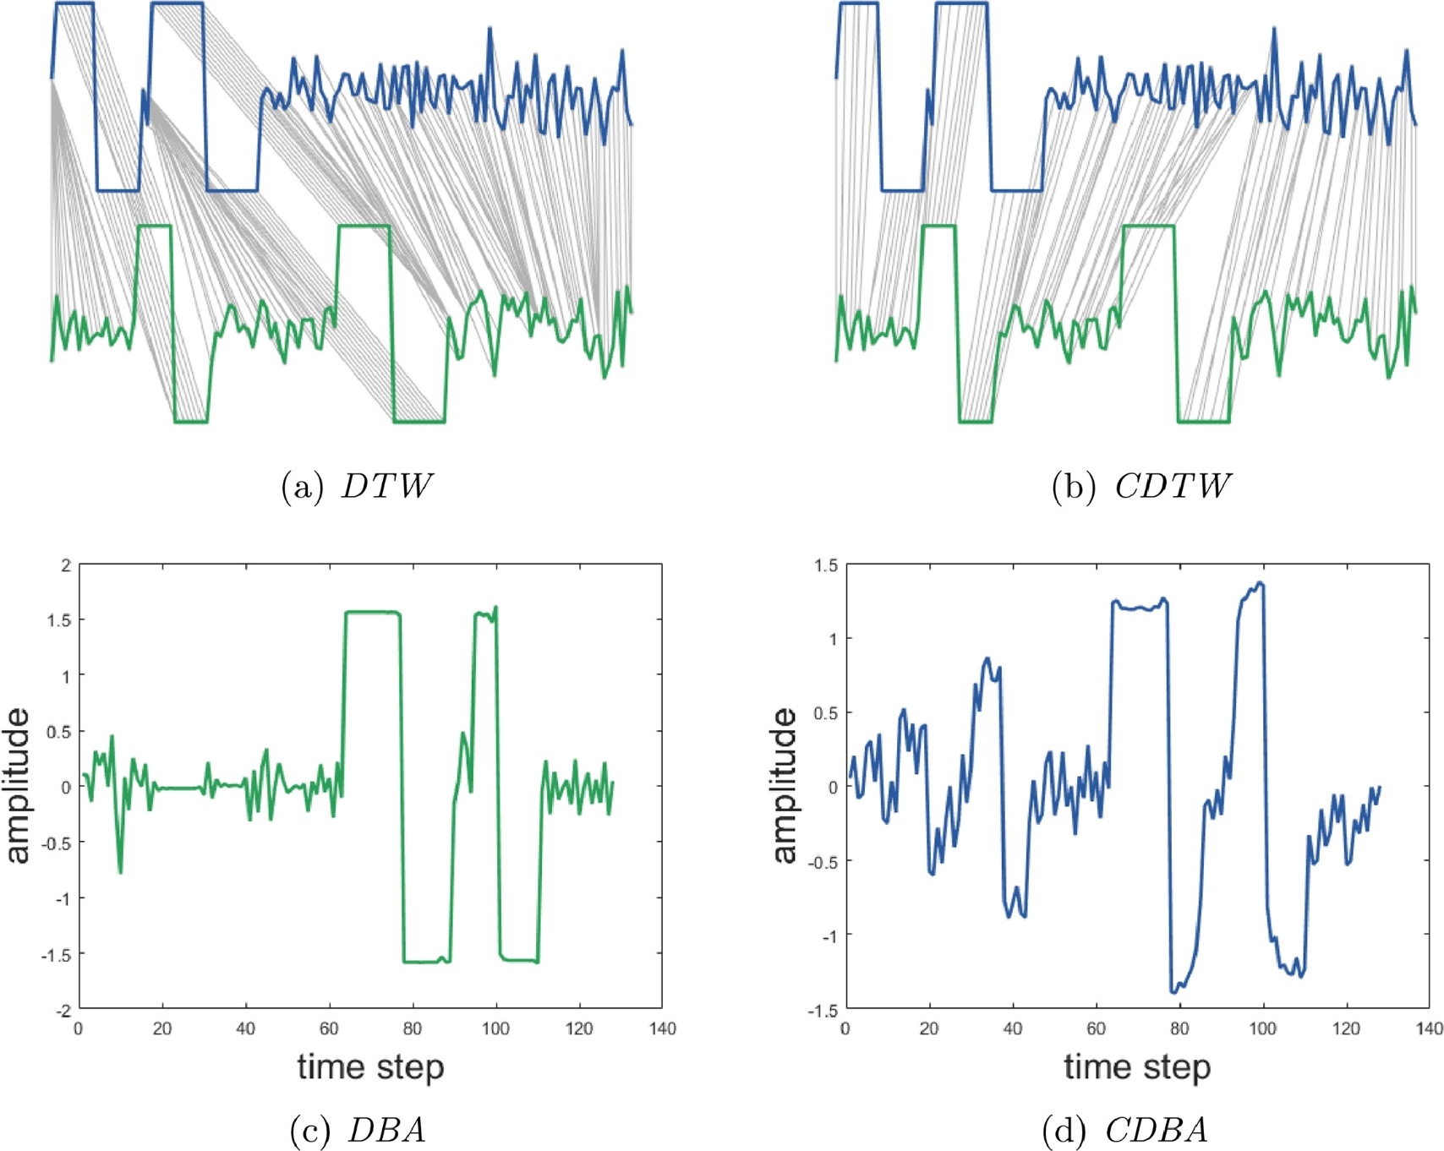
Experimental Results(3/4)

Slide 18
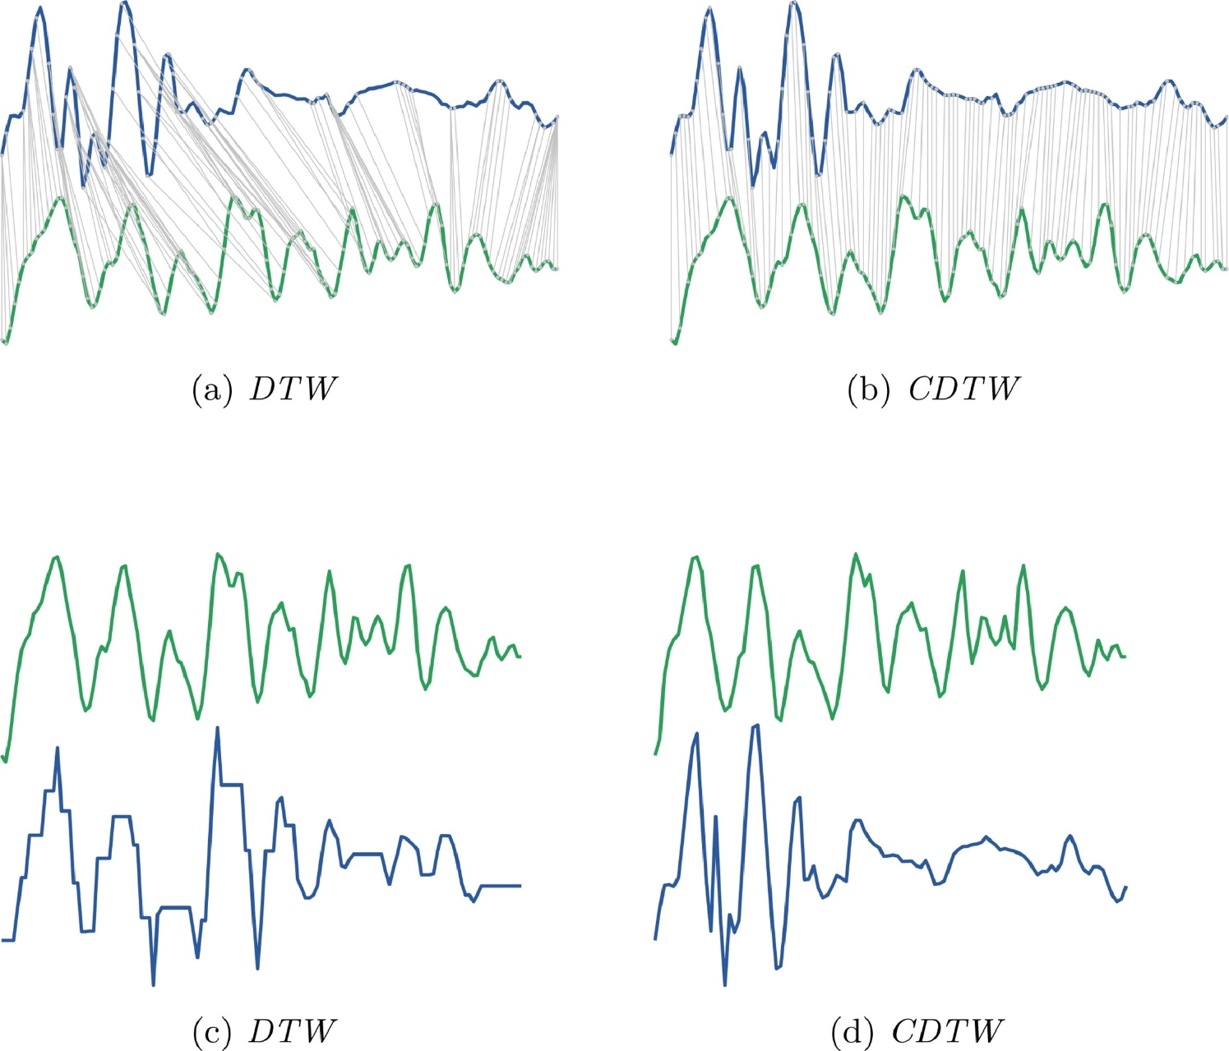
Experimental Results(4/4)

