Slide 1
IEEE Transactions on Image Processing, vol. 23, no. 4, pp. 1513-1526, April, 2014 Weiming Hu, Ruiguang Hu, Nianhua Xie, Haibin Ling and Stephen Maybank
Image Classification Using Multi-Scale Information Fusion Based on Saliency Driven Nonlinear Diffusion Filtering
Presenter：Wei-Hao Fu
Date：2017/09/20
Notes:
1

Slide 2
Abstract (1/2)
In this paper, we propose saliency driven image multi-scale nonlinear diffusion filtering. The resulting scale space in general preserves or even enhances semantically important structures such as edges, lines, or flow like structures in the foreground, and inhibits and smooths clutter in the background. The image is classified using multi-scale information fusion based on the original image, the image at the final scale at which the diffusion process converges, and the image at a mid-scale.

Slide 3
Abstract (2/2)
Our algorithm emphasizes the foreground features which are important for image classification. The background image regions, whether considered as contexts of the foreground or noise to the foreground, can be globally handled by fusing information from different scales. Experimental tests of the effectiveness of the multi-scale space for image classification are conducted on the following publicly available datasets: the PASCAL 2005 dataset, the Oxford 102 flowers dataset, and the Oxford 17 flowers dataset, with high classification rates.

Slide 4
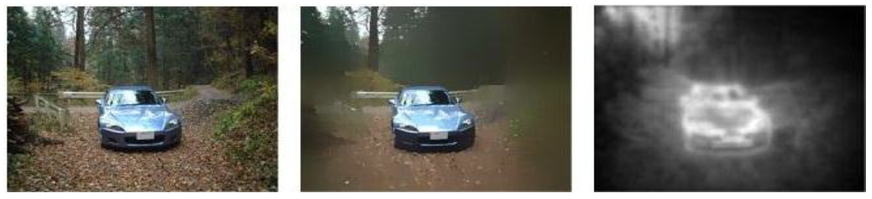
Saliency driven diffusion filtering

Slide 5
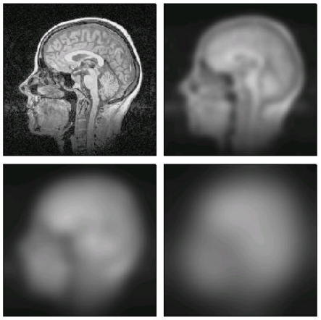
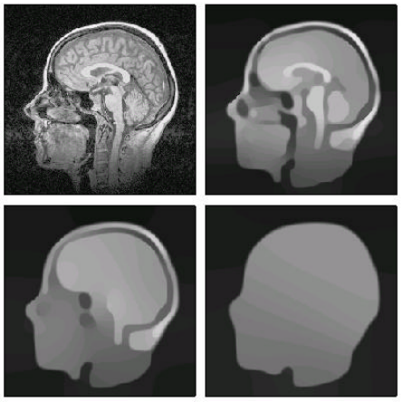
Nonlinear diffusion
The motivation of nonlinear diffusion is that we want to smooth the image with different weights.
We use smoothed image to smooth image again. Because the unimportant structure was smoothed and didn’t affect the result of smoothing.
Reference: http://webfiles.portal.chalmers.se/s2/undergraduate/SSY095/PDFdocuments/ForScreen/Notes/NonLinearDiffusion.pdf

Slide 6
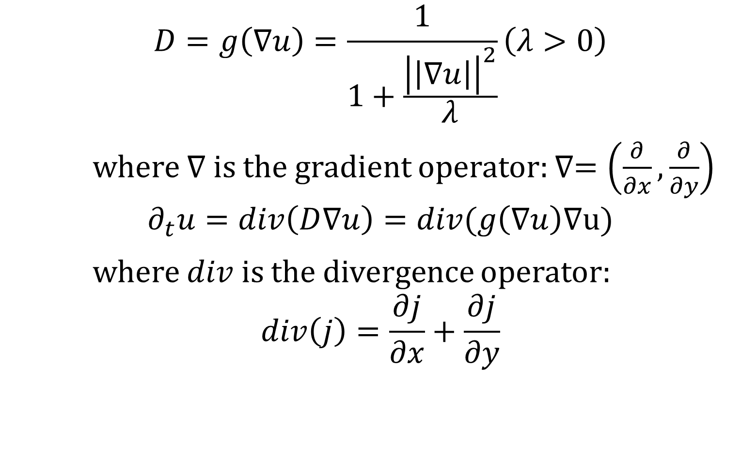
Nonlinear diffusion
$$D=g\left(∇u\right)=\frac{1}{1+\frac{{\left|\left|∇u\right|\right|}^{2}}{λ}}\left(λ>0\right)$$
where $∇$ is the gradient operator: $∇=\left(\frac{∂}{∂x},\frac{∂}{∂y}\right)$
$$∂_{t}u=div\left(D∇u\right)=div(g\left(∇u\right)∇u)$$
where $div$ is the divergence operator:
$$div\left(j\right)=\frac{∂j}{∂x}+\frac{∂j}{∂y}$$

Slide 7
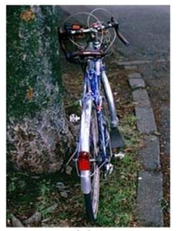
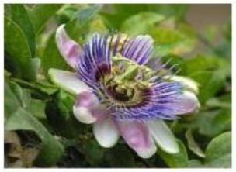
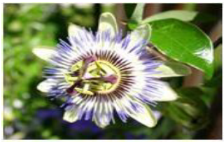
Saliency
What is saliency?
Something stands out more than others.

Slide 8
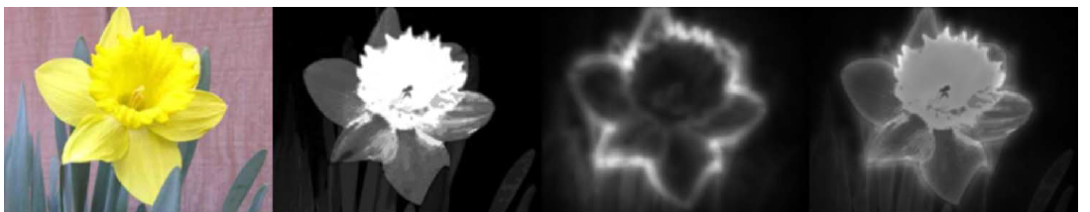
Saliency detection
Goferman’s method: produces high values of saliency at the edges of an object but lower saliency within the object.
Cheng’s method separates a large object from its surroundings, and enables the assignment of similar saliency values to homogenous object regions, and highlights entire objects.
Notes:
S. Goferman, L. Zelnik-Manor, and A. Tal, “Context-Aware Saliency Detection,” in Proc. of IEEE Conference on Computer Vision and Pattern Recognition, pp. 2376-2383, 2010.
M. M. Cheng, G. X. Zhang, N. J. Mitra, X. L. Huang, and S. M. Hu, “Global Contrast Based Salient Region Detection,” in Proc. of IEEE Conference on Computer Vision and Pattern Recognition, pp. 409-416, 2011.

Slide 9
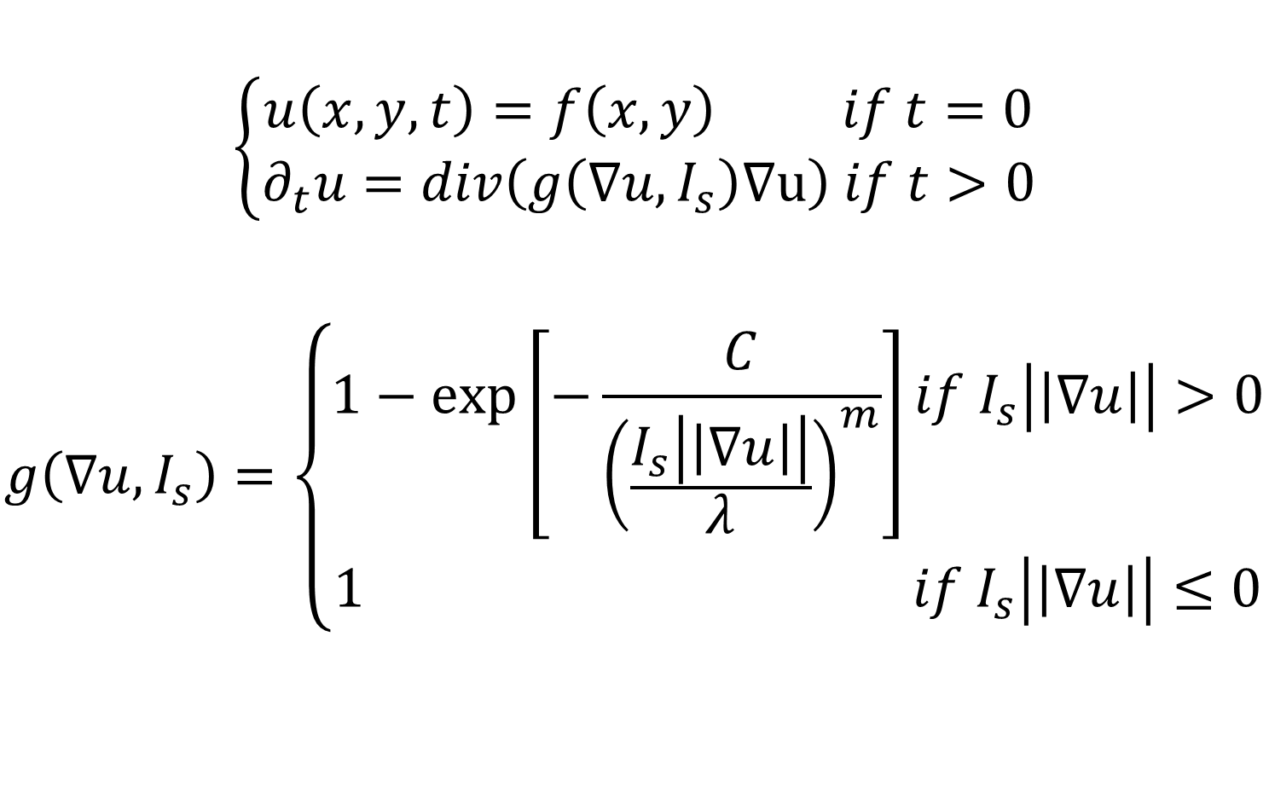
Saliency driven nonlinear diffusion
$$\left\{\begin{aligned}u\left(x, y, t\right)=f\left(x,y\right) if t=0 \\ ∂_{t}u=div\left(g\left(∇u, I_{s}\right)∇u\right) if t>0\end{aligned}\right.$$
$$g\left(∇u, I_{s}\right)=\left\{\begin{aligned}1−\exp\left[−\frac{C}{{\left(\frac{I_{s}\left|\left|∇u\right|\right|}{λ}\right)}^{m}}\right]if I_{s}\left|\left|∇u\right|\right|>0 \\ 1 if I_{s}\left|\left|∇u\right|\right|≤0\end{aligned}\right.$$

Slide 10
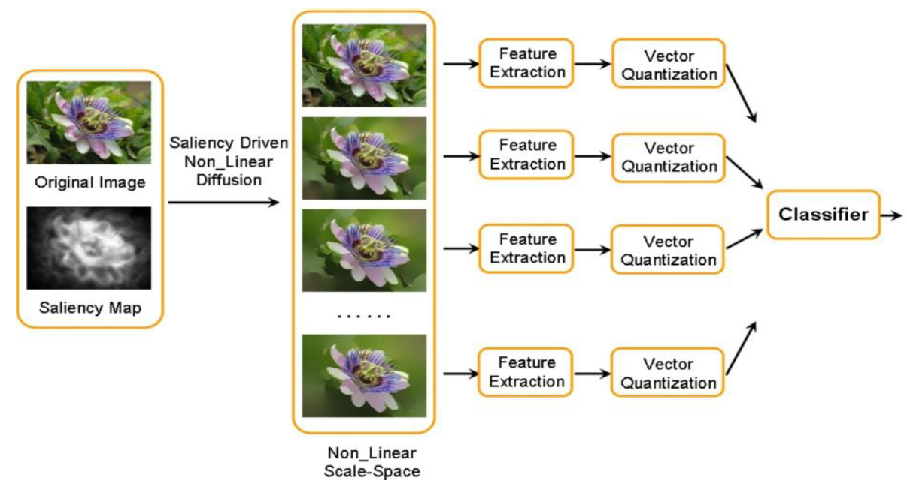
Framework

Slide 11
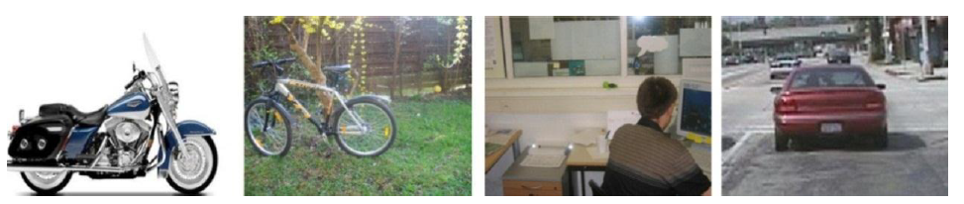
Experimental result
PASCAL VOC 2005 dataset: 4 categories and contains 1543 images.

Slide 12
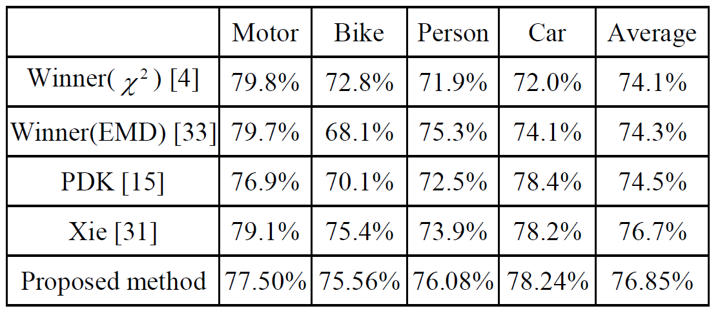
Experimental result
PASCAL VOC 2005 dataset: 4 categories and contains 1543 images.

Slide 13
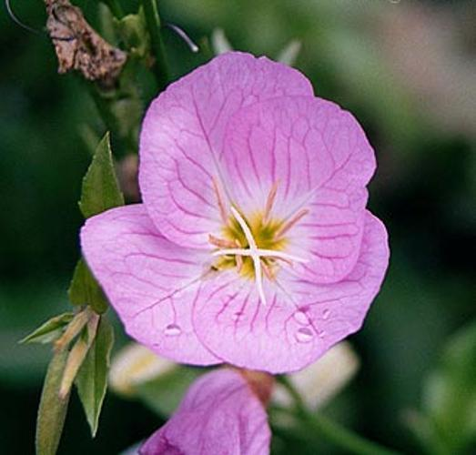
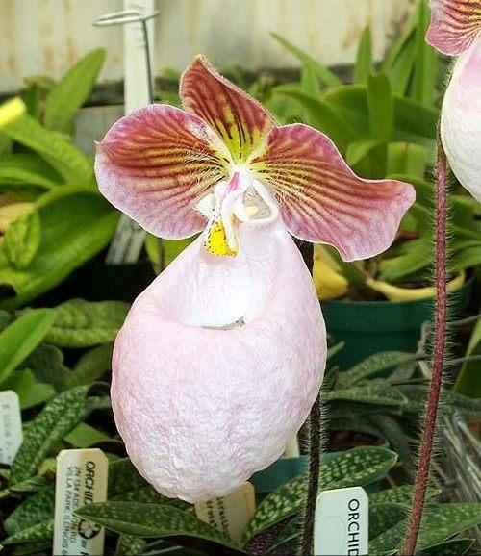
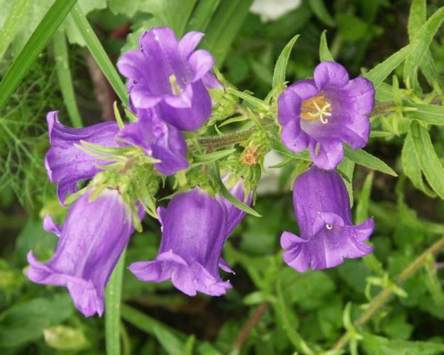
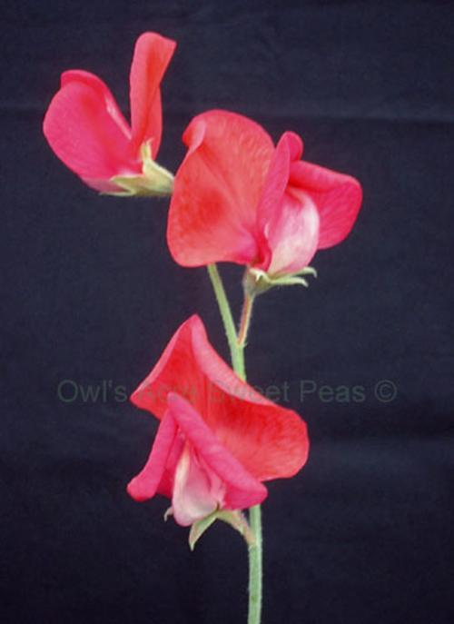
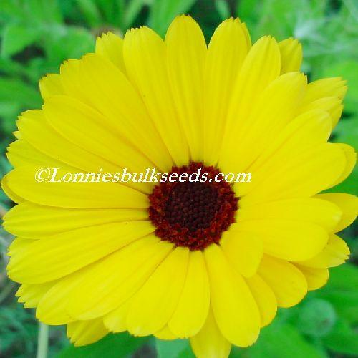
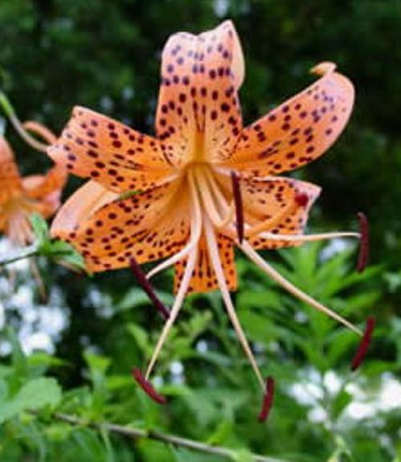
Experimental result
102 Oxford Flowers: 102 flower categories and contains 8189 images.

Slide 14
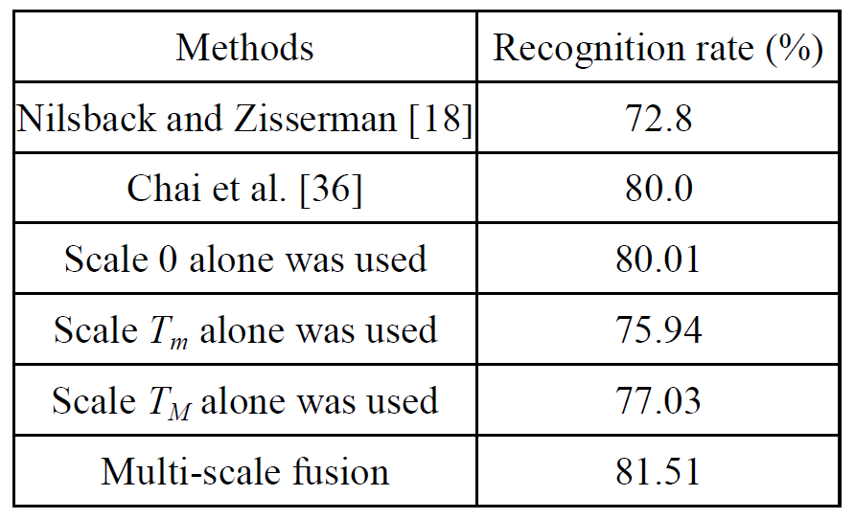
Experimental result
102 Oxford Flowers: 102 flower categories and contains 8189 images.

Slide 15
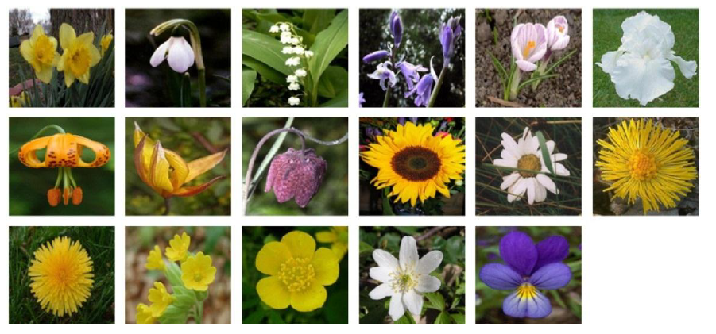
Experimental result
17 Oxford Flowers: 17 flower categories with 80 images per category.

Slide 16
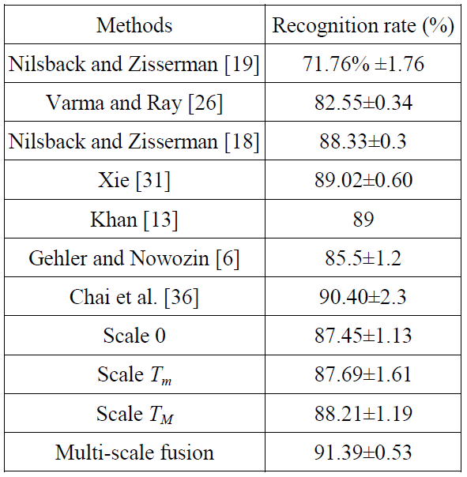
Experimental result
17 Oxford Flowers: 17 flower categories with 80 images per category.

