Slide 1
Stock Selection with a Novel Sigmoid-Based Mixed Discrete-Continuous Differential Evolution Algorithm
Lean Yu, Member, IEEE, Lunchao Hu, and Ling Tang
IEEE TRANSACTIONS ON KNOWLEDGE AND DATA ENGINEERING, VOL. 28, NO. 7, pp.1891-1904 JULY 2016
Presenter：Jia-Hong Liu
Date：2017/9/20
Notes:
余利恩, 胡倫昭, 唐林,

Slide 2
Abstract(1/3)
A stock selection model with both discrete and continuous decision variables is proposed, in which a novel sigmoid-based mixed discrete-continuous differential evolution algorithm is especially developed for model optimization. In particular, a stock scoring mechanism is first designed to evaluate candidate stocks based on their fundamental and technical features, and the top-ranked stocks are selected to formulate an equal-weighted portfolio.

Slide 3
Abstract(2/3)
Generally, the proposed model makes literature contributions from two main perspectives. First, to determine the optimal solution in terms of feature selections (discrete variables) and the corresponding weights (continuous variables), the original differential evolution algorithm focusing only on continuous problems is extended to a novel mixed discrete-continuous variant based on sigmoid-based conversion for the discrete part.

Slide 4
Abstract(3/3)
Second, the stock selection model also resolves the gap of the application of differential evolution algorithm to stock selection. Using the Shanghai A share market of China as the study sample, the empirical results show that the novel stock selection model can make a profitable portfolio and significantly outperform its benchmarks (with other model designs and optimization algorithms used in the existing studies) in terms of both investment return and model robustness.

Slide 5
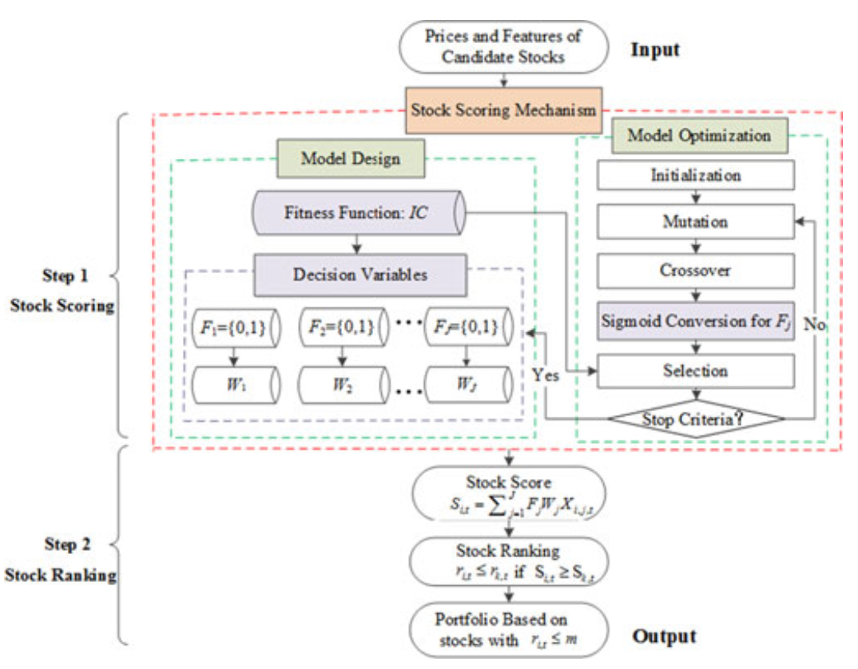

Slide 6
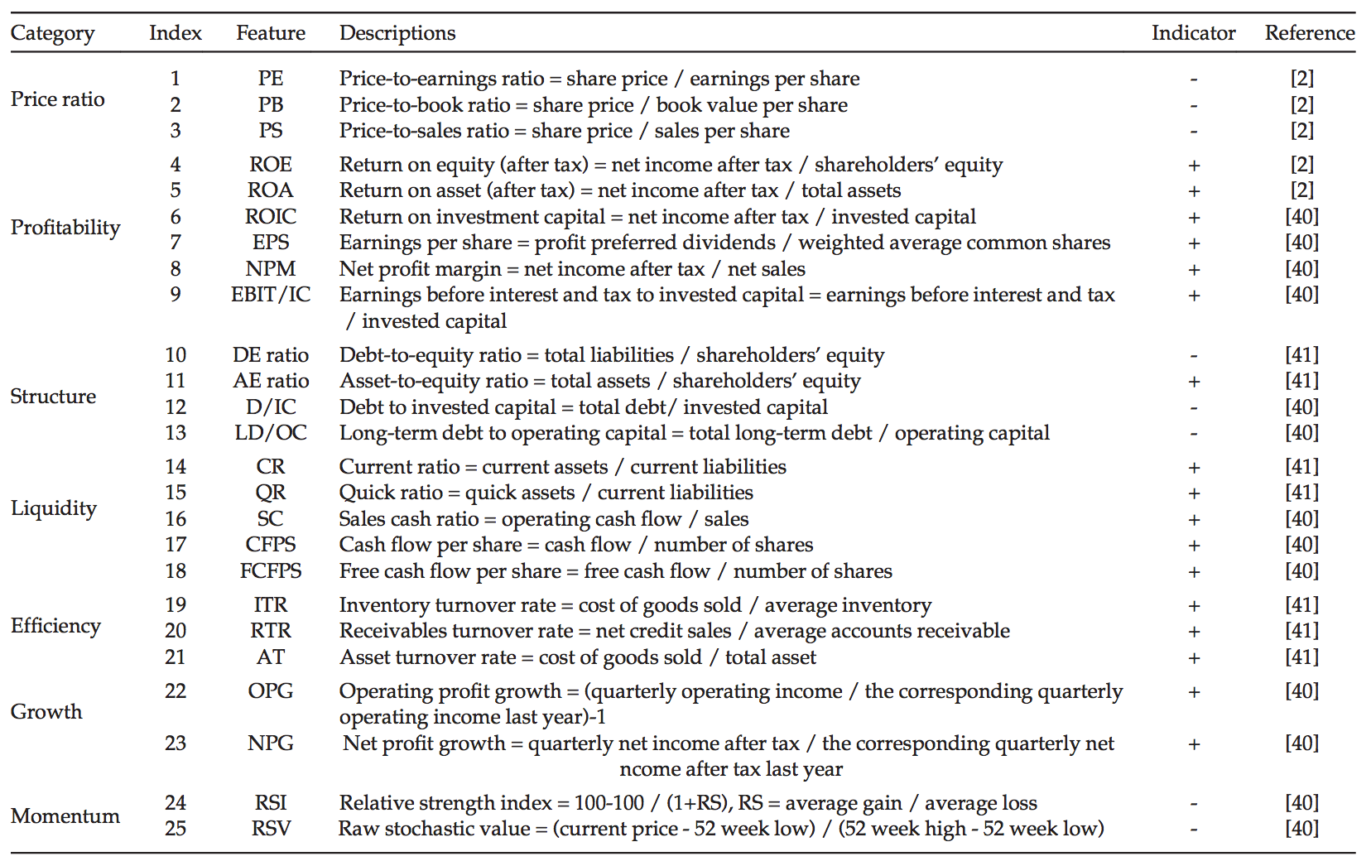
Notes:
股票的市淨率(PB/PBR)＝每股市價／每股淨資產
市值營收比(PS/PSR)＝股價／每股營收＝（股價 × 總股數）／營收＝總市值／營收
資產收益率(ROA)＝淨利潤／平均資產總額×100%
每股盈餘(EPS)＝稅後淨利／流通在外的普通股加權股數

Slide 7
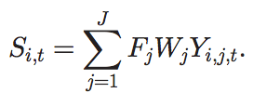




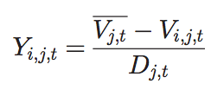
Score

Slide 8
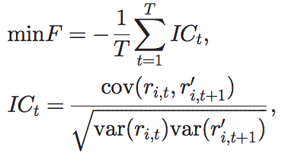


Rank

Slide 9




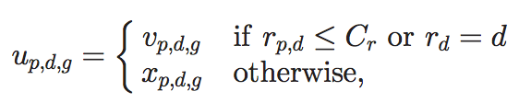
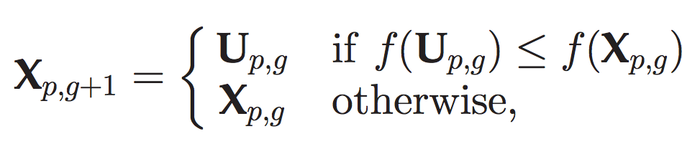

Differential Evolution(DE)
Initialization
Crossover
Mutation
Selection

Slide 10
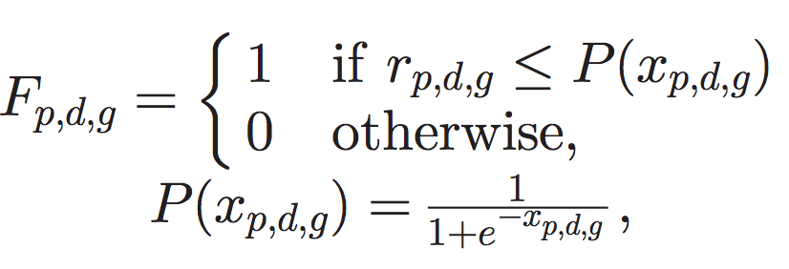
Sigmoid-Based Mixed Discrete-Continuous DE
Crossover

Slide 11
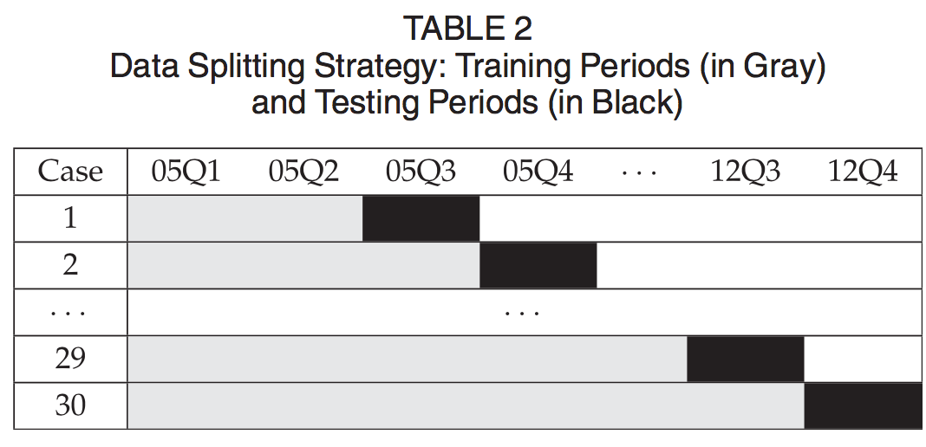
Data Descriptions

Slide 12
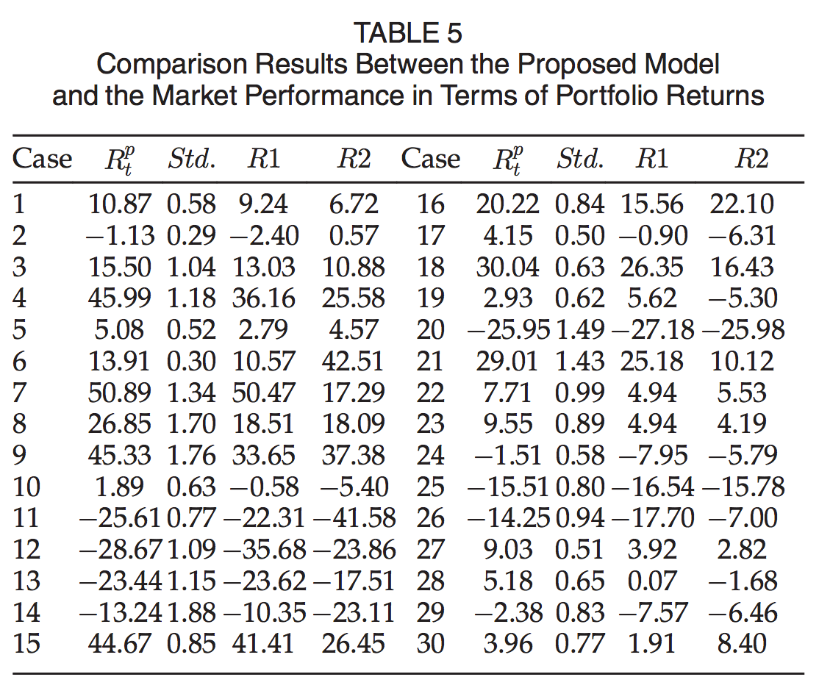
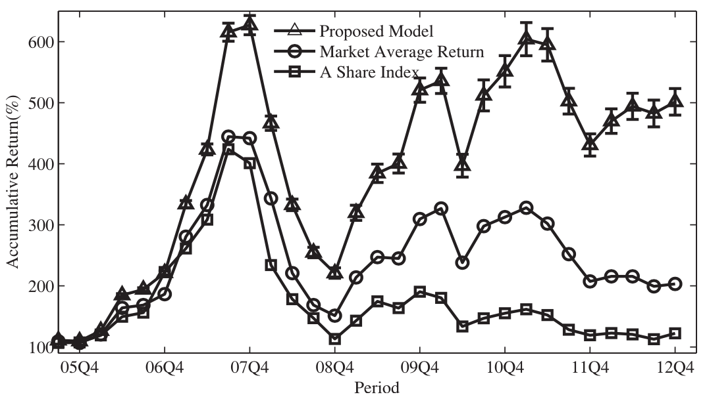
Model Effectiveness

Slide 13
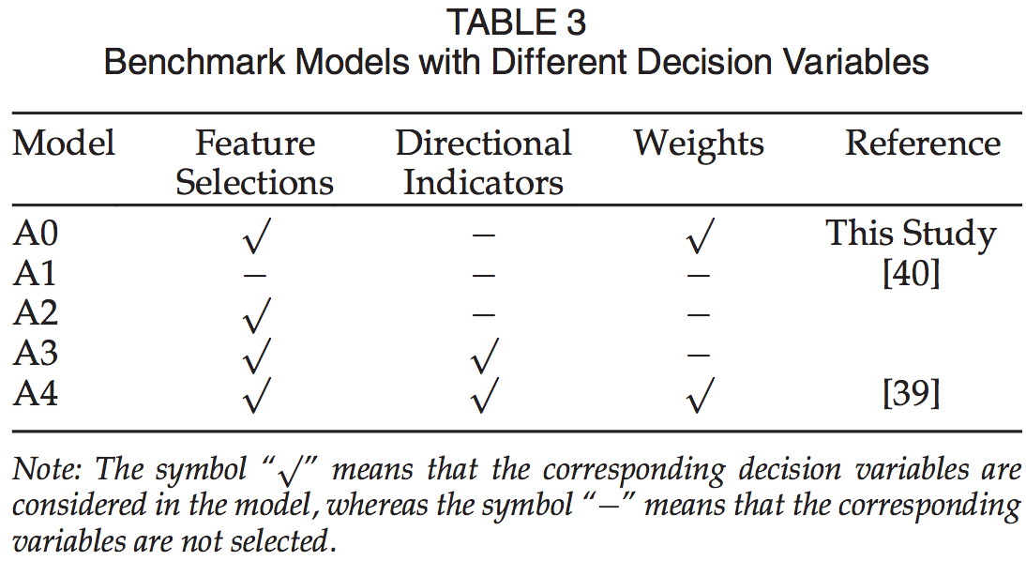
Benchmarks with Other Decision Variable Designs

Slide 14
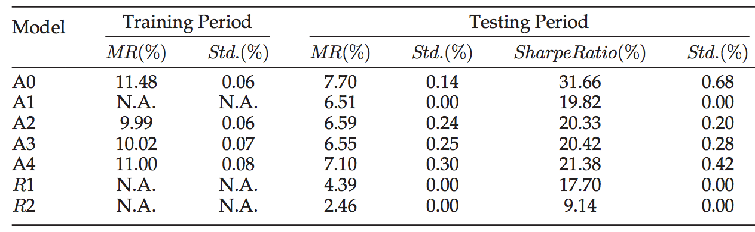
result

Slide 15
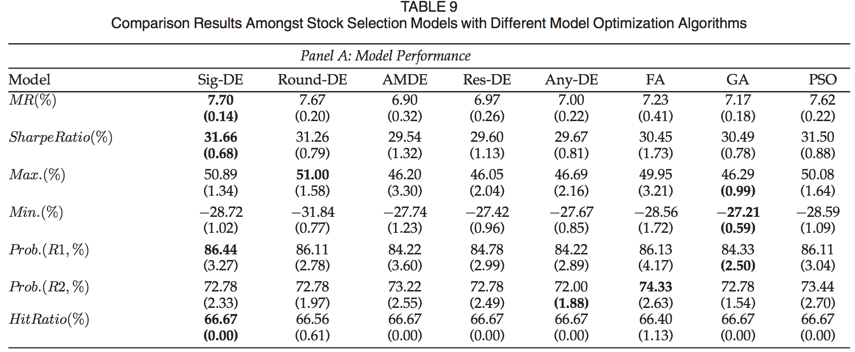
Notes:
26/30 = 86.44
22/30 = 72.78
20/30 = 66.67

Slide 16
