Slide 1
Efficient Selectivity and Backup Operators in Monte-Carlo Tree Search
Rémi Coulom
LIFL, SqueL, INRIA Futurs, Université Charles de Gaulle, Lille, France
5th International Conference on Computer and Games, May 2006, Turin, Italy
Presenter: Cheng-Han Wu
Date:2017/10/03

Slide 2
Abstract
Monte-Carlo evaluation consists in estimating a position by averaging the outcome of several random continuations, and can serve as an evaluation function at the leaves of a min-max tree. This paper presents a new framework to combine tree search with Monte-Carlo evaluation, that does not separate between a min-max phase and a Monte-Carlo phase. Instead of backing-up the min-max value close to the root, and the average value at some depth, a more general backup operator is defined that progressively changes from averaging to min-max as the number of simulations grows. This approach provides a fine-grained control of the tree growth, at the level of individual simulations, and allows efficient selectivity methods. This algorithm was implemented in a 9×9 Go-playing program, Crazy Stone, that won the 10th KGS computer-Go tournament.

Slide 3
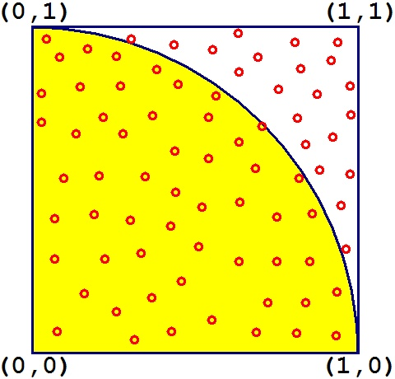
Monte-Carlo methods
問題轉化為某種隨機分布的特徵數，比如隨機事件出現的機率，或者隨機變數的期望值。通過隨機抽樣的方法，以隨機事件出現的頻率估計其機率，或者以抽樣的數字特徵估算隨機變數的數字特徵，並將其作為問題的解。

Slide 4
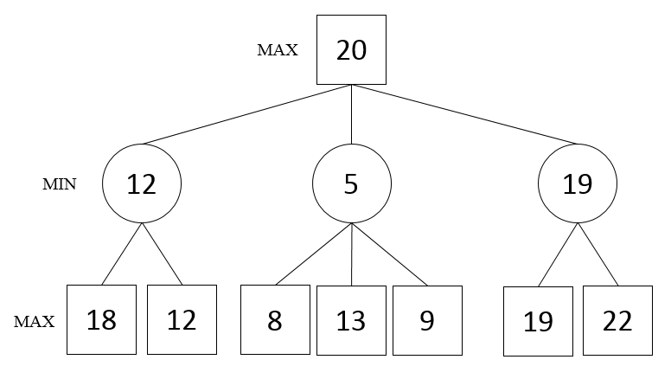
Min-Max tree

Slide 5
Algorithm structure
Iteratively running random simulations from the root position
Not to lose time on explore useless parts of the search tree, carefully allocate simulations at every node
Each simulation brings additional information immediately backed up to the root
The value of a simulation is the score of the game
As the number of tree grows, the probability distribution for selecting a move at random is altered

Slide 6
Selectivity
Moves that look best should be searched deeper, and bad moves should be searched less
As deeper as it will influence the backed-up value more.

Slide 7
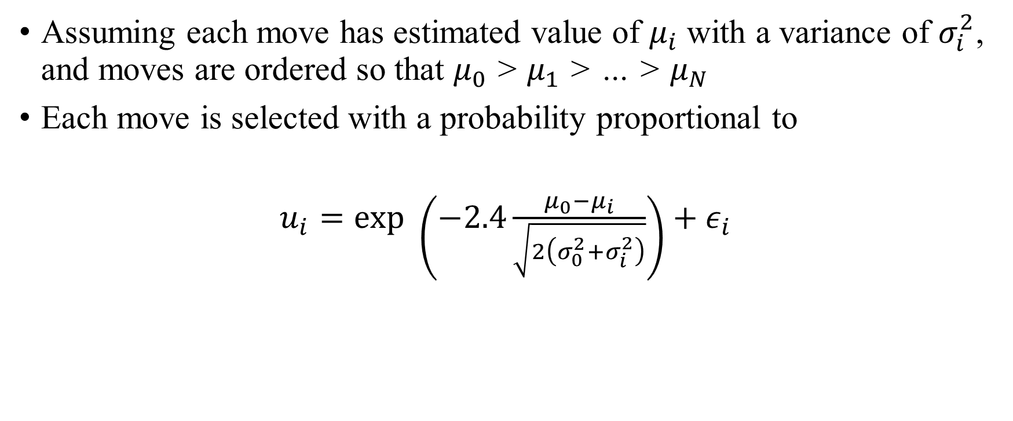
Crazy Stone’s algorithm
Assuming each move has estimated value of $μ_{i}$ with a variance of $σ_{i}^{2}$, and moves are ordered so that $μ_{0}$ > $μ_{1}$ > … > $μ_{N}$
Each move is selected with a probability proportional to
$u_{i}=exp \left(−2.4\frac{μ_{0}−μ_{i}}{\sqrt{2\left(σ_{0}^{2}+σ_{i}^{2}\right)}}\right)+ε_{i}$

Slide 8
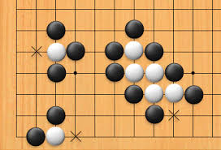
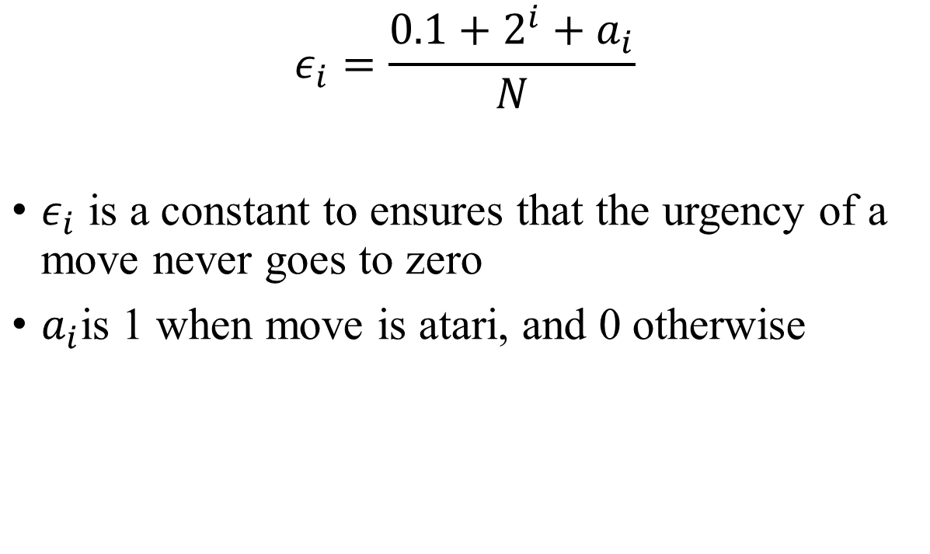
Crazy Stone’s algorithm
$$ε_{i}=\frac{0.1+2^{i}+a_{i}}{N}$$
$ε_{i}$ is a constant to ensures that the urgency of a move never goes to zero
$a_{i}$is 1 when move is atari, and 0 otherwise

Slide 9
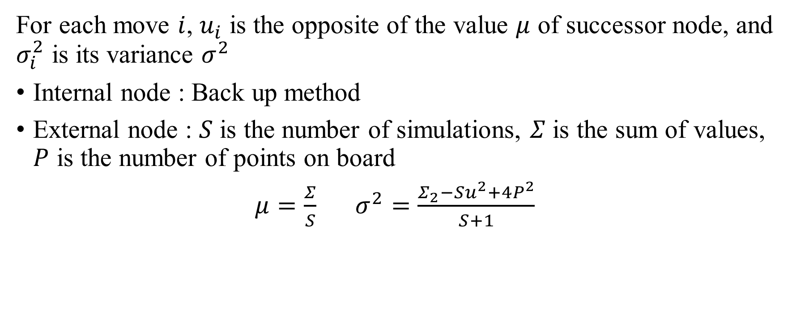
Crazy Stone’s algorithm
For each move $i$, $u_{i}$ is the opposite of the value $μ$ of successor node, and $σ_{i}^{2}$ is its variance $σ^{2}$
Internal node : Back up method
External node : $S$ is the number of simulations, $Σ$ is the sum of values, $P$ is the number of points on board
$μ=\frac{Σ}{S}$ $σ^{2}=\frac{Σ_{2}−Su^{2}+4P^{2}}{S+1}$

Slide 10
Back up method
Temporal difference method using past experience with an incompletely known system to predict its future behavior.
In the beginning, the backup method for internal nodes was the external node method.

Slide 11
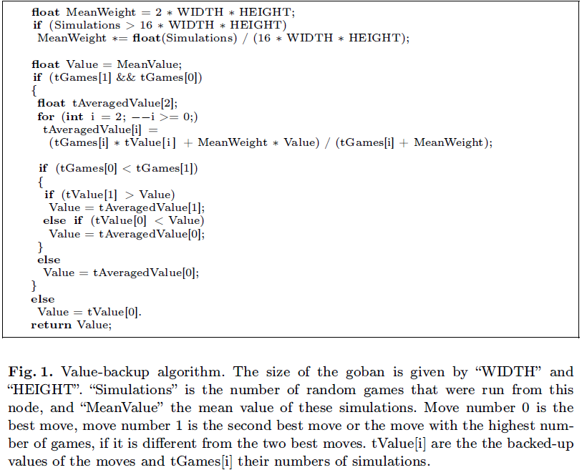
Back up method

Slide 12
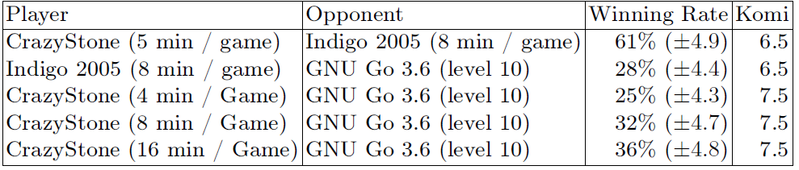
Game Results

