Slide 1
A fast algorithm for computing a longest common increasing subsequence
I-Hsuan Yang, Chien-Pin Huang, Kun-Mao, Chao
Information Processing Letters 93 (2005) 249–253
Speaker: Kuan-Chih Chen
Date: 2017.10.24
Notes:
作者: 楊一軒 陳建賓
台大 趙坤茂教授 演算法與計算生物學Lab
Received 21 May 2003; received in revised form 9 August 2004
Available online 2 December 2004

Slide 2
Abstract
Let A = ( a₁, a₂, …, a_{m}) and B = (b₁, b₂, …, b_{n}) be two sequences, where each pair of sequences is comparable. A common increasing subsequence of A and B is a subsequence (a_{i1} = b_{j1}, a_{i2} = b_{j2}, …, a_{il} = b_{jl}), where i₁ < i₂ < · · · < i_{l} and
j₁ < j₂ < · · · < j_{l}, such that for all 1 ≦ k < l, we have a_{ik} < a_{ik+1} .
A longest common increasing subsequence of A and B is a common increasing subsequence of the maximun length. This paper presents an algorithm for delivering a longest common increasing subsequence in O(mn) and O(mn) space.

Slide 3
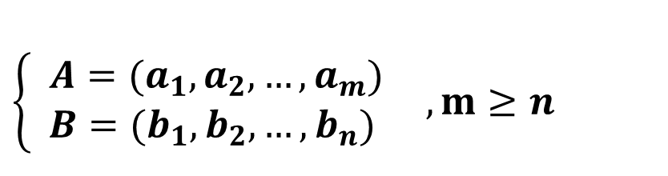
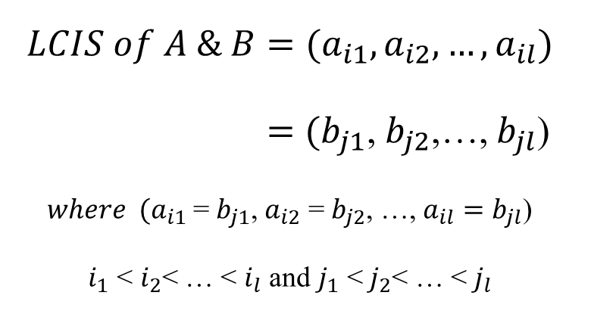
LCIS (Longest Common increasing subsequence)
find a maximum-length common subsequence of two sequences such that the subsequence is increasing
$$\left\{ \begin{aligned} A=(a_{1},a_{2}, …, a_{m}) \\ B=(b_{1},b_{2}, …, b_{n})\end{aligned}\right. ,m≥n$$
A = (3, 4 ,1, 5, 9, 2)
B = (3, 9, 2)
$LCIS of A \& B=(a_{i1},a_{i2},…,a_{il})$
$=$ $(b_{j1}$, $b_{j2}$,…, $b_{jl}$)
$where {(a}_{i1}$ = $b_{j1}$, $a_{i2}$ = $b_{j2}$, …, $a_{il}=b_{jl}$)
< $i_{2}$< … < $i_{l}$ and $j_{1}$ < $j_{2}$< … < $j_{l}$
LCS = (3, 9, 2)
LCIS = (3, 9)

Slide 4

A straightforward algorithm to find LCIS
For sequences A = ( a₁, a₂, …, a_{m}) and B = (b₁, b₂, …, b_{n}), where m ≧ n, find their LCIS:
Step1: sort the shorter sequence(B) as sequence C = (c₁, c₂, …, c_{n}),
where c_{1 ≦} c₂ ≦ … ≦ c_{n}
Step2: find a LCS among the two sequences and the sorted sequence (A, B, and C)
A = (3, 4 ,1, 5, 9, 2)
B = (3, 9, 2)
C = (2, 3, 9)
Time Complexity: O(${mn}^{2})$

Slide 5
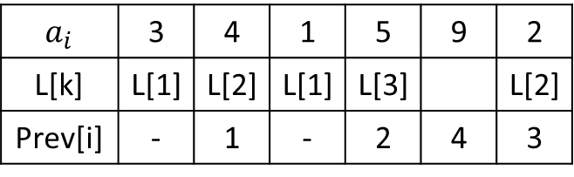
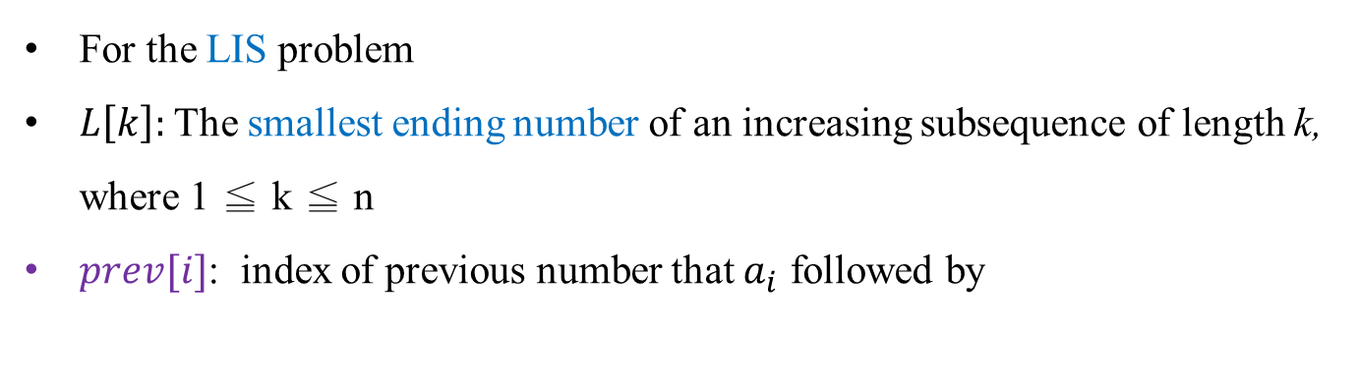


Folklore Algorithm
Time Complexity: O($nlogn)$
Space Complexity: O($n)$
For the LIS problem
$L\left[k\right]:$ The smallest ending number of an increasing subsequence of length k, where 1 ≦ k ≦ n
$prev[i]$: index of previous number that $a_{i}$ followed by
Step1: Assume that each entry in L is initially a ∞
Step2: for i = 1 to n do
binary search to update L
and make a backtracking link to former number
Step3: The length of LIS = the largest k such that
L[k] contains non-infinite value
Step4: Tracing back from L[k] and get LIS
A = (3, 4, 1, 5, 9, 2), n =6
$a_{i}$ | 3 | 4 | 1 | 5 | 9 | 2
L[k] | L[1] | L[2] | L[1] | L[3] |  | L[2]
Prev[i] | - | 1 | - | 2 | 4 | 3
L[4]
LIS :
3
4
5
9

Slide 6
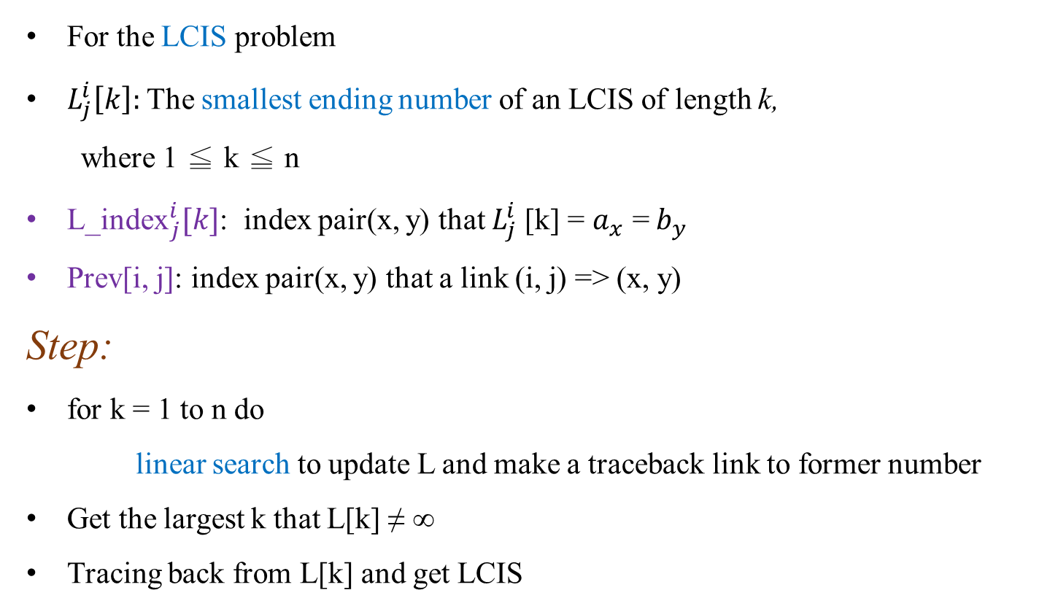
Their Algorithm
For the LCIS problem
$L_{j}^{i}\left[k\right]:$ The smallest ending number of an LCIS of length k,
where 1 ≦ k ≦ n
${\text{L}\text{_}\text{index}}_{j}^{i}[k]$: index pair(x, y) that $L_{j}^{i}$[k] = $a_{x}$ = $b_{y}$
Prev[i, j]: index pair(x, y) that a link (i, j) => (x, y)
Step:
for k = 1 to n do
linear search to update L and make a traceback link to former number
Get the largest k that L[k] ≠ ∞
Tracing back from L[k] and get LCIS

Slide 7









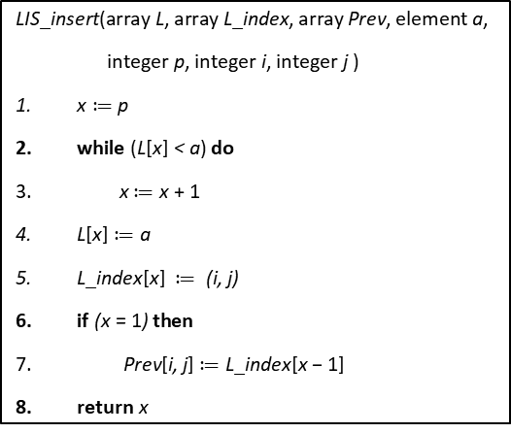


$INPUT:Two sequences A=\left(a_{1},a_{2},…,a_{m}\right) and$B =($b_{1}$, $b_{2}$,…, $b_{n}$), where m ≧ n.
$for j=1 to n do$
for k = 1 to n do
$L_{j}$[k] := ∞
…
for i = 1 to m do
X := -1, p := 1
for j = 1 to n do
if($a_{1}$ = $b_{j}) then$
X, p := $\text{LIS}\text{_}\text{insert}$($L_{j}, {L_index}_{j}, Prev,a_{i} , p, i, j)$
else
if((X≠ -1) and ($L_{j−1}\left[X\right]<L_{j}[X]$) then
${ L}_{j}\left[X\right]≔L_{j−1}\left[X\right]$
else
X := -1
X := the largest x that $L_{n}\left[x\right]$ ≠ ∞
($y_{1},y_{2}) ≔{L_index}_{n}\left[x\right]$
print $a_{y1}$
while(Prev[$y_{1}$, $y_{2}$] ≠ (-1, -1)) do
($y_{1 },y_{2})$ := Prev[$y_{1 },y_{2}$]
print $a_{y1}$
//Initialize
$$\text{LIS}\text{_}\text{insert}\text{(}\text{array} \text{L}\text{, }\text{array} \text{L}\text{_}\text{index}\text{, }\text{array} \text{Prev}\text{, }\text{element} \text{a}\text{, }$$
$\text{integer} \text{p}\text{, }\text{integer} \text{i}\text{, }\text{integer} \text{j} \text{)}$
$\text{x}≔\text{p}$
$\text{while} \text{(}\text{L}\text{[}\text{x}\text{] }\text{< }\text{a}\text{) }\text{do}$
$\text{x}≔\text{x} \text{+ 1}$
$\text{L}\text{[}\text{x}\text{]}≔\text{a}$
$\text{L}\text{_}\text{index}\text{[}\text{x}\text{]} ≔ \text{(}\text{i}\text{, }\text{j}\text{)}$
$\text{if} \text{(}\text{x} \text{= 1}\text{) }\text{then}$
$\text{Prev}\text{[}\text{i}\text{, }\text{j}\text{]}≔\text{L}\text{_}\text{index}\text{[}\text{x} \text{− 1]}$
$\text{return} \text{x}$
//match case
//mismatch case
A = ( , 4, 1, 5, , ), m = 6
3
9
2
//trace back for whole LCIS
B = ( , , ), n = 3
3
9
2
$L_{1}$[1] =
${L_index}_{1}$[1] = (1, 1)
${Prev}_{2}$[5, 2] = (1, 1)
∞
3
$L_{2}$[1] =
${L_index}_{2}$[2] = (5, 2)
∞
∞
9
3
$L_{2}$[2] =
${L_index}_{3}$[1] = (6, 3)
$L_{3}$[1] =
$L_{3}$[2] =
∞
∞
9
$L_{3}$[3] =
∞
2
3
LCIS:
3
9

Slide 8


Time Complexity
//outer loop for m times
for i = 1 to m do
X := -1, p := 1
for j = 1 to n do
if($a_{1}$ = $b_{j}) then$
X, p := $\text{LIS}\text{_}\text{insert}$($L_{j}, {L_index}_{j}, Prev,a_{i} , p, i, j)$
else
if((X≠ -1) and ($L_{j−1}\left[X\right]<L_{j}[X]$) then
${ L}_{j}\left[X\right]≔L_{j−1}\left[X\right]$
else
X := -1
X := the largest x that $L_{n}\left[x\right]$ ≠ ∞
($y_{1},y_{2}) ≔{L_index}_{n}\left[x\right]$
print $a_{y1}$
while(Prev[$y_{1}$, $y_{2}$] ≠ (-1, -1)) do
($y_{1 },y_{2})$ := Prev[$y_{1 },y_{2}$]
print $a_{y1}$
1 ≦ p ≦ n
//match case: linear search from index p to insert point
//mismatch case: 1 step
Time Complexity: O($mn)$

Slide 9


Space Complexity
L:
O(n)
for i = 1 to m do
X := -1, p := 1
for j = 1 to n do
if($a_{1}$ = $b_{j}) then$
X, p := $\text{LIS}\text{_}\text{insert}$($L_{j}, {L_index}_{j}, Prev,a_{i} , p, i, j)$
else
if((X≠ -1) and ($L_{j−1}\left[X\right]<L_{j}[X]$) then
${ L}_{j}\left[X\right]≔L_{j−1}\left[X\right]$
else
X := -1
X := the largest x that $L_{n}\left[x\right]$ ≠ ∞
($y_{1},y_{2}) ≔{L_index}_{n}\left[x\right]$
print $a_{y1}$
while(Prev[$y_{1}$, $y_{2}$] ≠ (-1, -1)) do
($y_{1 },y_{2})$ := Prev[$y_{1 },y_{2}$]
print $a_{y1}$
L_index:
O(n)
Prev[i, j]:
(for 1≦i≦m , 1≦j≦n)
O(mn)
Space Complexity: O($mn)$

