Slide 1
A linear space algorithm for computing a longest common increasing subsequence
Yoshifumi Sakai
Information Processing Letters 99 (2006) 203–207
Presenter: Kuo-Feng Huang
Date: 2017/10/24

Slide 2
Abstract
Let X and Y be sequences of integers. A common increasing subsequence of X and Y is an increasing subsequence common to X and Y . In this note, we propose an O(|X|·|Y |)-time and O(|X|+|Y |)-space algorithm for finding one of the longest common increasing subsequences of X and Y , which improves the space complexity of Yang et al. [I.H. Yang, C.P. Huang, K.M. Chao, A fast algorithm for computing a longest common increasing subsequence, Inform. Process. Lett. 93 (2005) 249–253] O(|X|·|Y |)-time and O(|X|·|Y |)-space algorithm, where |X| and |Y | denote the lengths of X and Y , respectively.

Slide 3
LCIS
X : 2 , 4 , 1 , 3 , 4
Y : 2 , 3 , 1 , 7 , 2 , 4 , 3
X的IS :
{1 , 3 , 4}{2 , 3 , 4}
{3 , 4}{2 , 3}{2 , 4}{1 , 3}{1 , 4}
{1}{2}{3}{4}
CIS : {2 , 3 , 4}...{1 , 3}{1 , 4} {1}{2}{3}{4}
LCIS : {2 , 3 , 4}
Y的IS :
{1 , 2 , 3}{1 , 2 , 4}{2 , 3 , 4}{2 , 3 , 7}
{1 , 2}{1 , 3} {1 , 4} {1 , 7} {2 , 3}
{2 , 4} {2 , 7} {3 , 4} {3 , 7}
{1}{2}{3}{4}{7}

Slide 4
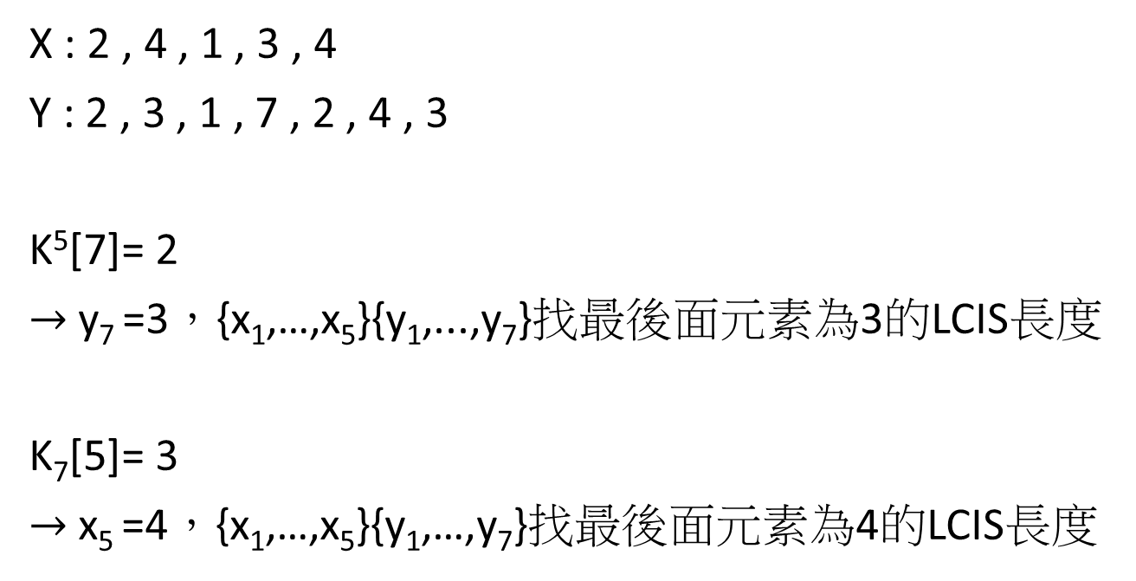
Symbol
X : 2 , 4 , 1 , 3 , 4
Y : 2 , 3 , 1 , 7 , 2 , 4 , 3
K⁵[7]= 2
$→$y₇ =3，{x₁,…,x₅}{y₁,...,y₇}找最後面元素為3的LCIS長度
K₇[5]= 3
$→$x₅ =4，{x₁,…,x₅}{y₁,…,y₇}找最後面元素為4的LCIS長度

Slide 5
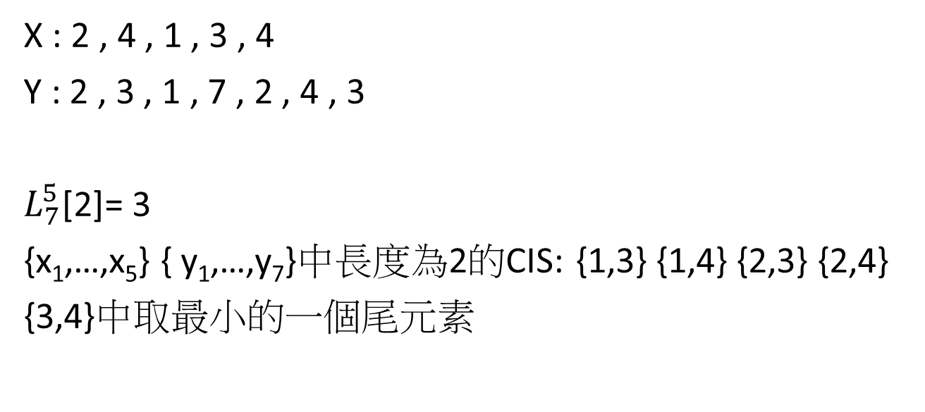
Symbol
X : 2 , 4 , 1 , 3 , 4
Y : 2 , 3 , 1 , 7 , 2 , 4 , 3
$L_{7}^{5}$[2]= 3
{x₁,…,x₅} { y₁,…,y₇}中長度為2的CIS: {1,3} {1,4} {2,3} {2,4}
{3,4}中取最小的一個尾元素

Slide 6

Example
X : 4 , 1 , 3
Y : 3 , 1 , 7, 2 ,4 ,3
$H_{j}^{i}$ :表示目前只有用到{x₁,…,x_{i}}{ y₁,...,y_{j}}，共2|X|+1個值。
K^{i}[j] K_{j}[i] $L_{j}^{i}$[K_{j}[i]]
$H_{1}^{0}$ : <0 , 0 , 0 , 0 , ∞ , ∞ , ∞>
$H_{1}^{1}$ : <0 , 0 , 0 , 0 , ∞ , ∞ , ∞>
$H_{1}^{2}$ : <0 , 0 , 0 , 0 , ∞ , ∞ , ∞>

Slide 7

Example
X : 4 , 1 , 3
Y : 3 , 1 , 7, 2 , 4 , 3
$H_{1}^{2}$ : <0 , 0 , 0 , 0 , ∞ , ∞ , ∞>
$H_{1}^{3}$ : <1 , 0 , 0 , 1 , 3 , ∞ , ∞>
$H_{2}^{0}$ : <0 , 0 , 0 , 1 , ∞ , ∞ , ∞>
$H_{6}^{1}$ : <0 , 1 , 1 , 1 , 4 , ∞ , ∞>
…..

Slide 8

Example
X : 4 , 1 , 3
Y : 3 , 1 , 7, 2 ,4 ,3
$H_{6}^{1}$ : <0 , 1 , 1 , 1 , 4 , ∞ , ∞>
$H_{6}^{2}$ : <0 , 1 , 1 , 1 , 1 , ∞ , ∞>
$H_{6}^{3}$ : <2 , 1 , 1 , 2 , 1 , 3 , ∞>
長度為2的CIS中最小的尾元素為3
所求LCIS為{1 , 3}

Slide 9

Time complexity
$H_{1}^{0}$ : O(|X|)
$H_{2}^{0}\sim$ $H_{y}^{0}$ : O(|X|·|Y|)
$H_{1}^{1}$~ $H_{|Y|}^{|X|}$ : O(|X|·|Y|)
Total : O(|X|·|Y|)

Slide 10
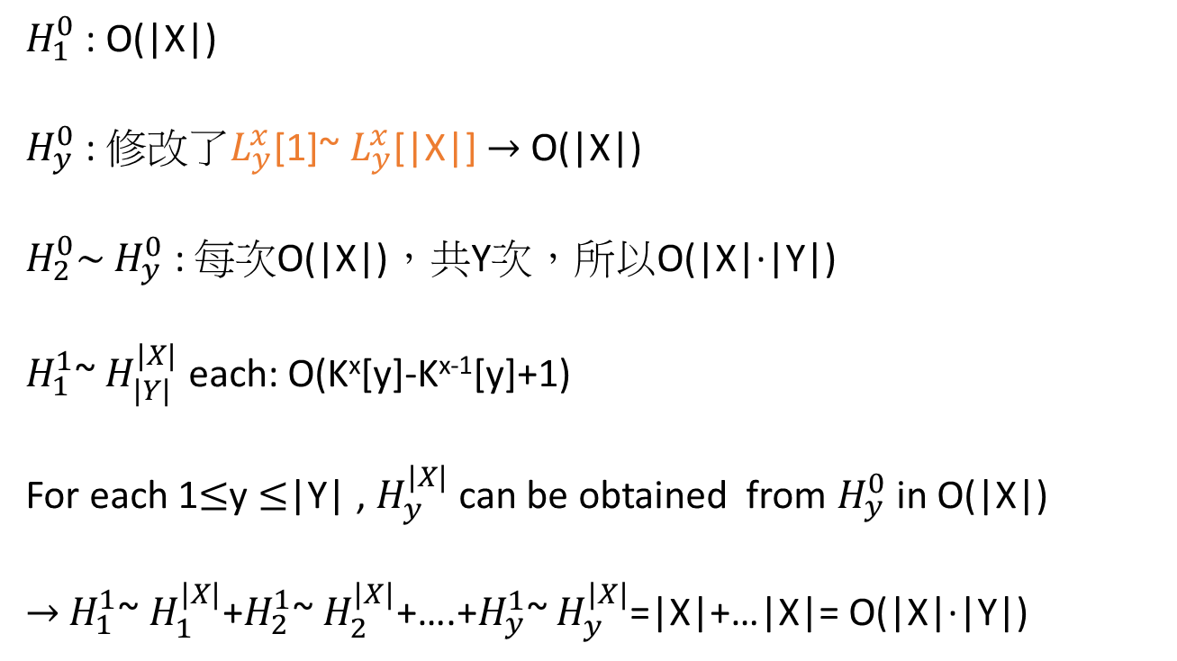
Time complexity
$H_{1}^{0}$ : O(|X|)
$H_{y}^{0}$ : $修改了L_{y}^{x}$[1]~ $L_{y}^{x}$[|X|] $→$ O(|X|)
$H_{2}^{0}\sim$ $H_{y}^{0}$ : 每次O(|X|)，共Y次，所以O(|X|·|Y|)
$H_{1}^{1}$~ $H_{|Y|}^{|X|}$ each: O(K^{x}[y]-K^{x-1}[y]+1)
For each 1$≤$y $≤$|Y| , $H_{y}^{|X|}$ can be obtained from $H_{y}^{0}$ in O(|X|)
$→$ $H_{1}^{1}$~ $H_{1}^{|X|}$+$H_{2}^{1}$~ $H_{2}^{|X|}$+….+$H_{y}^{1}$~ $H_{y}^{|X|}$=|X|+…|X|= O(|X|·|Y|)

Slide 11

Space complexity
每次只會用到一個$H_{j}^{i}$的空間，所以只花2|X|+1的空間，Space complexity為O(|X|+|Y|)

Slide 12
Theorem 1
For any integer sequences, X and Y , and any integers, l and u, one of the longest (X, Y , l , u)-CISs can be computed in O(|X|·|Y|) time and O(|X|+|Y|) space.

