Slide 1
The constrained longest common subsequence problem
Yin-Te Tsai
Department of Computer Science and Information Management, Providence University, 200 Chung Chi Road, Shalu, Taichung Hsien 433, Taiwan, R.O.C.
Information Processing Letters
Volume 88 (2003), Issues 4, Pages 173–176
Presenter: Ting-Wei Liang
Date:2017/10/24

Slide 2
Abstract
This paper considers a constrained version of longest common subsequence problem for two strings. Given strings S₁, S₂ and P, the constrained longest common subsequence problem for S₁ and S₂ with respect to P is to find a longest common subsequence lcs of S₁ and S₂ such that P is a subsequence of this lcs. An O(rn²m²) time algorithm based upon the dynamic programming technique is proposed for this new problem, where n, m and r are lengths of S₁, S₂ and P, respectively.

Slide 3
Longest common subsequence (LCS)
S₁ = a₁a₂…a_{n} = ABAADACBAABC , n = 12
S₂ = b₁b₂…b_{m} = CBCBDAADCDBA , m = 12
lcs = LCS(S₁, S₂) = B A A D C B A , | lcs | = 7

Slide 4
Constrained Longest common subsequence (CLCS)
S₁ = a₁a₂…a_{n} = ABAADACBAABC , n = 12
S₂ = b₁b₂…b_{m} = CBCBDAADCDBA , m = 12
P = CBB , r = 3
clcs = CLCS(S₁, S₂) = B C B A A B , | clcs | = 6

Slide 5

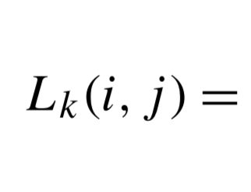
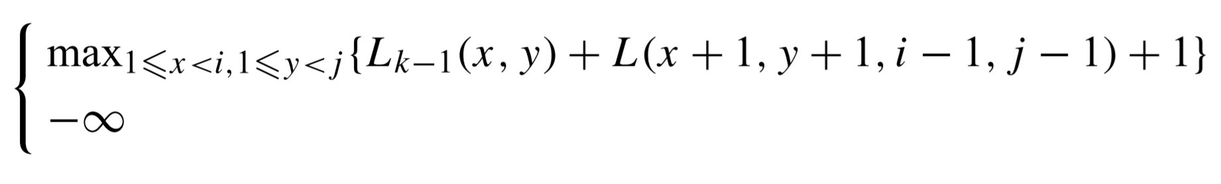


Algorithm
For $2≤k≤r , 1≤i≤n , and 1≤ j≤m ,$

Slide 6

Algorithm
P = CBB , $S_{1}\left[11\right]=S_{2}\left[11\right]=$ P[3]
${ L}_{3} (11, 11)$ = ${\max{ \{}L}_{2} (8, 4)$ + L (9, 5, 10, 10) + 1 = 6 ,
$L_{2 }\left(8, 2\right)$ + L (9, 3, 10, 10) + 1 = 5 }
= 6
 | 1 | 2 | 3 | 4 | 5 | 6 | 7 | 8 | 9 | 10 | 11 | 12
S₁ | A | B | A | A | D | A | C | B | A | A | B | C
S₂ | C | B | C | B | D | A | A | D | C | D | B | A

Slide 7
Algorithm
P = CBB , $S_{1}\left[11\right]=S_{2}\left[11\right]=$ P[3]
${ L}_{3} (11, 11)$ = ${\max{ \{}L}_{2} (8, 4)$ + L (9, 5, 10, 10) + 1 = 6 ,
$L_{2 }\left(8, 2\right)$ + L (9, 3, 10, 10) + 1 = 5 }
= 6
 | 1 | 2 | 3 | 4 | 5 | 6 | 7 | 8 | 9 | 10 | 11 | 12
S₁ | A | B | A | A | D | A | C | B | A | A | B | C
S₂ | C | B | C | B | D | A | A | D | C | D | B | A

Slide 8

Algorithm
$$\left|clcs\right|= \max_{1≤i≤n 1≤j≤m}\{L_{r}\left(i, j\right)+L(i+1,j+1,n,m)\}$$

Slide 9
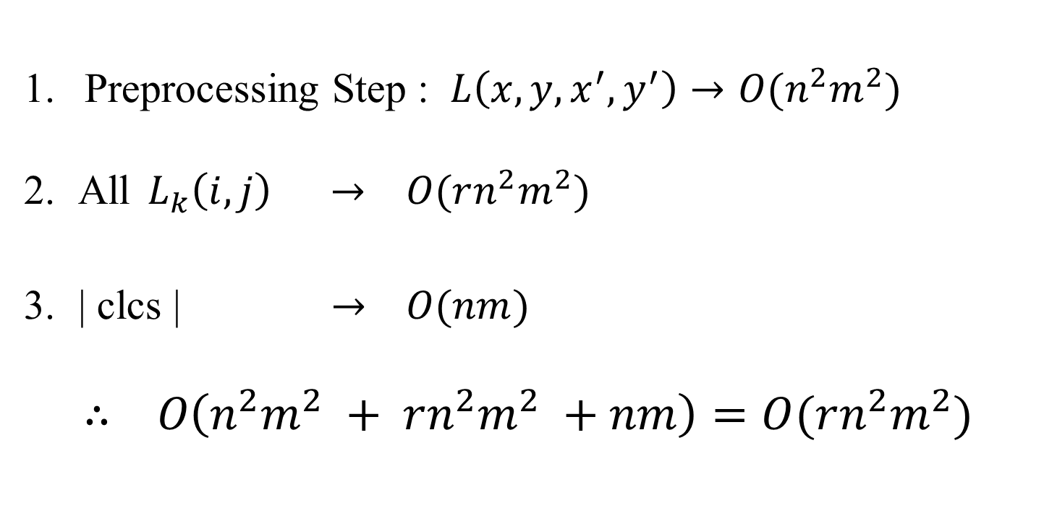
Time Complexity
Preprocessing Step : $L\left({x,y,x}^{′}, y^{′}\right)→O(n^{2}m^{2})$
All ${ L}_{k}\left(i, j\right) → O(rn^{2}m^{2})$
| clcs | $→ O(nm)$
$$∴ O\left(n^{2}m^{2} + rn^{2}m^{2} +nm\right)=O(rn^{2}m^{2})$$

