Slide 1
Time series for blind biosignal classification model
Derek F. Wong(黃輝), Lidia S. Chao(周沁), Xiaodong Zeng(鄭曉東), Mang-I Vai(韋孟宇), Heng-Leong Lam(林慶亮)
Computers in Biology and Medicine
Volume 54, Nov, 2014, Pages 32-36
Presenter: Shan-Ru Liu
Date: 2017/10/24

Slide 2
Abstract
Biosignals such as electrocardiograms (ECG), electroencephalograms (EEG), and electromyograms (EMG), are important noninvasive measurements useful for making diagnostic decisions. Recently, considerable research has been conducted in order to potentially automate signal classification for assisting in disease diagnosis. However, the biosignal type (ECG, EEG, EMG or other) needs to be known prior to the classification process. If the given biosignal is of an unknown type, none of the existing methodologies can be utilized. In this paper, a blind biosignal classification model (B²SC Model) is proposed in order to identify the source biosignal type automatically, and thus ultimately benefit the diagnostic decision. The approach employs time series algorithms for constructing the model. It uses a dynamic time warping (DTW) algorithm with clustering to discover the similarity between two biosignals, and consequently classifies disease without prior knowledge of the source signal type. The empirical experiments presented in this paper demonstrate the effectiveness of the method as well as the scalability of the approach.

Slide 3
Biosignals
All kinds of signals that can be measured and monitored from biological beings.
ECG (electrocardiogram) 心電圖
EEG (electroencephalogram) 腦電圖
EMG (electromyogram) 肌電圖
EOG (electrooculography) 眼電圖

Slide 4
Blind biosignal classification model (B²SC model)
Purpose:
Enabling non-skilled home-based users to operate a multi-function biosignal acquisition device easily for monitoring and managing their health conditions
Helping to improve the diagnostic capability of a disease or symptom without knowing the exact type of source biosignal
Allowing the use of only one device and one sensor which could adapt to multiple biosignals

Slide 5
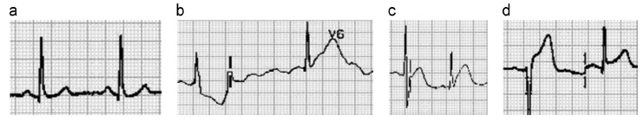
Blind biosignal classification model (B²SC model)
Three major phase:
Biosignal template construction
Template optimization and management
Pattern matching
Sample of different patterns from ECG signals
Normal ECG
Acute inferior myocardial infarction
Acute posterior myocardial infarction
Acute anterior myocardial infarction

Slide 6
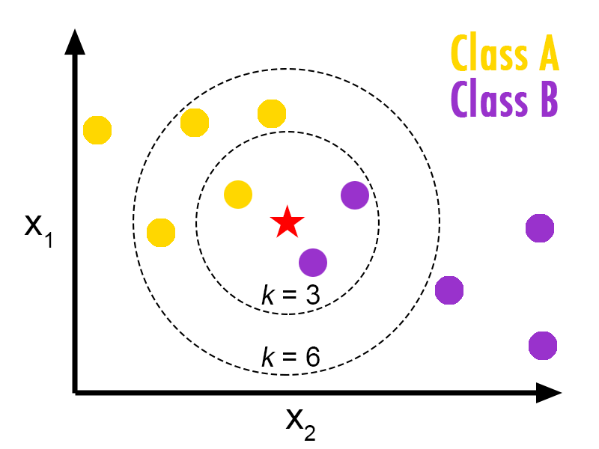
k-Nearest Neighbors Algorithm (kNN)

Slide 7
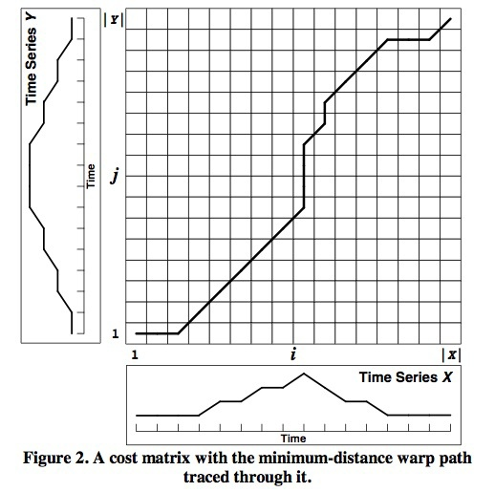
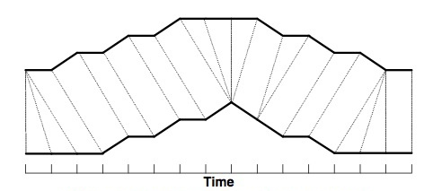


Dynamic Time Warping (DTW)
$$D\left(i,j\right)=Dist\left(i,j\right)+min⁡[D\left(i−1,j\right),D\left(i,j−1\right),D(i−1,j−1)]$$
$$Dist\left(W\right)= \sum_{k=1}^{k=K}{Dist\left(wki,wkj\right)}$$
$$Max\left(\left|X\right|,\left|Y\right|\right)≤K≤\left|X\right|+\left|Y\right|$$
Warping Path
W_{k}=($\left|X\right|$,$\left|Y\right|$)
W₁=(1,1)

Slide 8
Templates construction and optimization algorithm
Initialize k = # of categories for each type of biosignal;
Segment each biosignal into a number of one-cycle patterns;
Cluster all patterns into k classes by kNN algorithm;
For each k cluster, find a central (medoids) pattern of the cluster;
For each pattern p, calculate the distance between p and each medoids; Re-assign p to a cluster with nearest medoids;
For each cluster, calculate the distance among all p within a cluster; Assign a new medoids to p that has the minimum distance to other patterns;
If no more pattern can change the structure of clusters, retrieve the medoids and L nearest patterns for each cluster as the representatives; otherwise, repeat step 6.

Slide 9
Pattern matching phase of B²SC Model
Input:
S = {S₁,S₂,…,S_{m}} : a blind biosignal
OpTem = {P_{ecg}(i), P_{eeg}(j); 0≤i ≤k, 0≤j ≤w} : the optimal representative biosignal templates
λ : threshold for determining the type of an input biosignal

Slide 10
Pattern matching phase of B²SC Model
Output: Class = {ECG, EEG and Other} : the signal class
minecg <- Matching ECG templates and get the minimum similarity measurement
mineeg <- Matching EEG templates and get the minimum similarity measurement
min_{tp <- Compare} min_{ecg and} mineeg to get the minimum similarity measurement among the signal templates
If min_{tp} < λ , if min_{tp} = min_{ecg}, output is ECG, else output is EEG
If min_{tp} > λ , output is other biosignal

Slide 11
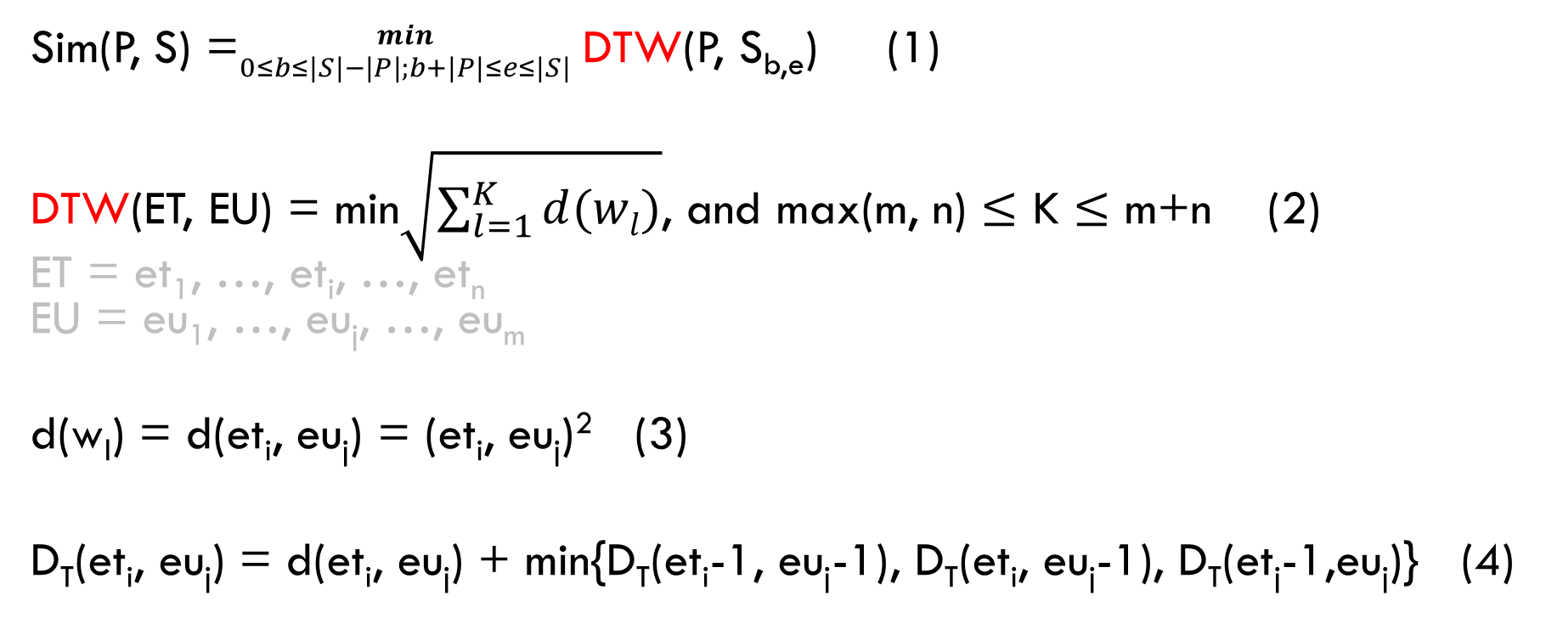
Pattern matching phase of B²SC Model
Sim(P, S) =${min \atop 0≤b≤\left|S\right|−\left|P\right|;b+\left|P\right|≤e≤\left|S\right|}$ DTW(P, S_{b,e}) (1)
DTW(ET, EU) = min$\sqrt{\sum_{l=1}^{K}{d(wl)}}$, and max(m, n) $≤$ K $≤$ m+n (2)
ET = et₁, …, et_{i}, …, et_{n}
EU = eu₁, …, eu_{j}, …, eu_{m}
d(w_{l}) = d(et_{i}, eu_{j}) = (et_{i}, eu_{j})² (3)
D_{T}(et_{i}, eu_{j}) = d(et_{i}, eu_{j}) + min{D_{T}(et_{i}-1, eu_{j}-1), D_{T}(et_{i}, eu_{j}-1), D_{T}(et_{j}-1,eu_{j})} (4)

Slide 12
Experimental setting
All data were divided into two disjunctive partitions :
training set and test set, based on the10-fold cross validation method, and the ratio for training and test sets was 80% vs. 20%.
The training set was used to construct the optimal biosignal templates, OpTem, and included ECG and EEG signals, whereas the test set was used for validation.
The threshold λ was computed automatically by taking the maximum similarity score among all pairs of the optimal templates.

Slide 13
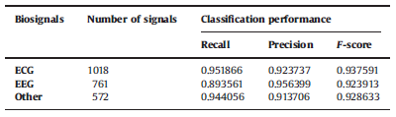
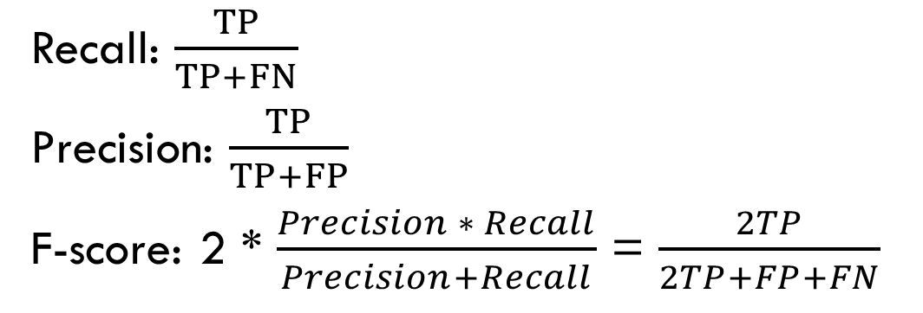
Classification results
TP : True Positive
FN : False Negative
FP : False Positive
Recall: $\frac{TP}{TP+FN}$
Precision: $\frac{TP}{TP+FP}$
F-score: 2 * $\frac{Precision ∗ Recall}{Precision+Recall}$ = $\frac{2TP}{2TP+FP+FN}$

