Slide 1
A lossless reference-free sequence compression algorithm leveraging grammatical, statistical, and substitution rules
Subhankar Roy, Dilip Kumar Maity, Anirban Mukhopadhyay
Briefings in Functional Genomics, 2025, 24, elae050
Presenter: Pei-Chian Lee
Date: Mar. 26, 2025

Slide 2
Abstract (1/2)
Deoxyribonucleic acid (DNA) or ribonucleic acid (RNA) sequence compressors for novel species frequently face challenges when processing wide-scale raw, FASTA, or multi-FASTA structured data. For years, molecular sequence databases have favored the widely used general-purpose Gzip and Zstd compressors. The absence of sequence-specific characteristics in these encoders results in subpar performance, and their use depends on time-consuming parameter adjustments. To address these limitations, in this article, we propose a reference-free, lossless sequence compressor called GraSS (Grammatical, Statistical, and Substitution Rule-Based). GraSS compresses sequences more effectively by taking advantage of certain characteristics seen in DNA and RNA sequences. It supports various formats, including raw, FASTA, and multi-FASTA, commonly found in GenBank DNA and RNA files. We evaluate GraSS’s performance using ten benchmark DNA sequences with reduced number of repeats, two highly repetitive RNA sequences, and fifteen raw DNA sequences. Test results indicate that the weighted average compression ratios (WACR) for DNA and RNA sequences are 4.5 and 19.6, respectively. Additionally, the entire DNA sequence corpus has a total compression time (TCT) of 246.8 seconds (s).

Slide 3
Abstract (2/2)
These results demonstrate that the proposed compression method performs better than several advanced algorithms specifically designed to handle various levels of sequence redundancy. The decompression time, memory usage, and CPU usage are also very competitive.

Slide 4
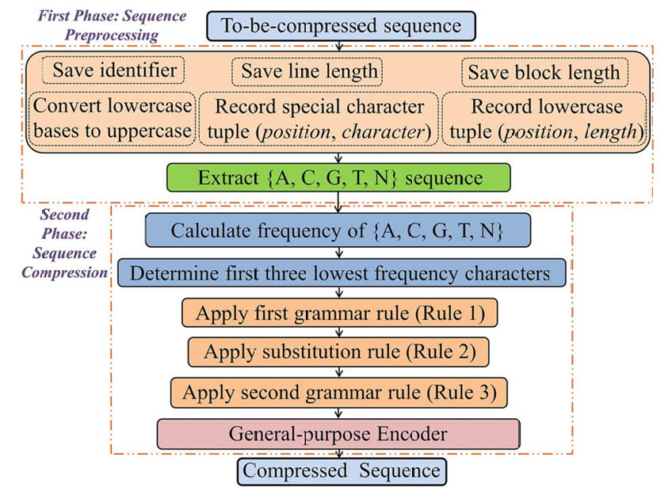
Methodology
Notes:
3b

Slide 5
First Phase
Example 1. seq1.fa
>chr
ATTGCATGTcgatggATGGggaAAA
ATCGataggatAGATTTTTAAAACC
CNNNNYYY
The following are included in the preprocessed output from file seq1.fa:
Sequence identifier (F2): >chr;
Lower case tuple (F2): (9, 6), (4, 3), and (7, 7); -> run-length encoding
Special character tuple (F2): (55, 24), (1, 24), and (1, 24); -> delta encoding
Line length (F2): 25; Block length (F2): 58;
Sequence (F1):
ATTGCATGTCGATGGATGGGGAAAA
ATCGATAGGA TAGATTTTTAAAACCCNNNN
Notes:
3b

Slide 6
Second Phase – step 1
Calculating the frequency of appearance of the letters A, C, G, T, and N in the previously stated sequence S:
Freq(A)=50
Freq(C)=14
Freq(G)=10
Freq(T) = 80
Freq(N) = 4
Notes:
3b

Slide 7
Second Phase – step 2
Determining the first three letters that appear the least
frequently: Small(Freq) = Freq(N) = 4
SndSmall(Freq) = Freq(G) = 10
TrdSmall(Freq)= Freq(C)=14
Freq(A)=50
Freq(C)=14
Freq(G)=10
Freq(T) = 80
Freq(N) = 4
Notes:
3b

Slide 8
Second Phase – step 3
Freq(A)=50
Freq(C)=14
Freq(G)=10
Freq(T) = 80
Freq(N) = 4
Rule 1 = {N → ZZ, G → ZT, C → ZA}
ATTGCATGTCGATGGATGGGGAAAA
ATCGATAGGA TAGATTTTTAAAACCCNNNN
ATTZTZA
ATZTTZAZTATZTZTATZTZTZTZTAAAAATZAZTATAAT
AZTATTTTTAAAAZAZAZAZZZZZZZZ ...
Notes:
3b

Slide 9
Second Phase – step 4
Freq(A)=50
Freq(C)=14
Freq(G)=10
Freq(T) = 80
Freq(N) = 4
Rule 2 = {T →0, A→1, Z→2}
ATTZTZA
ATZTTZAZTATZTZTATZTZTZTZTAAAAATZAZTATAAT
AZTATTTTTAAAAZAZAZAZZZZZZZZ ...
1002021102002
120102020102020202011111021201011012010000011 1112
1212122222222...
Notes:
3b

Slide 10
Second Phase – step 5
Rule 3 = {00→ P,01→Q,10→ R, 02→S,20 → U,11→V,12→ W,21→ X,22→ Y}
1002021102002
120102020102020202011111021201011012010000011 1112
1212122222222...
RSSVSPXURUURUUUUVVRXURVQURP
PVVW WWYYYY...
Freq(A)=50
Freq(C)=14
Freq(G)=10
Freq(T) = 80
Freq(N) = 4
Notes:
3b

Slide 11
Second Phase – step 6
The last phase uses block-sorting encoding (BSC) to
encode the intermediate data.
Notes:
Burrows-Wheeler Transform (BWT)

Slide 12
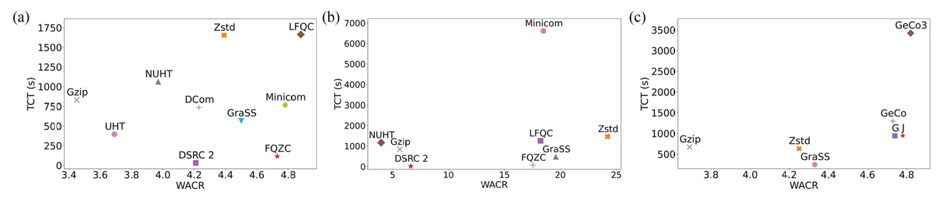
Result
FASTA DNA
FASTA RNA
raw DNA
Notes:
Size:O(mn)
construction time:O(mn)
Query:O($\sqrt{m^{′}+n^{′}}\log^{1+\text{ϵ}}(m^{′}+n′))$

Slide 13
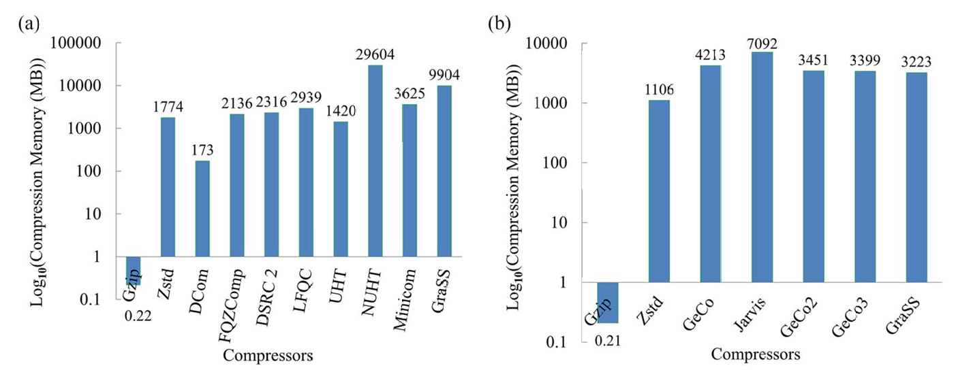
Result
FASTA DNA 序列
raw DNA 序列
Notes:
Size:O(mn)
construction time:O(mn)
Query:O($\sqrt{m^{′}+n^{′}}\log^{1+\text{ϵ}}(m^{′}+n′))$

