Slide 1
Cuckoo Filter: Practically Better Than Bloom
B. Fan, D. G. Andersen, M. Kaminsky, and M. D. Mitzenmacher
Proceedings of the 10th ACM International on Conference on emerging Networking Experiments and Technologies pp. 75-88. December 2014,.
Presenter : Jing-Xiang Yang
Date : Mar. 26, 2025

Slide 2
ABSTRACT
In many networking systems, Bloom filters are used for high speed set membership tests. They permit a small fraction of false positive answers with very good space efficiency. However, they do not permit deletion of items from the set, and previous attempts to extend “standard” Bloom filters to support deletion all degrade either space or performance. We propose a new data structure called the cuckoo filter that can replace Bloom filters for approximate set member ship tests. Cuckoo filters support adding and removing items dynamically while achieving even higher performance than Bloom filters. For applications that store many items and target moderately low false positive rates, cuckoo filters have lower space overhead than space-optimized Bloom filters. Our experimental results also show that cuckoo filters out perform previous data structures that extend Bloom filters to support deletions substantially in both time and space.

Slide 3
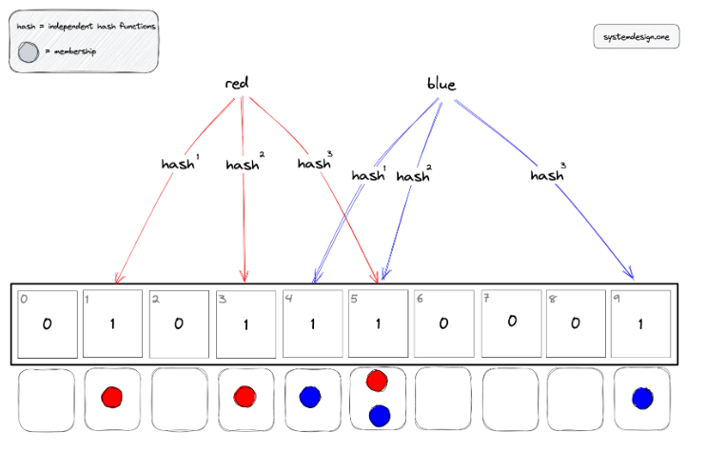
Bloom Filter
Purpose: Quickly checks if an item might exist or is definitely absent
Use Cases : Prevent unnecessary requests、 Quickly check if data is cached
Insert
Notes:
緩存穿透(完全沒命中)
資料並不存在於 cache中，也不會在db之中。 資料並不存在於 cache中，將會進db做查詢， 看似非常正常的操作。 但如果量一多，就會照成問題(e.g. 使用機器人直接掃)
了解了緩存穿透後，其實緩存穿透可以透過我們學過的bloom filter來解決， 當查詢db前，先經過bloom filter， 確定資料的存在性，就可以大量的減少緩存穿透問題。
IT :IndexType：Bloom - 緩存穿透(Cache Penetration)

Slide 4
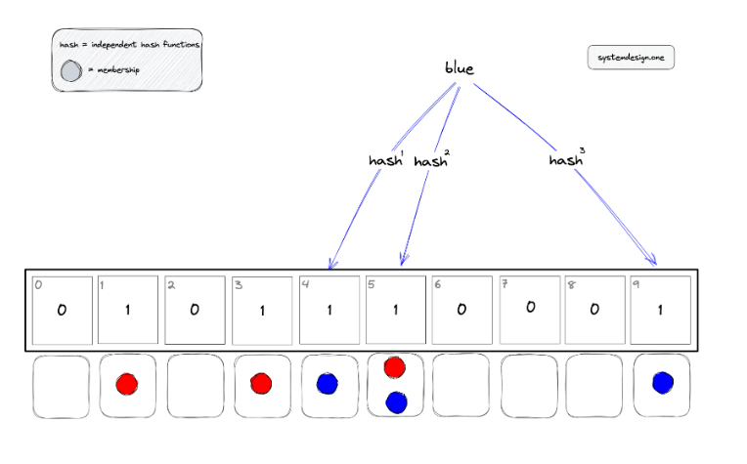
Look up
might exist

Slide 5
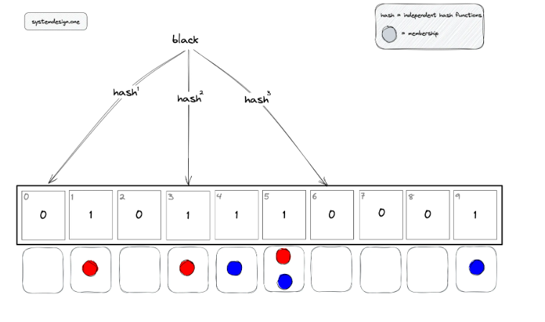
Look up
definitely absent

Slide 6
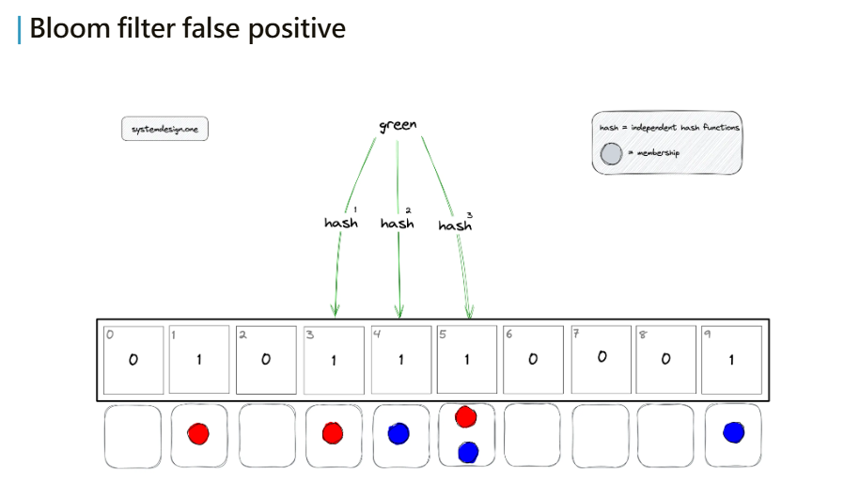
Notes:
可用數學推得方式來估算怎樣設計可以達到讓 false positive 是最小的

Slide 7
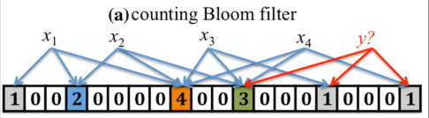
Counting Bloom Filter
Support deletion (using counter)

Slide 8
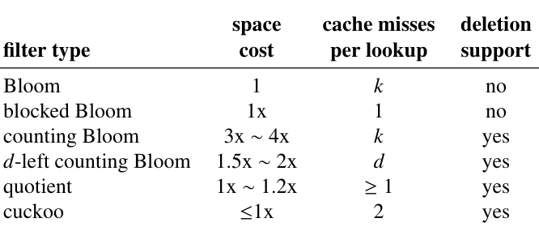
Cuckoo Filter
Bloom filter requires less memory than standard hashing methods hashing.
Cuckoo Filter is designed to support deletions and improve efficiency.

Slide 9
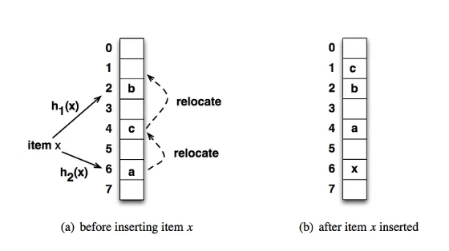

Cuckoo Hashing

Slide 10

Cuckoo Filter (Insert)
X = 5
Fingerprint(x) = 123
i₁ = 2, i₂ = 4
Backet
 |  | 123

Slide 11
Cuckoo Filter (Insert)
X = 6
Fingerprint(x) = 777
i1 = 1, i2 = 4
Backet
 | 777 | 123

Slide 12
Cuckoo Filter (Insert)
X = 7
Fingerprint(x) = 88
i1 = 1, i2 = 3
Backet
 | 777(88) | 123 |  | 777

Slide 13
Cuckoo Filter (Insert)
X = 7
Fingerprint(x) = 88
i1 = 1, i2 = 3
Backet
 | 777 | 88 |  | 123
Actually, a bucket has multiple slots.

Slide 14
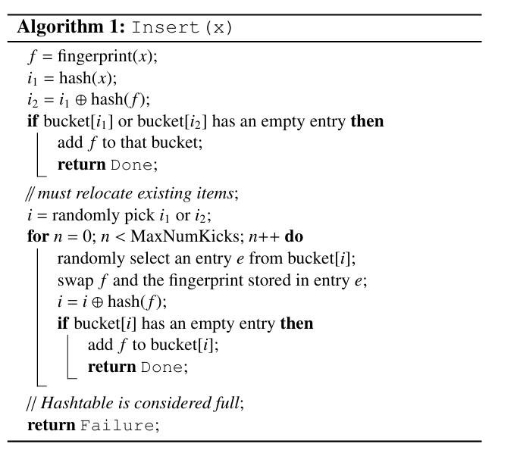

Slide 15
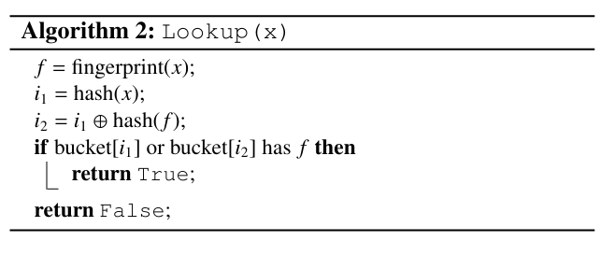
Cuckoo Filter (Look up)
X = 6
Fingerprint(x) = 777
i1 = 1, i2 = 4
Backet
 | 88 | 123 |  | 777
might exist

Slide 16
Cuckoo Filter (Look up)
X = 99
Fingerprint(x) = 234
i1 = 0, i2 = 3
definitely absent
Backet
 | 88 | 123 |  | 777

Slide 17
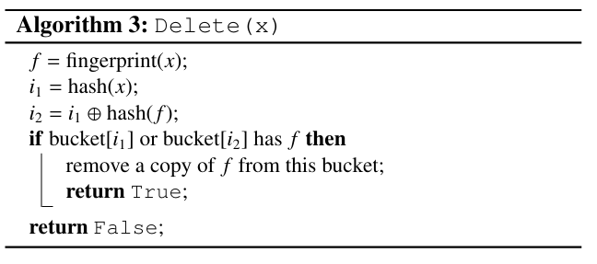
Cuckoo Filter (Delete)
X = 7
Fingerprint(x) = 88
i1 = 1, i2 = 3
Backet
 | 88 | 123 |  | 777

Slide 18
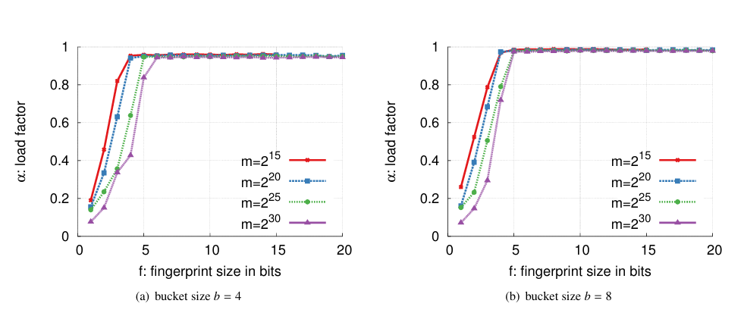
Load Factor
A short fingerprint ensures good load balancing.

Slide 19
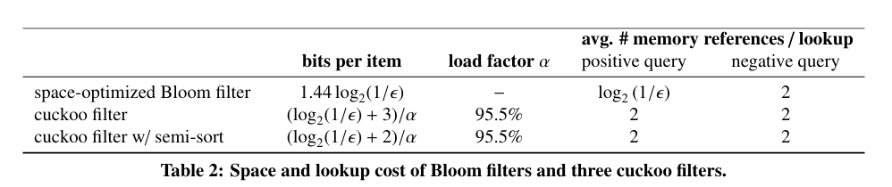
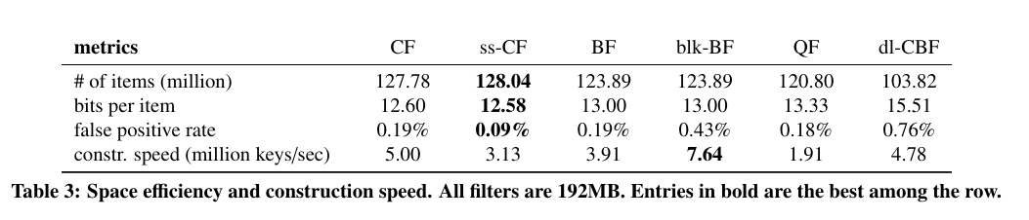
Analysis
Spatial utilization is better than many other variations.

Slide 20
Thanks

