Slide 1
A Block-sorting Lossless Data Compression Algorithm
M. Burrows and D. J. Wheeler
Digital Systems Research Center, 1994
Presenter: Yen-Yu Chen
Date: Apr.15, 2025

Slide 2
Abstract
We describe a block-sorting, lossless data compression algorithm, and our implementation of that algorithm. We compare the performance of our implementation with widely available data compressors running on the same hardware.
The algorithm works by applying a reversible transformation to a block of input text. The transformation does not itself compress the data, but reorders it to make it easy to compress with simple algorithms such as move-to-front coding.
Our algorithm achieves speed comparable to algorithms based on the techniques of Lempel and Ziv, but obtains compression close to the best statistical modelling techniques. The size of the input block must be large (a few kilobytes) to achieve good compression.

Slide 3
Transformation Step
Takes a string S of N characters
Generates all N cyclic rotations of S
Sorts the rotations in lexicographic order
Extracting the last character of each of the rotations
Extracts the last character of each sorted rotation to form a new string L
Records the index I of the original string S in the sorted list
Output is a pair (L,I)

Slide 4
Rotation
String S : "abraca"
a | b | r | a | c | a
a | a | b | r | a | c
c | a | a | b | r | a
a | c | a | a | b | r
r | a | c | a | a | b
b | r | a | c | a | a

Slide 5
Sort
String S : "abraca"
 | row | F |  |  |  |  | L
 | 0 | a | a | b | r | a | c
I= | 1 | a | b | r | a | c | a
 | 2 | a | c | a | a | b | r
 | 3 | b | r | a | c | a | a
 | 4 | c | a | a | b | r | a
 | 5 | r | a | c | a | a | b
Output:
(L,I)
L:’caraab’
I:1

Slide 6
Property
Any row and column is permutation of S
For any row i, the character L[i] comes immediately before F[i] in the original string S
The k-th occurrence of ch in L corresponds to the k-th occurrence of ch in F

Slide 7
Rotation
String S : ‘a0,b0,r0,a1,c0,a2’
a0 | b0 | r0 | a1 | c0 | a2
a2 | a0 | b0 | r0 | a1 | c0
c0 | a2 | a0 | b0 | r0 | a1
a1 | c0 | a2 | a0 | b0 | r0
r0 | a1 | c0 | a2 | a0 | b0
b0 | r0 | a1 | c0 | a2 | a0

Slide 8
Sort
a2 | a0 | b0 | r0 | a1 | c0
a0 | b0 | r0 | a1 | c0 | a2
a1 | c0 | a2 | a0 | b0 | r0
b0 | r0 | a1 | c0 | a2 | a0
c0 | a2 | a0 | b0 | r0 | a1
r0 | a1 | c0 | a2 | a0 | b0

Slide 9
Construct F
 | row | F |  |  |  |  | L
 | 0 | a | a | b | r | a | c
 | 1 | a | b | r | a | c | a
 | 2 | a | c | a | a | b | r
 | 3 | b | r | a | c | a | a
 | 4 | c | a | a | b | r | a
 | 5 | r | a | c | a | a | b
Notes:
每一個column row 都是 S

Slide 10
Decode
 | row | F |  |  |  |  | L
 | 0 | a | a | b | r | a | c
I= | 1 | a | b | r | a | c | a
 | 2 | a | c | a | a | b | r
 | 3 | b | r | a | c | a | a
 | 4 | c | a | a | b | r | a
 | 5 | r | a | c | a | a | b

Slide 11
Why L is Suitable for Compression
100 “the” in text
row “he … t” appear 100 times

Slide 12
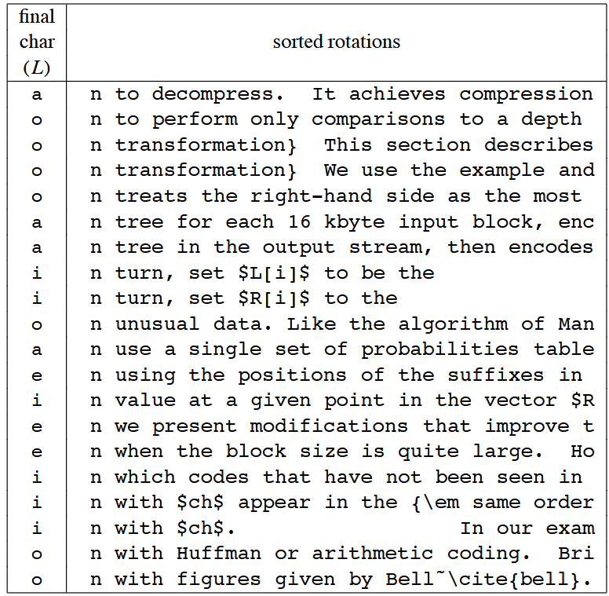

Slide 13
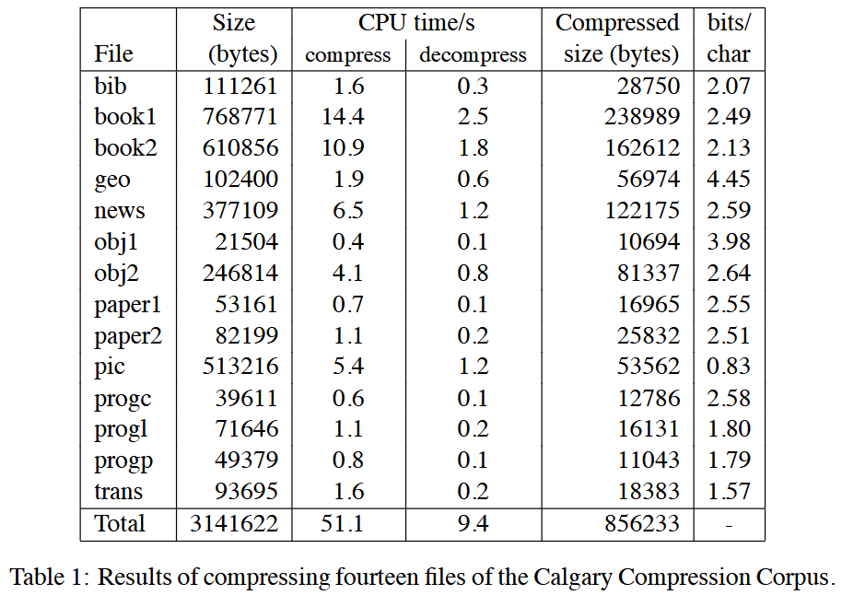
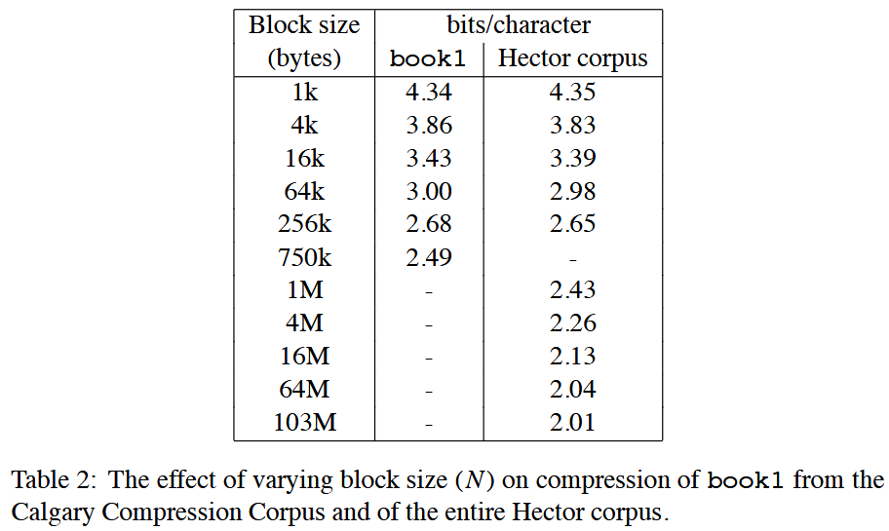
Experiment
BWT → Move-To-Front (MTF) → Huffman coding

