Slide 1
Build and Conquer: Solving N Queens Problem using Iterative Compression
Ahmed Alhassan
2019 International Conference on Computer, Control, Electrical, and Electronics Engineering (ICCCEEE)
Presenter: Tse-Ying Huang
Date: Apr. 15, 2025
Notes:
2014 年第十屆數字技術國際會議
斯洛伐克 日利納
1

Slide 2
Abstract
The N queens problem is a very hot topic for research use. Nonetheless all previous algorithms that solved the N queens problem treat each order of it as if they are separate problems with no connection among them. The main idea of this paper is to connect the dots among various orders of the N queens problem and demonstrate that all orders of the N-queens problem are connected with each other. And then we propose an algorithm using iterative compression to solve the problem i.e. beginning from the solution of the least order of the problem and then by using the relation among different orders we add a queen in every iteration until we have the N queens residing in the NxN board.

Slide 3
N-queens
The N queens problem is about trying to put N chess queens in an NxN chessboard without letting any queen attack any other queen i.e. placing queens so that:
There are no queen sharing the same row with any other queen.
2) There are no queen sharing the same column with any other queen.
3) There are no queen sharing the same diagonal with any other queen.

Slide 4
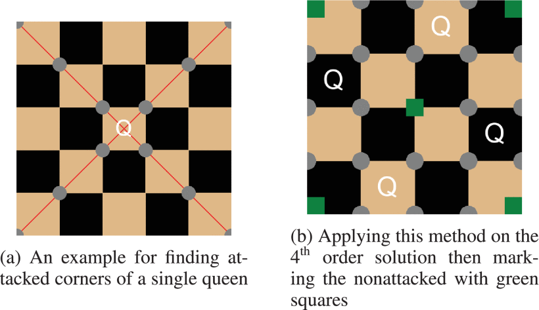
Nonattacked Corners

Slide 5
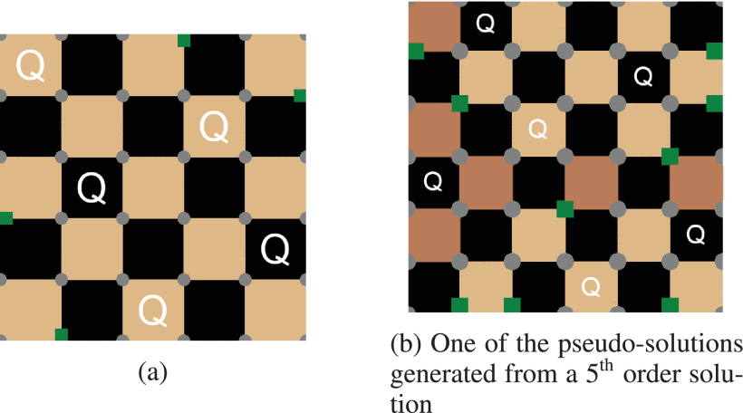
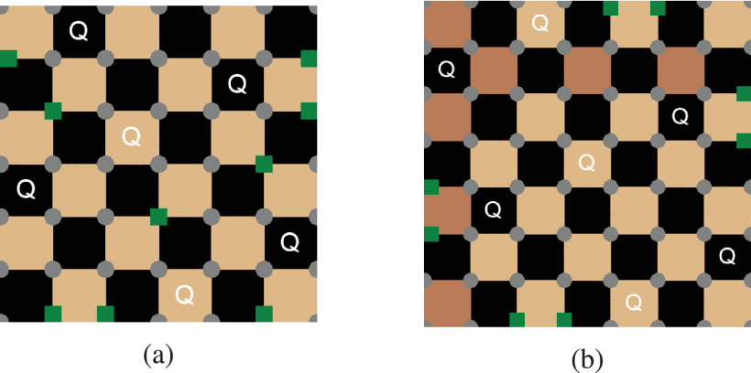
Pseudo-solution

Slide 6
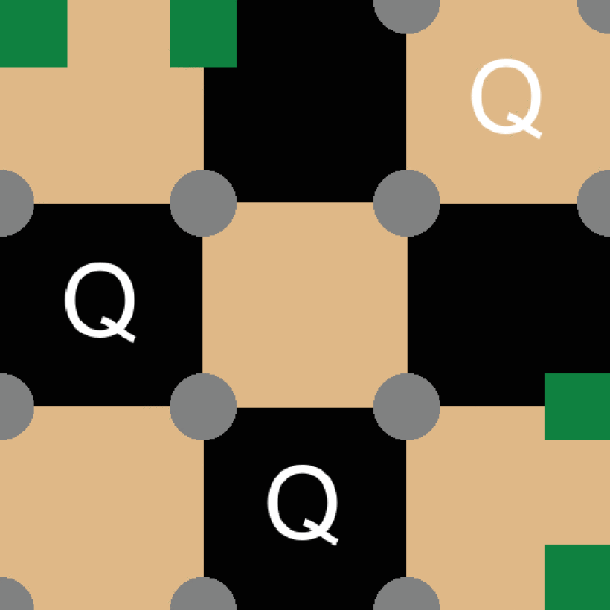
4th queen
 |  | Q
Q
 |  |  | Q
 | Q
Real solution
 |  | Q
Q
 | Q
 |  |  | Q
Pseudo-solution

Slide 7
BFS
1.遍歷目前階數的每一個棋盤配置
2.計算nonattacked corners
3.產生新配置（加入新皇后）
4.檢查新配置是否為有效解，且確保是否有對稱或旋轉的解
5.重複1~4直到完成所要的階數

Slide 8
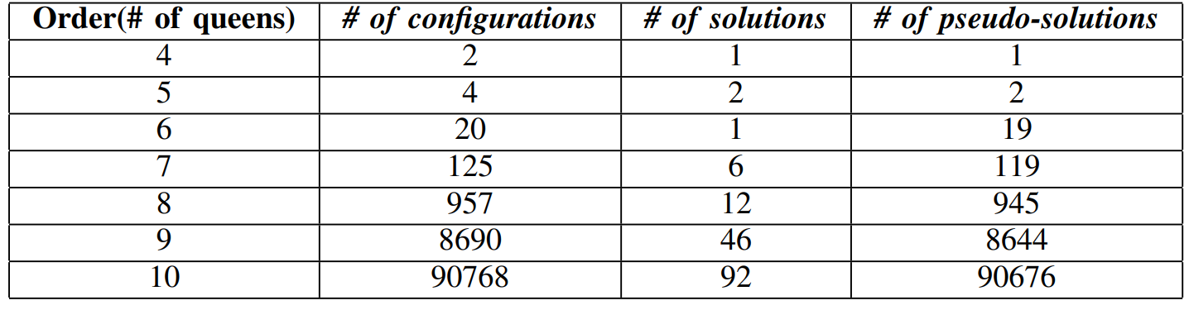
Results

