Slide 1
Order-preserving pattern matching with scaling
Youngho Kim, Munseong Kang, Joong Chae Na, Jeong Seop Sim
Information Processing Letters 180 (2023) 106333
Presenter: Wan-Ni Ou
Date: Apr. 15, 2025

Slide 2
Abstract
Given a text T and a pattern P , the order-preserving pattern matching (OPPM for short) problem is to find all substrings of T which have the same relative orders as P . Recently, approximate OPPM that allows errors have been studied such as OPPM with k-mismatches.
In this paper we define the OPPM with scaling which is a novel criteria for approximate OPPM by considering the relative orders of cusps and the scale of lengths of strings between them. Also we present an algorithm to solve the OPPM problem with scaling in O (n + m log m) time, which is the same time bound as the best known exact OPPM algorithm.

Slide 3
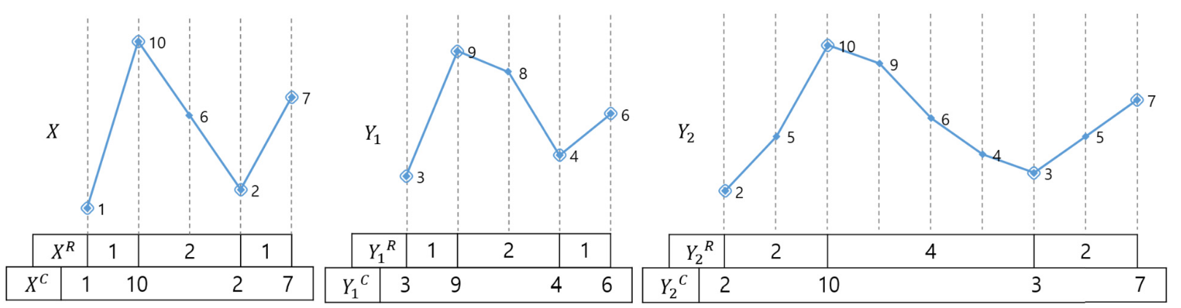
Scaled order-isomorphism (1/4)
cusp
X = 1, 10, 6, 2, 7
Y₁ = 3, 9, 8, 4, 6
Run-Length
Condition 1: | X^{R} | = | Y^{R} | and k × X^{R}[i] = Y^{R}[i].
Condition 2: X^{C} ≈ Y^{C} .

Slide 4
Scaled order-isomorphism (2/4)
X = 1, 10, 6, 2, 7
Y₂ = 2, 5, 10, 9, 6, 4, 3, 5, 7
cusp
Run-Length
Condition 1: | X^{R} | = | Y^{R} | and k × X^{R}[i] = Y^{R}[i].
Condition 2: X^{C} ≈ Y^{C} .

Slide 5
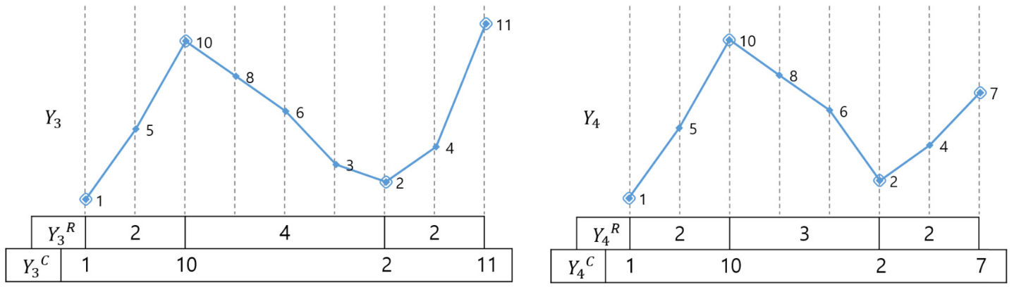
Scaled order-isomorphism (3/4)
X = 1, 10, 6, 2, 7
Y₃ = 1, 5, 10, 8, 6, 3, 2, 4, 11
cusp
Run-Length
Condition 1: | X^{R} | = | Y^{R} | and k × X^{R}[i] = Y^{R}[i].
Condition 2: X^{C} ≈ Y^{C} .

Slide 6
Scaled order-isomorphism (4/4)
X = 1, 10, 6, 2, 7
Y₄ = 1, 5, 10, 8, 6, 2, 4, 7
cusp
Run-Length
Condition 1: | X^{R} | = | Y^{R} | and k × X^{R}[i] = Y^{R}[i].
Condition 2: X^{C} ≈ Y^{C} .

Slide 7
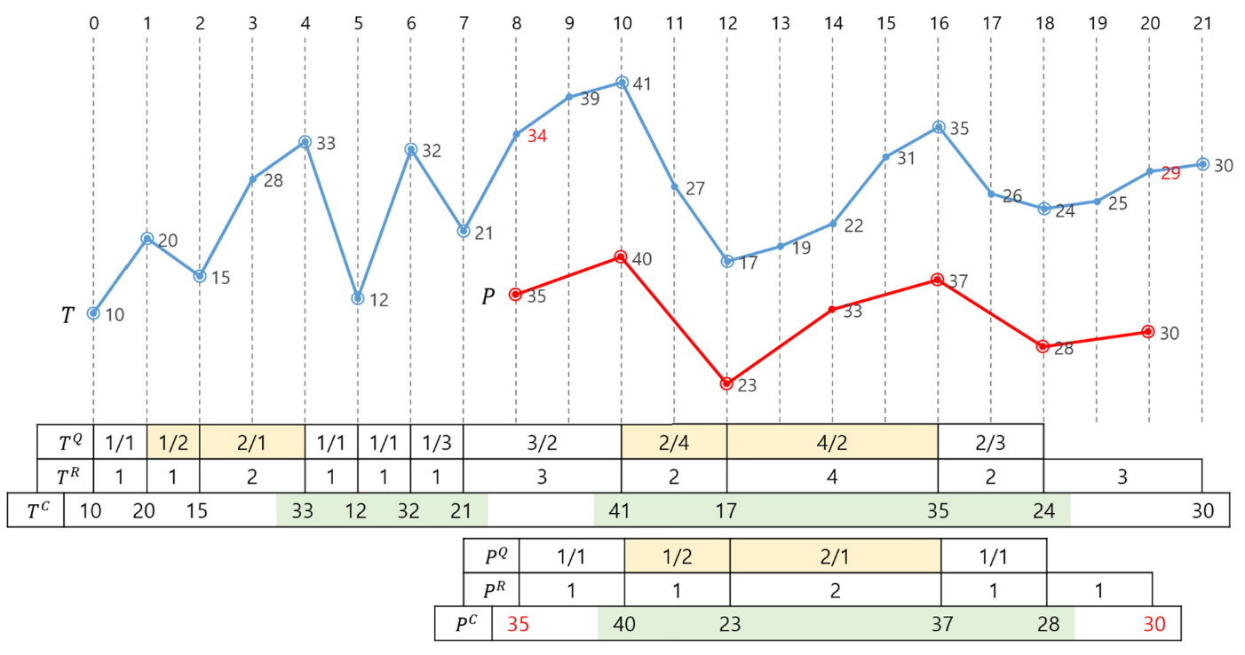
Algorithm for the OPPM problem with scaling (1/3)
Step1.1 Run-Length
P^{Q} = 鄰近run-length相除
J1 = { 1, 7 }
Condition 1: | X^{R} | = | Y^{R} | and k × X^{R}[i] = Y^{R}[i].
Condition 2: X^{C} ≈ Y^{C} .

Slide 8
Algorithm for the OPPM problem with scaling (2/3)
Step1.2 Cusp’s Order
P^{C}[1..4] = 40, 23, 37, 28
J2 = { 3, 7 }
J1∩J2 = { 7 }
Condition 1: | X^{R} | = | Y^{R} | and k × X^{R}[i] = Y^{R}[i].
Condition 2: X^{C} ≈ Y^{C} .

Slide 9
Algorithm for the OPPM problem with scaling (3/3)
Step2. verification
驗證首尾 run-length
T^{R}[6] ≥ kP^{R}[0]
T^{R}[10] ≥ kP^{R}[4]
首尾 + 所有cusp的order
T’ = 34, 41, 17, 35, 24, 29
P = 35, 40, 23, 37, 28, 30

Slide 10
Time Complexity
O (n + m log m)

Slide 11
Thanks

