Slide 1
The longest almost-increasing subsequence
Toan Thang Ta, Yi-Kung Shieh, Chin Lung Lu
Theoretical Computer Science 854 (2021) 44-51
Presenter: Tse-Ying Huang
Date: Apr. 29, 2025
1
Notes:
2014 年第十屆數字技術國際會議
斯洛伐克 日利納
1

Slide 2
Abstract
Given a positive constant c, a sequence S = s1, s2,..., sk of k numbers is said to be almost increasing if and only if si > max 1≤ j< i ≤ k. A longest common almost-increasing subsequence (LCaIS) between two input sequences is a longest common subsequence that is also an almost increasing sequence. We found out that the existing algorithm proposed by Moosa et al. [1] to find an LCaIS of two sequences without repeated elements gives an incorrect result for some instances. In this work, we present a dynamic programming algorithm that can correctly compute an LCaIS between any two sequences with repeated elements in O(nml) time and O(nm) space, where n and m are the lengths of two input sequences and l is the length of the output LCaIS.
2

Slide 3
LCaIS(Longest Common almost-Increasing Subsequence)
A= 3 , 2 , 1 , 3 ,2
B= 1 , 3 , 3 , 2
c=2
LCIS(A,B)=1,3 or 1,2
LCaIS(A,B)=1,3,2 or 3,3,2
Almost定義:下一個要加進來的值加上c會比前面數列中所有的數多大

Slide 4
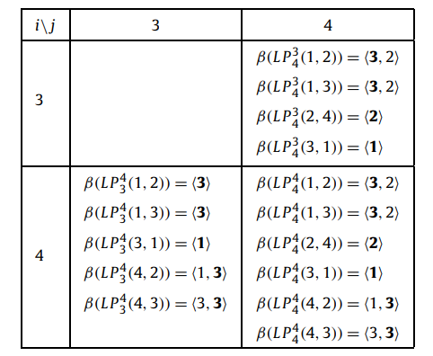
Algorithm
A= 3 , 2 , 1 , 3 ,2
B= 1 , 3 , 3 , 2
c=2
When A4≠B4
L(i,j)=L(i-1,j)+L(i,j-1)
Notes:
LP(?,?)指的是記最大值的位置 後面的序列是MATCH的序列

Slide 5
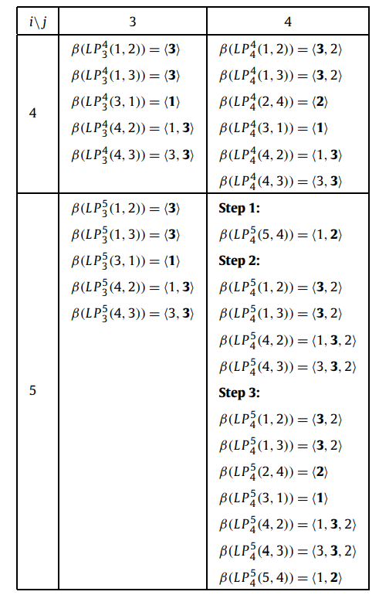
A= 3 , 2 , 1 , 3 ,2
B= 1 , 3 , 3 , 2
c=2
Algorithm
When A5=B4
Step1:
把match的值2加到左上角最大值比2小且長度最長的序列
Step2:
將左上角加上2符合almost這個條件的序列
Step3:
將L(i-1,j)和L(i,j-1)加入
Notes:
LP(?,?)指的是記最大值的位置 後面的序列是MATCH的序列

Slide 6
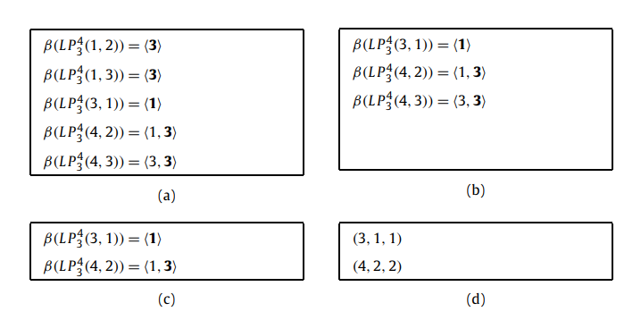
simplified
1.刪除dominated
2.刪除redundant
3.轉換3-tuple value
6
Notes:
LP(?,?)指的是記最大值的位置 後面的序列是MATCH的序列

Slide 7
complexity
O(nml) l為最後獲得LCaIS的長度
7
Notes:
LP(?,?)指的是記最大值的位置 後面的序列是MATCH的序列

