Slide 1
A novel lossless encoding algorithm for data compression–genomics data as an exemplar
Anas Al-okaily and Abdelghani Tbakhi
Front. Bioinform. 4:1489704.
PUBLISHED 23 January 2025
Presenter: Pei-Chian Lee
Date: Apr. 29, 2025

Slide 2
Abstract (1/2)
Data compression is a challenging and increasingly important problem. As the
amount of data generated daily continues to increase, efficient transmission and
storage have never been more critical. In this study, a novel encoding algorithm
is proposed, motivated by the compression of DNA data and associated
characteristics. The proposed algorithm follows a divide-and-conquer approach
by scanning the whole genome, classifying subsequences based on similarities
in their content, and binning similar subsequences together. The data is then
compressed into each bin independently. This approach is different than the
currently known approaches: entropy, dictionary, predictive, or transform-based
methods. Proof-of-concept performance was evaluated using a benchmark
dataset with seventeen genomes ranging in size from kilobytes to gigabytes.
Notes:
資料壓縮是一項具有挑戰性且日益重要的問題。隨著每日產生的資料量持續增加，高效的資料傳輸與儲存變得前所未有地關鍵。在本研究中，提出了一種新穎的編碼演算法，其靈感來自於DNA資料及其相關特性的壓縮需求。
所提出的演算法採取分而治之（divide-and-conquer）的方法，透過掃描整個基因組，根據子序列內容的相似性進行分類，並將相似的子序列分群（binning）放在一起。接著，每個分群中的資料會獨立地進行壓縮。
這種方法與目前已知的熵編碼、字典編碼、預測編碼或轉換編碼等傳統方法皆有所不同。為驗證概念的可行性，本研究使用了一個包含17個基因組的基準資料集來進行效能評估，這些基因組大小從數千位元組（KB）到數十億位元組（GB）不等。
實驗結果顯示，與現有最先進的壓縮工具相比，此演算法在每個基因組的壓縮上均有顯著改善，可節省數百萬位元組（MB）的空間。
此外，該演算法也可應用於其他類型資料的壓縮，例如文字、數字、影像、音訊與影片等，而這些資料類型正以前所未有的規模每日產生中。

Slide 3
Abstract (2/2)
The results showed a considerable improvement in the compression of each
genome, preserving several megabytes compared to state-of-the-art tools.
Moreover, the algorithm can be applied to the compression of other data
types include mainly text, numbers, images, audio, and video which are being
generated daily and unprecedentedly in massive volumes.

Slide 4
OST-DNA
TCCGA…………………………………………
……………………………………………………
…………………………………………………..
…………………………………………CCAGT
Notes:
DNA整體均勻。局部不均勻
相似subsequence,距離香遠

Slide 5
OST-DNA compression
T = "GATCGTCGTACCGATCGTATGTCGA “
w = 5
label length = 4
L = {bin_A, bin_B, bin_C,bin_B, bin_A} -> huffman algorithm
bin_A: {GATCG, GTCGA}-> other compression algorithm
bin_B: {TCGAT, CGTAT}-> other compression algorithm
bin_C: {CCGAT}-> other compression algorithm
G:0
A:10
T:110
C:111
subseq | Label | bin
GATCG | GATC_1233 | bin_A
TCGAT | TGCA_1233 | bin_B
CCGAT | CGAT_1233 | bin_C
CGTAT | TGCA_1233 | bin_B
GTCGA | GATC_1233 | bin_A
Notes:
GATC_1233 : 0,10,110,111
TGCA_1233:
CGAT_1223:0 ,10 ,110 ,111
TGCA_1233
GATC_1233

Slide 6
OST-DNA decompression
L = {bin_A, bin_B, bin_C,bin_B, bin_A}
bin_A: {GATCG, GTCGA}
bin_B: {TCGAT, CGTAT}
bin_C: {CCGAT}
T = " GATCGTCGTACCGATCGTATGTCGA “
Notes:
GATC_1233 : 0,10,110,111
TGCA_1233:
CGAT_1223:0 ,10 ,110 ,111
TGCA_1233
GATC_1233

Slide 7
Key Points of the OST-DNA Algorithm
This design facilitates organizing and sorting the input datausing a divide-and-conquer method by creating bins for similar data and encodes/compresses data in the same bin that are better if compressed together, to achieve better compression results with a minor increase in time costs.
Bin labels are computed using a Huffman tree encoding. The reason for selecting Huffman algorithm since the label of larger bin must be more frequent in L, hence encode this label with shorter codes (while the label of smaller bins with longer codes).
L = {bin_A, bin_B, bin_C,bin_B, bin_A} -> huffman algorithm
bin_A: {GATCG, ATCGA}
bin_B: {TCGAT, CGTAG}
bin_C: {CCGAT}
Notes:
3. OST-DNA 實作特點
bin label 的產生：
依據 Huffman 編碼結果，短碼代表高頻率字元。
不同 label 長度會影響 bin 的數量與內部相似度（label 長度越大 → bin 越多 → 壓縮效果越好但耗時增加）。
選擇 Huffman 的原因：
它能有效反映序列中字元的出現頻率，並使高頻 label 擁有較短的表示碼以提高效率。
那什麼是「大 bin」？
大 bin = 包含很多子序列的 bin → 出現次數（label 的頻率）比較高。
小 bin = 包含較少子序列的 bin → 出現次數（label 的頻率）比較低

Slide 8
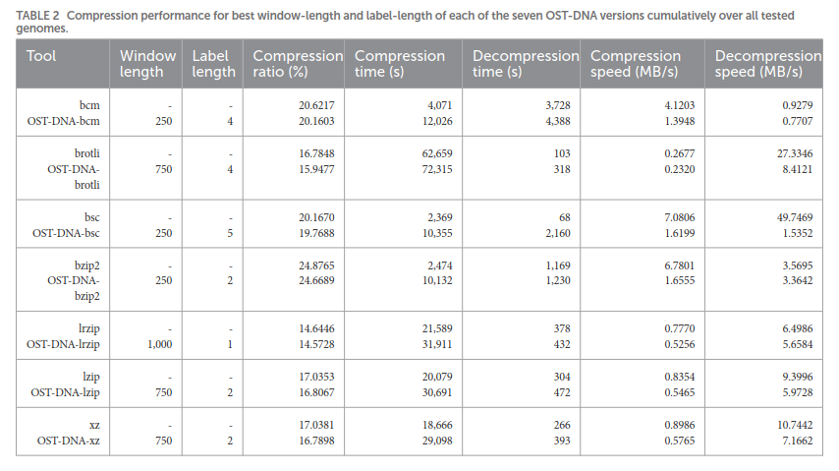
Result
Notes:
LZ : 2, 5, 6, 7

Slide 9
Complexities
compression : O(t)
decompression : O(t)
Notes:
例 2️⃣：查 run 的長度 count-consecutive(i, j)
查第2欄、第2條序列（位置2）這個字母的連續長度？
→ B2[2] = 1 → 它是新 run 的起點 → 第2個 run → select1(B2, 2) = 2（開始位置） → select1(B2, 3) = 4（下一個 run 的開始） → 所以這個 run 的長度 = 4 - 2 = 2
✔️ 結果是這個 C 出現了 2 次（在位置2和3）

