Slide 1

HOW TO WRITE A WORLD CLASS PAPER
Arnout Jacobs, Director of Strategy
Elsevier Author Workshop
March 2010

Slide 2
Outline
To publish or not to publish…
Writing a quality manuscript
    Preparations
    Article construction
    Language
    Technical details
Revisions and response to reviewers
Ethical issues
Conclusions: getting accepted

Slide 3
To publish or not to publish…

Slide 4
Why publish?
Scientists publish to share with the research community findings that advance knowledge and understanding
  To present new, original results or methods
  To rationalize published results
  To present a review of the field or to summarize a particular topic

Slide 5
Publish or perish
Funding Bodies
Grant Writing
Scientists / Clinicians
Journal Publication
Notes:
The purpose of this diagram is to show the audience the importance of publishing in peer-reviewed journals and why they need to continue to publish their research findings

Slide 6
Who judges your article?
Someone like you!
Chief editor has the final say
Reviewers check the manuscript in detail
All are based in a university and are fulltime researchers
Checking articles is an activity outside of their normal job
They’re very very busy…

Slide 7
Publishers do not want zero-cited articles
Editors now regularly analyze citations per article
“The statistic that 27% of our papers were not cited in 5 years was disconcerting. It certainly indicates that it is important to maintain high standards when accepting papers... nothing would have been lost except the CV's of those authors would have been shorter…”
– Marv Bauer, Editor, Remote Sensing of Environment

Slide 8
Publishers do want quality
  WANTED
Originality
Significant advances in field
Appropriate methods and conclusions
Readability
Studies that meet ethical standards
  NOT WANTED
Duplications
Reports of no scientific interest
Work out of date
Inappropriate methods or conclusions
Studies with insufficient data

Slide 9
Writing a quality manuscript
Preparations

Slide 10
What type of manuscript?
Full articles / Original articles
(including Theoretical, Methodology papers, Case studies, …)
Letters / Rapid Communications / Short Communications
Review papers / Perspectives
Self-evaluate your work: Is it sufficient for a full article? Or are your results so thrilling that they need to be revealed as soon as possible?
Ask your supervisor and colleagues for advice on manuscript type. Sometimes outsiders may see things more clearly than you.

Slide 11
Who is the audience?
Do you want to reach specialists, multidisciplinary researchers, or a general audience? You will need to adjust information and writing style accordingly
Journals, even in similar subjects, reach readers with different backgrounds
Each journal has its own style; read other articles to get an idea of what is accepted
Is the readership worldwide or local?

Slide 12
Which journal?
Consider:
  Aims and scope (check journal websites and recent articles)
  Types of articles
  Readership
  Current hot topics (go through recent abstracts)
  Asking colleagues for advice
Sometimes it is necessary to lower one’s sights or return to the lab/clinic to obtain more data

Slide 13
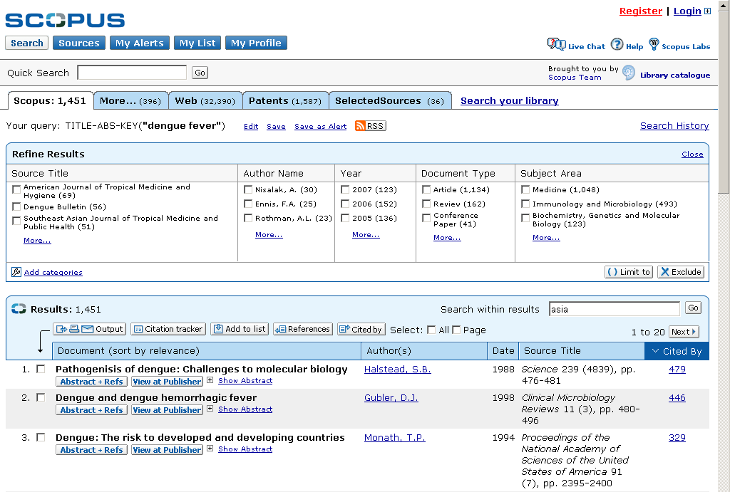
Sort by citations to find most cited article in this research area

Slide 14

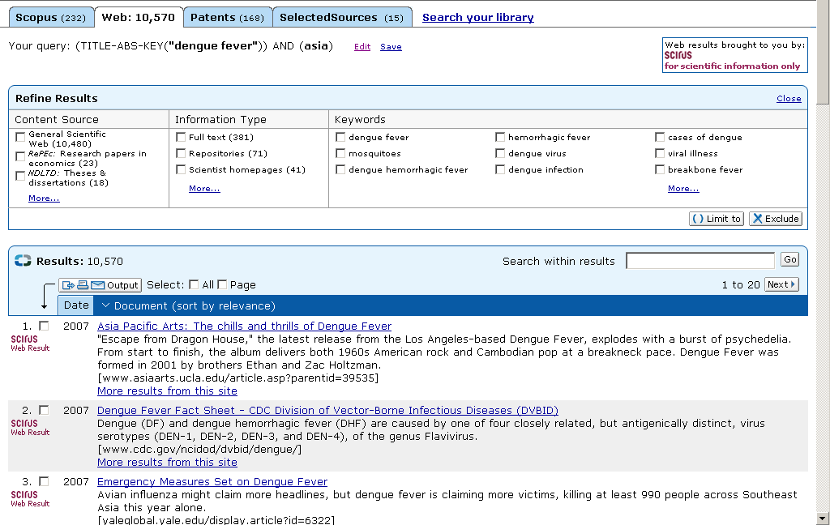

Web Results – Scirus.com

Slide 15
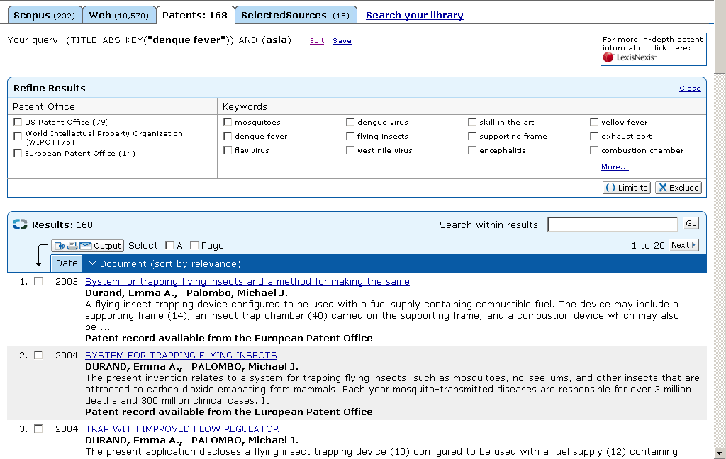
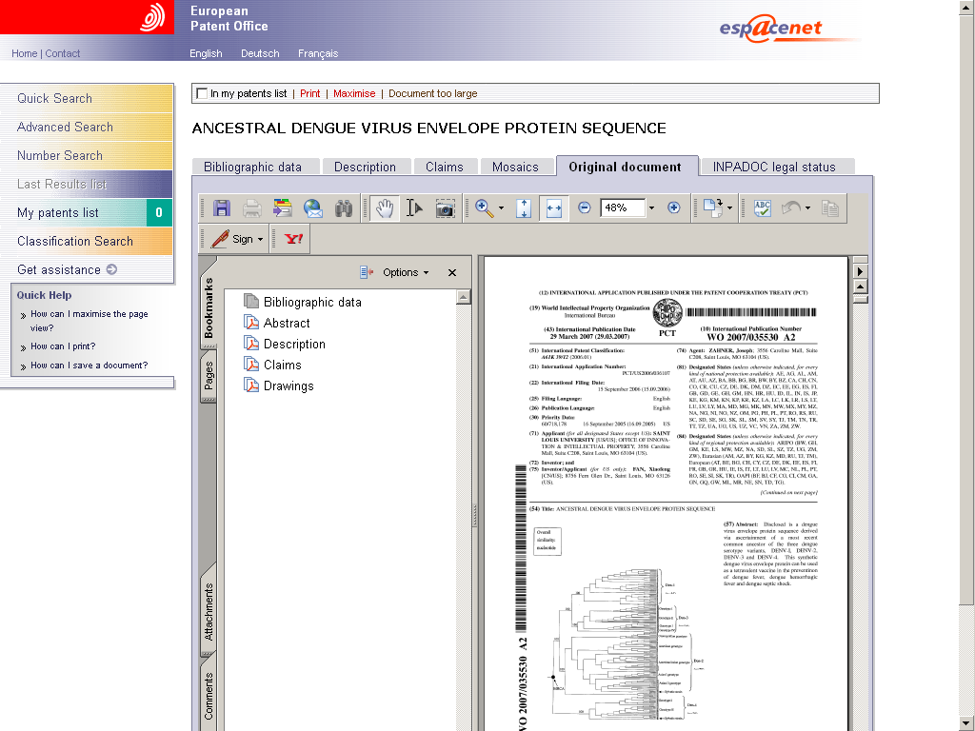
See Patents from 5 major patent offices
USPTO, JPTO, WIPO, EPTO, UKPTO

Slide 16
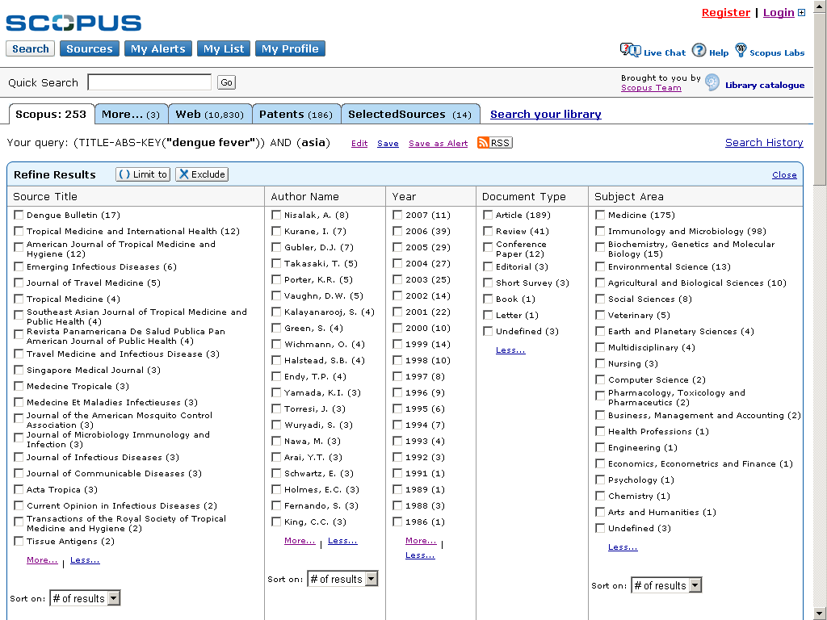
Get an overview
See Top Journals for specific topics in Asia

Slide 17
Get an overview
Top Authors’ to follow in the research of one topic
Use this information to find Experts in a subject field for peer-review. Email addresses provided where available

Slide 18
Get an overview
In which year was this research most popular

Slide 19
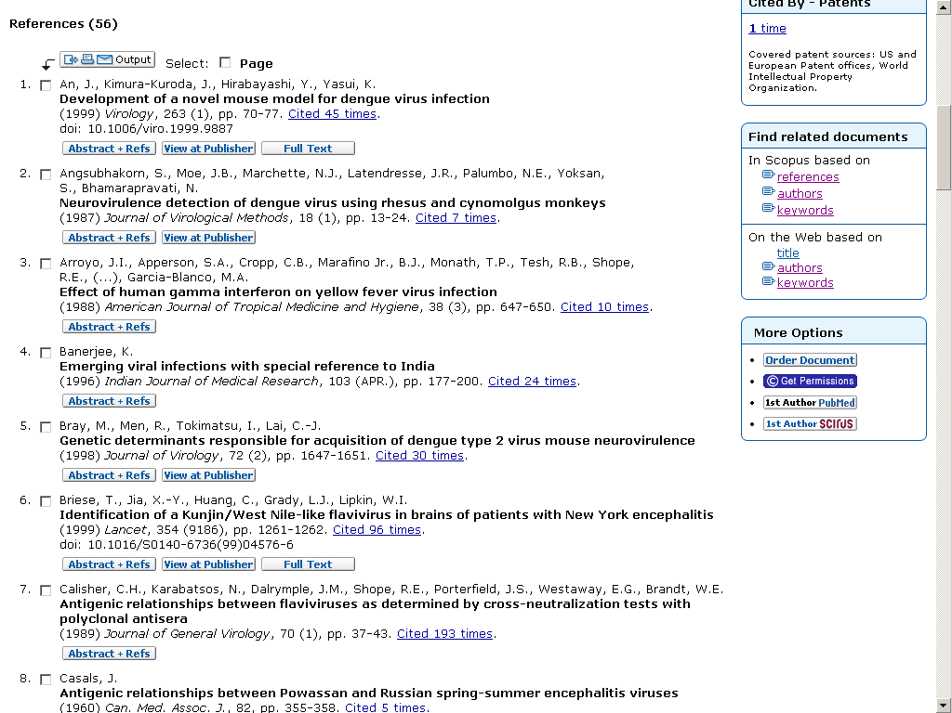
Scroll below to see references of that article
Allows you to keep browsing and discovering surprising research that you may never have found without a navigation tool like Scopus

Slide 20
Consulting the Guide for Authors will save your time and the editor’s
All editors hate wasting time on poorly prepared manuscripts

Slide 21
Format
Consult and apply the list of guidelines in the “Guide for Authors”
Ensure that you use the correct:
  Layout
  Section lengths (stick to word limits)
  Nomenclature, abbreviations and spelling (British vs. American)
  Reference format
  Number/type of figures and tables
  Statistics

Slide 22
Writing a quality manuscript
Article construction

Slide 23
Article structure
Title
Authors
Abstract
Keywords
Main text (IMRaD)
  Introduction
  Methods
  Results
  Discussion (Conclusion)
Acknowledgements
References
Supplementary material
Need to be accurate and informative for effective indexing and searching
Each has a distinct function

Slide 24
Title
A good title should contain the fewest possible words that adequately describe the contents of a paper
DO
Convey main findings of research
Be specific
Be concise
Be complete
Attract readers
DON’T
Use unnecessary jargon
Use uncommon abbreviations
Use ambiguous terms
Use unnecessary detail
Focus on part of the content only

Slide 25
Title
Slower processing is correlated with higher levels of depressed mood, fatigue, lower verbal fluency, fewer words and digits recalled and poorer recall of visual-spatial information in MS patients
Relationships between information processing, depression, fatigue and cognition in multiple sclerosis

Slide 26
Authors and affiliations
Be consistent with spelling, full versus short names, full versus short addresses
Surnames: Pérez-García / Pérez / García
Middle Initial: Use consistently or not at all
First Names: Dave / David
Affiliation: Faculty of Medicine / Faculty of Medical and Health Sciences

Slide 27
Abstract
The quality of an abstract will strongly influence the editor’s decision
A good abstract:
Is precise and honest
Can stand alone
Uses no technical jargon
Is brief and specific
Cites no references
Use the abstract to “sell” your article

Slide 28
Keywords
Keywords are important for indexing: they enable your manuscript to be more easily identified and cited
Check the Guide for Authors for journal requirements
Keywords should be specific
Avoid uncommon abbreviations and general terms

Slide 29

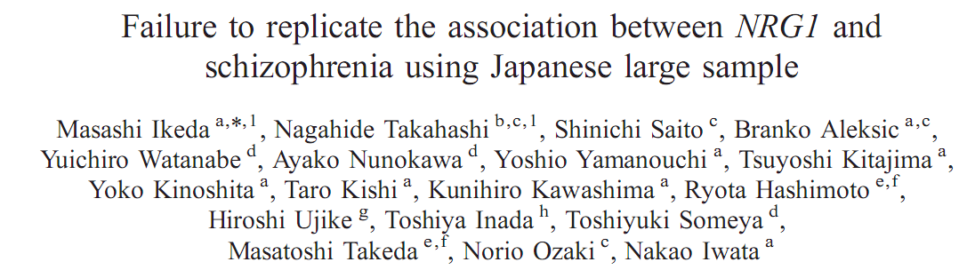
Keywords
Bad keywords: Psychiatric disorder, NRG1, LD, SNPs, Japanese large sample, association
Notes:
Presenter: feel free to replace the example here with one from your journal

Slide 30
Introduction
Provide the necessary background information to put your work into context
It should be clear from the introduction:
Why the current work was performed
    aims
    significance
What has been done before
What was done in your research (in brief terms)
What was achieved (in brief terms)

Slide 31
Introduction
DO
Consult the Guide for Authors for word limit
“Set the scene”
Outline “the problem” and hypotheses
Ensure that the literature cited is balanced, up to date and relevant
Define any non-standard abbreviations and jargon

Slide 32
Introduction
DON’T
Write an extensive review of the field
Cite disproportionately your own work, work of colleagues or work that supports your findings while ignoring contradictory studies or work by competitors
Describe methods, results or conclusions other than to outline what was done and achieved in the final paragraph
Overuse terms like “novel” and “for the first time”

Slide 33

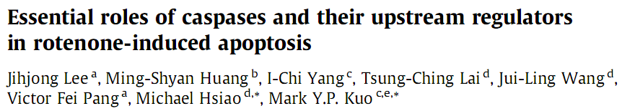
Introduction
Rotenone is a naturally occurring plant compound derived from the root and bark of some Luguminosae species… Administration of rotenone has been shown to lead to biochemical, anatomical, and behavioral symptoms resembling Parkinson’s disease due to neurotoxicity [1–3]. Previous studies have shown that… However, other studies contradict these ﬁndings… Understanding the exact mode of action of rotenone should provide additional useful information toward its possible application in oral cancer treatment. In this report, we…
Notes:
Red text shows important elements: setting the scene and defining terms; essential background information only; balanced; expression of problem/hypotheses; context; what we did
Presenter: feel free to replace this with an example from your own journal

Slide 34
Methods
The Methods section must provide sufficient information so that a knowledgeable reader can reproduce the experiment
List suppliers of reagents and manufacturers of equipment, and define apparatus in familiar terms:
“using an AD 340C plate reader (Beckman Coulter)”
OR
“using a plate reader (Beckman Coulter AD 340C)
NOT
“using a Beckman Coulter AD 340C.”
Unless the Guide for Authors states otherwise, use the past tense; the present tense is usually only used in methodology-type papers

Slide 35
Results
The main findings of the research
DO
Use figures and tables to summarize data
Show the results of statistical analysis
Compare “like with like”
DON’T
Duplicate data among tables, figures and text
Use graphics to illustrate data that can easily be summarized with text

Slide 36
Graphics
“Readers… often look at the graphics first and many times go no further. Therefore, the reviewer should be particularly sensitive to inclusion of clear and informative graphics.”
– Henry Rapoport, Associate Editor, Journal of Organic Chemistry

Slide 37
Graphics
Figures and tables are the most effective way to present results
BUT:
Captions should be able to stand alone, such that the figures and tables are understandable without the need to read the entire manuscript
The data represented should be easy to interpret
Colour should only be used when necessary

Slide 38
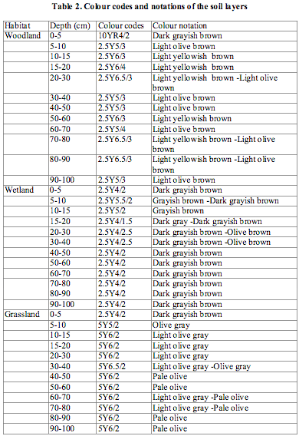
Graphics
Illustrations should only be used to present essential data
The information in the table can be presented in one sentence:
‘The surface soils were dark grayish brown, grading to light olive brown (woodland), light olive brown (wetland), and pale olive (grassland) at 100 cm.’
Summarize results in the text where possible

Slide 39
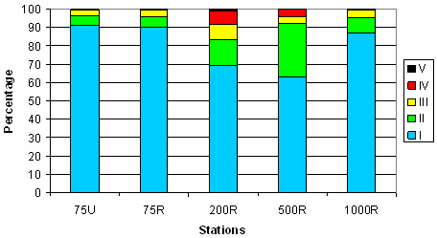
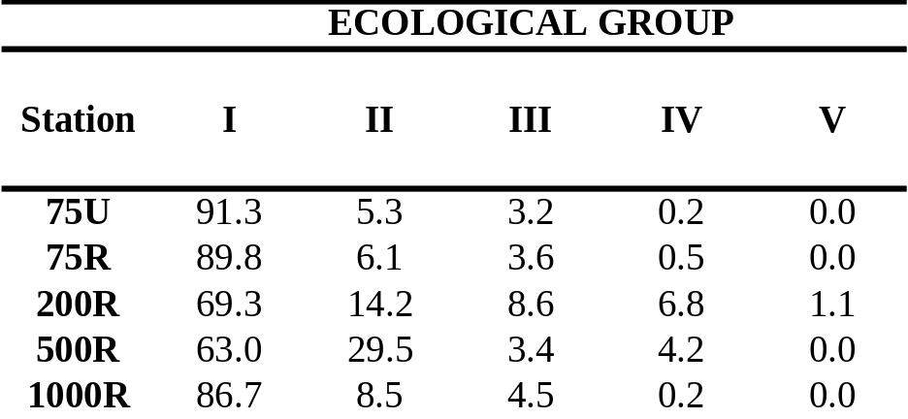
Graphics
The figure and table show the same information, but the table is more direct and clear

Slide 40
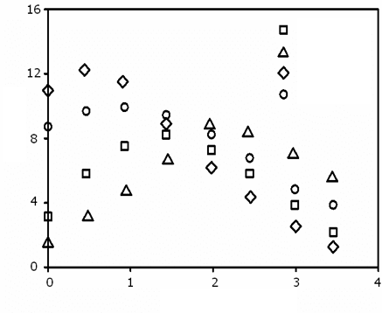
Graphics
Poor
Legend is poorly defined
Graph contains too much data
No trend lines
1-2
2-2
1-1
2-1
Computation time per example
Number of Examples (in thousands)

Slide 41
Graphics
Better
Legend is well defined but there is still too much data and no trendlines
method1,dual
method2,dual
method1,single
method2,single
Computation time per example
Number of Examples (in thousands)

Slide 42
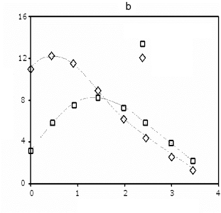
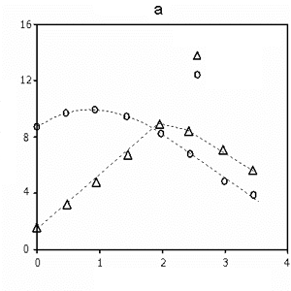
Graphics
Best
Method 1
Method 2
dual processors
single processor
dual processors
single processor
Computation time per example
Computation time per example
Number of Examples (in thousands)
Number of Examples (in thousands)
Legend is clear
Data is better organized
Trend lines are present

Slide 43
Statistics
Indicate the statistical tests used with all relevant parameters
mean ± SD
Give numerator and denominators with percentages
40% (100/250)
Use means and standard deviations to report normally distributed data

Slide 44
Statistics
Use medians and interpercentile ranges to report skewed data
Report P values
p=0.0035 rather than p<0.05
The word “significant” should only be used to describe “statistically significant differences”

Slide 45
Discussion
Describe
How the results relate to the study’s aims and hypotheses
How the findings relate to those of other studies
All possible interpretations of your findings
Limitations of the study
Avoid
Making “grand statements” that are not supported by the data
  Example: “This novel treatment will massively reduce the prevalence of malaria in the third world”
Introducing new results or terms

Slide 46
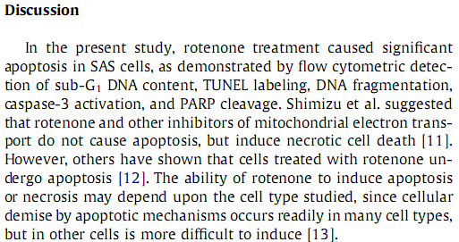
Discussion
Notes:
This example is taken from the same paper as the introduction example – feel free to replace with one from your own journal. Key points here are the statement of what was found; a restatement of the problem (and thus, an idea of how the findings relate to the original problem and the published literature), and a first interpretation of the findings (other followed).

Slide 47
Conclusion
Put your study into CONTEXT
Describe how it represents an advance in the field
Suggest future experiments
BUT
Avoid repetition with other sections
Avoid being overly speculative
Don’t over-emphasize the impact of your study

Slide 48

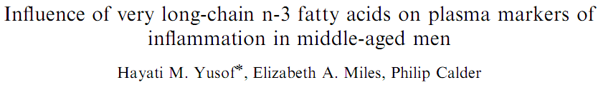
Conclusion
In summary, findings from the present study are in general accordance with previous studies that suggest…. There is a need to establish dose-dependent effects of EPA and DHA separately and in different population groups. If findings from this study are applicable to consumption of fish, then intake at the upper level of the current UK guideline range [42] may not influence cardiovascular risk factors in fairly healthy, normolipidemic and middle-aged males.
The Conclusion should put your study into CONTEXT
Notes:
Again, please feel free to replace this example with an example from your own journal; the key points here are that the findings are related to the literature and put into context. The main outcome is described and a future direction (need for further study) is also identified

Slide 49
Acknowledgements
Acknowledge anyone who has helped you with the study, including:
  Researchers who supplied materials or reagents, e.g. vectors or antibodies
  Anyone who helped with the writing or English, or offered critical comments about the content
  Anyone who provided technical help
State why people have been acknowledged and ask their permission
Acknowledge sources of funding, including any grant or reference numbers

Slide 50
References
Check the Guide for Authors for the correct format
Check
Spelling of author names
Punctuation
Number of authors to include before using “et al.”
Reference style
Avoid
Personal communications, unpublished observations and submitted manuscripts not yet accepted
Citing articles published only in the local language
Excessive self-citation and journal self-citation

Slide 51
Supplementary material
Information related to and supportive of the main text, but of secondary importance
Includes:
Microarray data
Sequence data
Method validation
Additional controls
Video data
Will be available online when the manuscript is published

Slide 52
Part 2
Resources

Slide 53
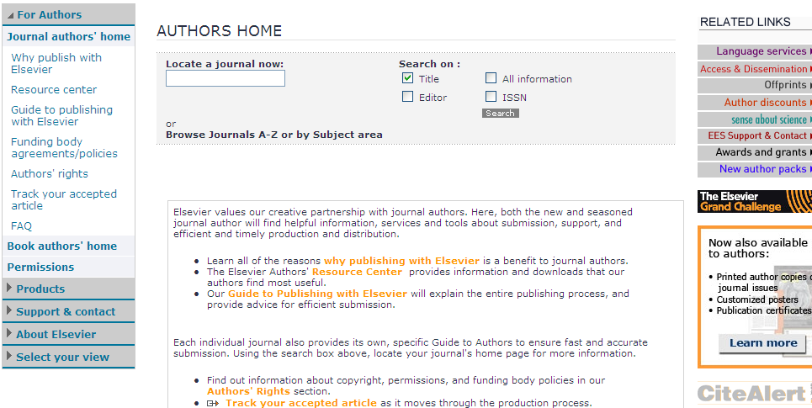
Elsevier.com/authors

Slide 54
Writing a quality manuscript
Language

Slide 55
The three “C”s
Good writing possesses the following three “C”s:
Clarity
Conciseness
Correctness (accuracy)
The key is to be as brief and specific as possible without omitting essential details

Slide 56
Know the enemy
Good writing avoids the following traps:
Repetition
Redundancy
Ambiguity
Exaggeration
These are common annoyances for editors

Slide 57
Language Editing Services
Your manuscript is precious, invest in it
Specialist scientific and medical editing services are commercially available to polish the language in your manuscript prior to journal submission
Rates start from $8 per page
More information can be found on the Elsevier website at:
http://www.elsevier.com/wps/find/authorsview.authors/languagepolishing

Slide 58
Language Editing Services
Recommended companies include:
- Edanz Editing
        - Liwen Bianji
        - International Science Editing
        - Asia Science Editing
        - SPI Publisher Services
        - Diacritech Language Editing Service
Use of an English-language editing service listed here is not mandatory, and will not guarantee acceptance for publication in Elsevier journals

Slide 59
Writing a quality manuscript
Technical details

Slide 60
Abbreviations
Define non-standard abbreviations on first use in both the abstract and the main text
Check the Guide for Authors for a list of standard abbreviations that don’t need defining
Don’t abbreviate terms used only once or twice in the entire manuscript – spell these out in full
Acronyms: capitals not required in the definition unless a proper noun or start of a sentence
ubiquitin proteasome system (UPS)
NOT
Ubiquitin Proteasome System (UPS)

Slide 61
Cover letter
This is your chance to speak to the editor directly
Keep it brief, but convey the particular importance of your manuscript to the journal
Suggest potential reviewers
This is your opportunity to convince the journal editor that they should publish your study, so it is worth investing time at this stage
Notes:
????

Slide 62
Cover letter
Include:
Editor name – Address to journal editor, not generic
First sentence – provide title, author list and journal name
Briefly describe:
        your research area and track record
        the main findings of your research
        the significance of your research
Confirm the originality of the submission
Confirm that there are no competing financial interests
Notes:
????

