Slide 1
Server Side Programming
A small introduction to
Java Servlet and JSP
Kuo-Si Huang
April 21, 2006

Slide 2


Key Words
Server Side Programming
Dynamic Web Content
Java Servlet & JSP
Apache
Tomcat

Slide 3
WWW: Client-Server Model
Web
Client
(browser)
Web
Server
(e.g. Apache)
HTTP Request
HTTP Response
(HTML/XML)

Slide 4
SSP – Server Side Programming
The technologies for developing web pages that
  include dynamic content
  contain connection- or time-dependent info
Examples:
  On-line shopping
  Employee directories
  Personalized content

Slide 5
Techs for Dynamic Web Content
Common Gateway Interface (CGI) – the first one
2G (2nd generation)
  FastCGI
  mod_perl
  NSAPI
  ISAPI
  Java Servlets
These embedded HTML in programming code and programmers had to develop them. Hence costly.

Slide 6
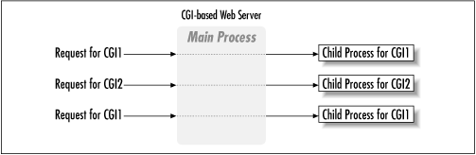
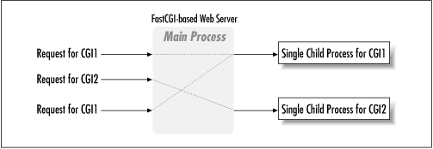
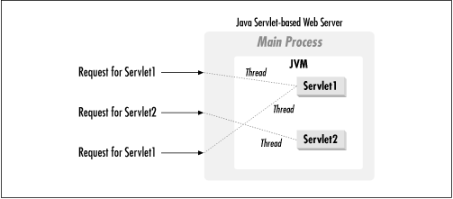

Slide 7
JSP vs. CGI
CGI(Common Gateway Interface) programs (typically written in C or Perl) interact with the user by reading the user's input, HTML forms, and returning custom HTML pages.
Problems:
  For each user request the CGI script must be loaded, run, and unloaded.
  Designed to handle only a single request: needed additional session support (to remember a user’s state between requests for a example).
JSP vs. CGI:
  JSP can maintain state on the server between requests
  Spawns a new thread for each request
  Does not have to be loaded each time, once it has been initialized
  Runs in a ready-loaded JVM as an extension to the web server.

Slide 8
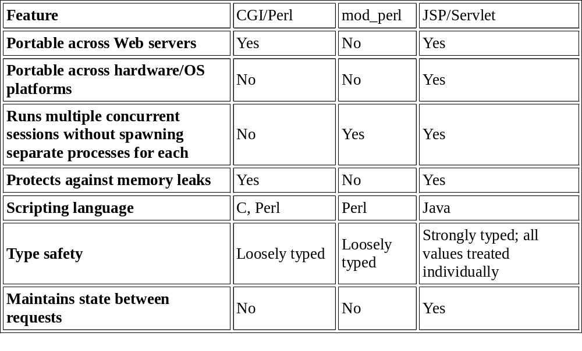
Server Mechanisms for Dynamic Content (1/2)
http://java.sun.com/products/jsp/jspservlet.html

Slide 9
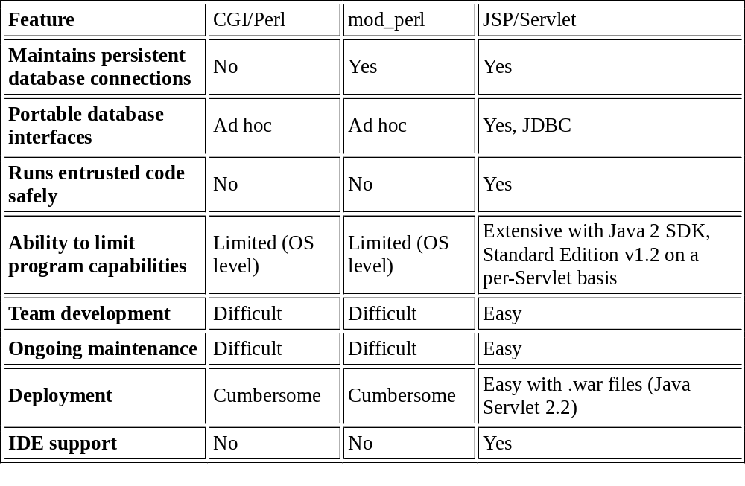
Server Mechanisms for Dynamic Content (2/2)

Slide 10
Scripting – 3G Approach
Idea: embed simple code in HTML pages!
The HTML pages the use the code to choose what elements and data to display.
Classes and/or subroutines may be called to compute information for inclusion in the web page. Existing APIs can be invoked.

Slide 11
Some Approaches to Scripting
JavaServer Pages (JSP, uses Java sparingly, will be covered in these lectures)
Active Server Pages (ASP, uses VBScript, Jscript, COM or ActiveX components, ODBC). ASP.NET is quite similar to JSP, using C#. Has not been very popular.
PHP (C-like syntax, many functions available)
ColdFusion (CFML, proprietary)
Java Servlet template engine (Velocity, FreeMarker)

Slide 12
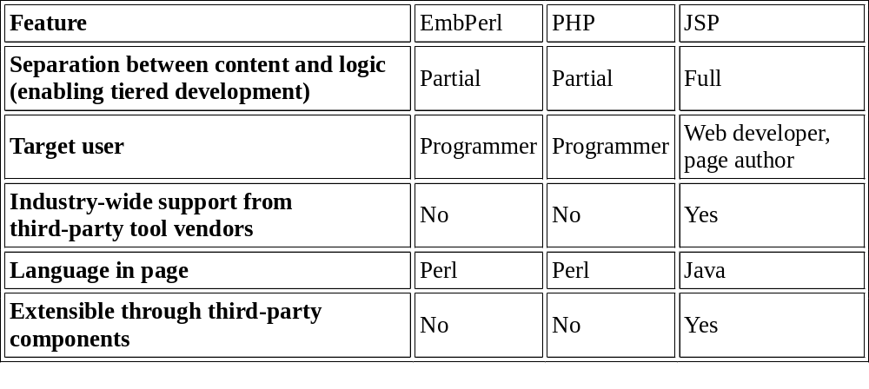
Page Template System Comparison
http://java.sun.com/products/jsp/jspservlet.html

Slide 13

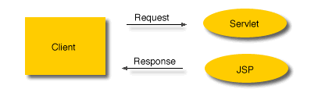

JSP – JavaServer Page

Slide 14
Advantages of Java Servlet & JSP
Platform- and server-independent methods
Portable, reusable logic components
High performance for multiple concurrent requests
Easy deployment
Easy maintenance

Slide 15
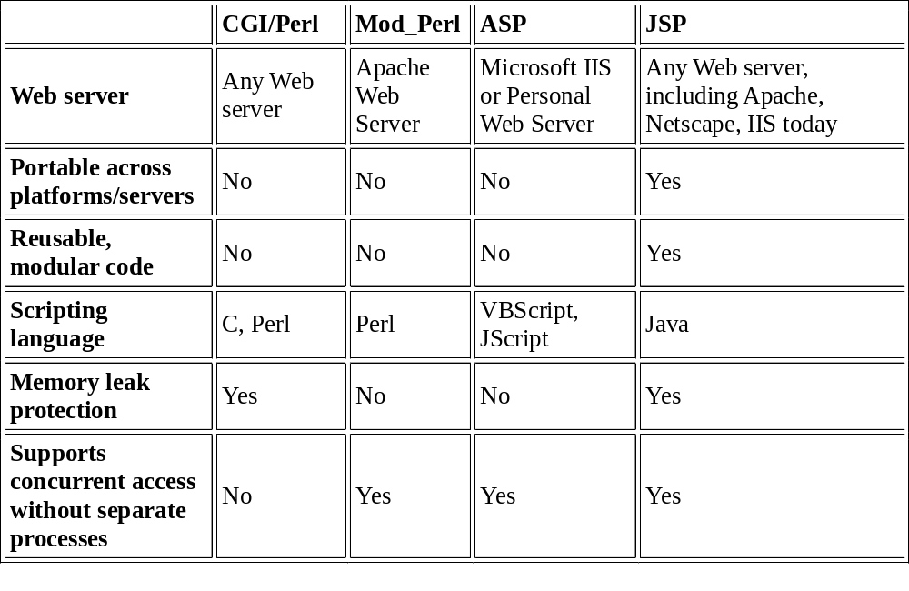
Techs for Dynamic Web Content

Slide 16
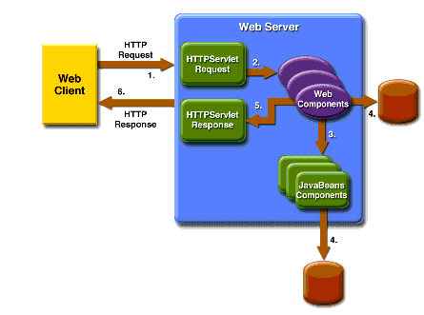
Java Servlet

Slide 17
Deformation of Java Servlet
import java.io.*;
import javax.servlet.*;
import javax.servlet.http.*;
public class HelloWorld extends HttpServlet {
public void doGet(HttpServletRequest request, HttpServletResponse response)
throws IOException, ServletException
{
response.setContentType("text/html");
PrintWriter out = response.getWriter();
out.println("<html>");
out.println("<head>");
out.println("<title>Hello World!</title>");
out.println("</head>");
out.println("<body>");
out.println("<h1>Hello World!</h1>");
out.println("</body>");
out.println("</html>");
}
}

Slide 18
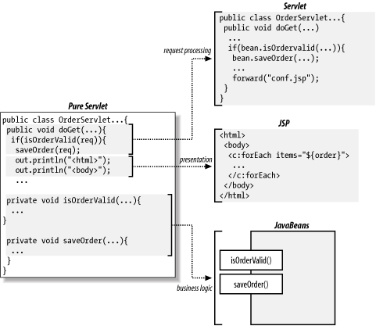
Decomposition

Slide 19
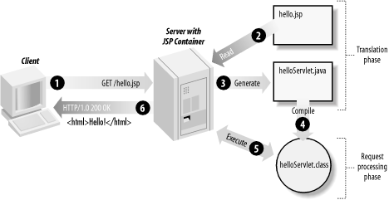
JSP - JavaServer Page

Slide 20
JSP Sample
<%@ page import = "num.NumberGuessBean" %>
<jsp:useBean id="numguess" class="num.NumberGuessBean" scope="session"/>
<jsp:setProperty name="numguess" property="*"/>
<html>
<head><title>Number Guess</title></head>
<body bgcolor="white">
<font size=4>
<% if (numguess.getSuccess()) { %>
Congratulations! You got it.
And after just <%= numguess.getNumGuesses() %> tries.<p>
<% numguess.reset(); %>
Care to <a href="numguess.jsp">try again</a>?
. . . . . .

Slide 21
Environment Preparing of Java Servlet & JSP
Apache: Web Server (v2.2.0)
  http://httpd.apache.org
Java Platform: JDK or JRE (JDK 5.0u6)
  http://java.sun.com
Tomcat: Java Servlet Container (v5.5.16)
  http://tomcat.apache.org/
  For Servlet 2.4 /JSP 2.0 Spec
  Plz install JDK 5.0
  April 20, 2006

Slide 22
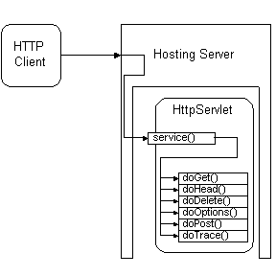
HTTP Servlet Support javax.servlet.http.HttpServlet
Servlet support
HTTP Methods
GET
HEAD
POST
DELETE
OPTIONS
TRACE

Slide 23
Servlet Architecture Overview - HTTP servlets
parameters, protocol, remote host,
ServerInputStream(binary data etc..)
Servlet
interface
ServletRequest
doGet(ServletRequest req, ServletResponse res);
Servlet
GET
Client
ServletResponnse
ServletRequest
POST
doPost(ServletRequest req, ServletResponse res);
Servlet
IS-A
ServletResponse
mime type to reply,reply data,
ServletOutputStream

Slide 24
Show Time
Input:
> T21
TCTGGTCTGGCATGTCGGTCAGATAGAGCTA
> A22
TCTGTGTCGATAG
> B23
GTCTGGCAGTCAGAGCTA
Output:
The alignment of LCS(T, E(A, B))

Slide 25
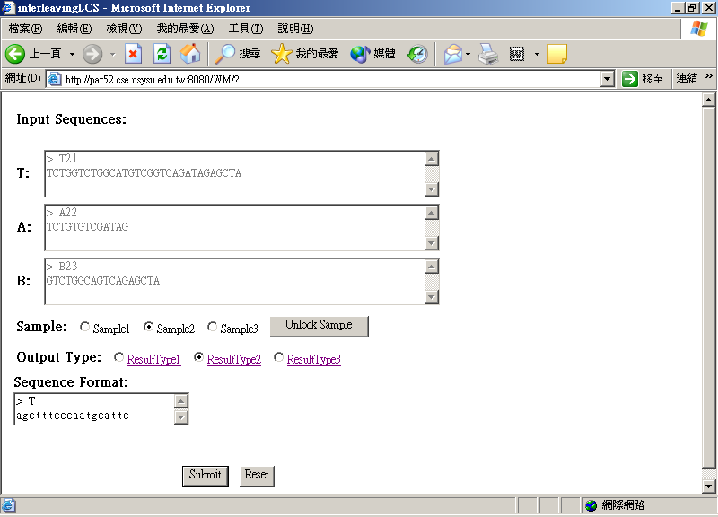
index.htm

Slide 26
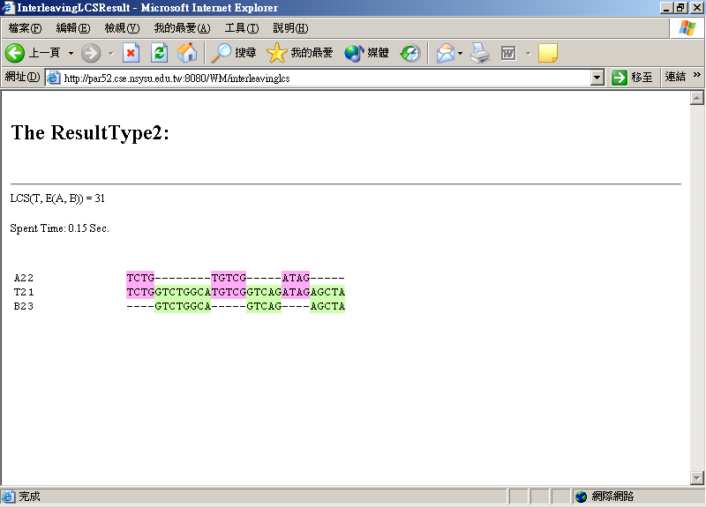

Slide 27
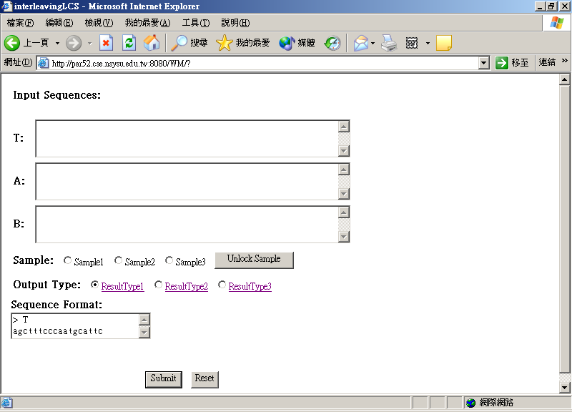
<form name="f1" action="/WM/interleavinglcs" method="post">
1
2
<textarea class="styleTextArea" name="T" cols="60" rows="3" onblur="toUpperCase(this);"></textarea><br>
name="T"
4
name="A"
name="B"
<Input type="radio" name="Sample" value="1"
3
<Input type="radio" name="ResultType" value="1"
index.htm
1
</form> </body> </html>

Slide 28
1
/* InterleavingLCS.java */
public class InterleavingLCS extends HttpServlet {
//Process the HTTP Get request
public void doGet(HttpServletRequest request, HttpServletResponse response) throws
ServletException, IOException {
try {
response.setContentType(CONTENT_TYPE);
String theSample = request.getParameter("Sample");
if (theSample == null) {
runGeneralCase(request, response);
}
else {
System.out.println("*********Sample = " + theSample.charAt(0));
switch (theSample.charAt(0)) {
case '1':
runSample1(request, response); break;
case '2':
runSample2(request, response); break;
case '3':
runSample3(request, response); break;
} } } catch (Exception ex) {
ex.printStackTrace(); } }
2
//Process the HTTP Post request
public void doPost(HttpServletRequest request, HttpServletResponse response) throws
ServletException, IOException {
doGet(request, response);
}
//-------------------------------------------------
private void runGeneralCase(HttpServletRequest request, HttpServletResponse response) throws Exception {
String strT = (request.getParameter("T"));
String strA = (request.getParameter("A"));
String strB = (request.getParameter("B"));
MergedLCS theMergedLCSAlgo = new MergedLCS(strT, strA, strB);
String theAlignStr = theMergedLCSAlgo.runAlignment();
getServletContext().getRequestDispatcher(ivResultURL2).forward(request,
response);
break;
}
//Process the HTTP Post request
public void doPost(HttpServletRequest request, HttpServletResponse response) throws
ServletException, IOException {
doGet(request, response);
}
//-------------------------------------------------
private void runGeneralCase(HttpServletRequest request, HttpServletResponse response) throws Exception {
String strT = (request.getParameter("T"));
String strA = (request.getParameter("A"));
String strB = (request.getParameter("B"));
MergedLCS theMergedLCSAlgo = new MergedLCS(strT, strA, strB);
String theAlignStr = theMergedLCSAlgo.runAlignment();
getServletContext().getRequestDispatcher(ivResultURL2).forward(request,
response);
break;
}
3
4
5
6
ivResultURL2 ="/InterleavingLCSResult2.jsp"

Slide 29
/* MergedLCS.java */
public class MergedLCS {
public MergedLCS(String inT, String inA, String inB) {
// constructor of class MergedLCS
}
public String runAlignment() throws Exception {
// do the alignment algorithm
}
}
5

Slide 30
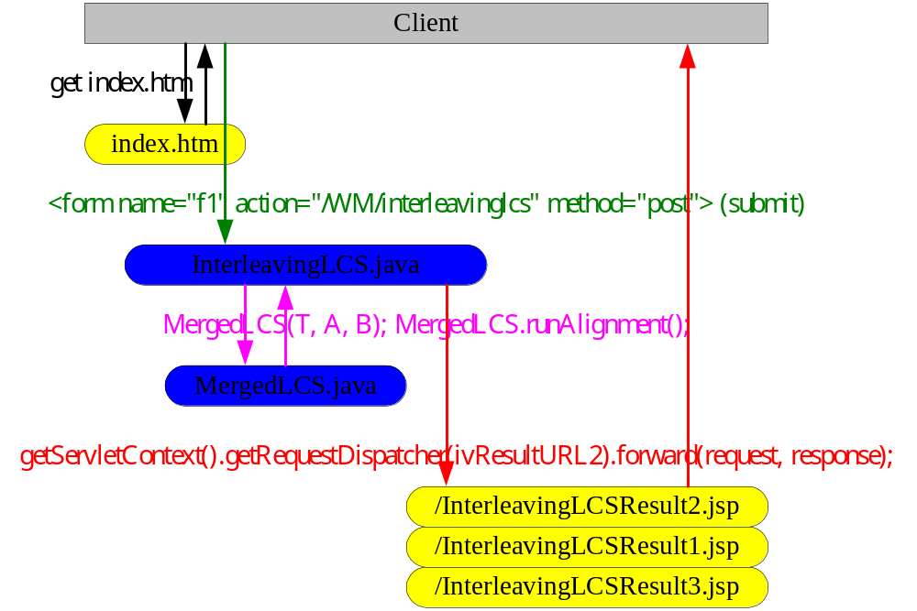

Slide 31
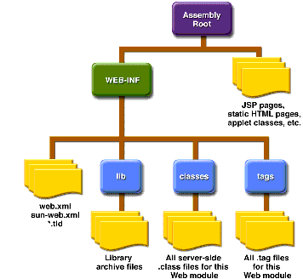
Web Module of Java Servlet or JSP

Slide 32
Directory Structure in Tomcat
TOMCAT_HOME
bin
common
webapps
conf
logs
examples
anotherapp
WebModule Root
WEB-INF
jsp/
index.html
web.xml
classes/
lib/
myfile.jsp
*.class
*.jar

